Slide 1
System Development Methods(SDM)
Group Members
Kapil Pokhrel
Saroj Kandel
Shivam Ranabhat
Bikram Shrestha

Slide 2
1.Project Planning
1.1 Introduction
The Khusii Car Rental company is a car leasing company that was established in 2014
This company specializes in car rentals and offers a variety of models and options to their customers.
Company also helps their customers save money by offering a more personalized approach.

Slide 3
1.3 Aim
The goal of analysis and design is to create a system that performs in each environment and sets out the objectives and functions of the system.

Slide 4
1.3 Objectives
To facilitate communication between the client and the server.
To make ordering easier for customers by providing a user-friendly interface.
To automate and computerize the system so that it can be scaled in the future.

Slide 5
2.Agile Principles
Agile methods which could be beneficial to apply in our project due to its twelve principles to make it more agile
Agile is a software development process where demands and solution of the obstacles are evolved during the collaboration stage between self-organized, cross-purpose teams and their client.
This methodology prefers to deliver the software by applying changes from the beginning rather than deliver everything at once during the end of the project.

Slide 6
2.2 Is Methodologies
Characteristics | XP | Scrum | RUP | Crystal | Waterfall
Time Period | Very Short (2-3 weeks maximum) | Medium (2-4 weeks) | Short | Depend upon project (Up to 4 months for large project) | Short
Project Size | Suitable for smaller project | Suitable for all types of projects | Suitable for all types of projects | Suitable for all type of projects | Suitable for small project
Involvement of client | Customer involvement required | Customers represent as the role of product’s owner | High involvement of clients | Involvement through incremental release | Very low involvement of client
Requirement Type | Requirement should be clear | Requirement not clear | Requirement should be clear | Requirement may not be clear | Clear requirement required
Team Size | Small size (less than 20 members) | Small size (2-9 members) | Based on size of project | Any team size (highly skilled and experienced members) | Not specified
Advantages | Customer are involved as a group member, more importance given to feedback | Involved top level of communication for best results | Based on few fundamental phases so that timing, place, and division of work to the team members is clearly defined. | Supports fixed price contracts | Requirement is clear and all phases must be completed before next phase.

Slide 7
3.System Analysis
System analysis and design is focused with identifying and describing what the system should perform to design and implement it
It also discusses how the system's many components should be integrated.

Slide 8
3.1 Business Intelligence(BI) Analysis
BI helps to make great data driven decision and support the organization to rapidly adapt to market change
BI also supports without any difficulty to the work of personnel. It makes easier and faster to report, plan, and analyse.

Slide 9
3.2 Statistical Analysis:
It is the process of analysing and collecting data to classify trends and patterns.
It is used to produce useful chart or graph to view data and to deliver business owner with insights to progress business presentation but also to make well decision.

Slide 10
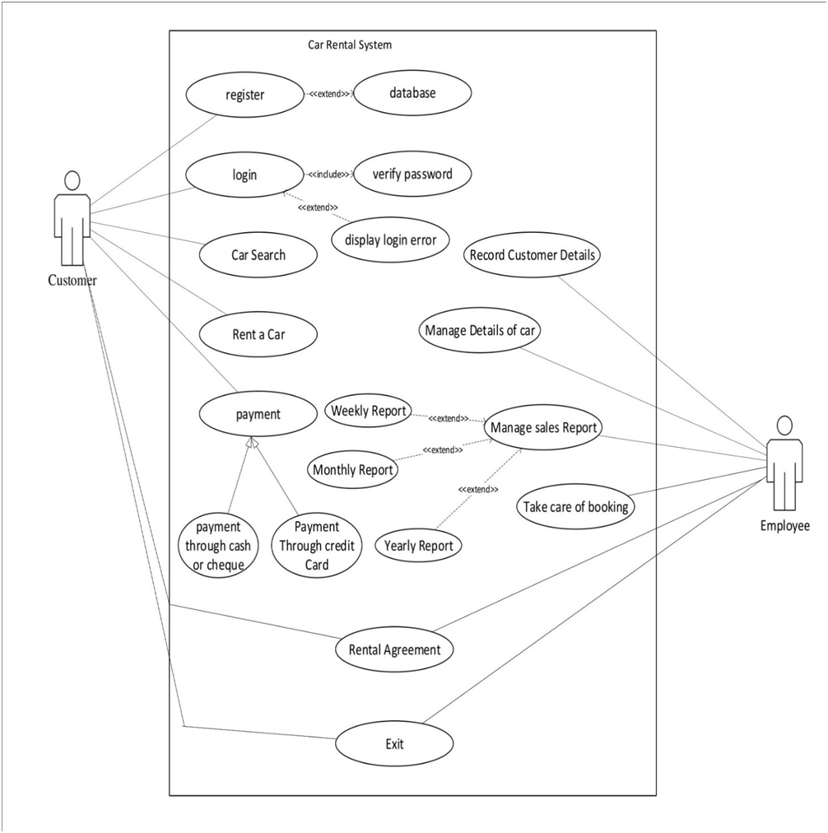
4.Design UML Use Case Diagram

Slide 11
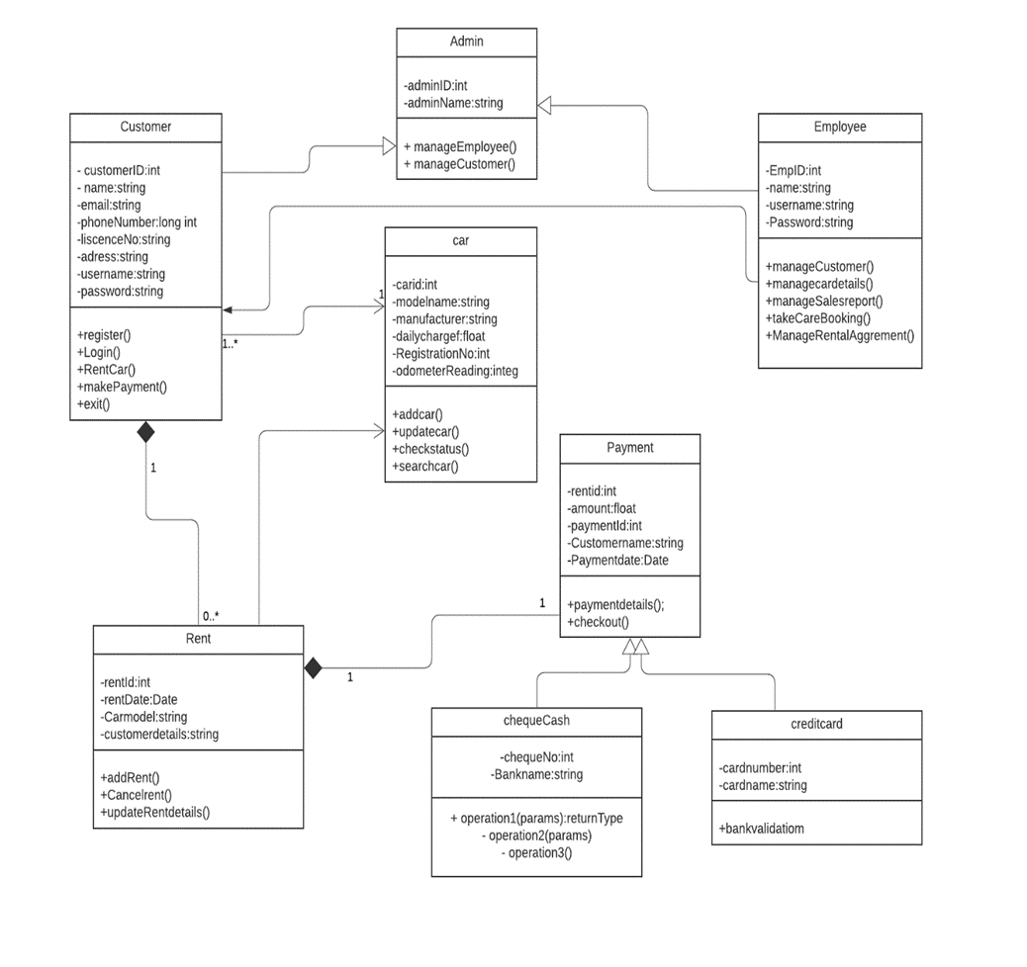
4.1 Class Diagram

Slide 12
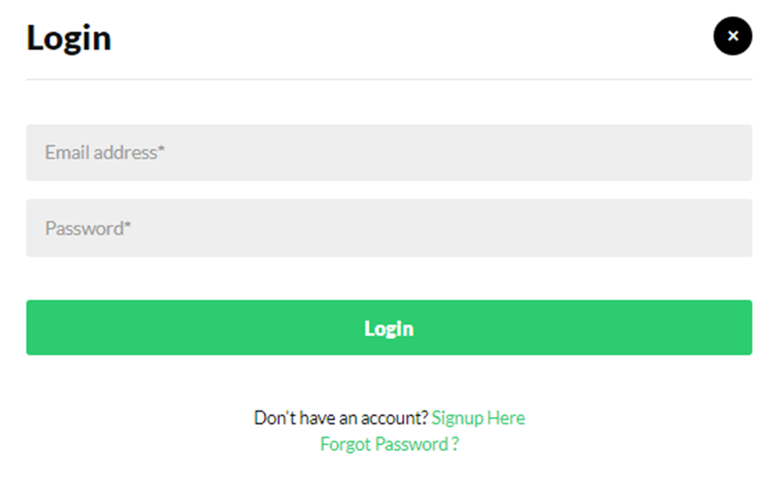
4.3 Physical Design :Prototype Login Menu

Slide 13
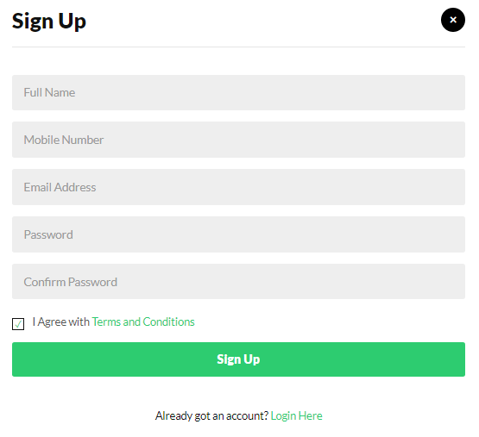
Register Menu

Slide 14

Home Page

Slide 15
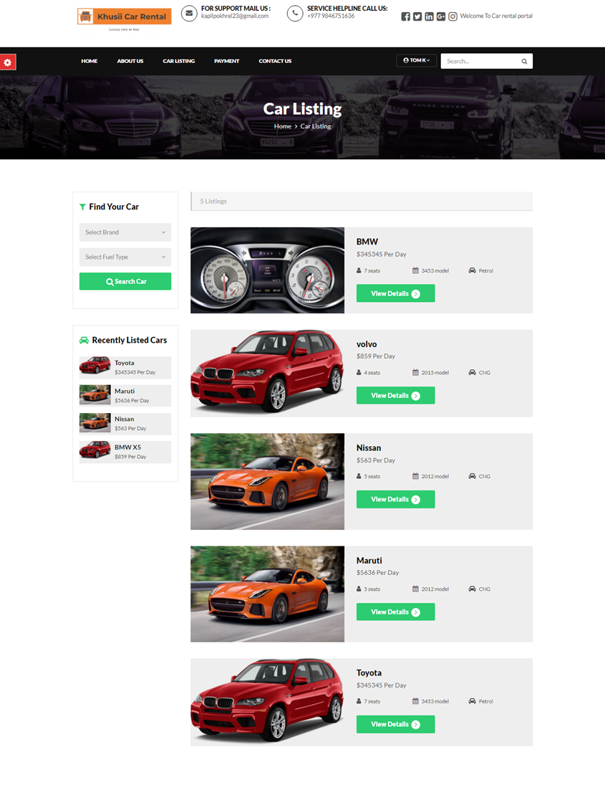
Car Listing

Slide 16
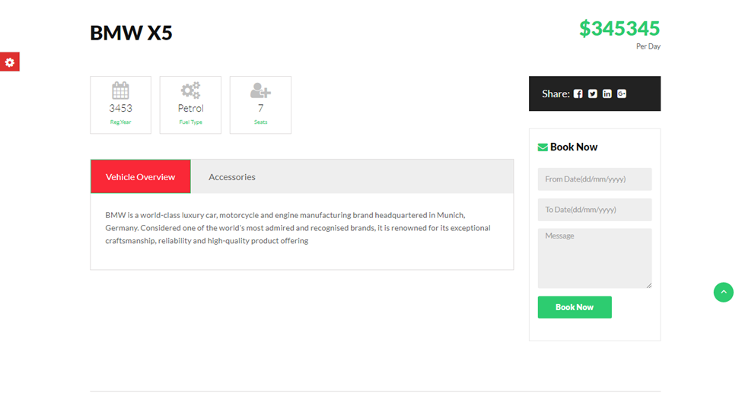
Order menu

Slide 17
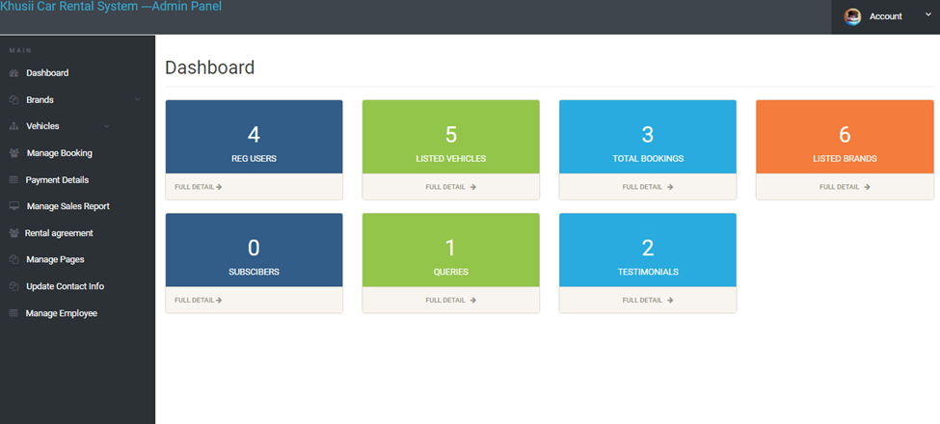
Admin Dashboard

Slide 18
5.Implementation and Deployment
Systems implementation is a set of procedures performed to complete the design.
Different phases of implementation and deployment are given below.

Slide 19
Construction Platform Language Database

Slide 20
Individual Components
6.1 Rational Unified Process (RUP) (Kapil Pokhrel NPI000030)
A component of the Software Development Process is the ‘Rational Unified Process’.
. It provides a method for delegating tasks and duties inside a company that is disciplined.
Rational Unified Process' objective is to assure the timely and cost-effective delivery of high-quality software that fulfills the demands of its end customers.

Slide 21
Individual Components 6.2 Scrum Methodologies (Shivam Ranabhat NPI000047)
Facilitates team work
Takes short time period(3-4 weeks)
Iterative type of framework

Slide 22
Scrum Principles
1.Empirical Process Control:
Make system transparent, evaluated and adaptive in nature
2.Self-Organization:
Increases the independence and performance of team members
3.Collaboration:
Prefer to work collaboratively
Increases awareness, clarity and distribution of work
4. Value based prioritization:
Tasks with maximum value will be prioritized from the beginning
5.Time-boxing
allocate a certain time for a certain task
6. Iterative development
Tasks are revised, reviewed and reconsidered to make it better.

Slide 23
Scrum Advantages
Reduce time
Create a system in short time period
Clear image of tasks through scrum meeting

Slide 24
Scrum Disadvantages
Frustration due to regular scrum meetings
More chances of project failure

Slide 25
6.3 Extreme Programming XP (Bikram Shrestha NPI000022)
XP is a software development methodology which is intended to improve software quality and responsiveness to changing customer requirements.
XP is the agile framework maximum specific to appropriate software development engineering practices
XP methodology provide principle and value to guiding the team performance. XP has methodological and software development tools.

Slide 26
Different phases of XP: Planning Designing Coding Testing

Slide 27
XP has five different values they are: Communication Simplicity Feedback Courage Respect

Slide 28
6.4 Crystal Methodology (Saroj Kandel NPI000043)
Crystal method is an agile software development approach that focuses primarily on people and their interactions.
when working on a project rather than on processes and tools people’s skills and talents as well as the way they communicate has the biggest impact on the outcome of the project.

Slide 29
Characteristics of crystal methodology
Human-Powered
Adaptive
Active user involvement
Delivery on commitments
Ultra-light

Slide 30
Properties of crystal methodology
Frequently delivery
Reflective improvements
Close or osmotic communication
Personal safety
Focus
Easy Access to expert users
Technical environment with automated tests.

Slide 31
References
References
Agile vs. Waterfall vs. Kanban vs. Scrum. Lucidchart.com. (2021). Retrieved 28 July 2021, from https://www.lucidchart.com/blog/agile-vs-waterfall-vs-kanban-vs-scrum.
Comprehensive Guide to the Agile Manifesto. Smartsheet. (2021). Retrieved 20 July 2021, from https://www.smartsheet.com/comprehensive-guide-values-principles-agile-manifesto?amp.
Crystal Methods · Activecollab Blog. ActiveCollab. (2021). Retrieved 3 July 2021, from https://activecollab.com/blog/project-management/crystal-methods.
Principles in Scrum | SCRUMstudy. Scrumstudy.com. (2021). Retrieved 25 July 2021, from https://www.scrumstudy.com/whyscrum/scrum-principles
Rational Unified Best Practices for Project Managers | Cprime. Cprime. (2021). Retrieved 5 July 2021, from https://www.cprime.com/resources/blog/rational-unified-best-practices-rup-a-primer-for-the-project-manager/.
Rational Unified Process (RUP) · ActiveCollab Blog. ActiveCollab. (2021). Retrieved 5 July 2021, from https://activecollab.com/blog/project-management/rational-unified-process-rup.

Slide 32
System Analysis and Design - Overview - Tutorialspoint. Tutorialspoint.com. (2021). Retrieved 21 July 2021, from https://www.tutorialspoint.com/system_analysis_and_design/system_analysis_and_design_overview.htm.
System Changeover - Know Computing. Know Computing. (2021). Retrieved 2 July 2021, from http://www.knowcomputing.com/system-changeover/.
What is Business Intelligence? BI Defined. SearchBusinessAnalytics. (2021). Retrieved 21 July 2021, from https://searchbusinessanalytics.techtarget.com/definition/business-intelligence-BI
What's the Difference? Agile vs Scrum vs Waterfall vs Kanban. Smartsheet. (2021). Retrieved 28 July 2021, from https://www.smartsheet.com/agil-vs-scrum-vs-waterfall-vs-kanban?amp
What Is The Crystal Agile Framework? Definition and Key Principles. Airfocus.com. (2021). Retrieved 4 July 2021, from https://airfocus.com/glossary/what-is-the-crystal-agile-framework.
What is Software Testing? Definition, Basics & Types in Software Engineering. Guru99. (2021). Retrieved 1 July 2021, from https://www.guru99.com/software-testing-introduction-importance.html.
XP Roles - Extreme Programming (XP). Explainagile.com. (2021). Retrieved 21 July 2021, from https://explainagile.com/agile/xp-extreme-programming/roles/.

