Slide 1

WEB APPLICATION (CT050-3-2)
Group Members
Kapil Pokhrel
Shivam Ranabhat
Bikash Baral
Saroj Kandel

Slide 2
Table of Contents
Introduction
Objectives
Scopes
Project Schedule
Audience Modelling
Major functions of the Website
Design and Modeling
Wire Framing
Website Navigational structure
Implementation (Code Snippet)
Future Enhancement
Conclusion

Slide 3
Introduction
System Name: Krypton Education
An educational platform for online coding and academic activities
Aims to help students and the university overcome the challenges that arise during the Covid-19 outbreak
Able to manage all academic activities such as:
Downloading course materials
Viewing assignments
Online assignment submissions and
View Feedbacks

Slide 4

Objectives
To allow students to access lecture videos and other courses.
To enable lecturers/professors to post learning resources such as pdf and slides.
To enable students to submit assignments and view feedback
To give potential students and visitors information about available courses

Slide 5
Scopes
Our e-learning system will assist people in conserving time and reinvesting it in more profitable endeavors
To keep track of krypton Education digital activities.
This online student Webspace will be cost-effective and simple to maintain

Slide 6
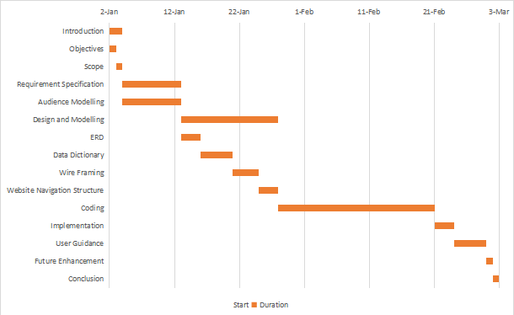
Project Schedule

Slide 7
Audience Modelling
Audience Categorization
1. Admin/ Super user
With access to all of the system's capabilities
In charge of adding new courses, revising pricing structures, issuing announcements, and approving newly enrolled students
Authority to create, update, delete accounts of all three users
Edit the content of course pages, manage class schedules, and update their respective profiles

Slide 8
2. Lecturer/ Professors
In charge of uploading study materials like lecture slides, pdf, tutorials on the website
Assign assessments and tasks to students and provide feedback
Manage the provided assignments and course materials by updating and deleting
can manage their respective profile
3. Enrolled Students:
Have access to course materials given by their lecturers/professors
View assignments and class schedules
Can download the provided courses materials and upload their assignments and examine their feedback

Slide 9
4. Potential Students:
Not permitted to access the course pages
Can see information about Krypton Education, available courses, and course cost
Permitted to submit inquiries and are allowed for registering into the system
Can become enrolled students only if they enroll in a particular course with full payment and approved by the admin

Slide 10
Audience Characterization
Technical users:
Individuals who are knowledgeable about online apps
They are not the ones to provide more clarity of thought
People who are unfamiliar with the framework and how to use it
The plan connection point should be easy enough for new customers to use
Beginner users:

Slide 11
Major Functions
Enrolled students get access to study materials, notes, and pdfs posted by their professors
Students can view and submit assignments as well as view assignment deadlines
Professors can post study materials, provide feedback, create assignments, track students' progress, and manage their profiles
Administration can register students, lecturers, as well as submit messages, adjust fee structures

Slide 12
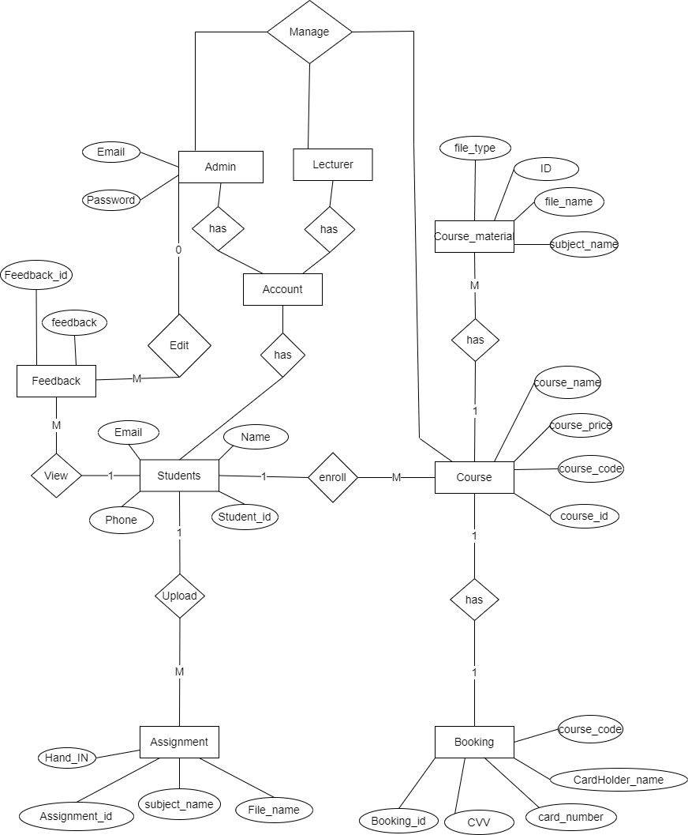
Entity Relationship Diagram (ERD)

Slide 13
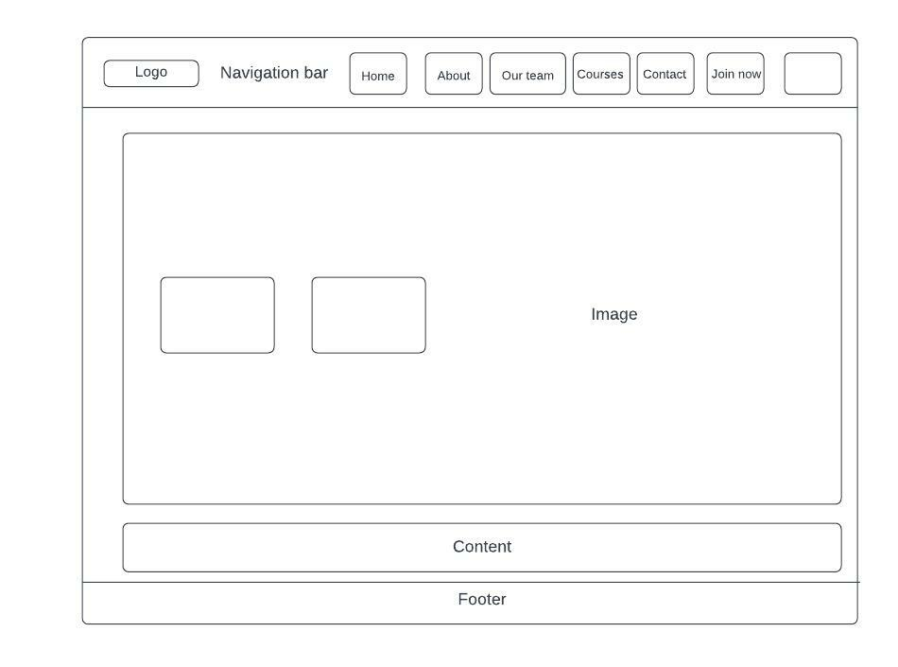
Wire Framing
Home page

Slide 14
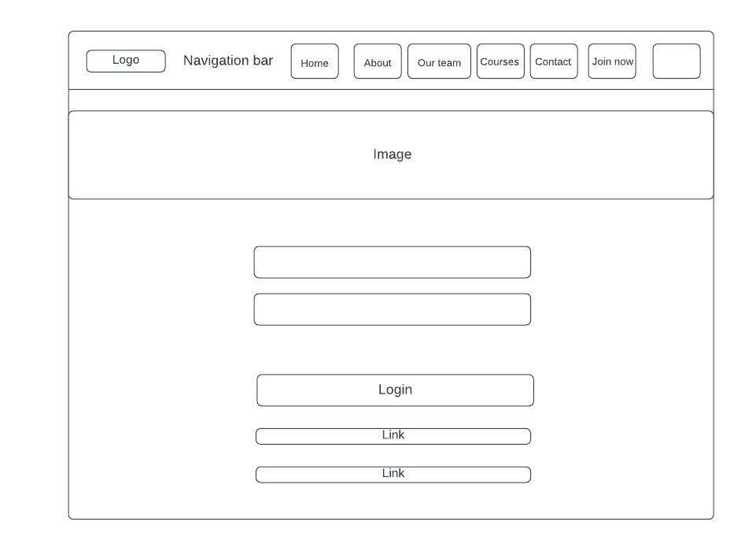
Contact Us

Slide 15
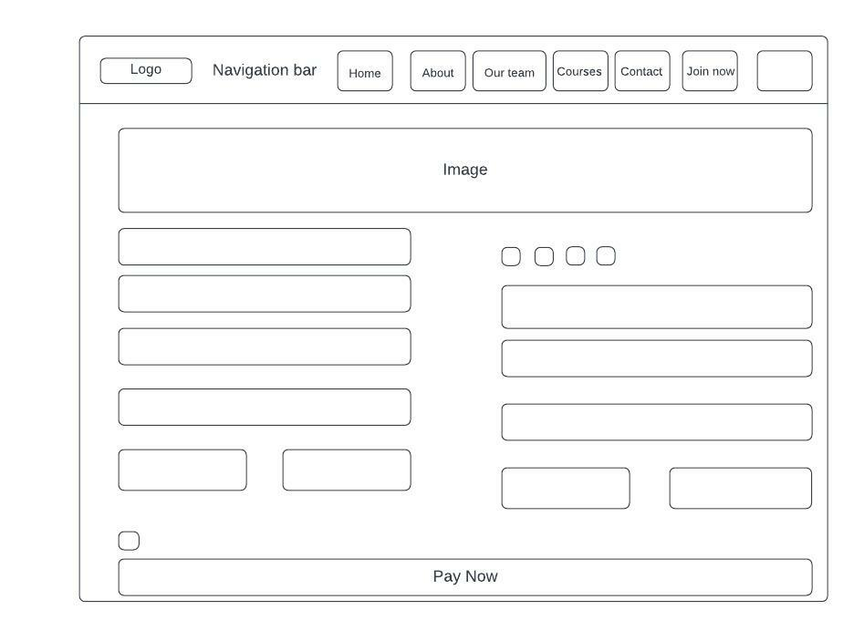
Course Enroll

Slide 16
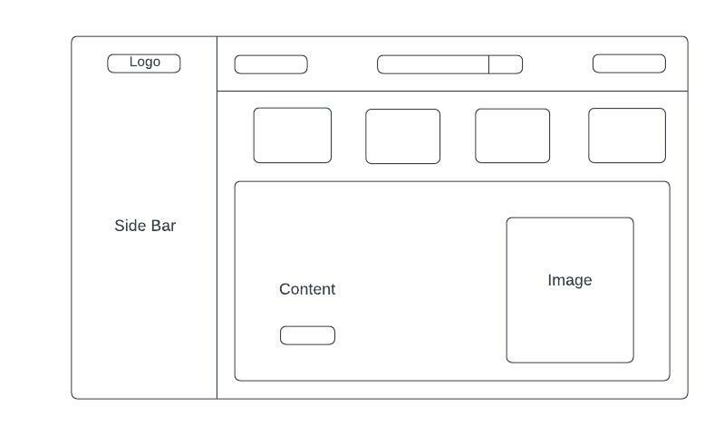
Admin Panel

Slide 17
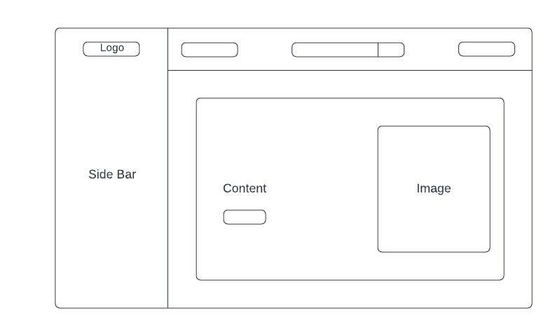
Lecturer Panel

Slide 18
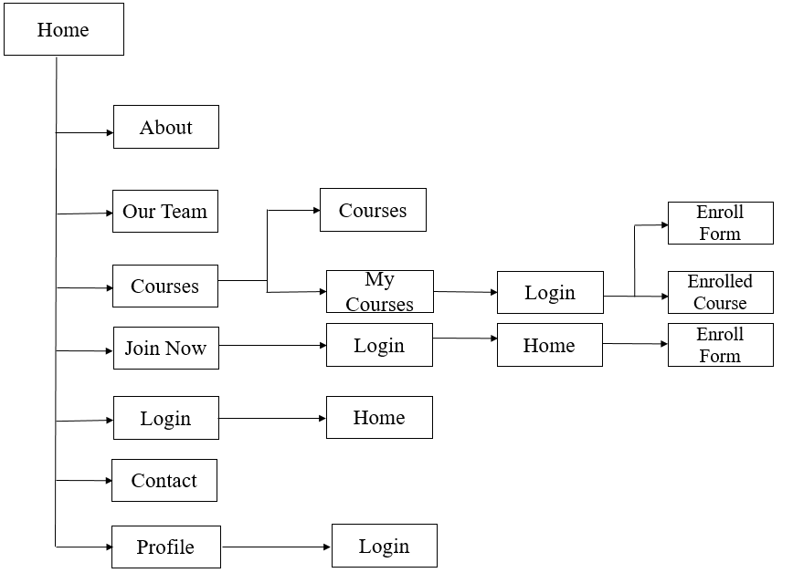
Website Navigational Structure
Users/ Students

Slide 19
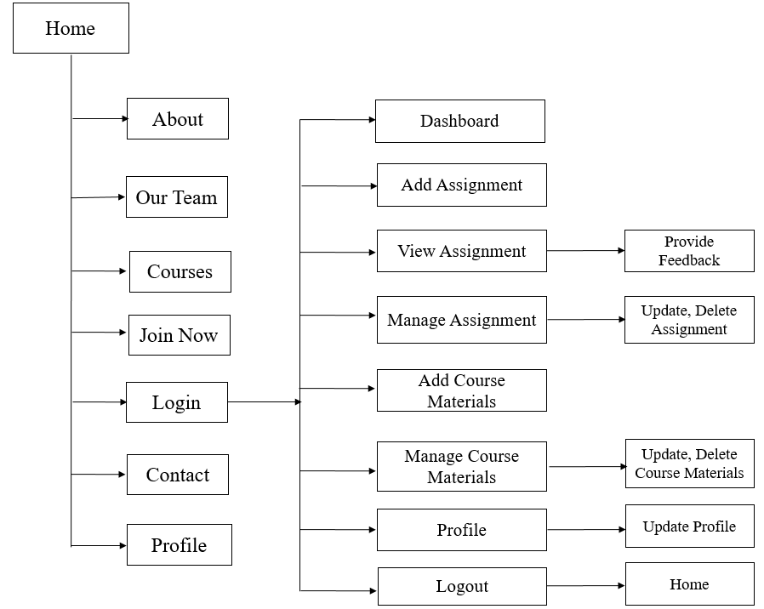
Lecturer

Slide 20
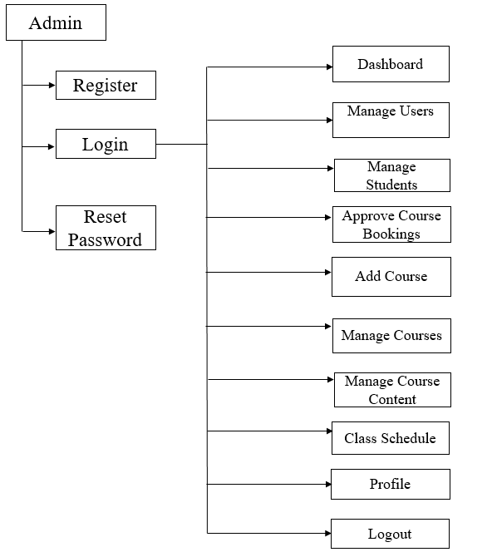
Admin

Slide 21
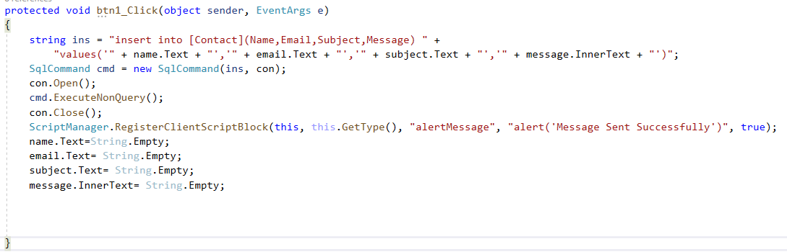
Implementation
Insert

Slide 22
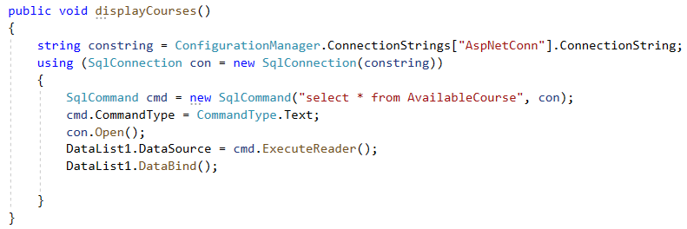
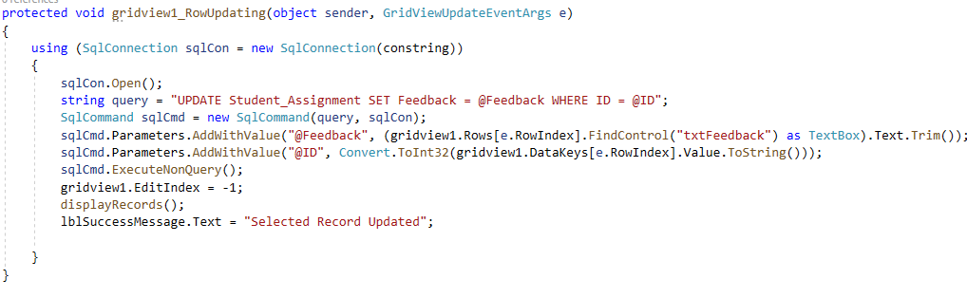
Display
Update

Slide 23
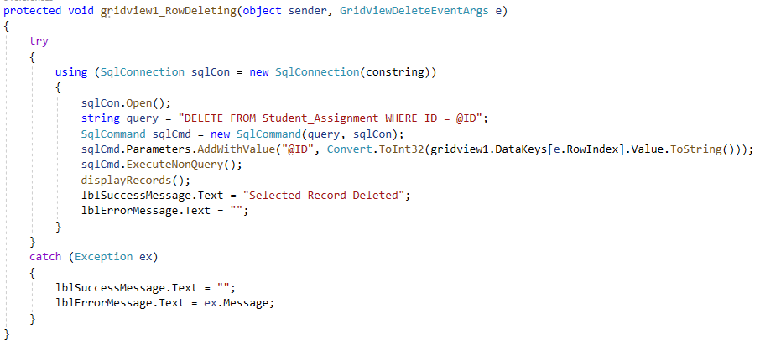
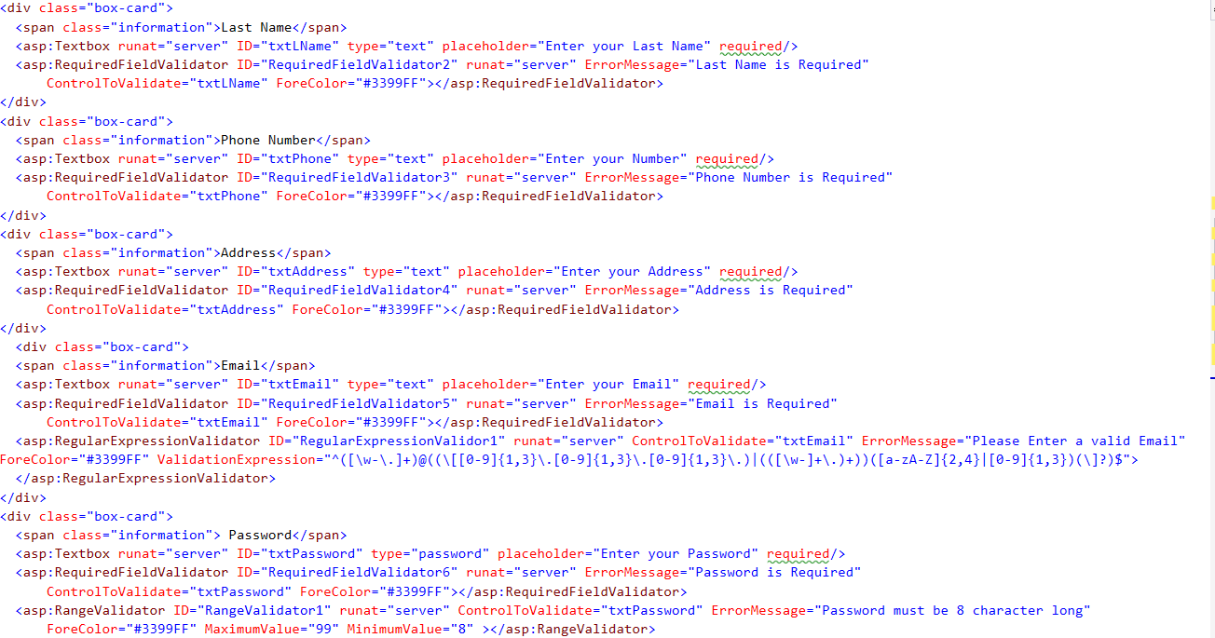
Delete
Validation

Slide 24
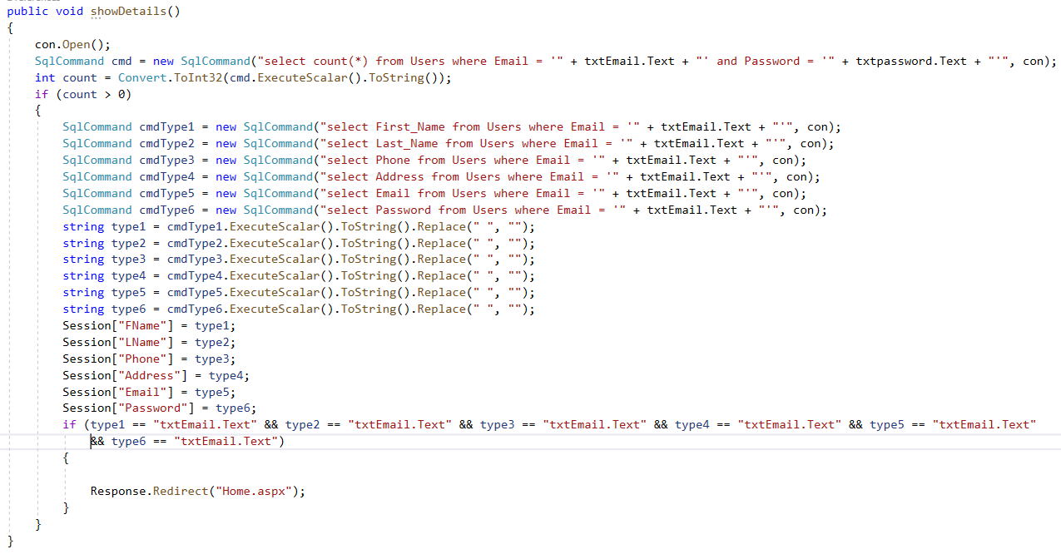
Session

Slide 25
Future Enhancement
Discuss board for students where user can interact with each other
Multiple payment option must be in the system like PayPal debit card
Quiz program and price for winner will be more effective
Current user interface is good but to get the traffic and to make easy for students we must improve on it
Only course image and details but in future we should add intro video of courses

Slide 26
Conclusion
Accomplished by the 4-member team after a lot of hard effort and excellent teamwork
Share our tasks fairly and are always eager to assist one
Construct a web-based e-learning system for students to improve their skills
Various functionalities in the system that uses JavaScript, ASP, C#, HTML and CSS
Learn to use front end and back end as database to create a dynamic web-based system
Develop our skills as web developers in the fundamentals of web development

Slide 27
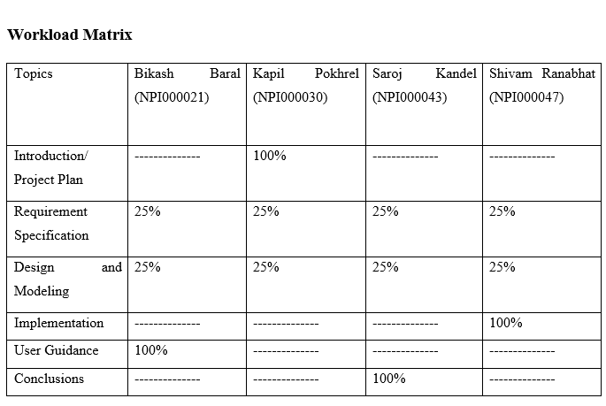
Workload Matrix

