Slide 1
WPCS Presentation
Group Member
Kapil Pokhrel
Shivam Ranabhat
Saroj Kandel
Bikash Baral

Slide 2
Introduction
Communication is an essential element of our daily lives. In terms of biology, humans would not have survived if we had not evolved to communicate effectively
It gives us a sense of being human in whatever group we are a part of.
Good communication skills increase social skills, professional abilities, and daily life in general.
In this report, four points will be discussed, two of which will elaborate on the skills required during an interpersonal communication process, and the remaining two will demonstrate the types of barriers that can be found during the communication process

Slide 3

Interpersonal Communication at the workplace
The term "interpersonal communications" refers to the process of exchanging ideas and information between two people
An interpersonal communication process necessitates six elements.
They are communicators who are willing to share and receive information, the topic's message, noise, feedback, context, and the channel via which the communicators communicate.
Interpersonal communication can be used in a variety of contexts. Some of these include providing and receiving information, sustaining a relationship, influencing others.

Slide 4
Importance of Interpersonal Communication
Interpersonal skills are important in the professional business context since they impact the daily routine
Another relevance is providing a positive organizational culture.
A more secure workplace will result from strong interpersonal skills.
As a result, it will foster more cooperation, proficiency, and execution in the workplace.

Slide 5
Empathy
Empathy is a relational correspondence skill that allows you to comprehend and comprehend the feelings and practices of another person.
Sympathy is an important skill for a leader to have since it aids in providing an accurate understanding of employees' perspectives and issues.
Having sympathy in the workplace is critical to commercial success

Slide 6
Active Listening
Most important skill to maintain both personal and professional relations
Foster a sense of trust, being valued or heard
According to (Wright State University, 2016)
59% of the hiring managers are struggling to find candidates with appropriate soft skills, and
92% of executives are agreeing with the statement “Soft skills are equally important than technical skills”

Slide 7
CASE STUDY
A McKinsey study found that
Well-connected teams were 20 to 25% more productive than others
Make a significant difference in the workplace by leading to fewer errors
Increased productivity, and customer satisfaction
According to (Alder, 2019),
Active listener is either born gifted or need the training to develop.

Slide 8

According to (Tariq,2022) there are three levels of active listening
Internal listening
Listening to our inner voice
Response is influenced by our thoughts and emotions
Leads to misunderstanding and missing the key information
Focused listening
Actively listen to what the speaker is trying to convey
Only reach this level if we are motivated due to the situation or speaker

Slide 9

Global listening:
One of the highest levels of listening
Analyze the speaker’s words genuinely
Involves the notice of body language, facial expressions,

Slide 10

IMPORTANCE
Improved productivity
Hulu and eBay are creating a sophisticated loop to connect the organization and employees
Found that employee feedback can help the company to adopt the customer expectations
Results in high productivity of that company
Strong relationship in the workplace
York University psychologist Faye Doell (2013)
People “who listen to understand” have better and happier relationships
Colleagues will be more inclined to come to you with positive intentions.

Slide 11

Self-Empowerment
In Conversational model by Case Western University (1980s)
Focuses on establishing a good environment to encourage genuine reflection
Leaders use this strategy to increase the self-empowerment of their employees
Resolves Conflicts
According to Erin Wrotham, Headspring’s director (2017)
Proper involvement in conversation and allowing each other to ask questions
Help to avoid misunderstanding and creating conflicts

Slide 12

Barriers to communication in a workplace
Psychological Barrier
Language Barrier

Slide 13

Psychological Barrier
“The psychological barrier of communication is the influence of psychological state of the communicators (sender and receiver) which creates an obstacle for effective communication”
When the mental condition of either side of the communication element (sender or receiver) is not well, it leads to a barrier in communication
Psychological conditions such as emotional instability,excitement,fear,anxiety can make problems during communication with other people.

Slide 14

Study
According to a study carried out by Stanford university, it is proven that around 90% of the companies in US struggle with psychological barrier on a daily basis.
Another study carried out by university of California reported that about 97% people working in group project reported their mental condition affecting their communication with their work colleagues

Slide 15
Causes of Psychological Barrier:
Inattentiveness
Limited retention
Distrust
Emotion
Premature Evaluation

Slide 16
Inattentiveness
A person is inattentive when his/her mental condition is occupied by other things and he/she does not listen to what other party has said.
Limited retention
A human brain cannot get hold or remember every information it gets. The information stored in our memory is not permanent and is lost with time.
Distrust
Trust is one of the most needed things when it comes to communication.
When a receiver distrust the sender, he/she will either ignore the provided information or will take the information and derive and negative meaning from the provided information.

Slide 17
Emotion
A communication can affect a person’s emotion whereas a person emotion also affects the communication process.
Emotions like anxiety,disgust,joy,fear,confusion,etc leads to problems in communication process
Premature Evaluation
It means jumping to conclusion without properly evaluating the information
This is usually done when a person is impatient or when the he/she is in a hurry

Slide 18
Ways to overcome psychological barrier:
Active listening
Giving full attention and listening to what the sender is saying.
Emotion Management
Getting upset,nervous and other emotions is common for everyone but showing them in front of an audience at workplace can be a problem for both you and your career.

Slide 19

Have a purpose
Having an objective in your mind can help to overcome the psychological barrier in communication.
Having made a mindset and diligently following it can help one to overcome his/her irrational or impulsive acts in a workplace.
For example, a working staff having a purpose of completing a project will pay more attention to the discussion meetings regarding to the project.

Slide 20
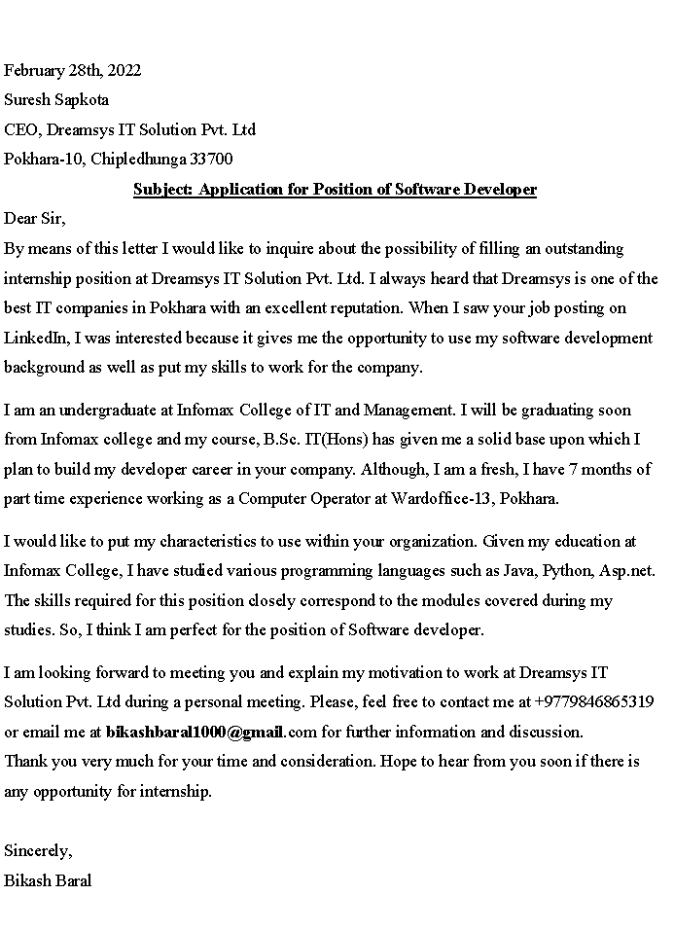
Internship Letter

Slide 21
Language barrier
Language barriers usually occur when two people who speak different languages cannot understand one another, and there is a breakdown in language and communication
Language barriers primarily refer to the challenges faced by people or groups speaking different languages and dialects.
For example: Foreign language, Pidgin, dialects, Accents, Verbosity, ambiguity, and word choice

Slide 22
Foreign language
Communication between people of different countries becomes difficult if neither of the speakers has a common language to communicate in.
While knowledge of foreign languages is common practice among people certain languages are still a hurdle for people to learn and communicate.
Many translation apps are available on the internet, but they are not effective while communicating culture-specific use of languages like idioms, phrases, proverbs and allusions.

Slide 23
Dialects
Dialects are regional variants of a language and very rarely have a written script.
Dialects are distinct from one another even though they have the same language as the base.
English spoken in the UK has 37 dialects! The use of dialects in workplaces or areas away from where it is practiced may result in miscommunication.

Slide 24
Accents
Accents are peculiar ways of pronouncing words of a language.
Accents occur when speakers belonging to different regions or countries speak a language not their own.
Their mother tongue will influence how they pronounce words in the foreign language. This causes difficulty in understanding what is being said.

Slide 25
word choice- Verbosity, ambiguity
The choice of words made by a speaker is a result of his/ her knowledge and mastery of the language.
Verbosity or wordiness can also make the message obscure.
The use of unfamiliar words or more words creates fatigue in the mind of the reader making for a break in communication.

Slide 26
Overcoming language obstacles in the workplace
Use plain language
Use of visual methods for communication
Find a reliable translation service
Use of repeating
Encourage employees to learn about other cultures

Slide 27
Conclusion
Communication in the workplace is critical for establishing and maintaining effective working relationships in businesses
. Interpersonal communication is crucial since it is usually observed in the workplace when individuals are expected to collaborate and combine their expertise in order to attain certain goals
. Overall, proficiency in correspondence and breaking through barriers to correspondence is essential in the workplace

