Slide 1
NIFTY100 Financial Intelligence & Business Analytics Platform
Technologies:-
Python
ETL PIPELINE
SQL
Postgre-SQL
Power BI
DAX
Data Engineering
Financial Analytics
Prepared By: Shivam Shukla

Slide 2
Project Overview
Problem Statement:-
Raw financial datasets are difficult to analyze directly.
Investors and analysts require:
Clean data
Financial KPIs
Risk analysis
Company comparison
Sector benchmarking
Solution:-
Build a complete financial intelligence platform.

Slide 3
Project Architecture
Raw Excel Files
↓
Python ETL
↓
Clean CSV Files
↓
Postgre-SQL Warehouse
↓
ML Health Scoring
↓
Power BI Dashboards
↓
Business Intelligence

Slide 4
Dataset Overview
Files Used:-
companies.xlsx
balancesheet.xlsx
cashflow.xlsx
analysis.xlsx
profitandloss.xlsx
prosandcons.xlsx
Challenges:-
Missing values
Header issues
Mixed data types
Duplicate records
Inconsistent year formats

Slide 5
ETL Pipeline
Extraction:-
Data ingestion
Validation
Transformation:-
Cleaning
Standardization
Fiscal Year Extraction
Sector Mapping
Loading:-
Postgre-SQL warehouse

Slide 6
Data Engineering & Warehouse
Dimension Tables:-
dim_company
dim_year
dim_sector
dim_health_label
Fact Tables:-
fact_profit_loss
fact_balance_sheet
fact_cash_flow
fact_analysis
fact_pros_cons
fact_ml_scores

Slide 7
Financial Metrics Engineering
Metrics Created:-
Debt-to-Equity Ratio
Net Profit Margin
Expense Ratio
Interest Coverage
Free Cash Flow
Asset Turnover
Return on Assets
Equity Ratio

Slide 8
ML Health Scoring System
Inputs:-
Profitability
Growth
Leverage
Cashflow
Dividend
Trend
Outputs:-
Strong
Moderate
Weak
Additional Scores:-
Growth Score
Dividend Score
Trend Score
Leverage Score

Slide 9
Power BI Dashboard Overview
Total 7 Dashboards:-
Executive Overview
Profitability & Growth
Debt & Cashflow Risk
ML Health Scoring
Advanced Financial Score Analysis
Company Deep Dive
Sector Intelligence

Slide 10
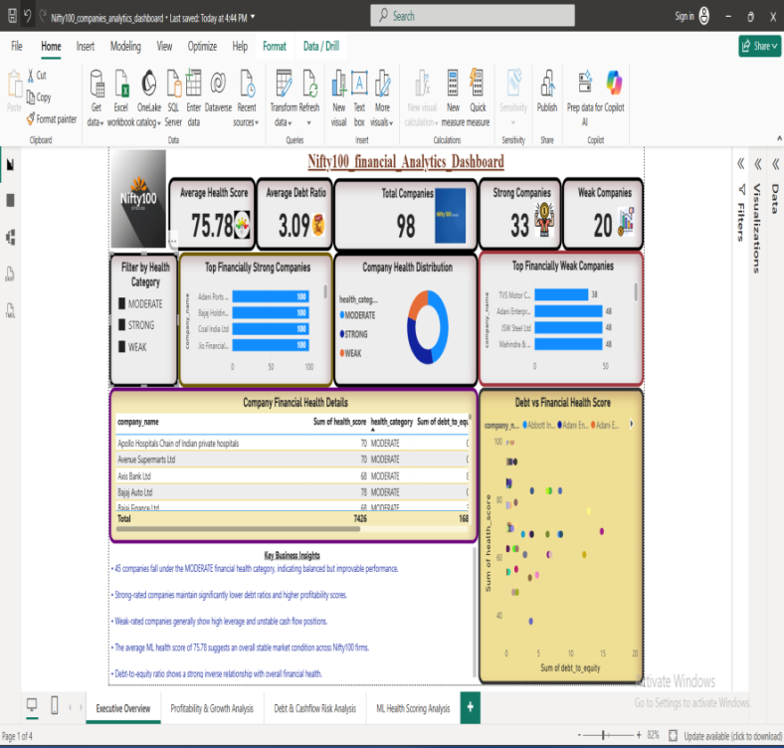
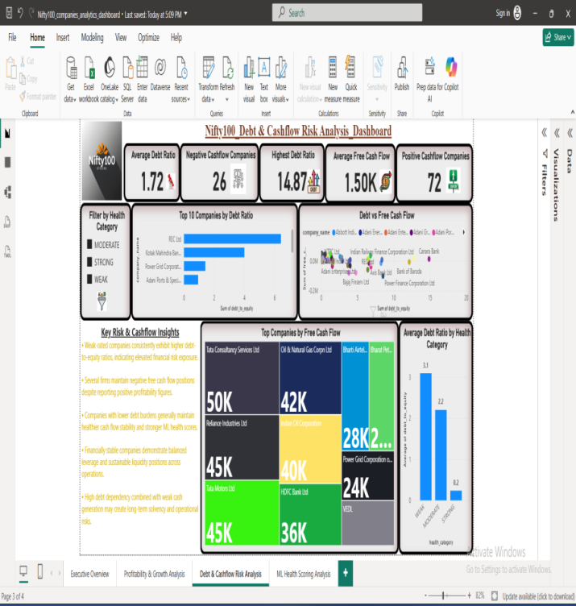
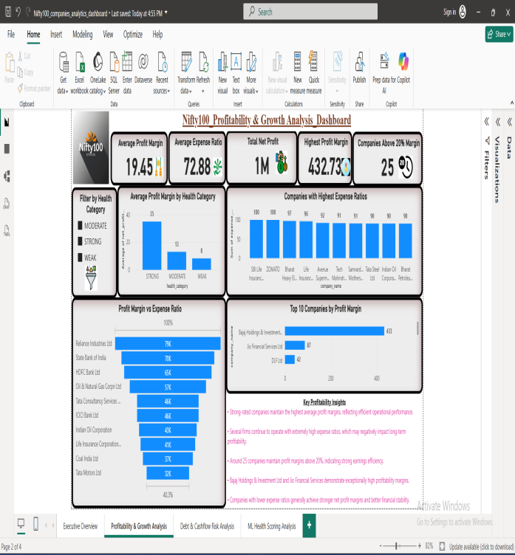
Dashboard 1, 2 & 3 Screenshots
Key Findings:-
High debt reduces health score
Strong cashflow improves ranking
Profitability drives overall performance

Slide 11
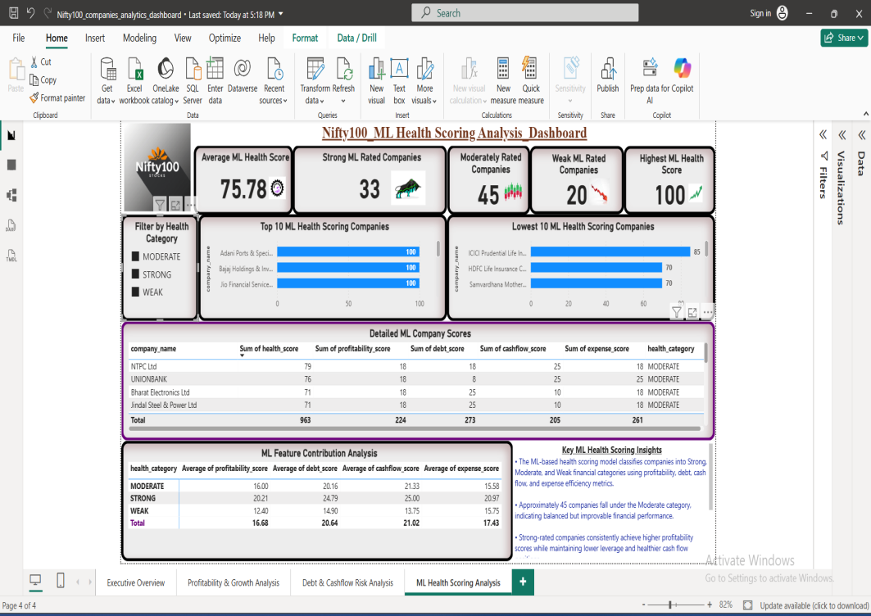
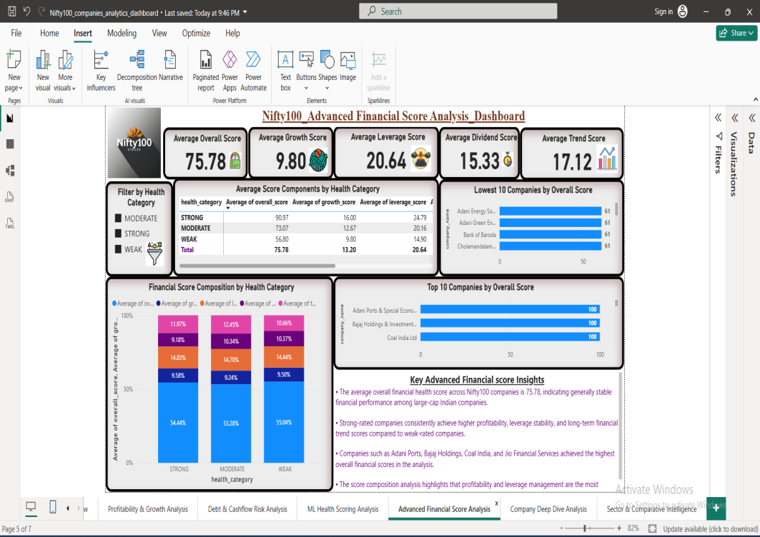
Dashboard 4 & 5 Screenshots
Key Findings:-
ML scoring simplifies company evaluation
Dividend and growth improve financial strength
Score decomposition improves transparency

Slide 12
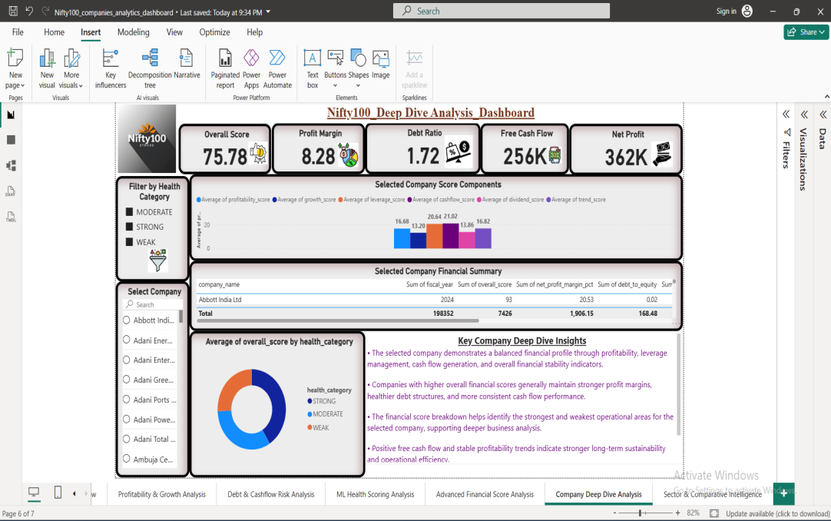
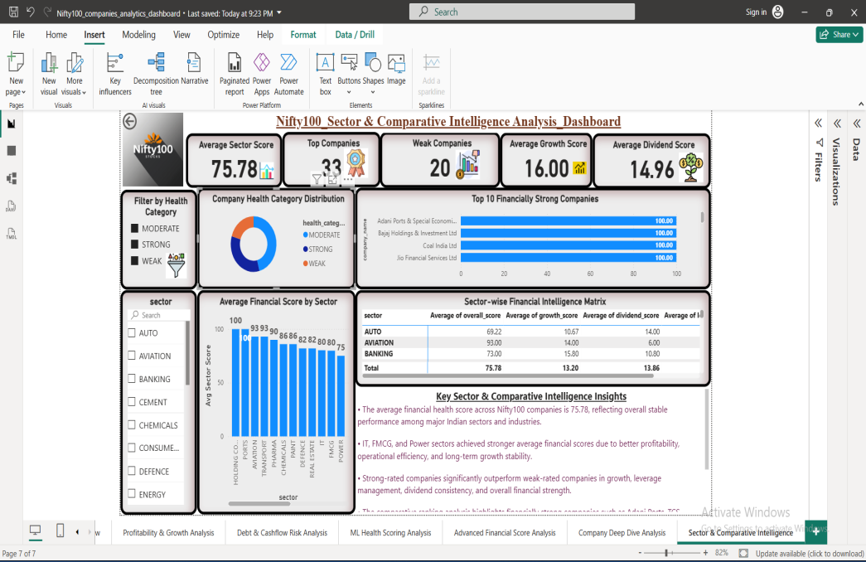
Dashboard 6 & 7 Screenshots
Key Findings:-
DAX KPIs enable company-level analysis
Sector benchmarking identifies industry leaders
Comparative analytics supports investment decisions

Slide 13
Key Business Insights
Top Insights:-
Strong companies consistently generate higher cashflows.
Debt-heavy firms show weaker financial scores.
IT and selected FMCG companies demonstrate financial stability.
Growth and dividend consistency improve overall health score.
Sector intelligence helps identify outperforming industries.

Slide 14
Challenges & Solutions
Challenge Solution
Header Issues ETL Cleaning
Missing Values Data Transformation
Sector Mapping Missing Sector Enrichment Layer
Dashboard Dependency Issues Versioned Datasets
Data Consistency Warehouse Validation

Slide 15
Conclusion
Project Achievements:-
ETL Automation
Postgre-SQL Warehouse
ML Financial Scoring
7 Power BI Dashboards
DAX Analytics
Sector Intelligence
Business Intelligence Reporting
Skills Demonstrated:-
Python
SQL
Postgre-SQL
Data Engineering
Power BI
DAX
Financial Analytics
Business Intelligence

