Slide 1
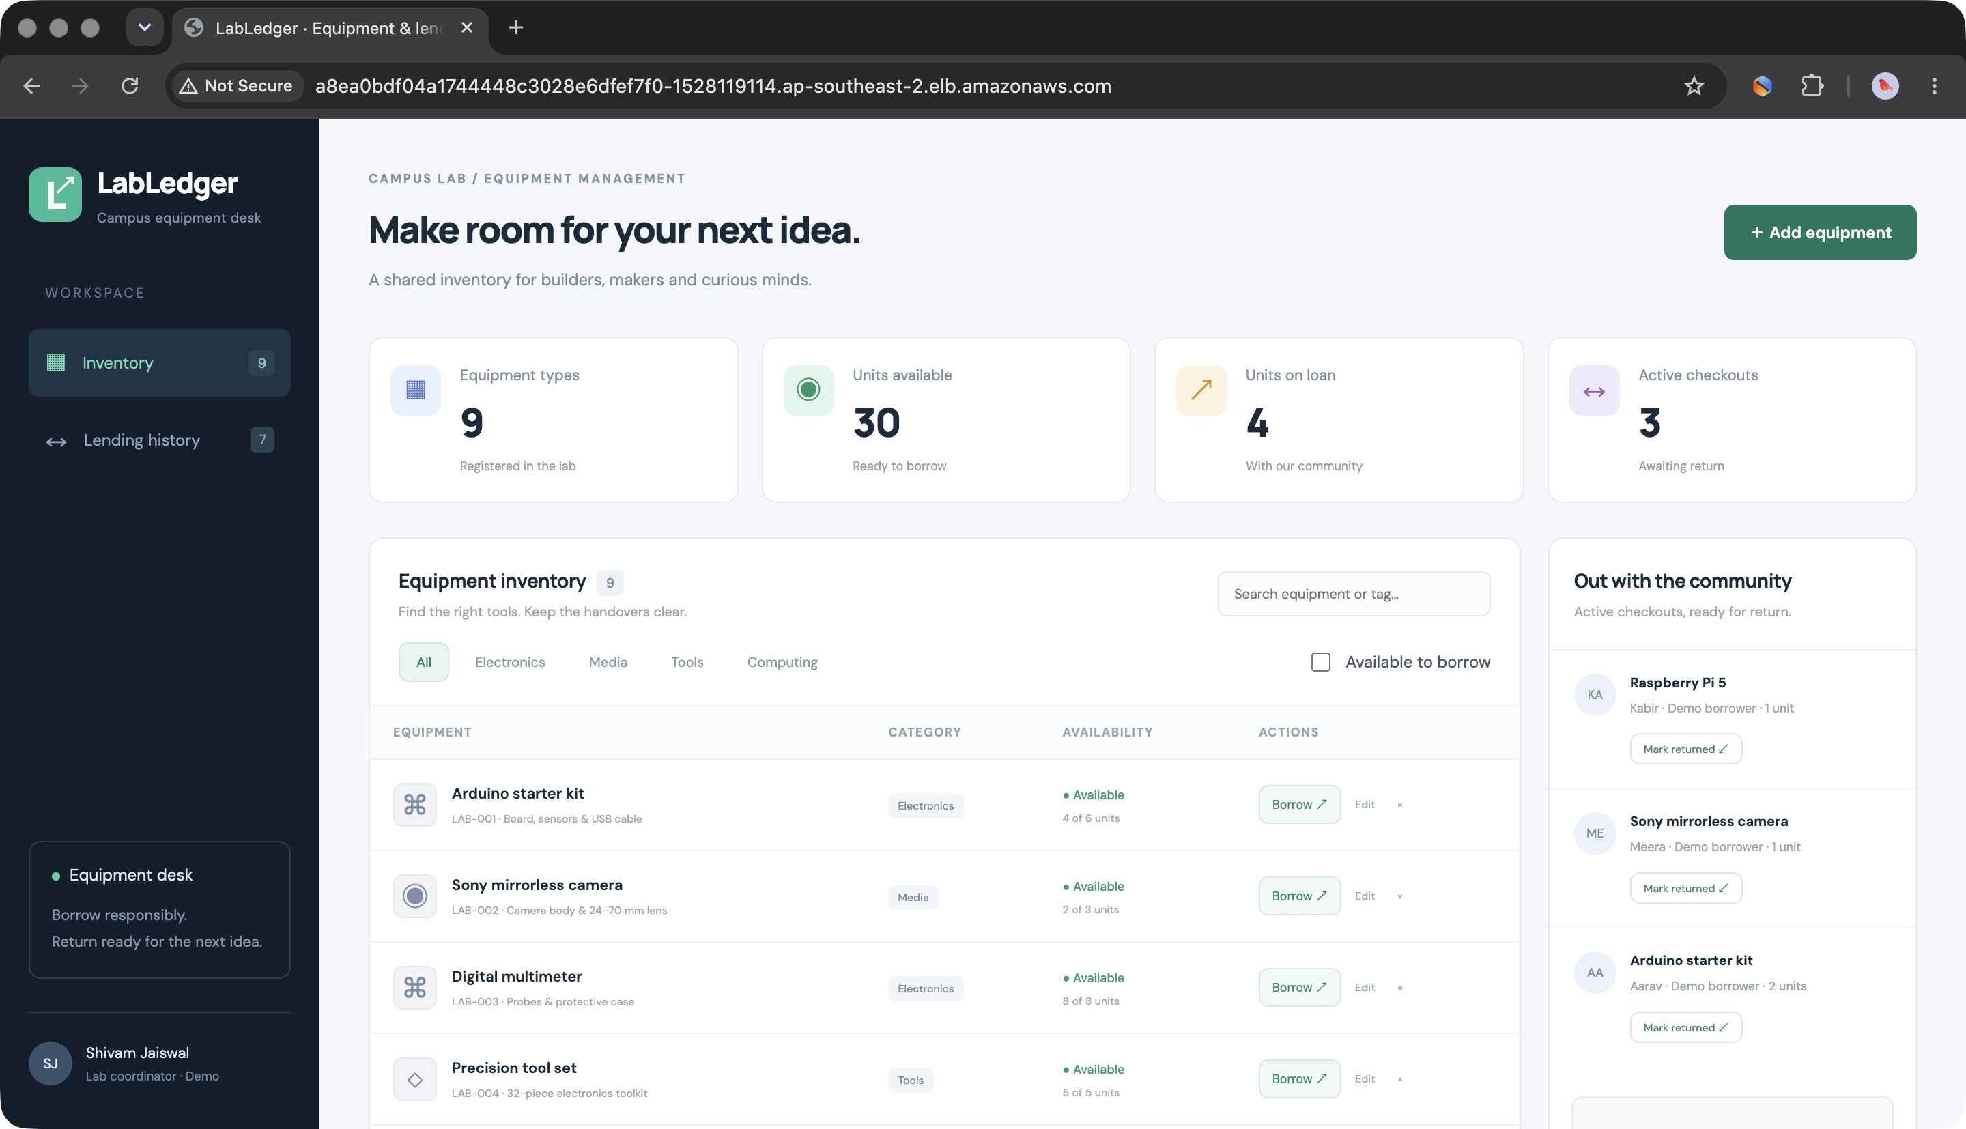
SESSION 21 / FINAL DEVOPS PROJECT
LabLedger
From commit to cloud.
A real campus equipment lending app, delivered with tested automation, Kubernetes, GitOps, observability and an AWS EKS deployment.
20 API tests • 2 CPU architectures • 21 AWS resources
Shivam Jaiswal
Recorded AWS deployment · 15 Oct 2026 · later torn down

Slide 2
FINAL DEVOPS CAPSTONE
A lending desk that needs trustworthy stock
THE PRODUCT
Know what exists. Know what is available. Record every handoff.
Inventory
Checkout & return
Operational proof
Asset tags, categories, quantities and searchable availability.
Borrowing changes stock; returns restore it once while history stays intact.
Health, readiness, metrics and release SHA connect behavior to deployment.
Why this matters
A live demo exercises business rules, not only a landing page.
Source: final-devops-project/README.md · Application and tests
LABLEDGER / SHIVAM JAISWAL
02 / 15

Slide 3
FINAL DEVOPS CAPSTONE
The running application
AWS EKS · REAL BROWSER
One screen, four jobs
01
See available equipment
02
Search and filter inventory
03
Borrow and return units
04
Review lending history
Screenshot captured before the temporary AWS deployment was removed.
LABLEDGER / SHIVAM JAISWAL
Output/49-aws-application-browser.png
03 / 15

Slide 4
FINAL DEVOPS CAPSTONE
Architecture: clear paths, clear ownership
USER REQUEST
EDGE
APP
DATA
Equipment desk
Traefik
FastAPI
PostgreSQL 17
Browser / React UI
Ingress / + API
2–4 Pods via HPA
StatefulSet + PVC
Release control
Runtime control
Visibility
GitHub Actions → GHCR → Argo CD
Helm · probes · migration Job · Secret
Prometheus → Grafana + JSON logs
Built once as application code; verified in Compose, Kind and AWS EKS.
LABLEDGER / SHIVAM JAISWAL
README.md · Architecture and technologies
04 / 15

Slide 5
FINAL DEVOPS CAPSTONE
The database protects the business rules
CONCURRENCY IS A PRODUCT REQUIREMENT
The final unit can only be borrowed once.
01
02
03
Lock the asset row
Apply constraints
Keep the record
Concurrent requests serialize at PostgreSQL.
Available stock stays between zero and total.
Double returns and deletion with loan history return 409.
Live PostgreSQL check: one HTTP 201 + one HTTP 409 for simultaneous attempts at the last unit.
Source: README.md · Business behavior; scripts/verify.py
LABLEDGER / SHIVAM JAISWAL
05 / 15

Slide 6
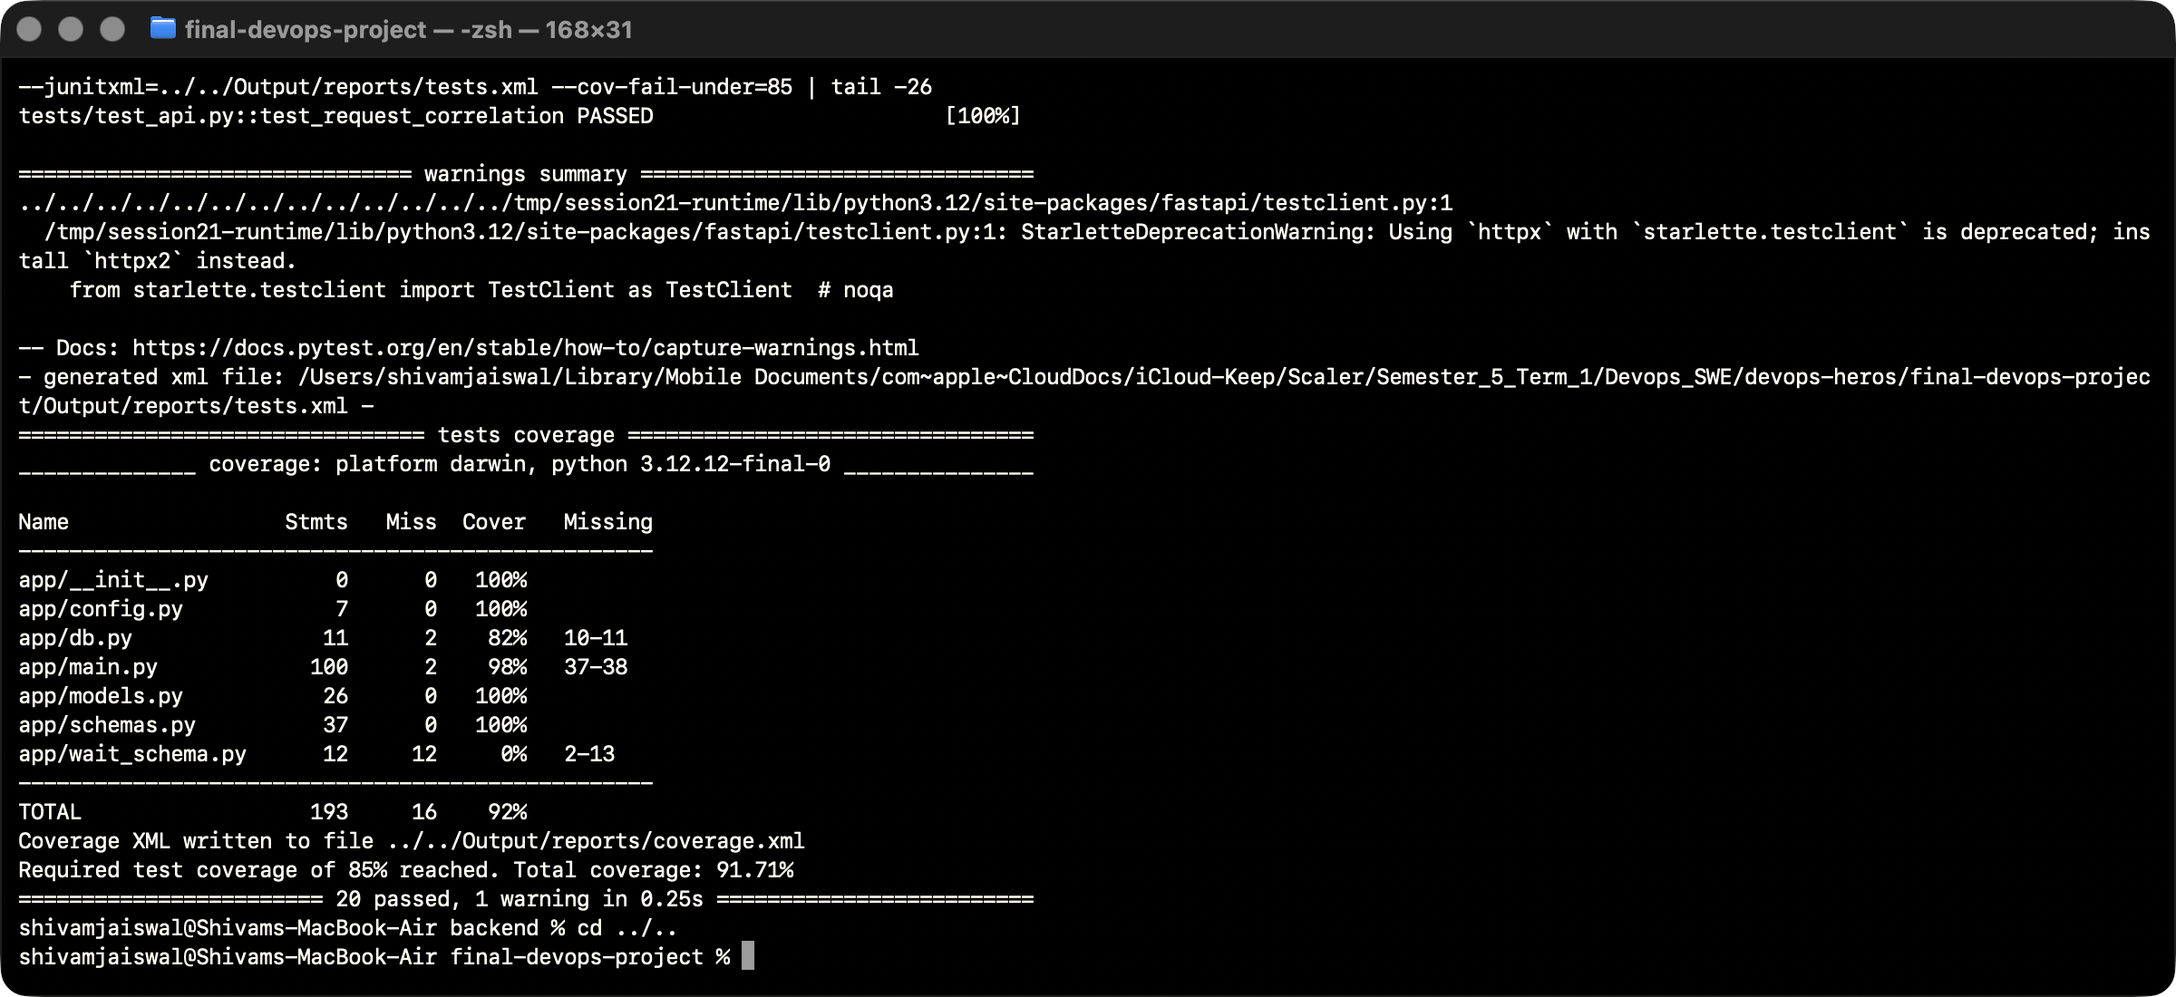
FINAL DEVOPS CAPSTONE
Tests that protect the experience
20
91.71%
6
2
API TESTS PASSED
API COVERAGE
FRONTEND TESTS
REAL DB CONCURRENCY OUTCOMES
Coverage is one layer.
The suite also checks oversubscription, return idempotency, asset deletion rules, readiness and request correlation.
CI GATE ≥ 85%
LABLEDGER / SHIVAM JAISWAL
Output/02-api-tests.png · reports/tests.xml
06 / 15

Slide 7
FINAL DEVOPS CAPSTONE
A release moves only after both architectures pass
01
02
03
04
05
06
Commit
Quality
Build
Verify
Promote
Reconcile
Source SHA
Tests + scans
AMD64 + ARM64
2 Kind clusters
SHA manifests
Argo CD → Helm
Promotion condition
Both native deployments pass real application and PostgreSQL checks.
Verified image tags become the desired state; Argo CD applies that state to Kubernetes.
LABLEDGER / SHIVAM JAISWAL
README.md · CI/CD and DevSecOps
07 / 15

Slide 8
FINAL DEVOPS CAPSTONE
Security checks are release gates
Source & secrets
Dependencies
Runtime images
Bandit SAST and Gitleaks scan committed source.
pip-audit and npm audit check the recorded dependency snapshot.
Trivy blocks HIGH and CRITICAL findings for both images on both architectures.
0
HIGH / CRITICAL findings
2 images × 2 architectures
across four CI image reports
Recorded scan results are point-in-time evidence.
Source: Output/reports/security-summary.json
LABLEDGER / SHIVAM JAISWAL
08 / 15

Slide 9
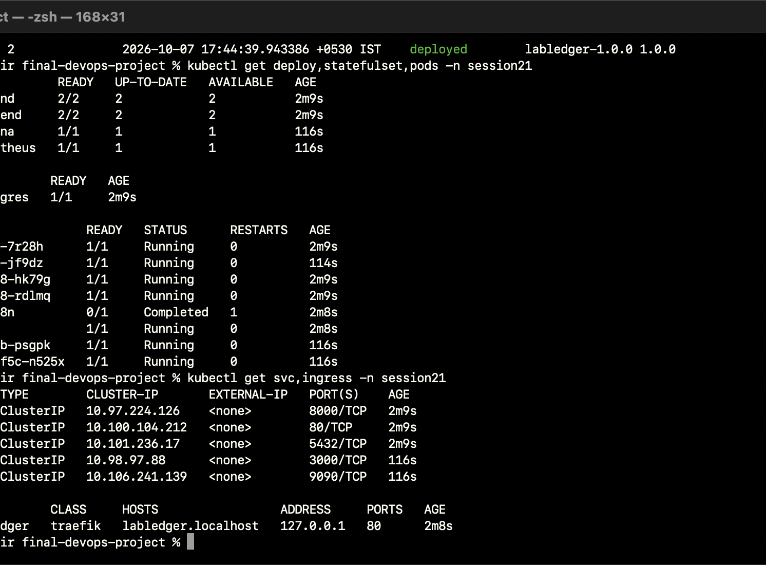
FINAL DEVOPS CAPSTONE
Kubernetes keeps the service available
01
Replicas + probes
Two frontend Pods; backend starts at two and scales to four.
02
Ordered schema
Alembic migration Job runs before the application release.
03
Stateful data
PostgreSQL uses a bound 2 GiB PVC; credentials stay in an external Secret.
Screenshot: Helm and Kubernetes verification from the local lab.
LABLEDGER / SHIVAM JAISWAL
README.md · Kubernetes and Helm
09 / 15

Slide 10
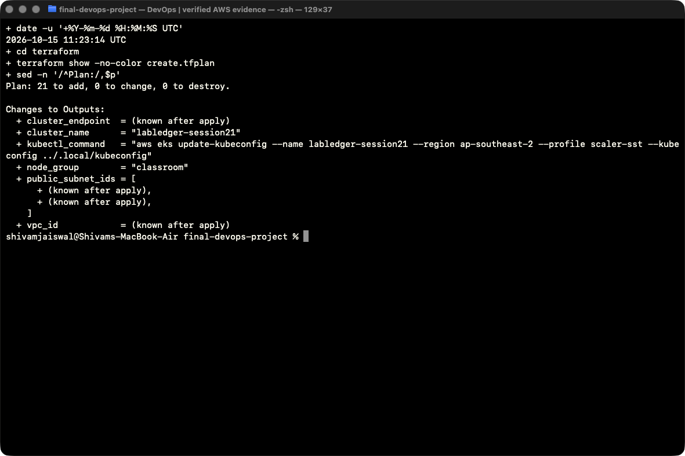
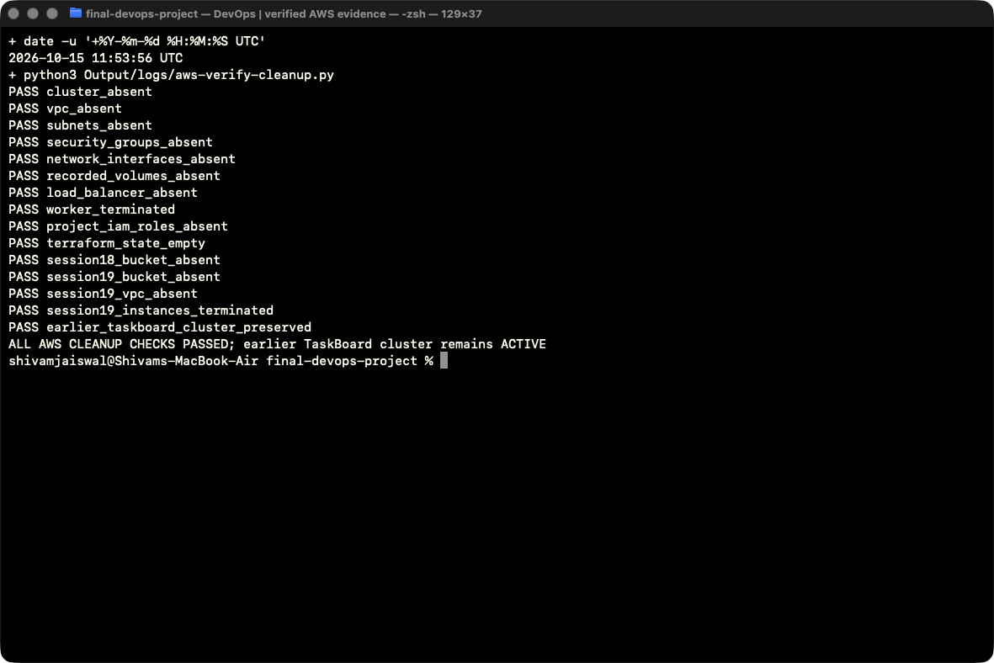
FINAL DEVOPS CAPSTONE
A complete AWS run, then a verified teardown
21
1
2
0
TERRAFORM RESOURCES
EKS WORKER
PUBLIC SUBNETS
TARGET RESOURCES AFTER CLEANUP
PLAN · 21 ADDITIONS
LIVE APPLICATION
ABSENCE CHECKS
15 Oct 2026 · Sydney (ap-southeast-2) · temporary deployment removed after evidence collection
LABLEDGER / SHIVAM JAISWAL
Output/43, 49, 55, 56 · AWS evidence
10 / 15

Slide 11
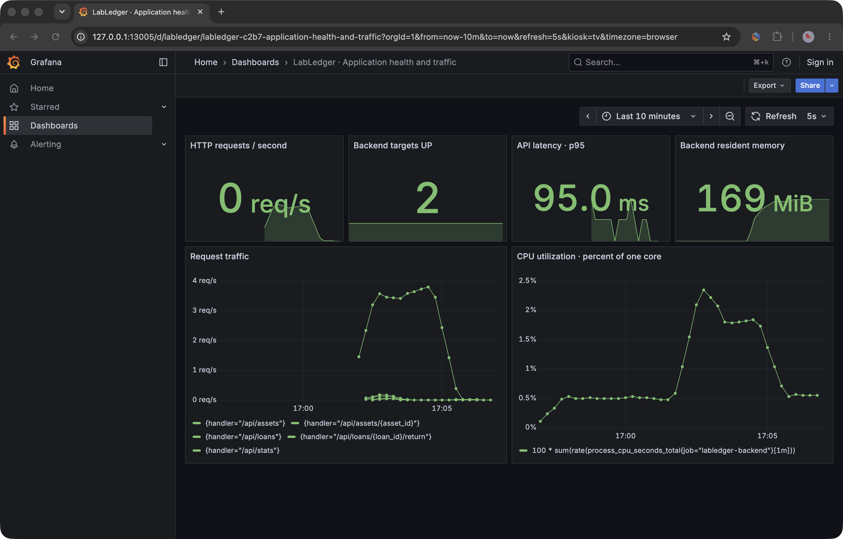
FINAL DEVOPS CAPSTONE
Observability follows each request
SIX LIVE PANELS
From traffic to cause
Traffic
Requests + p95 latency
Health
Two backend targets UP
Capacity
Process CPU + memory
Traceability
Request ID + release SHA in JSON logs
Prometheus scraped the EKS backend Pods; Grafana history was temporary.
LABLEDGER / SHIVAM JAISWAL
Output/53-aws-grafana-dashboard.png
11 / 15

Slide 12
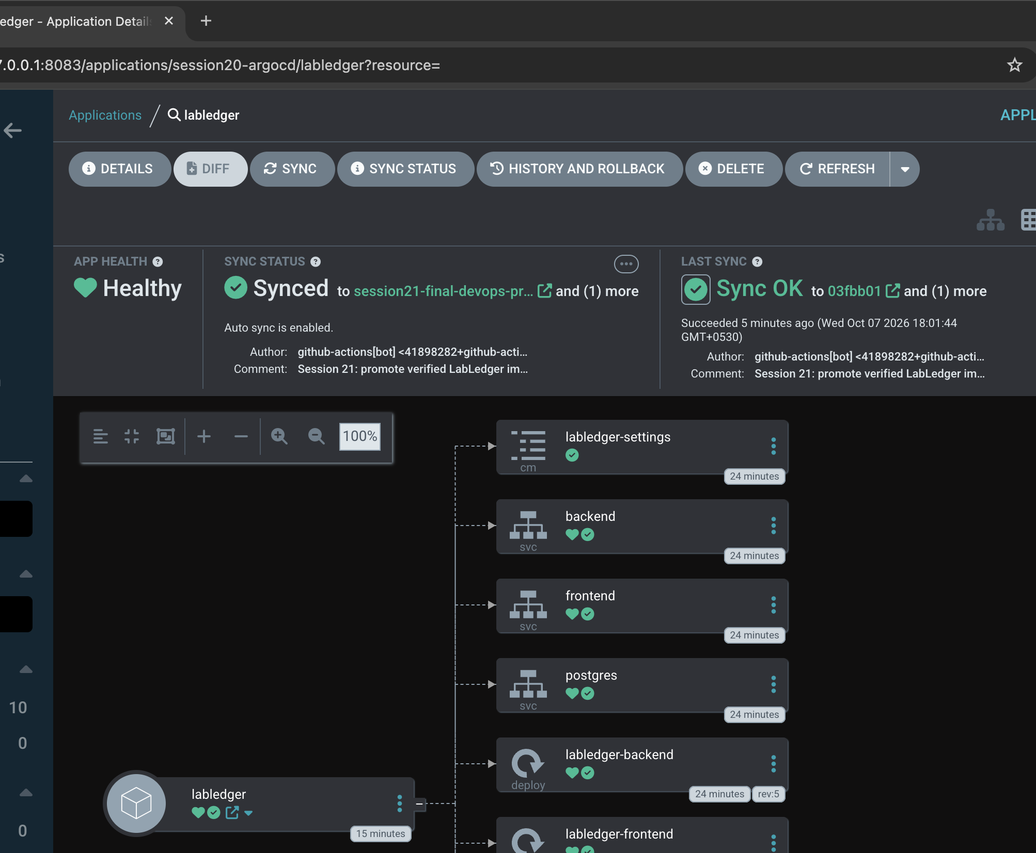
FINAL DEVOPS CAPSTONE
GitOps closes the loop from code to cluster
Verified release
9faeab4…
Feature: available-only inventory filter + searchable lending history.
CI writes verified image tags to Git. Argo CD sees the commit and reconciles Helm resources.
Synced / Healthy after migration and rollout
LABLEDGER / SHIVAM JAISWAL
README.md · GitOps and demonstrated release
12 / 15

Slide 13
FINAL DEVOPS CAPSTONE
Four failures, four demonstrated recoveries
Invalid image
Wrong selector
01
02
SIGNAL Pod pull fails
SIGNAL No backend endpoints
FIX Restore verified SHA
FIX Restore app label
Wrong port
Database down
03
04
SIGNAL Ingress returns 502
SIGNAL Ready returns 503
FIX Route to port 8000
FIX Restore StatefulSet
Each fault has a screenshot pair, command transcript, root cause and verification in troubleshooting/README.md.
LABLEDGER / SHIVAM JAISWAL
13 / 15

Slide 14
FINAL DEVOPS CAPSTONE
The evidence trail is part of the deliverable
56
SCREENSHOTS
4
FAULT PLAYBOOKS
2
RELEASES
Application, tests, CI, cluster, cloud and cleanup
Image, Service, Ingress and database recovery
Verified feature change and GitOps promotion
Operating limits
Classroom lab with synthetic data and HTTP. Production work would add authentication, TLS, managed backups, signed images, durable metrics and alert delivery.
The AWS endpoint shown in screenshots is historical; the cluster and its resources were deleted.
LABLEDGER / SHIVAM JAISWAL
Output/README.md · screenshot-verification.json
14 / 15

Slide 15
LABLEDGER / FINAL DEVOPS CAPSTONE
Built. Verified. Deployed. Recovered.
And cleaned up with proof.
20 API tests · 91.71% coverage · 2 architectures · 21 AWS resources · 4 fault recoveries
Source and full evidence: final-devops-project/README.md + Output/
Shivam Jaiswal · Session 21

