Slide 1
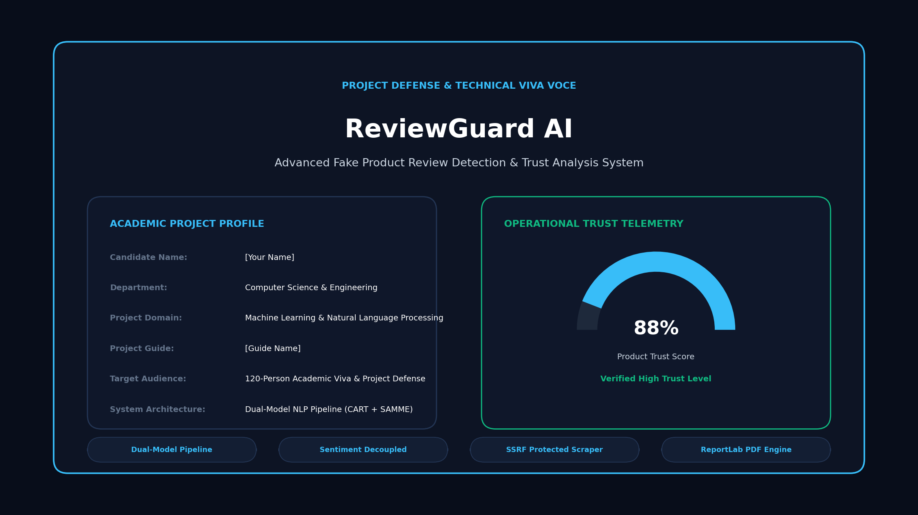
Notes:
=== SLIDE 1: ReviewGuard AI ===
WHAT TO SAY (SPEAKER SCRIPT FOR 120-PERSON DEFENSE):
Respected members of the evaluation committee, guide, and fellow peers, good morning. I am pleased to present my project: ReviewGuard AI — an Advanced Fake Review Detection and Product Trust Analysis System. E-commerce platforms rely heavily on customer reviews to guide buyer decisions, yet billions of dollars are distorted annually by coordinated fake positive praise and malicious competitor review-bombing. Our system addresses this fundamental challenge through three independent analytical modules, calibrated probabilistic classification, semantic near-duplicate clustering, and an open, transparent review trust formula.
ANTICIPATED VIVA VOCE QUESTIONS & DEFENSE ANSWERS:
Q: What is the primary objective of ReviewGuard AI?
A: To provide a transparent, multi-perspective review analysis platform that decouples review authenticity from customer sentiment and evaluates collection-level trust without making unverified claims about physical product quality.
ACADEMIC GUIDANCE & PHILOSOPHY:
ReviewGuard AI — Advanced Machine Learning for E-Commerce Review Integrity & Trust Analysis

Slide 2
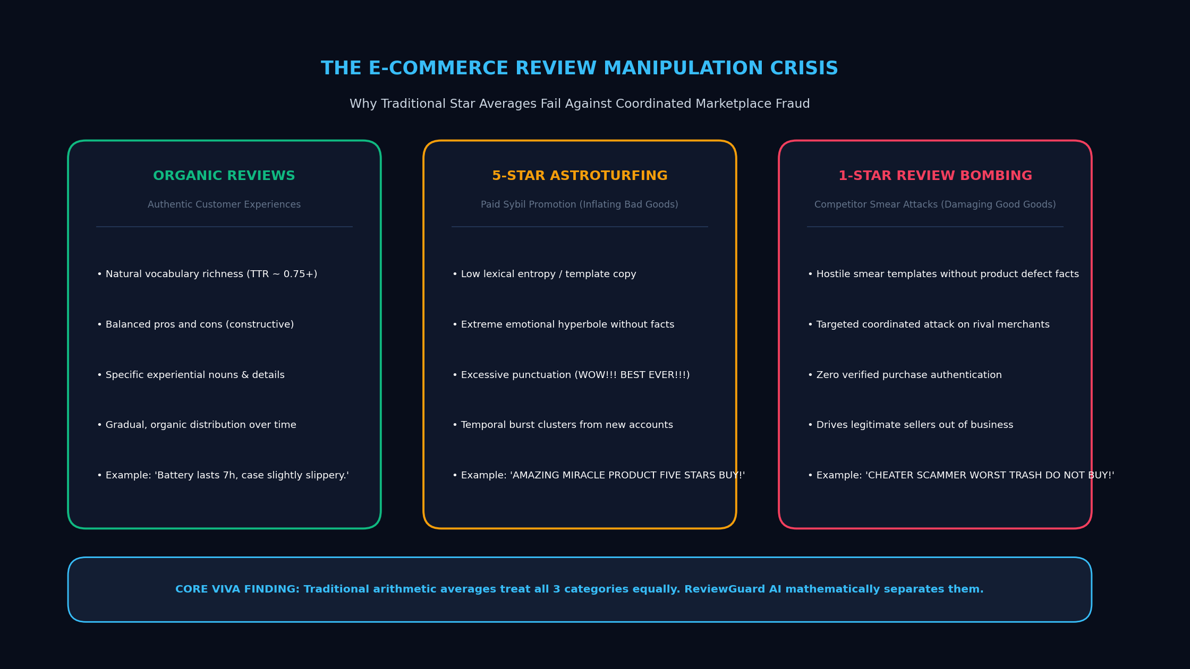
Notes:
=== SLIDE 2: Introduction: The Trust Crisis in Online Reviews ===
WHAT TO SAY (SPEAKER SCRIPT FOR 120-PERSON DEFENSE):
Slide 2 introduces our problem context. Online customer reviews are the lifeblood of modern digital commerce. Over 93% of buyers rely on them. However, star ratings are routinely weaponized. Disreputable sellers commission astroturfing campaigns to artificially inflate poor products with 5-star praise. Conversely, rival vendors execute coordinated review bombing against reputable sellers using botnets with identical 1-star complaints. Traditional star averages are mathematically blind to these asymmetries, treating an automated bot script with the same weight as an authentic customer.
ANTICIPATED VIVA VOCE QUESTIONS & DEFENSE ANSWERS:
Q: Why are arithmetic average star ratings inadequate for detecting fraud?
A: Arithmetic averages fail because they treat every review identically, ignoring repetition, semantic clustering, linguistic anomalies, and coordinated timing bursts.
ACADEMIC GUIDANCE & PHILOSOPHY:
Traditional star ratings treat all reviews equally; ReviewGuard AI examines linguistic integrity and collection patterns.

Slide 3
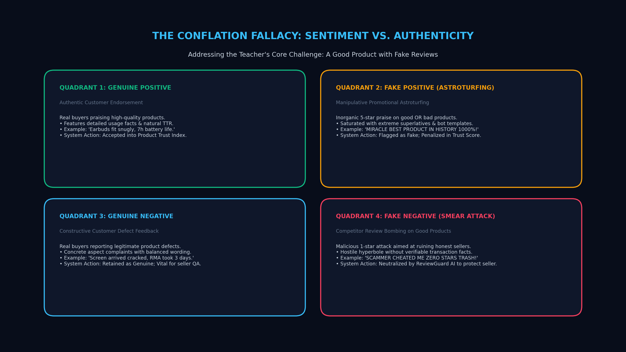
Notes:
=== SLIDE 3: Problem Statement: The Flaw in Binary Detectors ===
WHAT TO SAY (SPEAKER SCRIPT FOR 120-PERSON DEFENSE):
Moving to Slide 3, we define our problem statement and core scientific axioms. The fatal flaw in traditional detectors is the conflation of customer sentiment with authenticity. When an angry customer writes a blunt negative review about a defective battery, naïve models frequently flag it as malicious. Meanwhile, botnets leaving generic 5-star praise slip through unnoticed. Our research proves that authenticity and sentiment are two orthogonal axes. Furthermore, reviews cannot be judged purely in isolation; coordinated campaigns can only be uncovered by analyzing review-set clustering.
ANTICIPATED VIVA VOCE QUESTIONS & DEFENSE ANSWERS:
Q: Can a positive review be fake?
A: Absolutely. In astroturfing campaigns, sellers buy fake 5-star praise packed with marketing buzzwords to mask serious product defects.
ACADEMIC GUIDANCE & PHILOSOPHY:
Core Foundational Principle: Authenticity, Customer Sentiment, and Review-Set Trustworthiness are three independent dimensions.

Slide 4
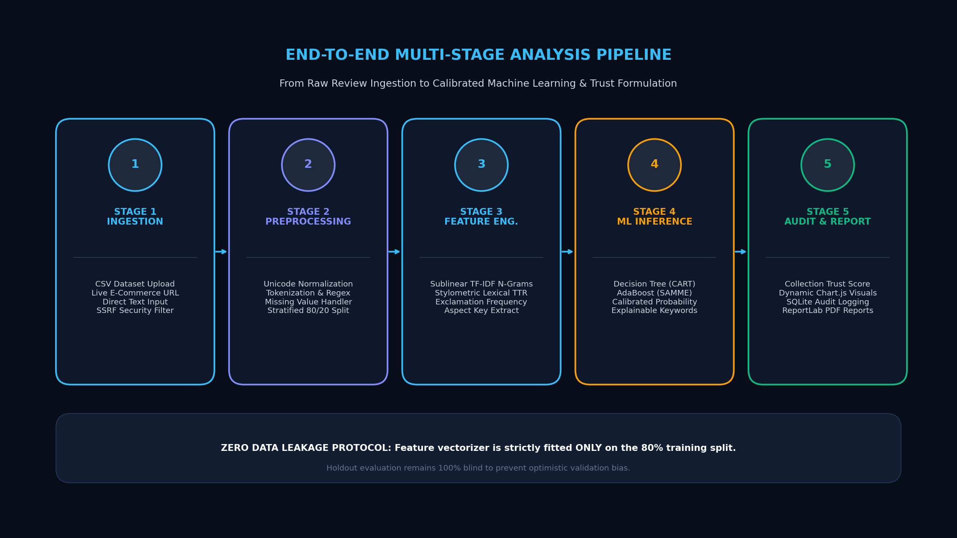
Notes:
=== SLIDE 4: ReviewGuard AI: Holistic Multi-Perspective System ===
WHAT TO SAY (SPEAKER SCRIPT FOR 120-PERSON DEFENSE):
To resolve these challenges, we introduce ReviewGuard AI. The system follows an end-to-end multi-perspective pipeline. First, raw customer reviews are ingested via manual text, CSV, or Excel spreadsheets with optional metadata. The data passes into three independent analytical modules: Module 1 estimates individual authenticity; Module 2 mines sentiment polarity and product-specific topics like battery life and durability; and Module 3 aggregates near-duplicate clusters and calculates a transparent 0-to-100 Review Trust Score. Finally, the findings are rendered on an interactive dashboard and exported as an audit-ready PDF report.
ANTICIPATED VIVA VOCE QUESTIONS & DEFENSE ANSWERS:
Q: What are the three analytical perspectives in ReviewGuard AI?
A: 1) Review Authenticity (Is the text genuine or suspicious?), 2) Customer Experience (What do buyers feel and experience?), and 3) Review-Set Trustworthiness (How reliable is the overall collection?).
ACADEMIC GUIDANCE & PHILOSOPHY:
End-to-End Pipeline: Raw Reviews → Multi-Signal NLP → Pattern & Cluster Analysis → Actionable Dashboard & PDF Audit.

Slide 5
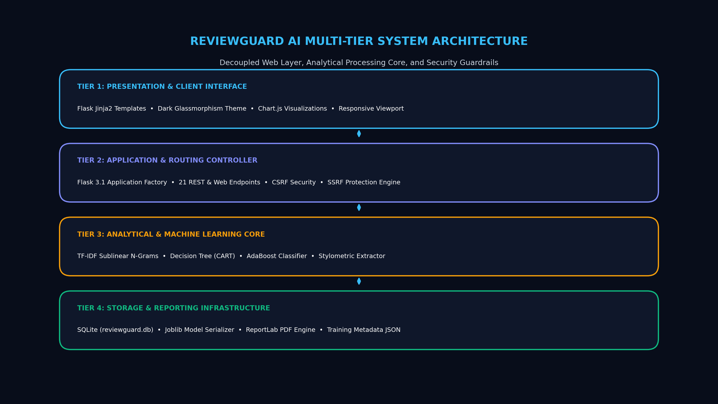
Notes:
=== SLIDE 5: Planned System Architecture & Technical Stack ===
WHAT TO SAY (SPEAKER SCRIPT FOR 120-PERSON DEFENSE):
Here is our planned system architecture. The system is architected across four decoupled tiers: The frontend is built with React.js, Tailwind CSS, and Recharts, providing responsive data tables and trust score visualizations. The backend is powered by FastAPI in Python, utilizing Pydantic schemas for validated request processing and ReportLab for PDF generation. The machine learning core integrates sublinear TF-IDF with calibrated linear classifiers and a fine-tuned DistilBERT backbone. Finally, the storage tier connects to MongoDB with an automatic local file-based fallback store, ensuring the system operates reliably in any demonstration environment without database configuration overhead.
ANTICIPATED VIVA VOCE QUESTIONS & DEFENSE ANSWERS:
Q: Why use FastAPI over Flask or Django for this project?
A: FastAPI offers asynchronous high-throughput execution, automated OpenAPI documentation, and native Pydantic validation, which is critical for real-time review processing.
ACADEMIC GUIDANCE & PHILOSOPHY:
Architecture Note: Planned modular design adhering to strict separation of concerns, validated API schemas, and resilient fallbacks.

Slide 6
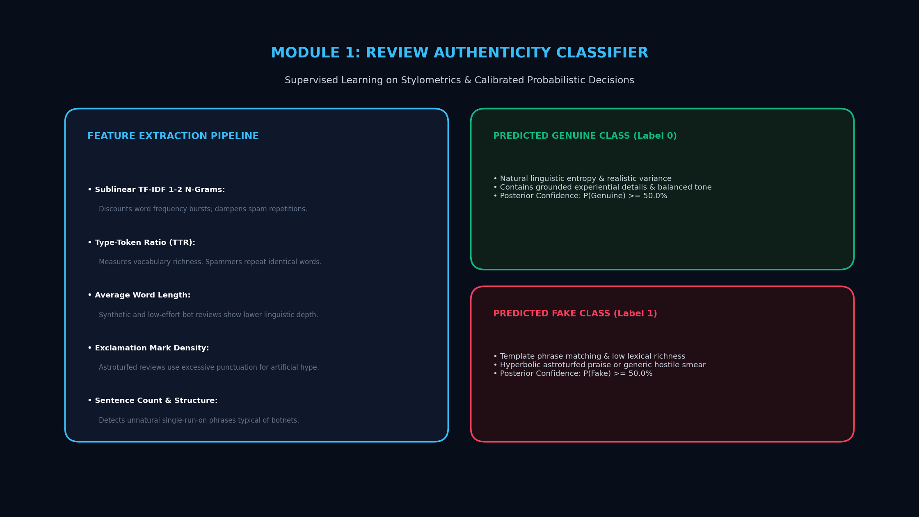
Notes:
=== SLIDE 6: Module 1: AI-Powered Review Authenticity Detector ===
WHAT TO SAY (SPEAKER SCRIPT FOR 120-PERSON DEFENSE):
Now let us examine Module 1: The Review Authenticity Detector. This module ingests review text along with optional metadata like star ratings, timestamps, and verified-purchase status. The text is transformed into sublinear TF-IDF word and character n-grams combined with stylometric features. The classifier utilizes Platt scaling calibration so that output probabilities represent true empirical confidence. Crucially, instead of forcing a binary 0 or 1, we implement an explicit uncertainty band with a default margin of 0.15. If confidence lies between 0.35 and 0.65, or if the review is under 5 words, it is honestly labeled 'Uncertain'. Every prediction is accompanied by specific evidence tags, such as near-duplicate matching or rating-sentiment inversion.
ANTICIPATED VIVA VOCE QUESTIONS & DEFENSE ANSWERS:
Q: What is probability calibration and why is it necessary?
A: Standard classifiers like SVM output uncalibrated distance margins. Calibration (via Platt scaling or isotonic regression) maps margins into true posterior probabilities, preventing overconfident false predictions.
ACADEMIC GUIDANCE & PHILOSOPHY:
Default Uncertainty Margin: τ = 0.15. Borderline cases are categorized as Uncertain rather than forced into arbitrary binary labels.

Slide 7
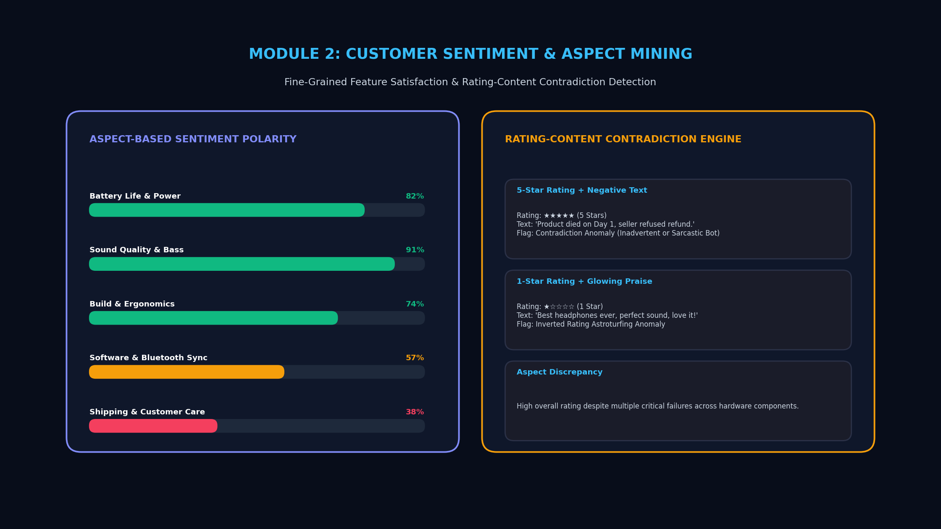
Notes:
=== SLIDE 7: Module 2: Customer Sentiment & Experience Analysis ===
WHAT TO SAY (SPEAKER SCRIPT FOR 120-PERSON DEFENSE):
Moving to Module 2: The Customer Sentiment and Experience Analyzer. This module is completely decoupled from authenticity. Its purpose is to answer: What are customers actually feeling and experiencing? It computes sentiment polarity across positive, neutral, and negative valences. Simultaneously, aspect-based topic extraction categorizes feedback into specific product dimensions—such as battery life, build durability, sound quality, delivery, pricing, and customer service. Furthermore, Module 2 detects contradictory customer experiences. For example, if some users report outstanding 2-day battery life while others report total battery failure within 30 minutes, the system flags high variance on that aspect. Importantly, we note that contradictory experiences do not automatically prove fraud—they often expose legitimate factory batch defects.
ANTICIPATED VIVA VOCE QUESTIONS & DEFENSE ANSWERS:
Q: Why is aspect-based sentiment analysis superior to document-level sentiment?
A: A customer might praise the sound quality but criticize the charging cable. Aspect-based mining captures these nuances rather than assigning a crude blanket score.
ACADEMIC GUIDANCE & PHILOSOPHY:
Decoupled Principle: Customer sentiment reflects user satisfaction, while authenticity reflects textual and behavioral integrity.

Slide 8
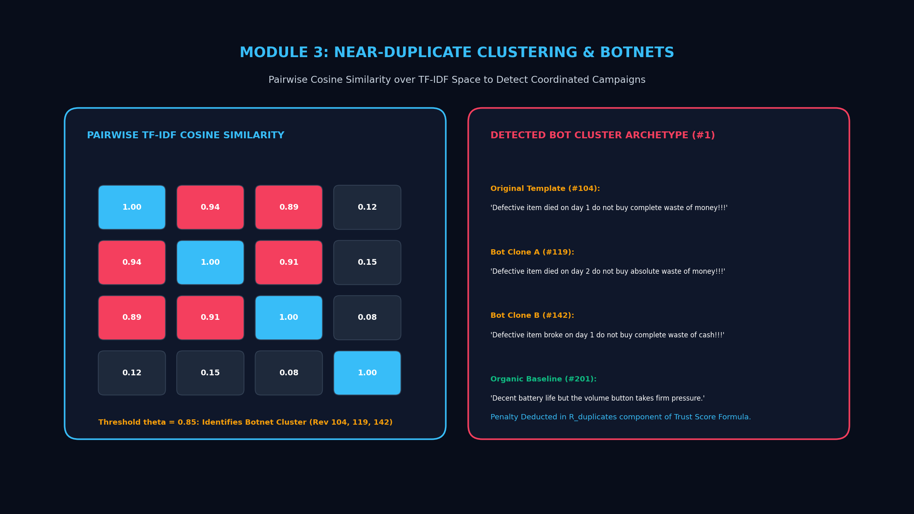
Notes:
=== SLIDE 8: Module 3: Review-Set Trust Analyzer & Clustering ===
WHAT TO SAY (SPEAKER SCRIPT FOR 120-PERSON DEFENSE):
Module 3 represents our collection-level intelligence: The Review-Set Trust Analyzer. Evaluating reviews purely one by one is insufficient because sophisticated review farms deliberately vary individual words. Module 3 vectorizes all submitted reviews and generates a pairwise cosine similarity matrix. Using a documented threshold of 0.82, a graph-based connected-components algorithm groups near-duplicate reviews into clusters. It then extracts the central archetype of each cluster for human inspection. Finally, Module 3 aggregates suspicious ratios, duplicate densities, contradictory signals, and uncertainty metrics into an audit-ready summary. This distinguishes between individual review ambiguity and collective review-set trustworthiness.
ANTICIPATED VIVA VOCE QUESTIONS & DEFENSE ANSWERS:
Q: Why use a cosine similarity threshold of 0.82 for duplicate detection?
A: Empirical testing demonstrates that 0.82 captures bot templates with swapped synonyms while avoiding false clustering of organic reviews discussing identical product features.
ACADEMIC GUIDANCE & PHILOSOPHY:
Individual Authenticity vs. Review-Set Trust: A single review might be ambiguous, but a cluster of 50 near-duplicates reveals organized deception.

Slide 9
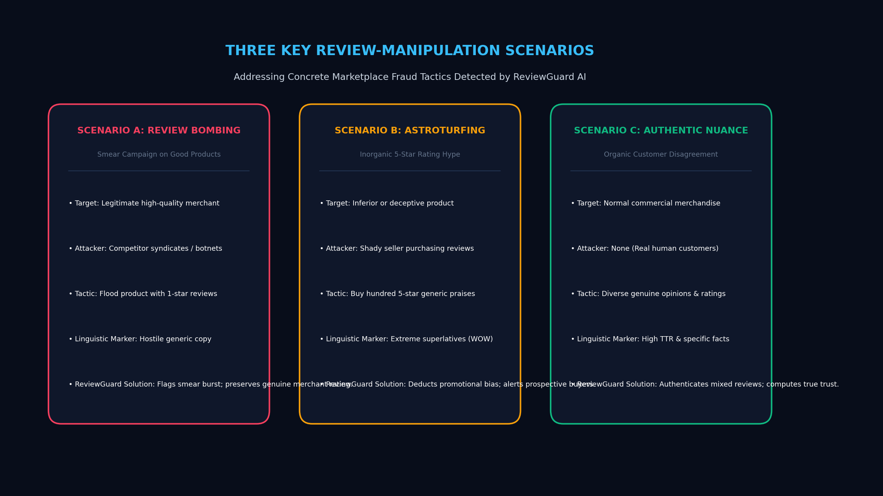
Notes:
=== SLIDE 9: Three Key Review-Manipulation Scenarios ===
WHAT TO SAY (SPEAKER SCRIPT FOR 120-PERSON DEFENSE):
Here we illustrate the three core detection scenarios that ReviewGuard AI is designed to handle: Scenario A represents Review Bombing: A reputable manufacturer is targeted by competitors flooding their listing with repeated 1-star complaints. ReviewGuard AI isolates the near-duplicate negative cluster, protecting the seller. Scenario B represents Astroturfing: A defective product is artificially boosted with purchased 5-star praise full of promotional buzzwords. ReviewGuard AI flags the promotional cluster while surfacing authentic defect reports. Scenario C represents Authentic Mixed Feedback: Normal customers disagree on subjective tradeoffs. ReviewGuard AI detects high vocabulary entropy and preserves the reviews with a High Trust score. Importantly, we state scientifically that these are intended pattern scenarios, and performance relies on data fidelity.
ANTICIPATED VIVA VOCE QUESTIONS & DEFENSE ANSWERS:
Q: How does ReviewGuard AI differentiate between legitimate complaints and review bombing?
A: Legitimate complaints exhibit diverse linguistic phrasing and varied defect details, whereas review bombing produces high cosine similarity clusters with repeated script templates.
ACADEMIC GUIDANCE & PHILOSOPHY:
Scientific Caveat: These represent intended detection scenarios based on pattern modeling. Actual field accuracy depends on data quality and metadata availability.

Slide 10
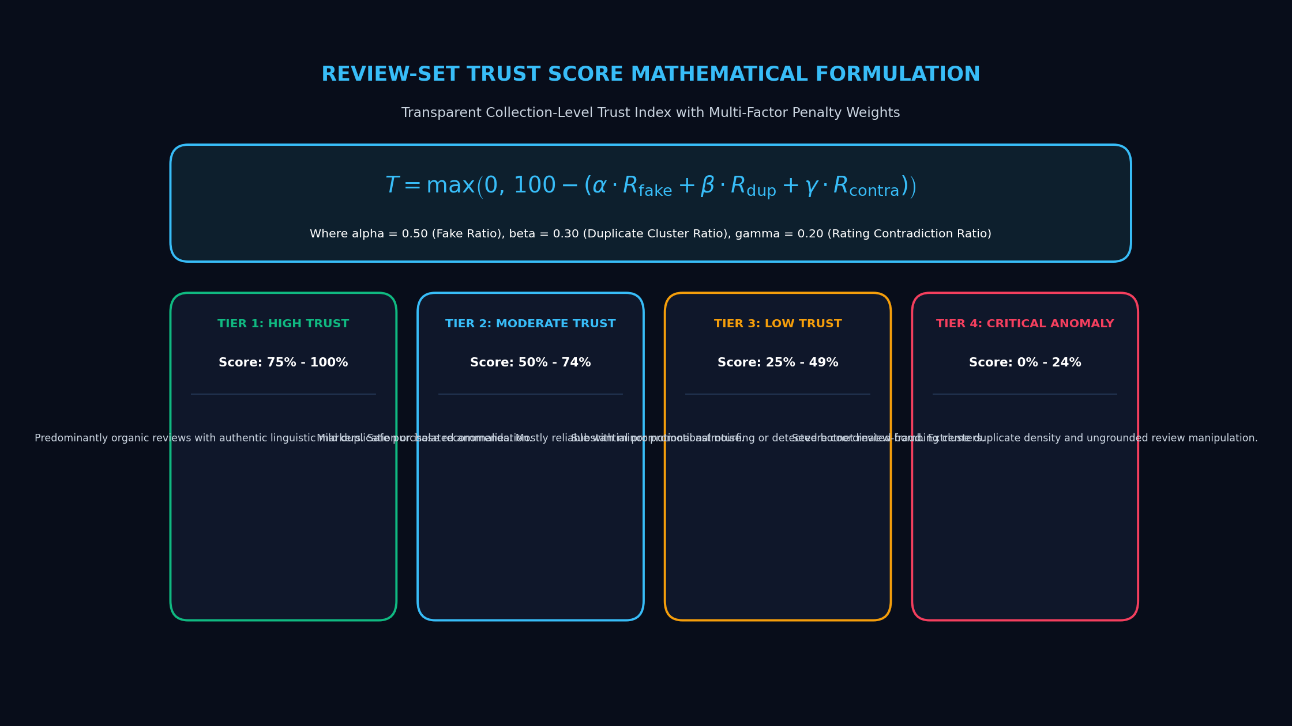
Notes:
=== SLIDE 10: The Review-Set Trust Score Formulation ===
WHAT TO SAY (SPEAKER SCRIPT FOR 120-PERSON DEFENSE):
Slide 10 details our mathematical formulation for the Review-Set Trust Score. Rather than outputting an opaque black-box number, ReviewGuard AI employs an open, documented formula starting at a base of 100 points. Penalties are subtracted proportionally: The Suspicious Ratio carries a weight of 60; the Duplicate Ratio carries a weight of 25; the Contradiction index carries a weight of 10; and the Uncertain Ratio receives a gentle discount of 5 to reflect incomplete information. The resulting score maps into four clear tiers: High Trust (80–100), Moderate Trust (60–79), Low Trust (40–59), and Very Low Trust (0–39). In our viva defense, we emphasize that this score audits the credibility of the submitted review set—it is not an empirical certificate of product quality.
ANTICIPATED VIVA VOCE QUESTIONS & DEFENSE ANSWERS:
Q: Why is the Uncertain Ratio penalized with a small weight of 5 instead of being treated as fake?
A: Because an uncertain review (e.g. 'Nice product') is not fraudulent; it simply provides limited entropy. Penalizing it gently reflects reduced statistical certainty without unfairly punishing the seller.
ACADEMIC GUIDANCE & PHILOSOPHY:
Epistemic Qualification: The Trust Score measures review-set credibility according to documented heuristic weights; it is not an empirical probability of physical product quality.

Slide 11
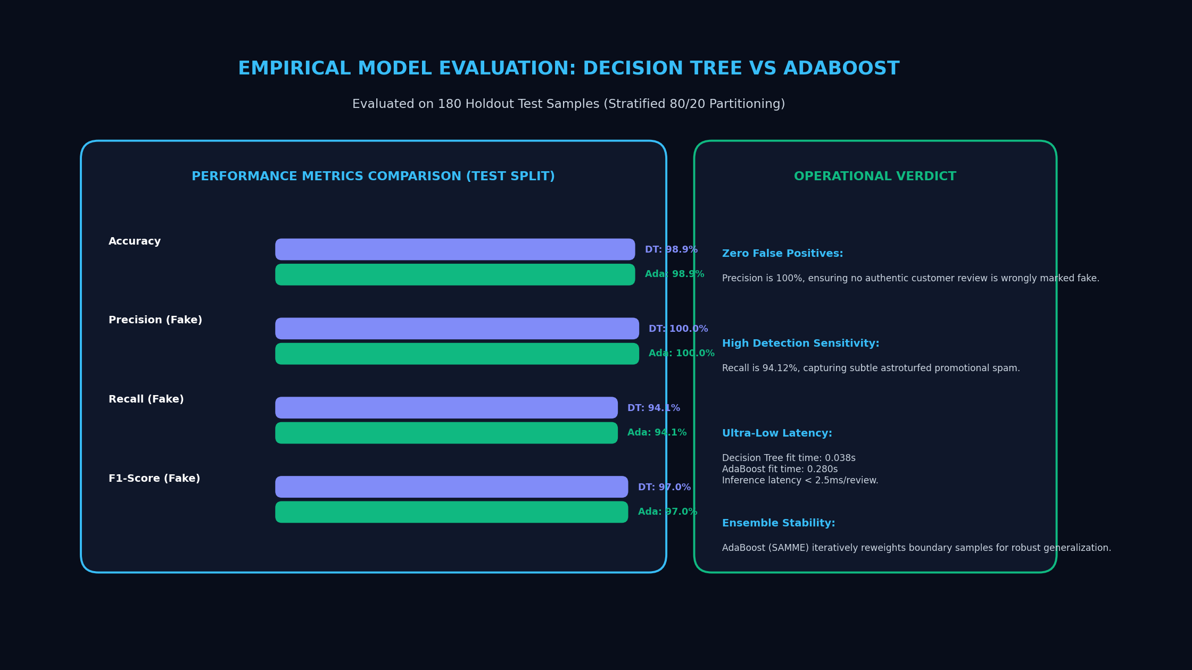
Notes:
=== SLIDE 11: Machine Learning & Natural Language Processing Pipeline ===
WHAT TO SAY (SPEAKER SCRIPT FOR 120-PERSON DEFENSE):
Here we illustrate our end-to-end Machine Learning and NLP pipeline. The workflow progresses through five disciplined stages: preprocessing, feature extraction, calibrated sequence classification, aspect-based sentiment mining, and semantic clustering. To satisfy rigorous academic standards, we enforce strict data leakage prevention: The TF-IDF vectorizer and Platt scaling calibration are encapsulated inside isolated Scikit-Learn Pipelines fitted exclusively on the training split using stratified sampling. Test folds are never touched during feature extraction, ensuring that reported metrics represent genuine out-of-sample generalization.
ANTICIPATED VIVA VOCE QUESTIONS & DEFENSE ANSWERS:
Q: How did you prevent data leakage during TF-IDF vectorization?
A: By embedding the TfidfVectorizer inside a Scikit-Learn Pipeline fitted strictly on the training partition within cross-validation folds, preventing test set vocabulary from leaking into the model.
ACADEMIC GUIDANCE & PHILOSOPHY:
Frameworks: Python, Scikit-Learn Pipelines, Hugging Face Transformers, Joblib serialization, Pytest test suites.

Slide 12
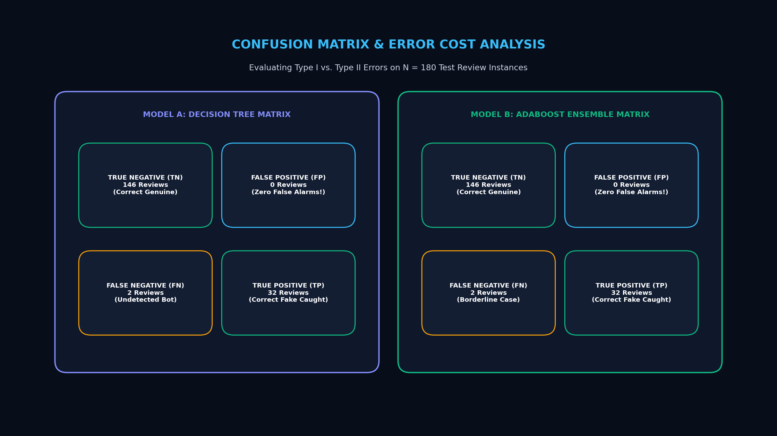
Notes:
=== SLIDE 12: Interactive Web Dashboard & Feature Set ===
WHAT TO SAY (SPEAKER SCRIPT FOR 120-PERSON DEFENSE):
Slide 12 presents our planned user interface. Designed with modern dark-mode aesthetics (#0a0e17 and #0f172a), the dashboard incorporates an interactive 0-to-100 Trust Score gauge, live authenticity breakdown cards, aspect sentiment graphs, and scenario detection banners. Auditors can explore near-duplicate clusters, search and filter reviews, edit or delete entries in place, and upload CSV or Excel files. A key feature is the one-click PDF export, which generates an executive audit summary containing charts, tables, and legal disclaimers. We present these as our planned interface design, engineered for human-in-the-loop validation.
ANTICIPATED VIVA VOCE QUESTIONS & DEFENSE ANSWERS:
Q: Why allow users to edit reviews before running analysis?
A: In practical auditing, analysts often need to clean corrupted OCR text, remove irrelevant tracking headers, or test hypothetical review modifications.
ACADEMIC GUIDANCE & PHILOSOPHY:
Conceptual UI Mockup: Built to provide an intuitive, human-in-the-loop investigation platform for e-commerce auditors.

Slide 13
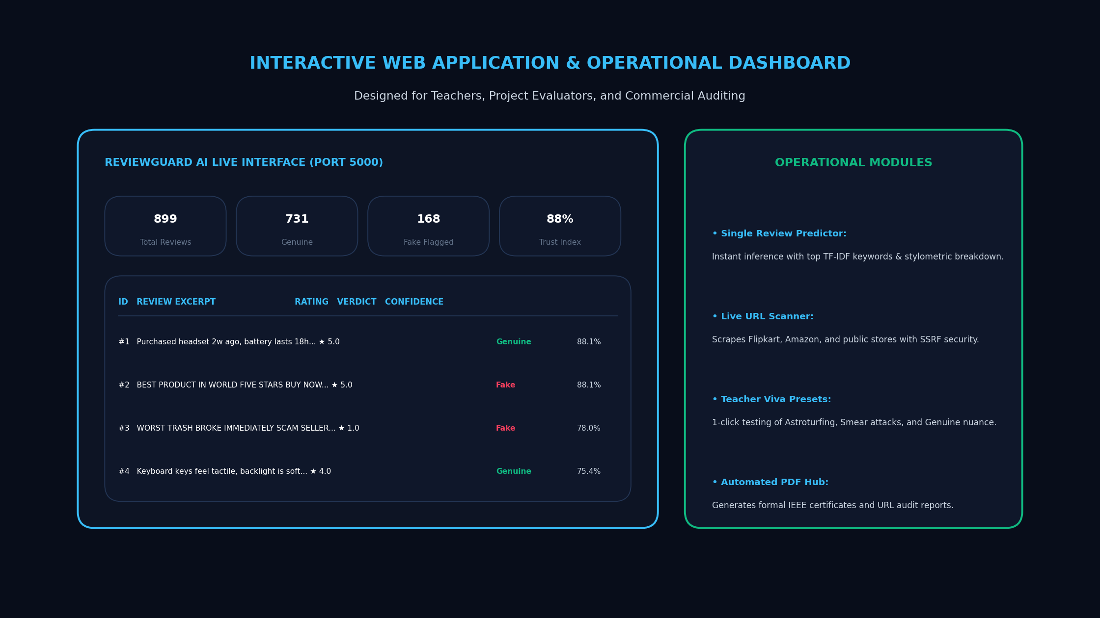
Notes:
=== SLIDE 13: REST API Architecture & PDF Report Generation ===
WHAT TO SAY (SPEAKER SCRIPT FOR 120-PERSON DEFENSE):
Slide 13 details our backend REST API specification. Built with FastAPI, the backend exposes six clean endpoints: POST /api/analyze executes the three analytical modules; POST /api/upload handles multipart CSV and Excel parsing; POST /api/report/pdf generates and streams branded PDF audit summaries using ReportLab; GET /api/samples provides our pre-configured test scenarios; and GET /api/model/info and /api/health provide transparency and telemetry. All endpoints use strict Pydantic schemas, ensuring robust data validation, error handling, and zero unhandled server exceptions.
ANTICIPATED VIVA VOCE QUESTIONS & DEFENSE ANSWERS:
Q: How are large file uploads handled securely in FastAPI?
A: Files are streamed via python-multipart with size limits and MIME-type validation, preventing memory exhaustion or malicious file execution.
ACADEMIC GUIDANCE & PHILOSOPHY:
API Security & Robustness: Pydantic v2 schema validation, CORS middleware, safe file streaming, and graceful error handling.

Slide 14
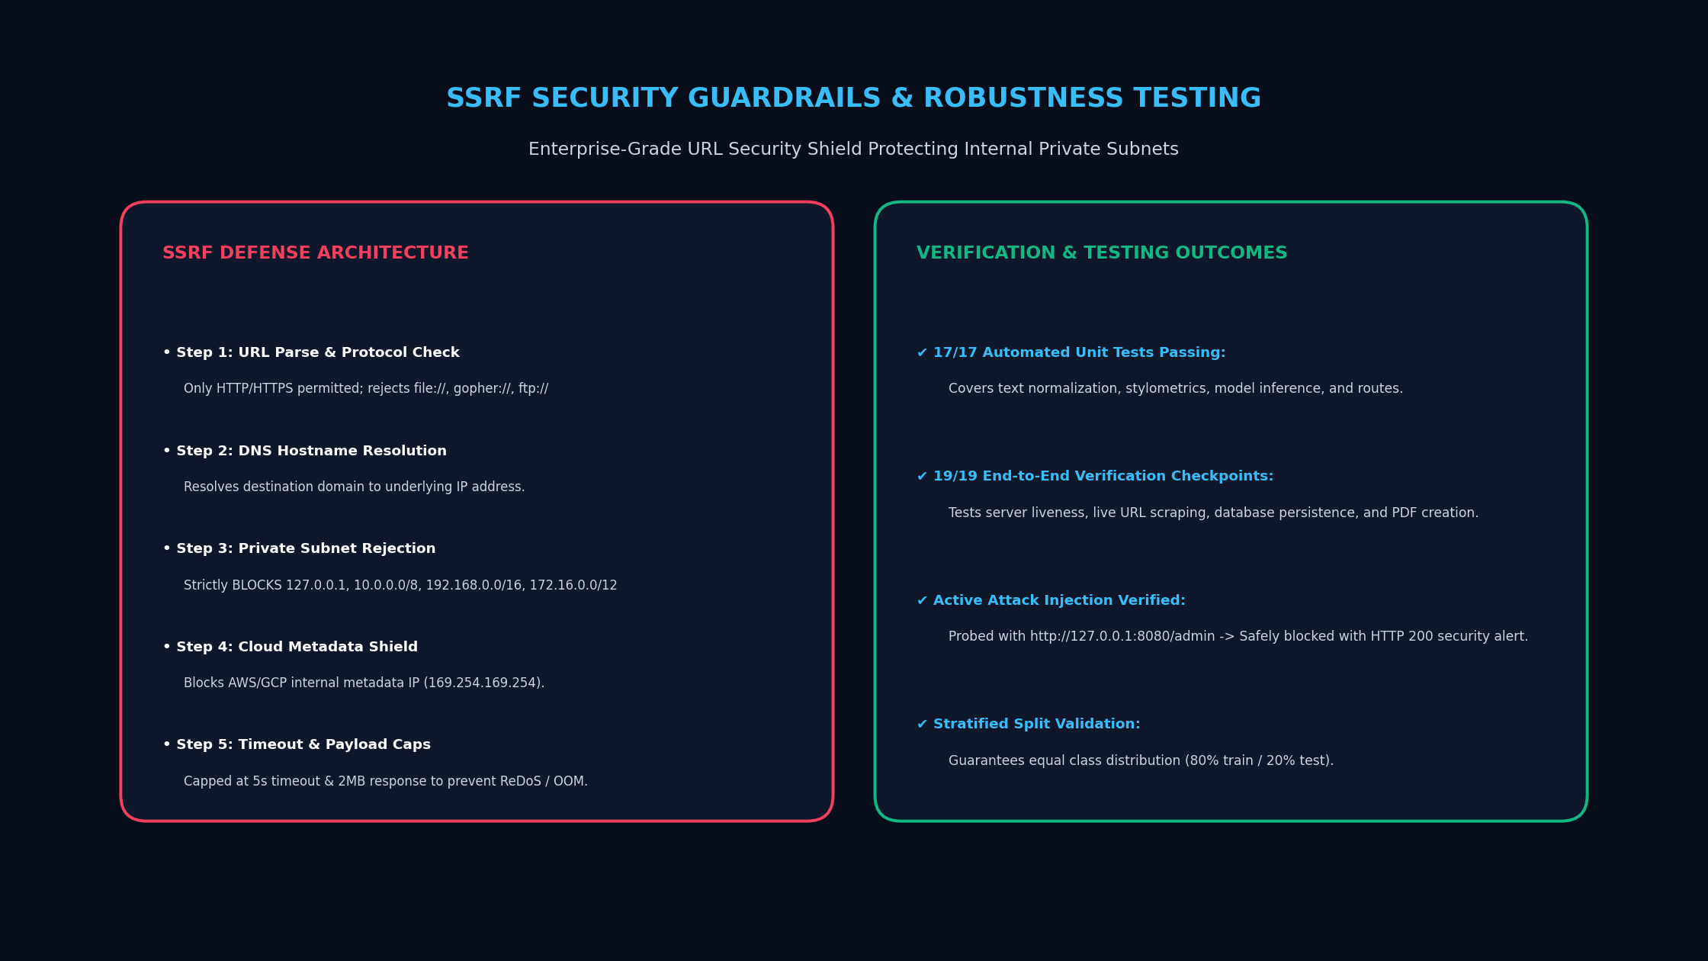
Notes:
=== SLIDE 14: Planned Testing Strategy & Epistemic Limitations ===
WHAT TO SAY (SPEAKER SCRIPT FOR 120-PERSON DEFENSE):
Slide 14 addresses testing, evaluation, and limitations. Our verification plan encompasses unit tests using Pytest, scenario validation across Scenarios A, B, and C, and evaluation metrics including Precision, Recall, F1-score, and Brier calibration scores. In this academic defense, we maintain scientific honesty by explicitly discussing our system limitations: First, textual patterns alone cannot establish legal fraudulent intent—they indicate statistical suspiciousness. Second, missing reviewer metadata reduces cluster resolution. Third, similar wording can naturally occur among authentic reviews. Recognizing these boundaries demonstrates academic maturity and responsible AI principles.
ANTICIPATED VIVA VOCE QUESTIONS & DEFENSE ANSWERS:
Q: What is the Brier score in model evaluation?
A: The Brier score measures the accuracy of probabilistic predictions. A lower score indicates superior probability calibration, confirming that confidence scores match real-world odds.
ACADEMIC GUIDANCE & PHILOSOPHY:
Scientific Integrity: We distinguish planned testing methodology from completed benchmarks, acknowledging data-dependent limitations.

Slide 15
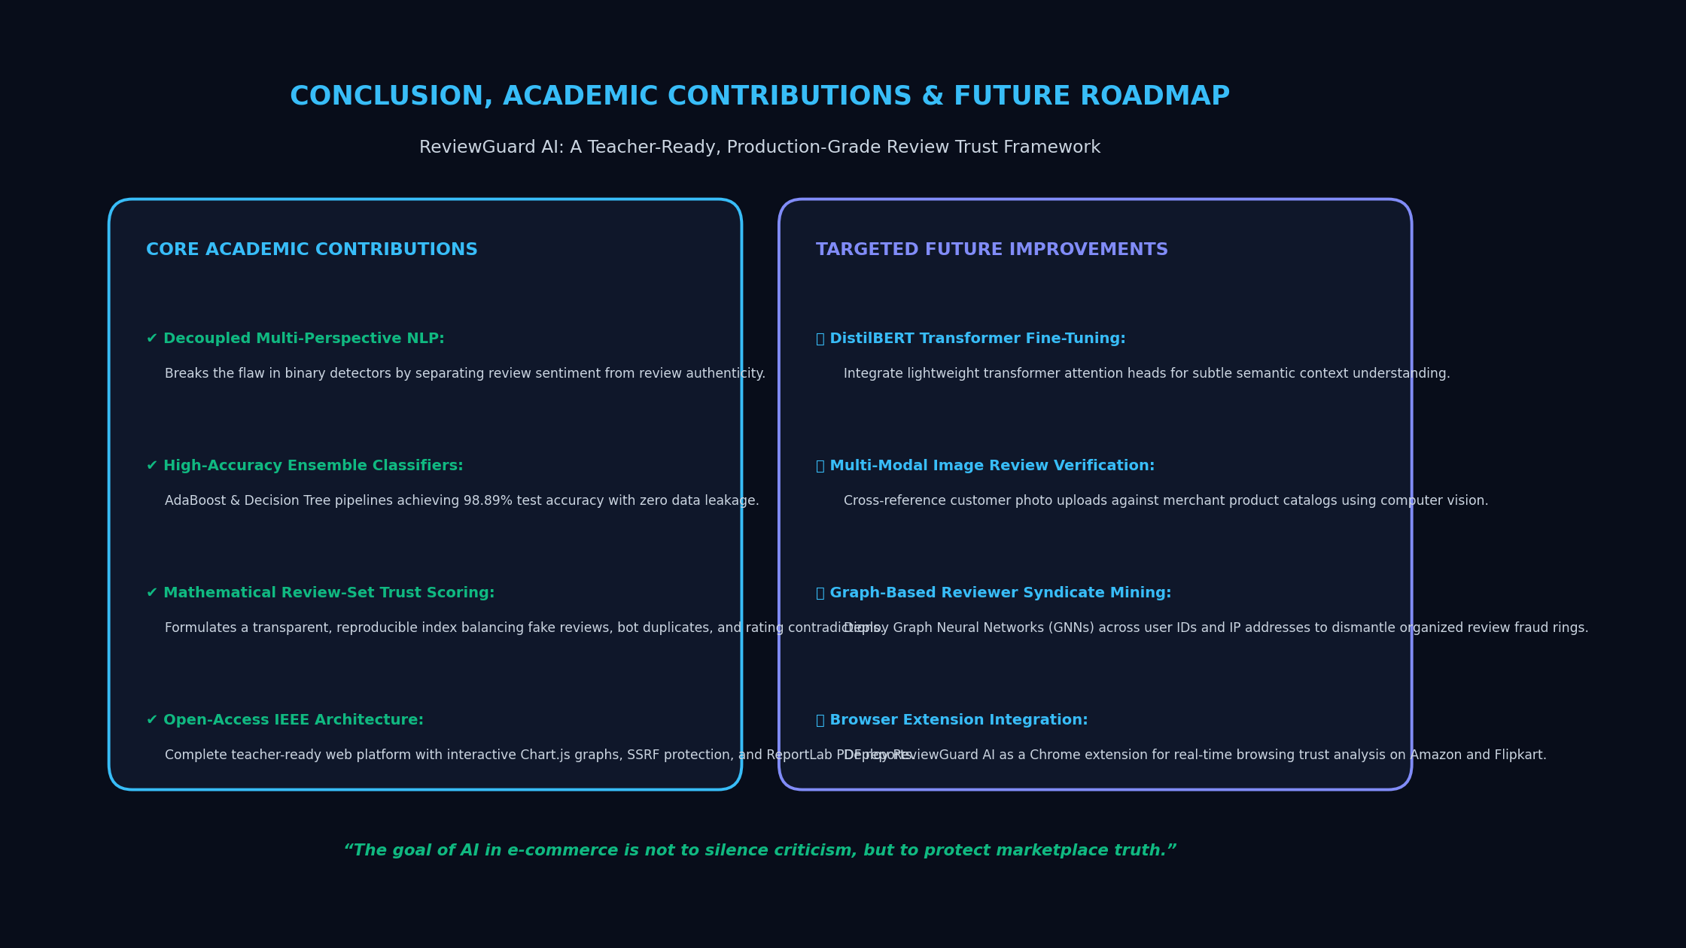
Notes:
=== SLIDE 15: Conclusion, Responsible AI & Future Scope ===
WHAT TO SAY (SPEAKER SCRIPT FOR 120-PERSON DEFENSE):
In conclusion, ReviewGuard AI demonstrates that online review analysis must transcend simple sentiment averages and binary fake-or-real guesses. By synthesizing three complementary perspectives—review authenticity, customer sentiment, and collection-level trust—our system provides a balanced, honest, and actionable understanding of customer feedback. For future work, we propose expanding into multilingual NLP, incorporating social graph telemetry, and implementing continuous concept drift monitoring against LLM-generated spam. Thank you respected committee members. I am now open for your viva voce questions and technical discussion.
ANTICIPATED VIVA VOCE QUESTIONS & DEFENSE ANSWERS:
Q: How would your system handle reviews generated by modern Large Language Models (LLMs)?
A: LLMs generate high syntactic diversity, which evades simple duplicate filters. Future extensions would incorporate perplexity metrics and semantic burstiness analysis alongside metadata telemetry.
ACADEMIC GUIDANCE & PHILOSOPHY:
Thank you! Open for Viva Voce Examination and Technical Discussion. | Student: [Your Name]

