Slide 1
Artificial Intelligence
What is AI?

Slide 2

Intelligence
Since the invention of computers or machines, their capability to perform various tasks went on growing exponentially
A branch of Computer Science named Artificial Intelligence pursues creating the computers or machines as intelligent as human beings
According to the father of Artificial Intelligence John McCarthy, it is The science and engineering of making intelligent machines, especially intelligent computer programs
Artificial Intelligence is a way of making a computer, a computer-controlled robot, or a software think intelligently, in the similar manner the intelligent humans think
While exploiting the power of the computer systems, the curiosity of human, lead him to wonder, Can a machine think and behave like humans do
Computer Dept., AISSMS COE

Slide 3
Humans
Thus, the development of AI started with the intention of creating similar intelligence in machines that we find and regard high in humans
Understand, think, learn, and behave like humans
Programming Without and With AI A computer program without AI can answer the specific questions it is meant to solve
Modification in the program leads to change in its structure
Out of the following areas, one or multiple areas can contribute to build an intelligent system
Computer Dept., AISSMS COE

Slide 4
Understand
AI programs can absorb new modifications by putting highly of information together
It keeps changing constantly
It should be easily modifiable to correct errors
They provide explanation and advice to These systems understand, interpret, and comprehend visual input on the computer
O A spying aeroplane takes photographs which are used to figure out spatial o Doctors use clinical expert system to diagnose the patient
Computer Dept., AISSMS COE

Slide 5
Software
Stored portrait made by forensic artist
It can handle different accents, slang words, noise in the background, change in human s noise due to cold, etc
The handwriting recognition software reads the text written on paper by a pen or on screen by a stylus
Robots are able to perform the tasks given by a human
They have efficient processors, multiple sensors and huge memory, to exhibit intelligence
Computer Dept., AISSMS COE

Slide 6
Motor
Foundations for neural networks laid
Joseph Weizenbaum at MIT built ELIZA, an interactive problem that carries on a dialogue in English
Scheduling Games Significant demonstrations in machine learning natural language understanding and translation What is Intelligence
This chapter covers Idea of intelligence, types, and components of intelligence
The ability to use complete or part of the body to solve problems or fashion products, control over fine and coarse motor skills, and manipulate the objects
Computer Dept., AISSMS COE

Slide 7
Making
The ability to distinguish among one s own feelings, intentions, and motivations
The intelligence is intangible
Problem Solving
Perception
Reasoning: It is the set of processes that enables us to provide basis for judgement, making decisions, and prediction
Computer Dept., AISSMS COE

Slide 8
Logical
There are broadly two types: Inductive Reasoning The ability to recognize and make distinctions among other people s feelings, beliefs, and intentions
Deductive Reasoning It starts with a general statement and examines the possibilities to reach a specific, logical conclusion
If something is true of a class of things in general, it is also true for all members of that class
Mass Communicators, Interviewers Example: Nita is a teacher
All teachers are studious
Computer Dept., AISSMS COE

Slide 9
<Please Fill In An Appropriate Title>
Therefore, Nita is studious
Learning: It is the activity of gaining knowledge or skill by studying, practising, being taught, or experiencing something
Learning enhances the awareness of the subjects of the study
The ability of learning is possessed by humans, some animals, and AI-enabled o Auditory Learning: It is learning by listening and hearing
Computer Dept., AISSMS COE

Slide 10
Colors
For example, o Perceptual Learning: It is learning to recognize stimuli that one has seen before
For Example, Adding little less salt at the time of cooking potatoes that came up salty last time, when cooked with adding say a tablespoon of salt
O Spatial learning: It is learning through visual stimuli such as images, colors, maps, etc
Picking objects, Writing, etc
This is linear and orderly
Computer Dept., AISSMS COE

Slide 11
Perception
Shalini is 65 years
Therefore, Shalini is a grandmother
Perception presumes sensing
In humans, perception is aided by sensory organs
Linguistic Intelligence: It is one s ability to use, comprehend, speak, and write the verbal and written language
Computer Dept., AISSMS COE

Slide 12
Humans
It is important in interpersonal communication
Humans perceive by patterns whereas the machines perceive by set of rules and data
Humans store and recall information by patterns, machines do it by searching algorithms
For example, the number 40404040 is easy to remember, store and recall as its pattern is simple
The converter turns the analog signal into equivalent digital signal for the speech processing
Computer Dept., AISSMS COE

Slide 13
Examples
5 Robotics Examples: Industrial robots for moving, spraying, painting, precision checking, drilling, cleaning, coating, carving etc
Fuzzy Logic Examples: Consumer electronics, automobiles, etc
Humans learn mundane (ordinary) tasks since their birth
For humans, the mundane tasks are easiest to learn
Earlier, all work of AI was concentrated in the mundane task domain
Computer Dept., AISSMS COE

Slide 14
Agents
Later, it turned out that the machine requires more knowledge, complex knowledge representation, and complicated algorithms for handling mundane tasks
The environment may contain other agents
An agent is anything that can perceive its environment through sensors and acts upon that environment through effectors
Percept: It is agent s perceptual inputs at a given instance
A robotic agent replaces cameras and infrared range finders for the sensors, and A software agent has encoded bit strings as its programs and actions
Computer Dept., AISSMS COE

Slide 15
Performing
Rationality is concerned with expected actions and results depending upon what the agent has perceived
Performing actions with the aim of obtaining useful information is an important part of rationality
An ideal rational agent is the one, which is capable of doing expected actions to maximize its performance measure, on the basis of
Agent s Percept Sequence till now
The agent s prior knowledge about the environment
Computer Dept., AISSMS COE

Slide 16
Agent
The actions that the agent can carry out
The problem the agent solves is characterized by Performance Measure, Environment, Actuators, and Sensors
Architecture = the machinery that an agent executes on
Agent Program = an implementation of an agent function
They choose actions only based on the current percept
Computer Dept., AISSMS COE

Slide 17
Agent
They are rational only if a correct decision is made only on the basis of current precept
Condition-Action Rule It is a rule that maps a state (condition) to an action
Its percept sequence Its built-in knowledge base Agent = Architecture + Agent Program Their environment is completely observable
Model: knowledge about how the things happen in the world
Updating state requires the information about Model-Based Reflex Agents They use a model of the world to choose their actions
Computer Dept., AISSMS COE

Slide 18
State
Internal State: It is a representation of unobserved aspects of current state depending on percept history
How the world evolves
How the agent s actions affect the world
Figure 17_3 Artificial_intelligence_1_tutorial Goal-Based Agents Utility-Based Agents They choose their actions in order to achieve goals
Goal-based approach is more flexible than reflex agent since the knowledge supporting a decision is explicitly modeled, thereby allowing for modifications
Computer Dept., AISSMS COE

Slide 19
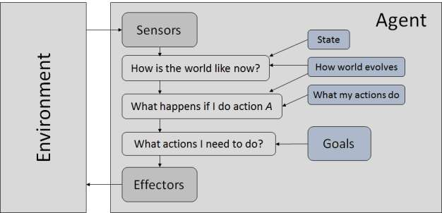
Figure 17_3
Computer Dept., AISSMS COE

Slide 20
Softbots
Goal: It is the description of desirable situations
They choose actions based on a preference (utility) for each state
Figure 18_2 Artificial_intelligence_1_tutorial Goals are inadequate when: The Nature of Environments There are conflicting goals only some of which can be achieved
In contrast, some software agents (software robots or softbots) exist in rich, unlimited softbots domains
A softbot designed to scan the online preferences of the customer and show interesting items to the customer works in the real as well as an artificial environment
Computer Dept., AISSMS COE

Slide 21
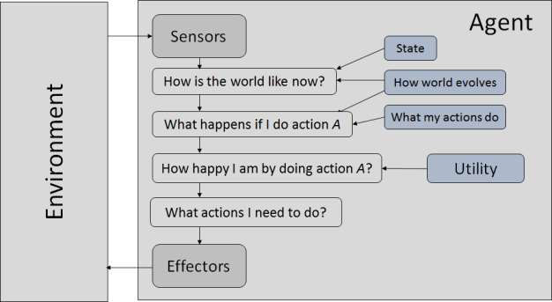
Figure 18_2
Computer Dept., AISSMS COE

Slide 22
Test
The most famous artificial environment is the Turing Test environment, in which one real and other artificial agents are tested on equal ground
This is a very challenging environment as it is highly difficult for a software agent to perform as well as a human
Two persons and a machine to be evaluated participate in the test
Success against the importance of a goal
Properties of Environment The environment has multifold properties: This test aims at fooling the tester
Computer Dept., AISSMS COE

Slide 23
Observable
If the tester fails to determine machine s response from the human response, then the machine is said to be intelligent
Otherwise it is continuous
Observable / Partially Observable: If it is possible to determine the complete state of the environment at each time point from the percepts it is observable
Otherwise it is only partially observable
Inaccessible: If the agent s sensory apparatus can have access to the complete state of the environment, then the environment is accessible to that agent
Computer Dept., AISSMS COE

Slide 24
Episodic
Deterministic vs
Non-deterministic: If the next state of the environment is completely determined by the current state and the actions of the agent, then the environment is deterministic
Otherwise it is non-deterministic
Episodic vs
Non-episodic: In an episodic environment, each episode consists of the agent perceiving and then acting
Computer Dept., AISSMS COE

Slide 25
Branching
The quality of its action depends just on the episode itself
Subsequent episodes do not depend on the actions in the previous episodes
Episodic environments are much simpler because the agent does not need to think ahead
It is static
Branching Factor: The average number of child nodes in the problem space graph
Computer Dept., AISSMS COE

Slide 26
Games
There are some single-player games such as tile games, Sudoku, crossword, etc
Problem Space: It is the environment in which the search takes place
Depth of a problem: Length of a shortest path or shortest sequence of operators from Initial State to goal state
They work fine with small number of possible states
State description
Computer Dept., AISSMS COE

Slide 27
Nodes
Popular Search Algorithms The total no of nodes created in worst case is b + b2 + b3 + + bd
Its complexity depends on the number of paths
It cannot check duplicate nodes
Its complexity depends on the number of nodes
Depth-First Search It is implemented in recursion with LIFO stack data structure
Computer Dept., AISSMS COE

Slide 28
Paths
The solution to this issue is to choose a cut-off depth
It cannot check duplicate nodes
A set of valid operators Goal state description Initial state It explores paths in the increasing order of cost
Each search is done only up to half of the total path
Uniform Cost Search Sorting is done in increasing cost of the path to a node
Computer Dept., AISSMS COE

Slide 29
<Please Fill In An Appropriate Title>
Disadvantage: There can be multiple long paths with the cost C
It never creates a node until all lower nodes are generated
It only saves a stack of nodes
The algorithm ends when it finds a solution at depth d
The number of nodes created at depth d is bd and at depth d-1 is bd
Computer Dept., AISSMS COE

Slide 30
Heuristic
Heuristic Evaluation Functions They calculate the cost of optimal path between two states
Pure Heuristic Search It expands nodes in the order of their heuristic values
It creates two lists, a closed list for the already expanded nodes and an open list for the created but unexpanded nodes
The shorter paths are saved and the longer ones are disposed
It avoids expanding paths that are already expensive, but expands most promising paths first
Computer Dept., AISSMS COE

Slide 31
Solution
Greedy Best First Search It expands the node that is estimated to be closest to goal
It expands nodes based on f(n) = h
It is implemented using priority queue
They start from a prospective solution and then move to a neighboring solution
They can return a valid solution even if it is interrupted at any time before they end
Computer Dept., AISSMS COE

Slide 32
Solution
If the change produces a better solution, an incremental change is taken as a new solution
F(n) estimated total cost of path through n to goal
It is implemented using priority queue by increasing f
They start from a prospective solution and then move to a neighboring solution
They can return a valid solution even if it is interrupted at any time before they end
Computer Dept., AISSMS COE

Slide 33
Local
This process is repeated until there are no further improvements
Function Hill-Climbing (problem), returns a state that is a local maximum
If any of the states = solution, then return the state Local Beam Search In this algorithm, it holds k number of states at any given time
At the start, these states are generated randomly
The successors of these k states are computed with the help of objective function
Computer Dept., AISSMS COE

Slide 34
Initial
If any of these successors is the maximum value of the objective function, then the algorithm stops
The highest k states are selected as new initial states
In simulated annealing process, the temperature is kept variable
We initially set the temperature high and then allow it to cool' slowly as the algorithm proceeds
When the temperature is high, the algorithm is allowed to accept worse solutions with high frequency
Computer Dept., AISSMS COE

Slide 35
Number
L = integer number of variables
From i -> j, search the performance difference
If <= 0 then accept else if exp( /T(k)) > random(0,1) then accept
Find out all (n -1)! Possible solutions, where n is the total number of cities
Determine the minimum cost by finding out the cost of each of these (n -1)! What is Fuzzy Logic
Computer Dept., AISSMS COE

Slide 36
Fuzzy
Fuzzy logic is useful for commercial and practical purposes
Fuzzy Logic (FL) is a method of reasoning that resembles human reasoning
It can be implemented in hardware, software, or a combination of both
Inference Engine: It simulates the human reasoning process by making fuzzy
It is called membership value or degree of membership
Computer Dept., AISSMS COE

Slide 37
Value
There can be multiple membership functions applicable to fuzzify a numerical value
Simple membership functions are used as use of complex functions does not add more precision in the output
The operations used for OR and AND are Max and Min respectively
All results of evaluation are combined to form a final result
This result is a fuzzy value
Computer Dept., AISSMS COE

Slide 38
Fuzzy
Defuzzification is then performed according to membership function for output variable
It resembles human reasoning and decision making
They are understandable only when simple
Mathematical concepts within fuzzy reasoning are very simple
Fuzzy logic Systems can take imprecise, distorted, noisy input information
Computer Dept., AISSMS COE

Slide 39
Human
It resembles human reasoning and decision making
There is no systematic approach to fuzzy system designing
They are suitable for the problems which do not need high accuracy
You can modify a FIS by just adding or deleting rules due to flexibility of fuzzy logic
Fuzzy logic Systems can take imprecise, distorted, noisy input information
Computer Dept., AISSMS COE

Slide 40
Useful
It involves: Components of NLP The NLU is harder than NLG
The field of NLP involves making computers to perform useful tasks with the natural languages humans use
Mapping the given input in natural language into useful representations
Analyzing different aspects of the language
Text Realization: It is mapping sentence plan into sentence structure
Computer Dept., AISSMS COE

Slide 41
Sentence
NL has an extremely rich form and structure
It is very ambiguous
There can be different levels of ambiguity: Text planning: It includes retrieving the relevant content from knowledge base
Sentence planning: It includes choosing required words, forming meaningful Text Realization: It is mapping sentence plan into sentence structure
It is very ambiguous
Computer Dept., AISSMS COE

Slide 42
Analysis
There can be different levels of ambiguity: Speech Written Text phrases, setting tone of the sentence
NL has an extremely rich form and structure
Lexical Analysis
Syntactic Analysis (Parsing) Phonology: It is study of organizing sound systematically
Morpheme: It is primitive unit of meaning in a language
Computer Dept., AISSMS COE

Slide 43
World
The structural role of words in the sentence and in phrases
And how the interpretation of the sentence is affected
World Knowledge: It includes the general knowledge about the world
Morphology: It is a study of construction of words from primitive meaningful units
Syntax: It refers to arranging words to make a sentence
Computer Dept., AISSMS COE

Slide 44
Syntactic
Lexicon of a language means the collection of words and phrases in a language
The sentence such as The school goes to boy is rejected by English syntactic analyzer
The structural role of words in the sentence and in phrases
Meaningful phrases and sentences
And how the interpretation of the sentence is affected
Computer Dept., AISSMS COE

Slide 45
Cap
Rima went to Gauri
O One input can mean different meanings
And how the interpretation of the sentence is affected
O For example, He lifted the beetle with red cap
Did he use cap to lift the o Referential ambiguity: Referring to something using pronouns
Computer Dept., AISSMS COE

Slide 46
Tired
For example, Rima went to Gauri
She said, I am tired
Exactly who is tired
Lexicon of a language means the collection of words and phrases in a language
Lexical analysis is dividing the whole chunk of txt into paragraphs, sentences, and words
Computer Dept., AISSMS COE

Slide 47
Analysis
It involves analysis of words in the sentence for grammar and arranging words in a manner that shows the relationship among the words
The sentence such as The school goes to boy is rejected by English syntactic analyzer
Let us create grammar to parse a sentence
Semantic Analysis
Discourse Integration
Computer Dept., AISSMS COE

Slide 48
Meaning
It draws the exact meaning or the dictionary meaning from the text
The text is checked for meaningfulness
The semantic analyzer disregards sentence such as hot ice-cream
In addition, it also brings about the meaning of immediately succeeding sentence
During this, what was said is re-interpreted on what it actually meant
Computer Dept., AISSMS COE

Slide 49
Different
If not, the process is started over again with a different set of rules
This is repeated until a specific rule is found which describes the structure of the sentence
They are not highly precise
It may require a completely different sets of rules for parsing singular and plural variations, passive sentences, etc
These are then checked with the input sentence to see if it matched
Computer Dept., AISSMS COE

Slide 50
Slow
If not, the process is started over again with a different set of rules
This is repeated until a specific rule is found which describes the structure of the sentence
Slow speed of working
It is inefficient, as the search process has to be repeated if an error occurs
It is introduced by the researchers at Stanford University, Computer Science Department
Computer Dept., AISSMS COE

Slide 51
Complex
The expert systems are the computer applications developed to solve complex problems in a particular domain, at the level of extra-ordinary human intelligence and expertise
Knowledge is required to exhibit intelligence
The success of any ES majorly depends upon the collection of highly accurate and precise knowledge
What is Knowledge
The data is collection of facts
Computer Dept., AISSMS COE

Slide 52
Experience
Data, information, and past experience combined together are termed as knowledge
It is the method used to organize and formalize the knowledge in the knowledge base
He acquires information from subject expert by recording, interviewing, and observing him at work, etc
Use of efficient procedures and rules by the Inference Engine is essential in deducting a correct, flawless solution
In case of knowledge-based ES, the Inference Engine acquires and manipulates the knowledge from the knowledge base to arrive at a particular solution
Computer Dept., AISSMS COE

Slide 53
Rules
Knowledge Acquisition The success of any expert system majorly depends on the quality, completeness, and accuracy of the information stored in the knowledge base
The knowledge base is formed by readings from various experts, scholars, and the Knowledge Engineers
The knowledge engineer is a person with the qualities of empathy, quick learning, and case analyzing skills
He acquires information from subject expert by recording, interviewing, and observing him at work, etc
Applies rules repeatedly to the facts, which are obtained from earlier rule application
Computer Dept., AISSMS COE

Slide 54
Chaining
Evaluation, and guessing
Forward Chaining Backward Chaining Engineers and scholars in the task domain
It explains how the ES has arrived at a particular recommendation
It should be designed to work for user s existing or desired work practices
Its technology should be adaptable to user s requirements
Computer Dept., AISSMS COE

Slide 55
Shells
Not the other way round
Diagnosis Systems to deduce cause of disease from observed data, conduction medical operations on humans
Design the System Expert System Technology
Shells: A shell is nothing but an expert system without knowledge base
A shell provides the developers with knowledge acquisition, inference engine, user interface, and explanation facility
Computer Dept., AISSMS COE

Slide 56
Systems
Develop and Complete the ES
Maintain the System Benefits of Expert Systems Form Knowledge Base: The knowledge engineer works to: Document the ES project well
Train the user to use ES
Cater for new interfaces with other information systems, as those systems evolve
Availability: They are easily available due to mass production of software
Computer Dept., AISSMS COE

Slide 57
Error
Less Production Cost: Production cost is reasonable
This makes them affordable
Speed: They offer great speed
They reduce the amount of work an individual puts in
Less Error Rate: Error rate is low as compared to human errors
Computer Dept., AISSMS COE

Slide 58
Steady
Reducing Risk: They can work in the environment dangerous to humans
Steady response: They work steadily without getting motional, tensed or fatigued
In performance
Databases, and other information systems
What are Robots
Computer Dept., AISSMS COE

Slide 59
Construction
What is Robotics
Difference in Robot System and Other AI Program Robotics is a domain in artificial intelligence that deals with the study of creating intelligent and efficient robots
Robotics is a branch of AI, which is composed of Electrical Engineering, Mechanical Engineering, and Computer Science for designing, construction, and application of robots
The robots have mechanical construction, form, or shape designed to accomplish a They have electrical components which power and control the machinery
They contain some level of computer program that determines what, when and how particular task
Computer Dept., AISSMS COE

Slide 60
Leg
Robotics They operate in real physical world Inputs to robots is analog signal in the form of speech waveform or images They need special hardware with sensors and effectors
Releasing the Left leg
Releasing the Right leg Combination of Legged and Wheeled Locomotion then leg coordination is necessary for locomotion
It is little difficult to implement because of It comes with the variety of one, two, four, and six legs
Lifting the Right leg
Computer Dept., AISSMS COE

Slide 61
Leg
Releasing the Right leg
Figure 49_2 Artificial_intelligence_1_tutorial figure 49_3 Artificial_intelligence_1_tutorial figure 49_4 Artificial_intelligence_1_tutorial Wheeled Locomotion It requires fewer number of motors to accomplish a movement
It is little easy to implement as there are less stability issues in case of more number of wheels
It is power efficient as compared to legged locomotion
It offers stability because of large contact area of track and ground
Computer Dept., AISSMS COE

Slide 62
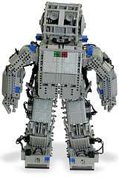
Figure 49_2
Computer Dept., AISSMS COE

Slide 63
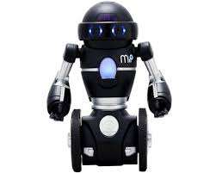
Figure 49_3
Computer Dept., AISSMS COE

Slide 64
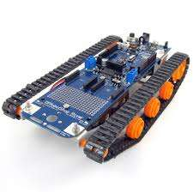
Figure 49_4
Computer Dept., AISSMS COE

Slide 65
Motors
Point, around the wheel axle, and around the rollers
Pneumatic Air Muscles: They contract almost 40% when air is sucked in them
Muscle Wires: They contract by 5% when electric current is passed through them
Piezo Motors and Ultrasonic Motors: Best for industrial robots
Sensors: They provide knowledge of real time information on the task environment
Computer Dept., AISSMS COE

Slide 66
Human
Robots are equipped with vision sensors to be to compute the depth in the environment
Human fingertips
Object Recognition: They are installed in supermarkets, cameras, high-end cars such as BMW, GM, and Volvo
A computing system made up of a number of simple, highly interconnected processing elements, which process information by their dynamic state response to external inputs
ANNs are composed of multiple nodes, which imitate biological neurons of human brain
Computer Dept., AISSMS COE

Slide 67
<Please Fill In An Appropriate Title>
The neurons are connected by links and they interact with each other
The nodes can take input
Neural Networks figure 54_2 Artificial_intelligence_1_tutorial figure 54_3 Artificial_intelligence_1_tutorial Types of Artificial Neural Networks data and perform simple operations on the data
The result of these operations is passed to other neurons
A unit sends information to other unit from which it does not receive any information
Computer Dept., AISSMS COE

Slide 68
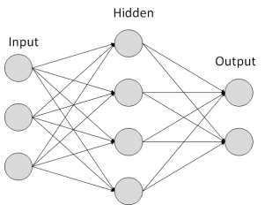
Figure 54_2
Computer Dept., AISSMS COE

Slide 69
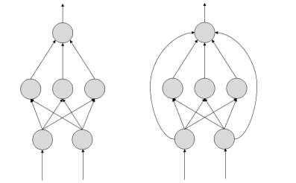
Figure 54_3
Computer Dept., AISSMS COE

Slide 70
Generation
They are used in pattern generation/recognition/classification
If the network generates a good or desired output, there is no need to adjust the weights
However, if the network generates a poor or undesired output or an error, then the system alters the weights in order to improve subsequent results
ANNs are capable of learning and they need to be trained
There are several learning strategies: Supervised Learning: It involves a teacher that is scholar than the ANN itself
Computer Dept., AISSMS COE

Slide 71
Required
In this case, clustering i
Out based on the existing data sets present
Bayesian Networks
Range of prepositions
If the observation is negative, the network adjusts its weights to be able to make a different required decision the next time
Computer Dept., AISSMS COE

Slide 72
Networks
It learns by example
Back Propagation networks are ideal for simple Pattern Recognition and Mapping Tasks
These are the graphical structures used to represent the probabilistic relationship among a set of random variables
Bayesian networks are also called Belief Networks or Bayes Nets
The structure of BN is ideal for combining prior knowledge and observed data
Computer Dept., AISSMS COE

Slide 73
Nodes
The doctor knows that barring lung cancer, there are various other possible diseases the patient might have such as tuberculosis and bronchitis
For now let us consider nodes, with only discrete values
The variable must take on exactly one of these values at a time
Pollution and smoking
Then add arcs from node Pollution and node Smoker to node Lung-Cancer
Computer Dept., AISSMS COE

Slide 74
Common
Similarly if patient has lung cancer, then X-ray result will be positive
Then add arcs from Lung-Cancer to X-Ray
Node Name Pollution Smoker Lung-Cancer X-Ray Which nodes to represent
Common types of discrete nodes are: Create Arcs between Nodes Is the patient a smoker
Is the patient exposed to air pollution
Computer Dept., AISSMS COE

Slide 75
Values
Take an X-Ray positive X-ray would indicate either TB or lung cancer
What values can they take
In which state can they be
Boolean nodes: They represent propositions, taking binary values TRUE (T) and FALSE
Ordered values: A node Pollution might represent and take values from {low, medium, high} describing degree of a patient s exposure to pollution
Computer Dept., AISSMS COE

Slide 76
Node
Integral values: A node called Age might represent patient s age with possible values from 1 to
The set of parent nodes of a node X is given by Parents
The Lung-Cancer node has two parents (reasons or causes): Pollution and Smoker, while node Smoker is an ancestor of node X-Ray
Now quantify the relationships between connected nodes: this is done by specifying a conditional probability distribution for each node
For each distinct instantiation of parent node values, we need to specify the probability that the child will take
Computer Dept., AISSMS COE

Slide 77
<Please Fill In An Appropriate Title>
For example, the Lung-Cancer node s parents are Pollution and Smoking
The CPT specifies the probability of cancer for each of these cases as
Computer Dept., AISSMS COE

Slide 78
Referred Image(s)
All relevant non-referred useful images are shown in upcoming slides.
Computer Dept., AISSMS COE

Slide 79
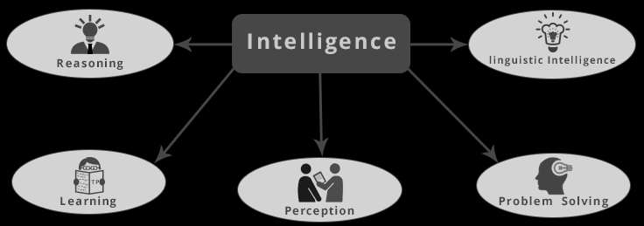
Figure 7_2 (f_no.1)
Computer Dept., AISSMS COE

Slide 80
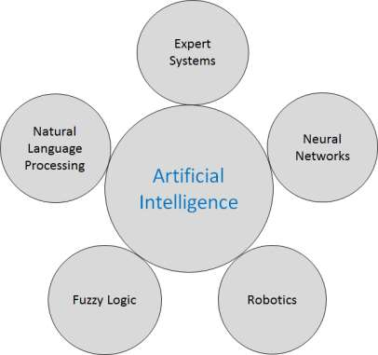
Figure 10_2 (f_no.1)
Computer Dept., AISSMS COE

Slide 81

Figure 11_2 (f_no.1)
Computer Dept., AISSMS COE

Slide 82

Figure 11_4 (f_no.1)
Computer Dept., AISSMS COE

Slide 83

Figure 11_3 (f_no.1)
Computer Dept., AISSMS COE

Slide 84
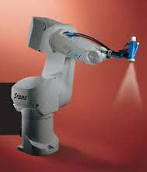
Figure 12_2 (f_no.1)
Computer Dept., AISSMS COE

Slide 85

Figure 12_4 (f_no.1)
Computer Dept., AISSMS COE

Slide 86
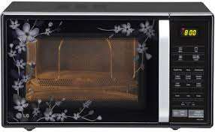
Figure 12_3 (f_no.1)
Computer Dept., AISSMS COE

Slide 87
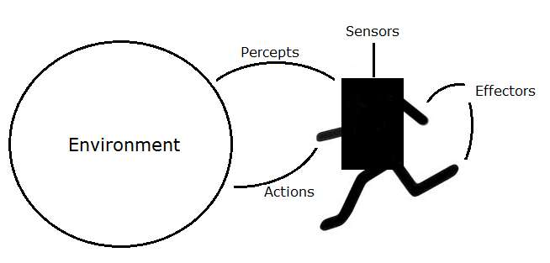
Figure 14_2 (f_no.1)
Computer Dept., AISSMS COE

Slide 88
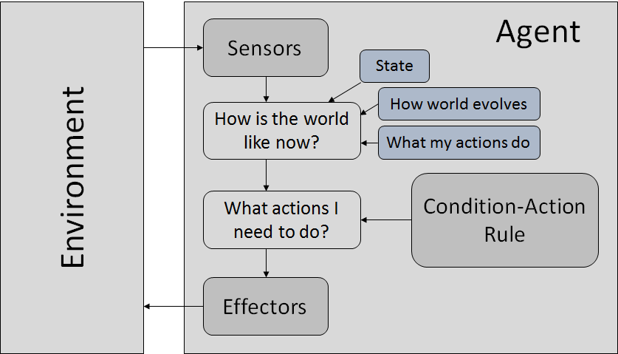
Figure 17_2 (f_no.1)
Computer Dept., AISSMS COE

Slide 89
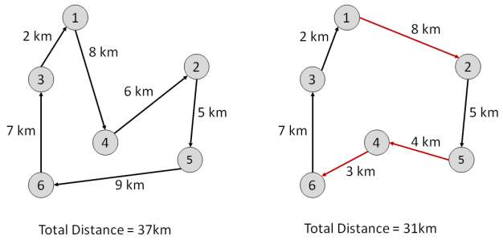
Figure 26_2 (f_no.1)
Computer Dept., AISSMS COE

Slide 90
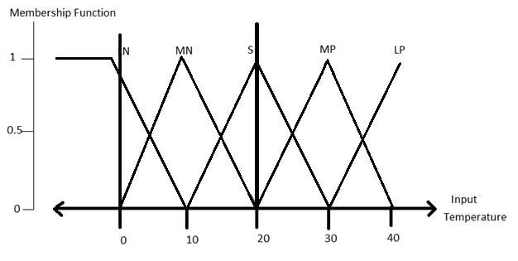
Figure 31_2 (f_no.1)
Computer Dept., AISSMS COE

Slide 91
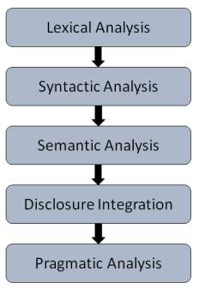
Figure 36_2 (f_no.1)
Computer Dept., AISSMS COE

Slide 92
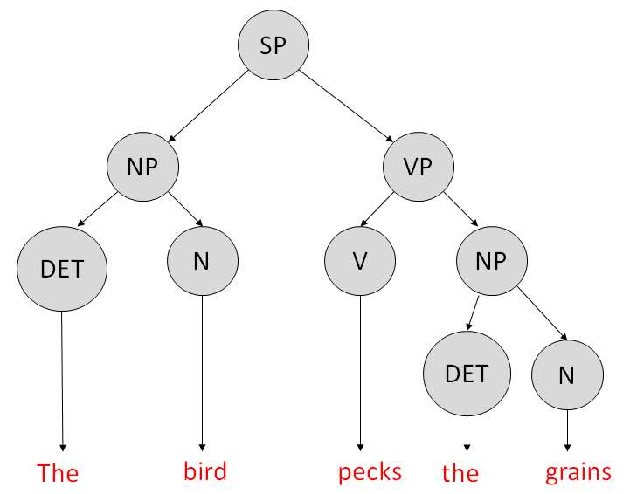
Figure 38_2 (f_no.1)
Computer Dept., AISSMS COE

Slide 93
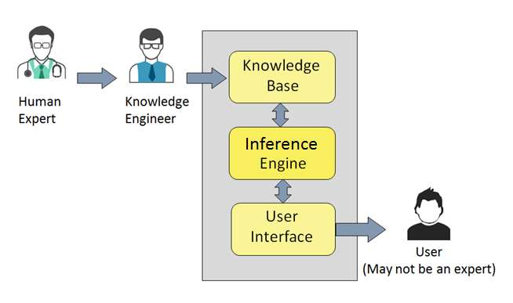
Figure 41_2 (f_no.1)
Computer Dept., AISSMS COE

Slide 94
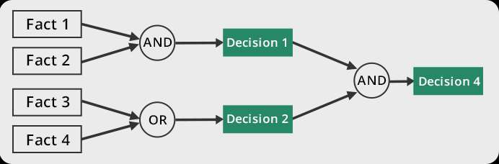
Figure 43_2 (f_no.1)
Computer Dept., AISSMS COE

Slide 95
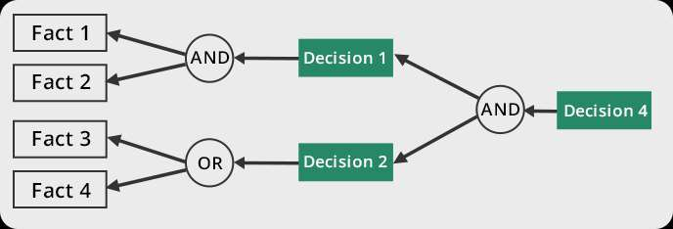
Figure 43_3 (f_no.1)
Computer Dept., AISSMS COE

Slide 96
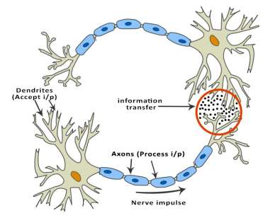
Figure 53_2 (f_no.1)
Computer Dept., AISSMS COE

Slide 97
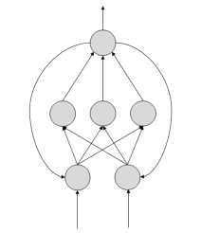
Figure 55_2 (f_no.1)
Computer Dept., AISSMS COE

Slide 98
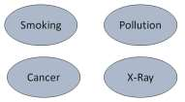
Figure 57_2 (f_no.1)
Computer Dept., AISSMS COE

Slide 99
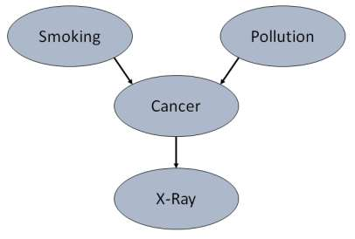
Figure 58_2 (f_no.1)
Computer Dept., AISSMS COE

