Slide 1
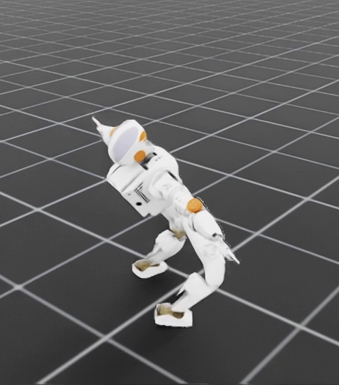
FINAL PROJECT SUBMISSION
EasyRTG
A no-code training ground
for robot learning
Shivam Chavan · 3053682
Supervisor: Shraddha Naik

Slide 2
02
Why I built this
In my final year of engineering
I set myself a harder project than I needed to: build a physical robot, then train the simulated version of it with reinforcement learning.
It took three months
Three months of work before I had something I could show anyone. Almost none of that time went into the robot or the behaviour. It went into wiring the tools together.
The project worked
I finished it, and the robot learned what I wanted. But I could see what the three months had really been spent on.
That is the gap
Anyone new to this cannot get started at all unless they already understand the algorithms and can write the code. The knowledge needed to begin is the barrier, not the robot.
So I built the application I wanted when I started: the same workflow, without the three months.

Slide 3
03
To train one robot you must first
connect six separate systems
Every piece already works on its own. The hard part is joining them together. Before a robot can learn anything, someone has to connect the physics, the sensors, the motors, the reward, the training code and the tests.
Robot model
→
Simulator
→
Environment
→
Reward
→
Training
→
Evaluation
The user only wants the robot to walk. The first thing they actually have to do is write software.

Slide 4
04
The tools all exist, but putting them
together still needs an expert
What already exists
What was missing
Simulation
PyBullet · Brax · NVIDIA Isaac
One desktop app that joins these parts together, explains each choice, and lets someone who is not a programmer train a robot without writing code first.
Learning
Stable-Baselines3 · PPO
Robot files
URDF and ready-made models

Slide 5
05
What the research already gives us,
and what it leaves out
Area
Where it comes from
What it gives this project
Algorithms
PPO (Schulman et al., 2017), SAC (Haarnoja et al., ICML 2018), TD3 (Fujimoto et al., ICML 2018)
Reliable published methods. All three are in this project.
GPU simulation
Isaac Gym (Makoviychuk et al., NeurIPS Datasets 2021), Isaac Lab / Orbit (Mittal et al., RA-L 2023)
Thousands of robots on one GPU. This is the engine we train on.
Legged locomotion
Rudin, Hoeller, Reist & Hutter (CoRL 2022)
Showed a quadruped can be trained in minutes with massively parallel simulation.
Differentiable physics
Brax (Freeman et al., 2021)
Fast and elegant, but our own attempt with it did not produce a usable robot.
Libraries
Stable-Baselines3 (Raffin et al., JMLR 2021), PyBullet (Coumans & Bai)
Well-tested implementations, all written for people who already code.
The gap is not in the algorithms or the simulators. It is that using them still requires an expert.

Slide 6
06
EasyRTG turns a robot file and a goal
into a trained robot
01
02
03
04
05
Load
→
Describe
→
Configure
→
Train
→
Evaluate
Open any robot file
Say what it should do
The assistant suggests a setup
Train thousands of copies at once
Watch it and compare results
You can check and approve every important change, and the app still works without the assistant.

Slide 7
07
We started with the easiest setup to run
Choice
Why it made sense
Windows + CPU
Runs on a normal student laptop
Flutter + FastAPI
A desktop app with a Python training engine behind it
PyBullet + SB3
Free, well-tested physics and a standard learning method
Built-in assistant
Answers questions in plain English, and the app works without it
The first goal was a working process. Speed could come later.

Slide 8
08
It worked, but the CPU was too slow
to learn anything quickly
240
Why this mattered
steps a second, one robot
Our first working setup
The app could load a robot, set it up, train it and test it. But checking one change to the reward took hours, so we could only try a handful of ideas.
1,750
steps a second, many robots
Faster, but still too slow to test ideas

Slide 9
09
Linux and the GPU gave us speed,
but not a robot that walked
1
2
3
Move to Linux
→
Adopt Brax
→
Train the robot
The only way to get GPU support
Train many robots at the same time
It never walked properly
Speed only helps if the physics and the reward make the robot move correctly.

Slide 10
10
Then the laptop died.

Slide 11
11
We kept the same simple process
and changed the training engine
EasyRTG desktop
Agent + FastAPI
Load, set up, watch, compare
Reads your goal, checks changes, starts runs
NVIDIA Isaac Sim + PPO
Saved records
Thousands of robots training on the GPU
Settings, numbers, saved robots and videos
Windows stayed the app the user opens. Isaac Sim does the heavy training.

Slide 12
12
The assistant helps at every step,
not only inside the chat box
01
02
03
04
Inspect
→
Translate
→
Run & watch
→
Evaluate (planned)
Reads the robot's joints and limits
Turns your goal into a reward
Starts training and reports progress
Runs a saved robot and compares results
Anything that changes the setup, or starts training, asks you first.

Slide 13
13
The assistant grew from a chat helper
into the part that writes the setup
01
02
03
04
JUNE
LATE JUNE
EARLY JULY
AUGUST
Answers questions
→
Two AI models
→
Asks first
→
Writes the reward
It could read the robot. You still filled in every field.
It picks the better model for each question.
Anything that changes the setup needs your approval.
If the reward is wrong, it sees the error and fixes it.
It went from 22 tools to 27. The bigger change was giving it a reward format the app can check,
so a mistake comes straight back to the assistant instead of wasting hours of training.
11 of the 27 tools still ask you to confirm before they run.

Slide 14
14
The reward the assistant writes
has improved six times
Version
What the reward did
Rules
v1 · 13–27 Jul
Seven fixed rules, the same for every robot and every task
7
v2 · 28 Jul
Added four rules to stop the robot crawling along the floor
11
v3 · 29 Jul
One block of hand-written code. It worked, but nobody could check it
1
v4 · 30 Jul
First reward written by the assistant. Three rules, checked before saving
3
v5 · 1 Aug
Eleven rules for walking, and a rule that ends the run after a fall
11
v6 · 2 Aug
Reads the feet, and pays the robot for being off the ground
7
Every version is saved with its own training run, so this history comes straight from the files.

Slide 15
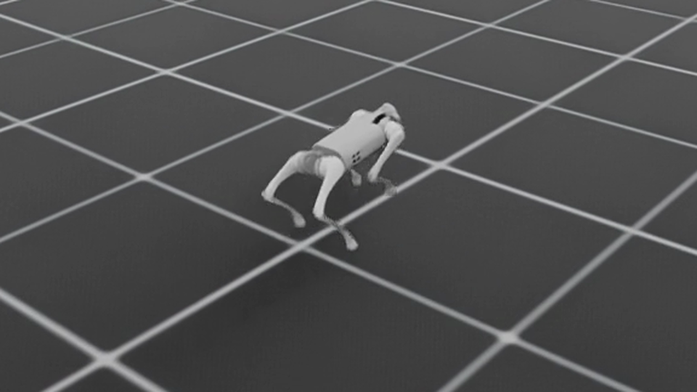
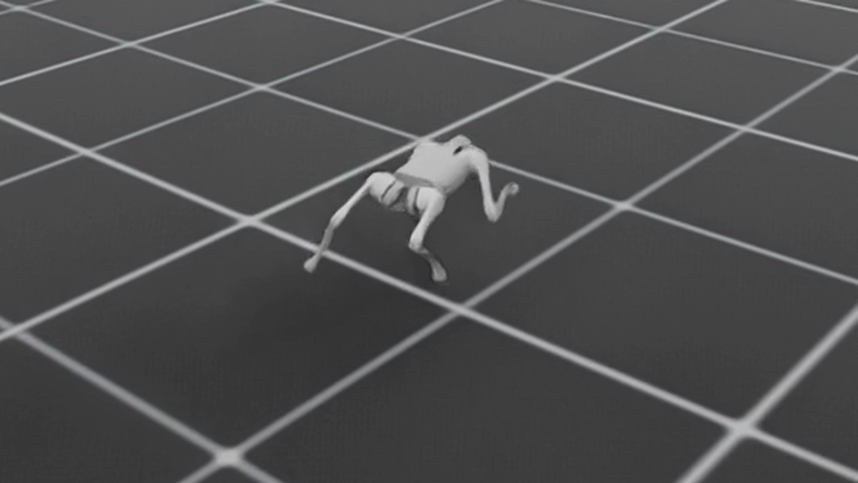
15
The same robot with two different rewards
moves in two different ways
WALKING REWARD · 11 RULES
GAIT REWARD · 7 RULES
0.98
963
0.99
1.38
1,000
43%
metres/second
steps per attempt
how upright
metres/second
steps per attempt
of time in the air
This reward punishes bouncing, so the robot keeps its feet on the ground.
This reward pays the robot for leaving the ground, and drops the rules against it.
The same Unitree Go1 robot and the same 40 million training steps. Only the reward changed.

Slide 16
16
Four problems that changed the code
What was wrong
What we changed
The robot could not stand up
Motor commands were absolute angles centred on zero, but the Go1 stands with its thigh at 0.8 radians. The pose it needed was outside the range it could ask for.
Commands are now offsets from the robot's own standing pose. Nothing could be trained properly before this.
A gallop could not be described
The reward could talk about speed and height, but not about feet. Asking for a gallop returned a fast trot every time, and no weighting of the available rules could fix it.
Isaac created one contact sensor instead of thirteen, because its setup stops at the first body it meets. Walking the tree ourselves gave every foot a sensor.
Wheeled robots were untrainable
The app decided which joints to drive by matching words in joint names. On the wheeled quadrupeds the wheels are called foot joints, so all four drive joints were switched off.
The robot is now read from the structure of its own file: root, limbs, and which limbs reach the ground. Those robots went from 12 usable joints to 16.
Rewards were a fixed menu
The user could only combine components we had written in advance, so any new behaviour meant new code from us.
The reward is now a short expression the assistant writes and the app checks before saving. A broken reward is caught in seconds instead of after 20 million steps.
None of these were settings. Each one needed a change in the code before any robot could learn the task.

Slide 17
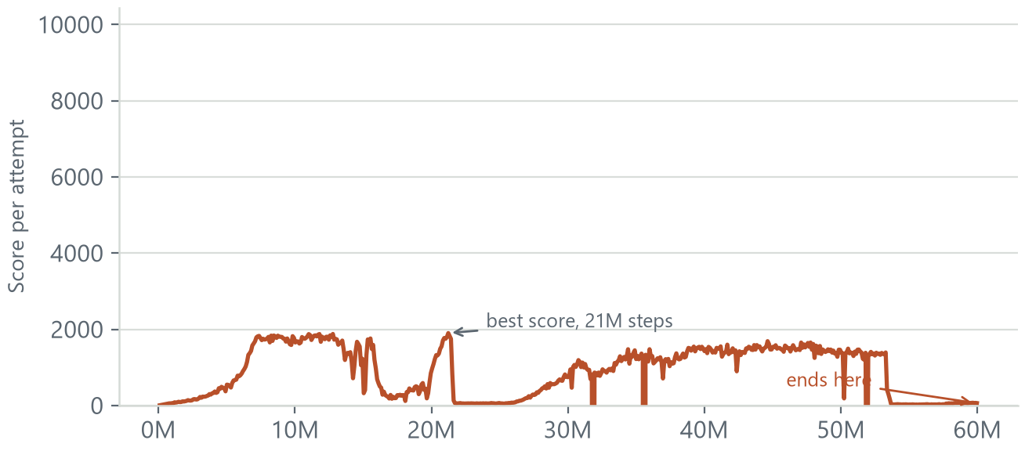
17
One reward broke the training,
and that taught us a rule
Average score per attempt, over 60 million steps of training
What we changed
Penalties are now an average across the joints instead of a sum
The best version is saved as well as the last one
Each rule is recorded on its own graph
The app checks the reward size before training starts
Higher is better. The score climbs, crashes, climbs again and ends near zero:
the robot kept losing what it had learned.
Unitree A1, 60 million steps. One penalty grew with the number of joints until falling over scored better than walking.

Slide 18
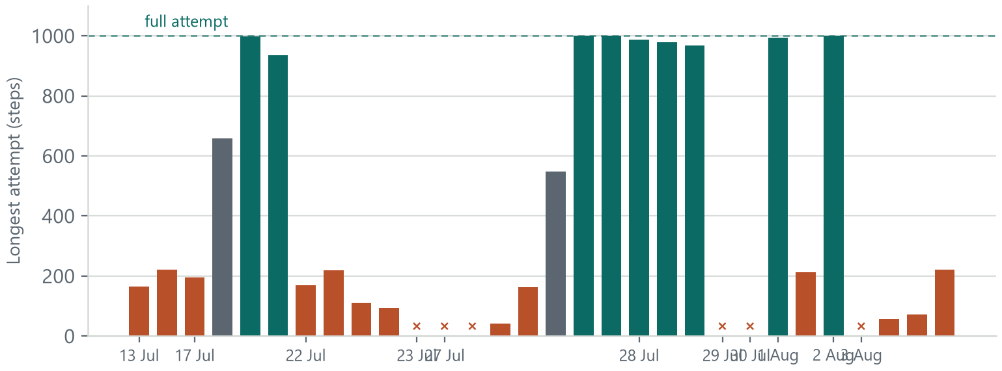
18
Most of our training runs did not work
Longest attempt each run managed, in date order
30
training runs
9
gave a usable robot
6
crashed at launch
Each column is one run. Green finished full 1,000-step attempts, grey learned a little, red fell over quickly.
Six columns sit at zero: those runs crashed before training started.
Between 13 July and 3 August. The failures are the reason the working runs work.

Slide 19
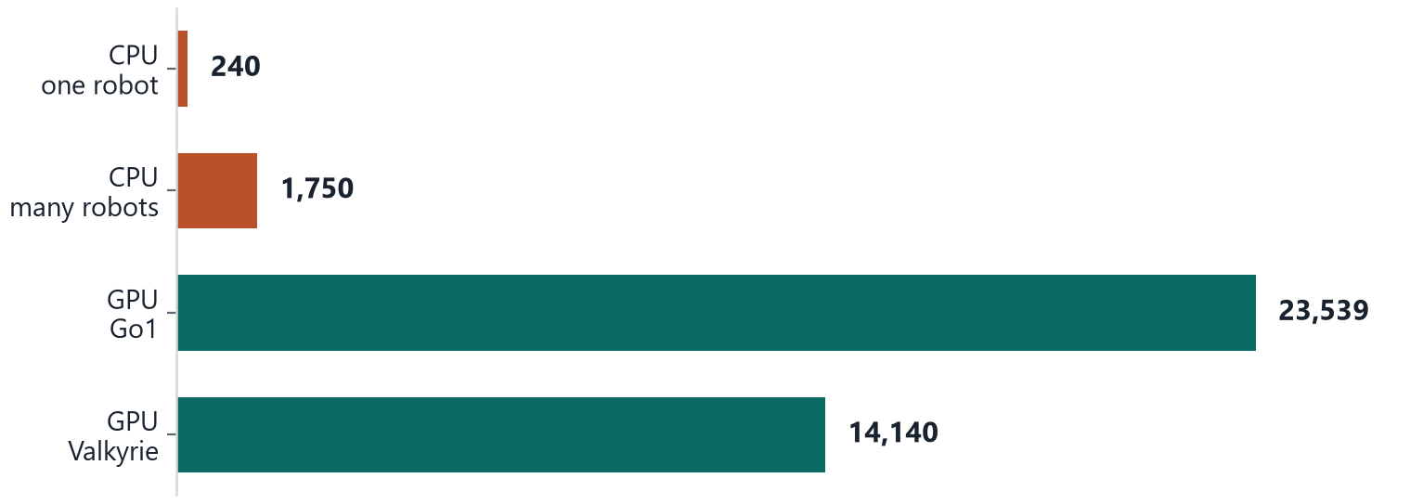
19
The GPU changed how fast we could try ideas
Steps of simulation per second
≈25k
Go1 target
was reached
14.6k peak
Valkyrie
A rough comparison between our own setups. It is not a controlled benchmark.
A longer bar is better. The GPU simulates roughly a hundred times more steps per second than the CPU did,
which is what made it possible to test a change in minutes instead of hours.

Slide 20
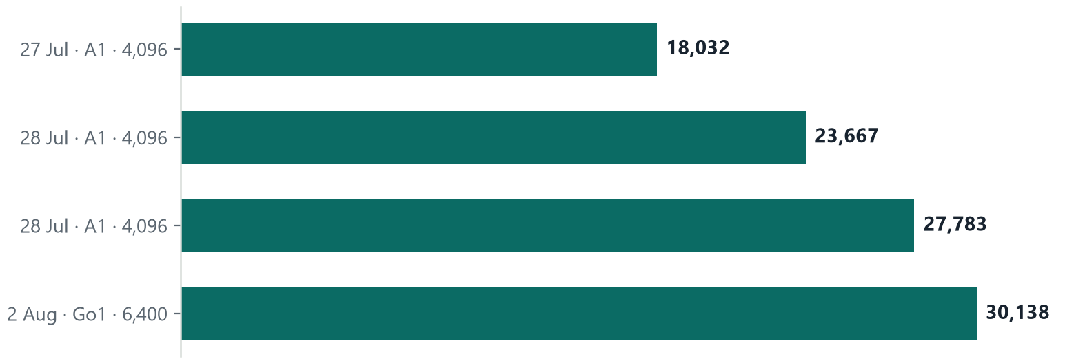
20
Every run was faster than the one before
Steps of simulation per second, averaged over each run
30,138
steps a second
in our best run
22.7 min
to train the Go1
for 40 million steps
A longer bar is better. Running more robots at once, and fixing the setup between runs,
took us from 18,000 steps a second to 30,000.
On the CPU the same work ran at 240 steps a second with one robot, or about 1,750 with many.

Slide 21
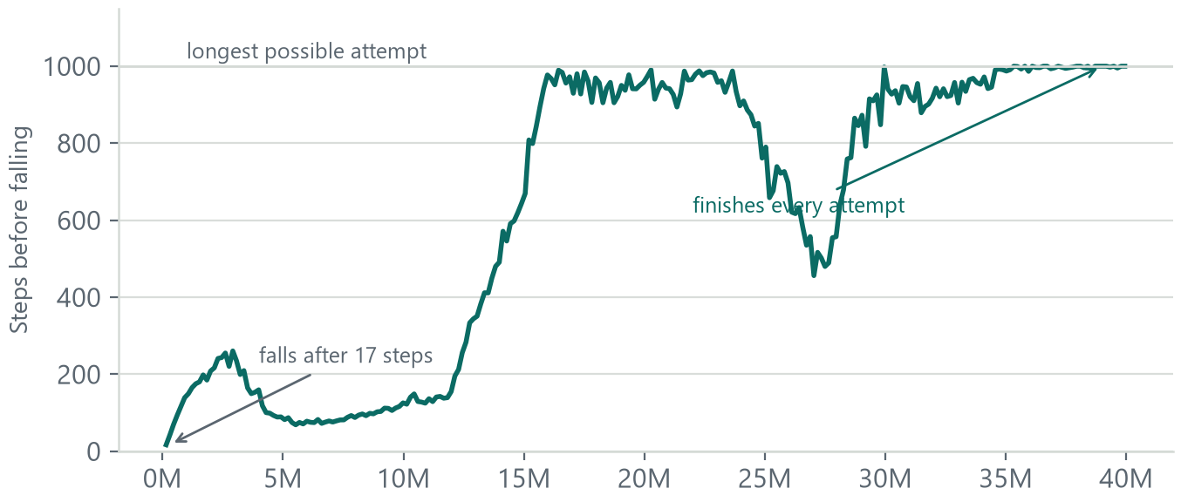
21
What learning looks like during one run
How many steps the Go1 lasted before falling over
17 → 1,000
steps per attempt,
start to finish
One thing to watch
Early on the robot is off the ground a lot, but each attempt only lasts 82 steps. That is falling, not running. Time in the air only counts once the attempts last the full 1,000 steps.
Higher is better, and 1,000 is the maximum length of one attempt. The robot went from
falling after 17 steps to finishing every attempt.
Unitree Go1, 40 million steps, trained with the gait reward.

Slide 22
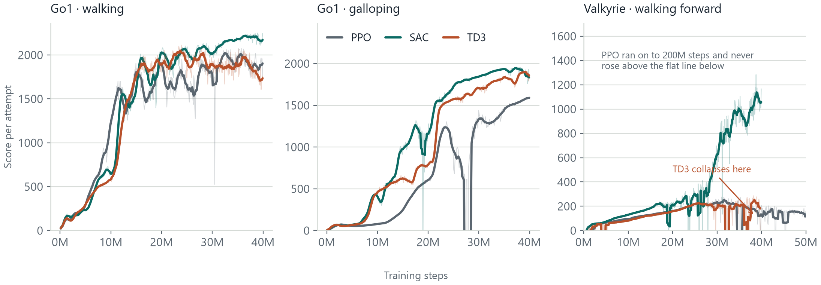
22
All three algorithms on all three tasks
Every task has its own reward, so the three heights are not comparable across the panels.
Within a panel the comparison is fair: same robot, same reward, same 40 million steps.
On the two Go1 tasks all three algorithms learn. On the humanoid only SAC does.

Slide 23
23
The numbers behind that comparison
Task
PPO
SAC
TD3
Go1 walking
2,074
2,250
2,113
best score
steps per attempt at the end
818
995
809
Go1 galloping
1,601
1,953
1,905
best score
time in the air
43%
52%
29%
Valkyrie humanoid
276
1,284
287
best score
steps per attempt
204
821
206
minutes of training
233
67
58
Bold marks the best of the three. SAC wins every task, and on the humanoid it is not close. TD3 finished the humanoid run fastest, but with a policy that had already broken down.

Slide 24
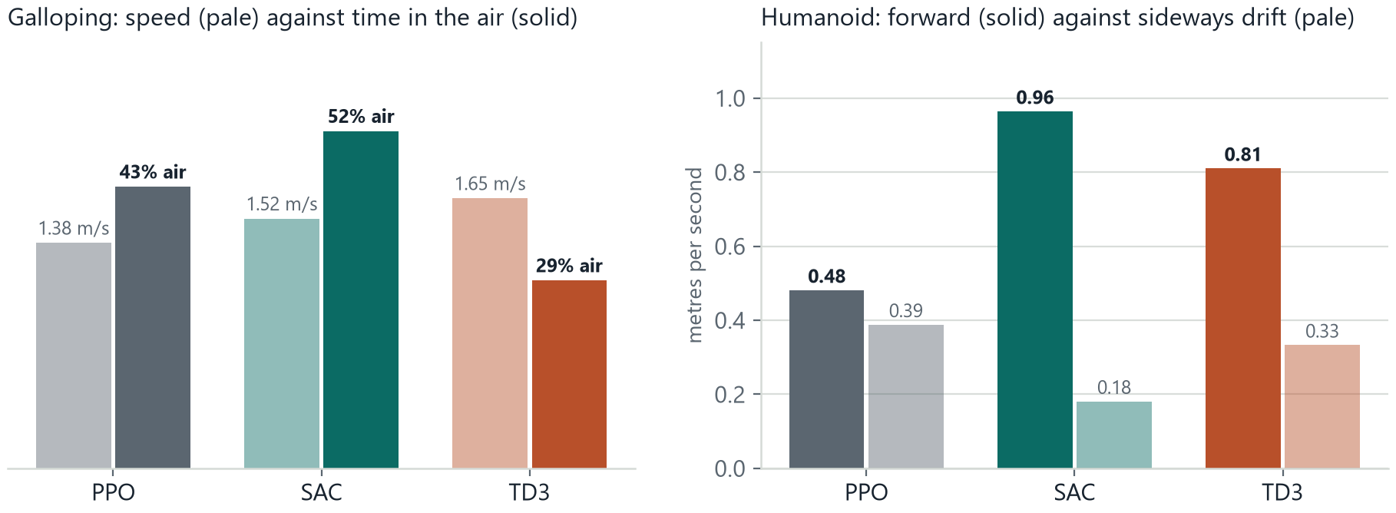
24
A similar score does not mean
the robot did the same thing
On the galloping task TD3 scored within 3% of SAC, and it moves faster, yet it is airborne for 29% of the stride against SAC's 52%: it found a quick trot rather than a gallop.
On the humanoid PPO drifts sideways almost as fast as it walks forward, so its score comes partly from movement that is not the task at all.

Slide 25
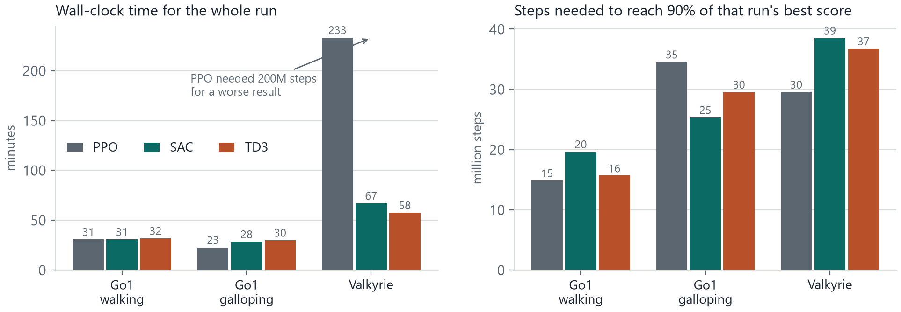
25
How long each algorithm took
On the two Go1 tasks the three are within ten minutes of each other,
so the choice comes down to behaviour, not speed.
On the humanoid, SAC reached four times PPO's score in 67 minutes.
PPO spent 233 minutes and 200 million steps to do worse.

Slide 26
26
Two ways a robot can learn
ON-POLICY · WHAT WE USE
OFF-POLICY
The robot tries something, learns from that attempt, then throws the attempt away.
The robot keeps a memory of old attempts and learns from them again and again.
It always needs fresh attempts
It gets more out of every attempt
Simple, and steady during training
It needs a large memory of past attempts
Fine when attempts are cheap: we run 6,400 robots at once
Better when attempts are expensive, such as on a real robot
PPO learns this way.
SAC and TD3 learn this way.
The difference is whether old attempts are reused. Our simulator produces new attempts almost for free, so keeping
a memory of old ones buys us little, so we train on-policy.

Slide 27
27
Which algorithm suits which task
SAC
Reuses old attempts, so it gets more out of each one. It won every task here, and it was the only algorithm that got the humanoid walking at all.
best on all three
PPO
Learns only from its newest attempts. Reached a good Go1 walk fastest of the three, but on the humanoid it stalled and never recovered, even after 200 million steps.
steady, and where we started
TD3
Also reuses old attempts. Peaked earliest on the Go1 walk and then slid back, and on the humanoid the run broke down completely near the end.
fast, then fragile
Evolution strategies
Parallelises perfectly on this hardware, but scales badly to a humanoid with 129 sensor readings.
not tried here
Model-based (Dreamer)
Useful when attempts are expensive. Our simulator is already fast, so learning a copy of it adds little.
not tried here
We started with PPO because it ships with Isaac Sim's training library. Running the comparison is what showed us SAC was the better default.

Slide 28
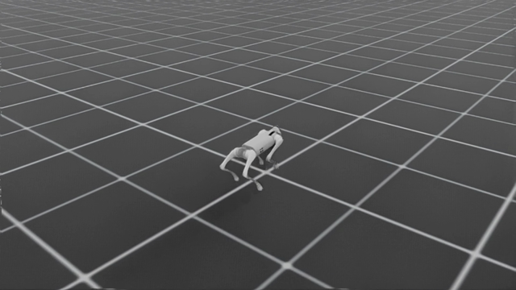
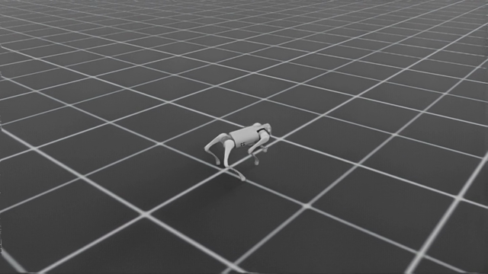
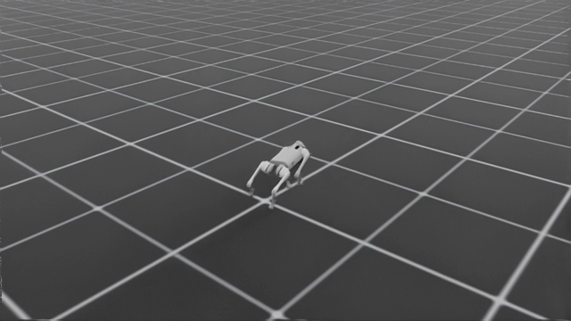
28
Unitree Go1, walking reward
Same robot, same reward, three algorithms. 40 million steps each.
PPO
SAC
TD3
Walks, then loses it: attempts fall back to 818 steps by the end.
Holds a steady walk to the last attempt, 995 steps and 0.99 m/s.
Best walk of the three at 24M steps, then slides back to 809.
Click any frame during the talk to play the recording.

Slide 29
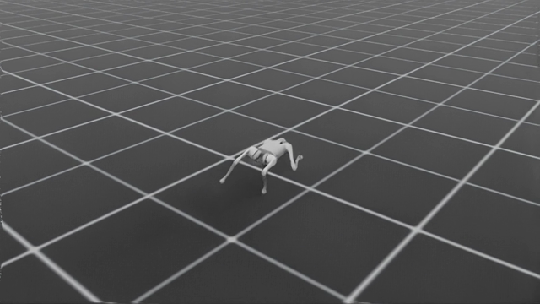
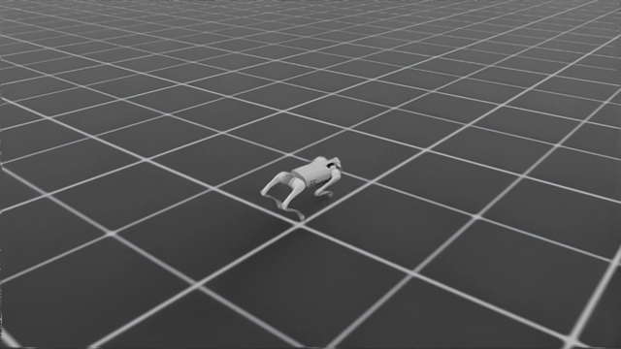
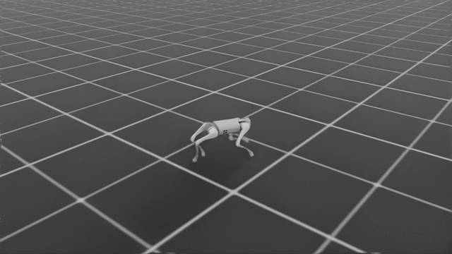
29
Unitree Go1, galloping reward
The task is to leave the ground, not simply to move fast.
PPO
SAC
TD3
1.38 m/s with 43% of the stride airborne. A real gallop.
1.52 m/s and 52% airborne: the clearest gallop we trained.
Fastest at 1.65 m/s, but only 29% airborne. This is a quick trot.
Click any frame during the talk to play the recording.

Slide 30
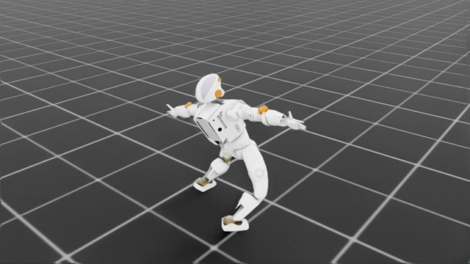
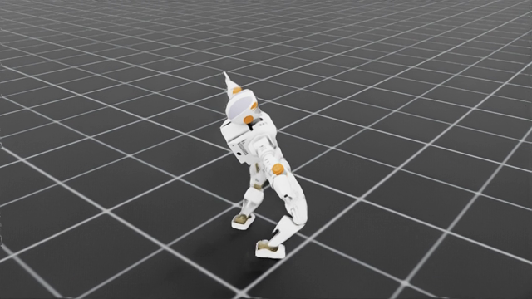
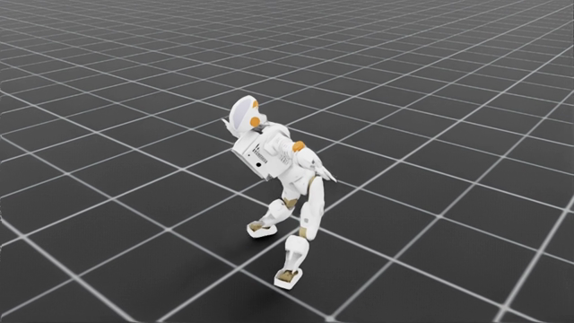
30
Valkyrie humanoid, walking forward
The hardest of the three tasks, and the one that separates the algorithms.
PPO
SAC
TD3
Stalls at 204-step attempts and drifts sideways almost as fast as it walks.
Walks 821 steps at 0.96 m/s. The only humanoid result worth showing.
Reaches 206 steps, then the run breaks down numerically.
Click any frame during the talk to play the recording.

Slide 31
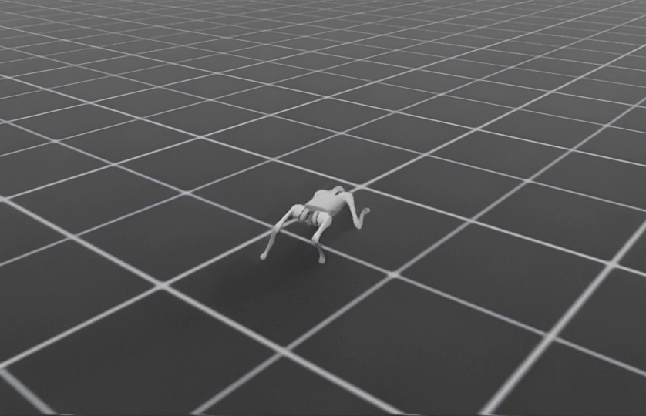
31
The Go1 learned to gallop, and we can measure it
1.38 m/s
forward speed
43%
of the time in the air
Full 1,000-step attempts · 22.7 minutes of training
40M STEPS · 6,400 ROBOTS
The robot finished every attempt while moving forward and leaving the ground again and again. That is what galloping means here.

Slide 32
32
The Go1 also learned to walk
0.98 m/s
forward speed
963
steps per attempt
Best version at 35.2 million steps · 30.8 minutes of training
40M STEPS · 4,096 ROBOTS
This reward limits the speed to 1.0 m/s on purpose, and the robot held 0.98 m/s while staying upright almost the whole way. Same robot, same app, a different reward.

Slide 33
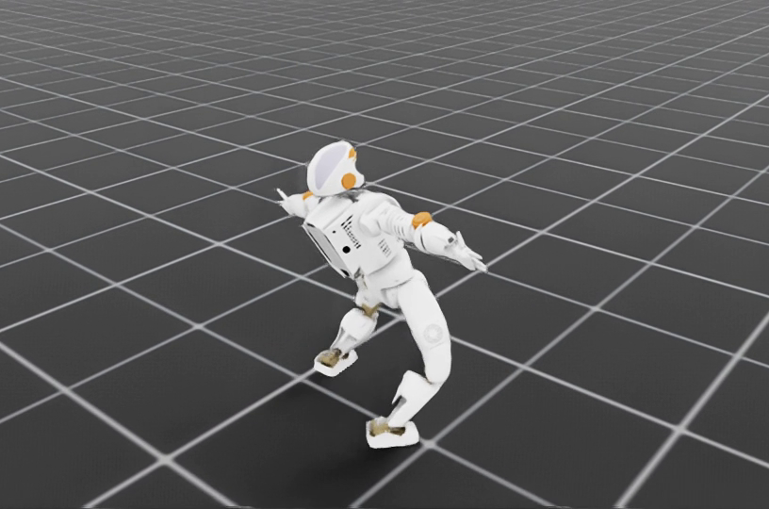
33
The same process also worked on a humanoid
0.48 m/s
forward speed
at its best version
204
steps per attempt
measured at 31 million steps
14,600 steps a second at its peak
Walking on two legs stayed the harder problem. Even so, the same app trained forward motion using 129 sensor readings and 12 motors, with no new code written by hand.

Slide 34
34
One process, two kinds of robot,
and robots that really trained
01
02
03
Academic value
Commercial value
Project proof
A repeatable way to teach reward design and compare training runs, without spending the class on setting tools up.
A faster way to get from a robot file to a working robot, before spending time on real hardware.
A galloping Go1, a walking Go1, early humanoid walking, and a comparison of three algorithms that made SAC our default.
EasyRTG turns robot training from a pile of tools into a process you can follow.

