Slide 1
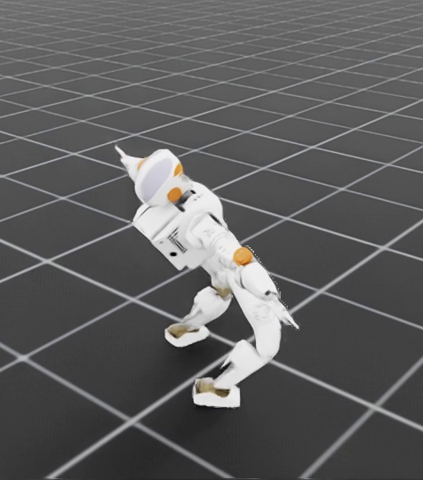
FINAL PROJECT SUBMISSION
EasyRTG
A no-code training ground
for robot learning
Shivam Chavan · 3053682
Supervisor: Shraddha Naik

Slide 2
02
Project Motivation
In my final year of engineering
I set myself a harder project than I needed to: build a physical robot while also training the simulated version of it with reinforcement learning.
It took three months
Three months of work before I had something I could show anyone. Almost all of that time went into the robot behavior and into wiring the tools together.
The project worked
I finished it, and the robot learned what I wanted. But I could see what the three months had really been spent on.
That is the gap
Anyone new to this cannot get started at all unless they already understand the algorithms and can write the code. The knowledge needed to begin is the barrier, here
So, I built the application I would’ve wanted when I started

Slide 3
03
Literature Survey
Area
What already exists
Project application
Algorithms
PPO (Schulman et al., 2017), SAC (Haarnoja et al., ICML 2018), TD3 (Fujimoto et al., ICML 2018)
Reliable published methods. All three are in this project.
GPU simulation
Isaac Gym (Makoviychuk et al., NeurIPS Datasets 2021), Isaac Lab / Orbit (Mittal et al., RA-L 2023)
Thousands of robots on one GPU. This is the engine we train on.
Legged locomotion
Rudin, Hoeller, Reist & Hutter (CoRL 2022)
Showed a quadruped can be trained in minutes with massively parallel simulation.
Differentiable physics
Brax (Freeman et al., 2021)
Fast, but our own attempt with it did not produce a usable robot, very rigid.
Libraries
Stable-Baselines3 (Raffin et al., JMLR 2021), PyBullet (Coumans & Bai)
Well-tested implementations, all written for people who already code.
The gap is that using them still requires an expert understanding.

Slide 4
04
EasyRTG turns a robot file and a goal
into a trained robot
Load
→
Describe
→
Auto Configure
→
Train
→
Evaluate
User can load any universal robot description file (.urdf) file.
User mentions what this loaded robot should do/train itself on
The AI assistant in the app suggests a setup
User can train thousands of copies at once. True Parallelism
Watch it train live and compare results
You can check and approve every important change
(human in the loop)

Slide 5
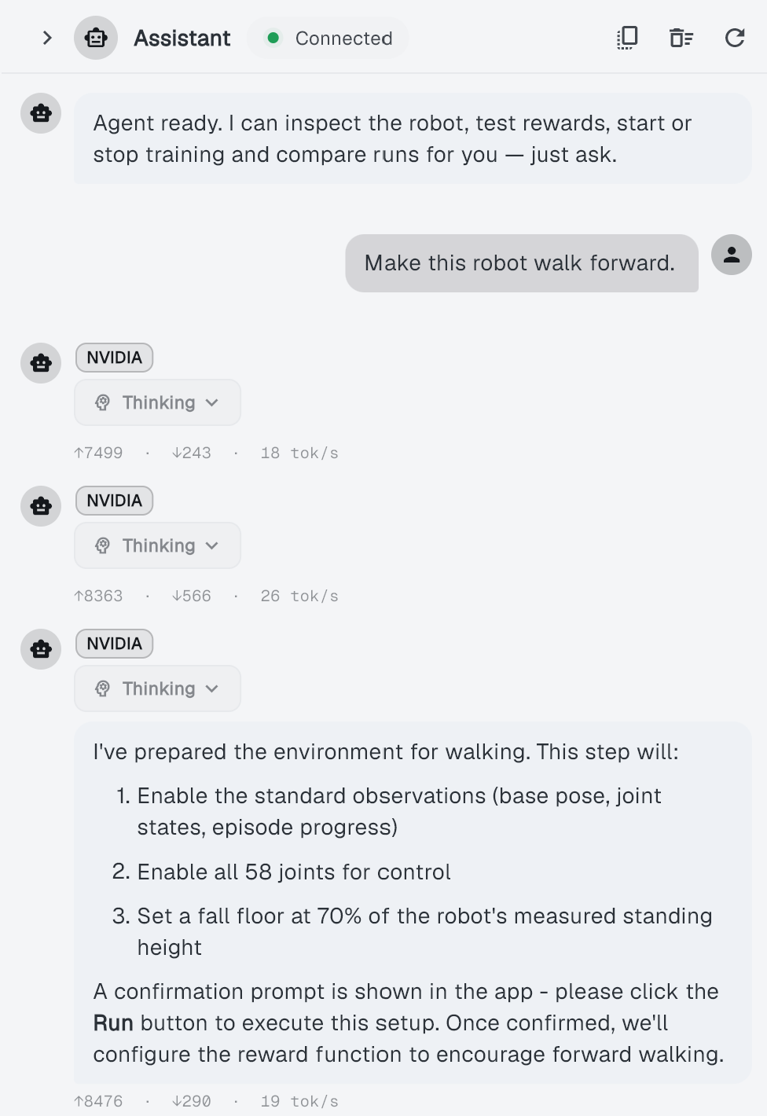
06
The AI Assistant
Inspects
Translates
Runs & watches
Reads the robot's joints its geometry and limits.
→
Turns your goal into a 3 stages
1. Environment Observations
2. Performable Actions
3. reward function
→
Starts training and reports progress
Two models, routed per message
SIMPLE COMMANDS · OLLAMA
GOALS & DIAGNOSIS · NVIDIA NIM
Ministral-3:8b
llama-3.3-nemotron-super-49b
show, list, load, start, stop. Temperature 0.2, short replies, thinking on.
"make it walk", reward design, why a run failed. Temperature 0.6, 16k reasoning budget, and it always asks before applying.
One assistant, 27 tools. The 11 that change state need user approval first.

Slide 6
05
The Underlaying Tech Stack & Features
Frontend
Backend
Flutter
Fast Api
NVIDIA Isaac Sim + PPO
Agent
Thousands of robots training on the GPU
Ollama/Nvidia custom agent

Slide 7
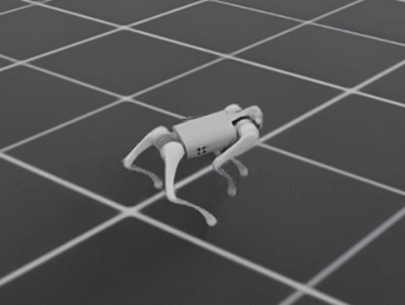
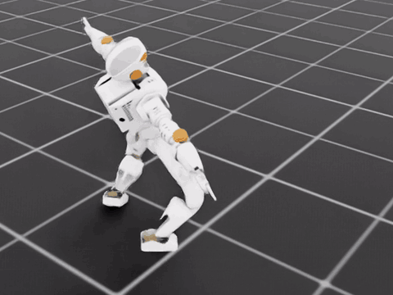
07
Unitree Go1 & NASA Valkyrie
12
58
actuated joints
actuated joints
46
69
links in the file
links in the file
13.3 kg
134.4 kg
total mass
total mass
UNITREE GO1 · QUADRUPED
NASA VALKYRIE · HUMANOID
0.43 m at the hip. Three joints per leg; the four feet are the only ground contacts.
1.16 m at the pelvis. Two feet on the ground, plus arms, torso and neck.
Both are loaded as plain .urdf files. Nothing in the app is specially written for either robot.

Slide 8
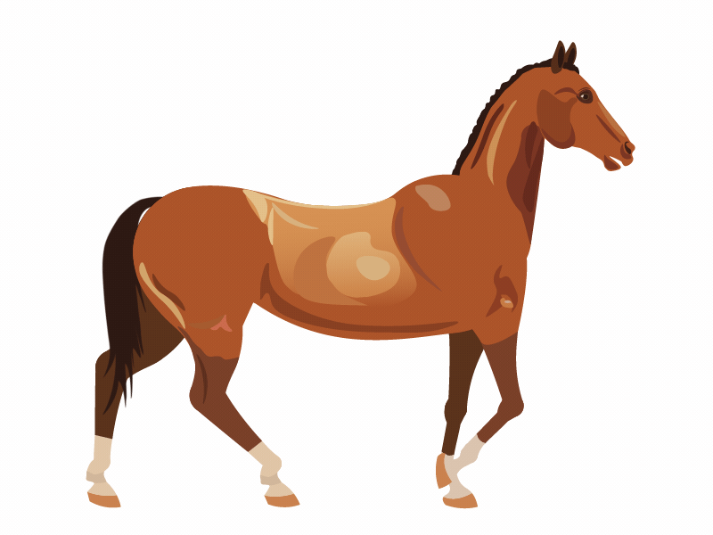
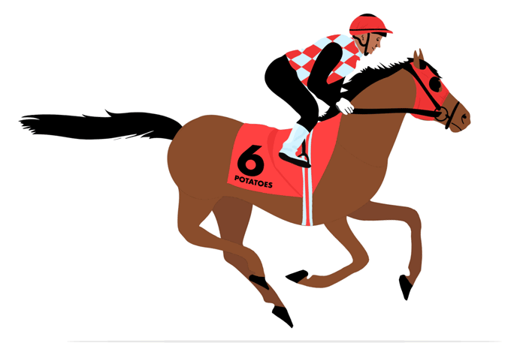
08
What walking and galloping mean
WALK · A FOOT IS ALWAYS DOWN
GALLOP · ALL FOUR LEAVE THE GROUND
One hoof lifts at a time and the ground is never empty. The reward pays whenever ANY foot is up, so the robot has to step.
All four hooves leave the ground together — the flight phase. The reward pays only then. Our Go1 gallop is airborne 43% of the stride.
Same robot, same per-foot contact signal. min asks "is any foot up?", max asks "is every foot up?"

Slide 9
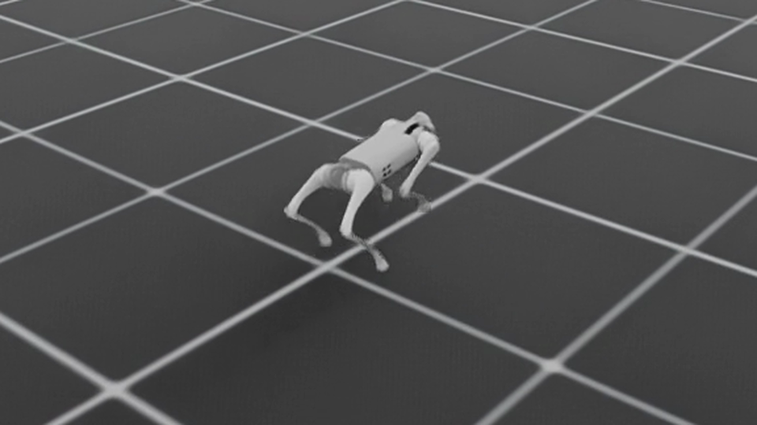
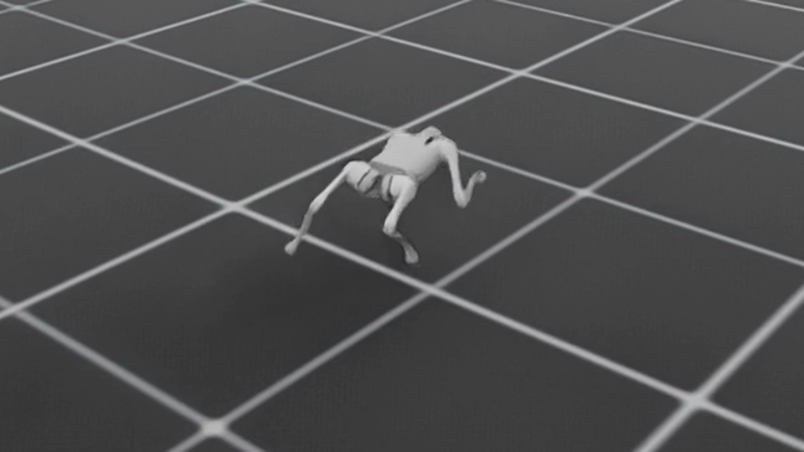
09
GO1 Robot
WALKING REWARD · 11 RULES
GALLOP REWARD · 7 RULES
0.98
963
0.99
1.38
1,000
43%
metres/second
steps per attempt
how upright
metres/second
steps per attempt
of time in the air
This reward punishes bouncing, so the robot keeps its feet on the ground.
This reward pays the robot for leaving the ground, and drops the rules against it.
The same Unitree Go1 robot and the same 40 million training steps. Only the reward changed.

Slide 10
Improvements Over Time
10
Area
Initial stages
Now
Writing the reward
Users picked from a list of rewards we had written.
The agent writes the reward as one short line of maths
Any behaviour is possible, not only the ones we shipped
Reading the robot
We guessed the moving parts from words in their names.
We read the robot's own shape: body, limbs, and which limbs touch the ground
Legs, wheels, arms and humanoids all work.
Standing pose and height
One pose and one height for every robot, copied from a sample.
We measure each robot's standing pose and height before training
Falling is judged against its own height, not a fixed number
What the reward can see
Only speed, height and how upright the robot was.
It now feels ground contact for each limb, and time spent in the air
The same reward line works on two legs, four legs or six
Checking a setup
A bad setup only showed up after millions of steps.
Every setup is checked the moment it is saved
A broken reward fails in seconds instead of after a whole run
Each change moved work out of our code, so the app fits more robots and more tasks without us writing more.

Slide 11
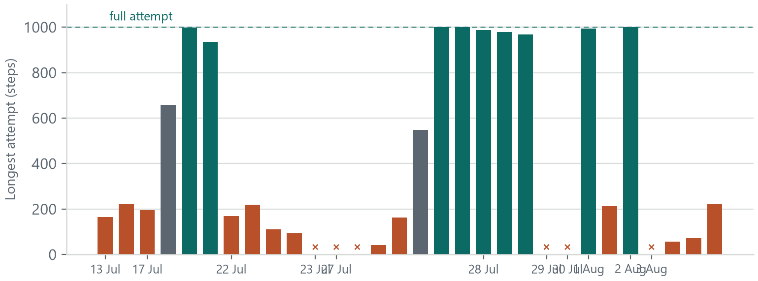
11
Most of our training runs did not work
Longest attempt each run managed, in date order
30
training runs
9
gave a usable robot
6
crashed at initial stage
Each column is one run. Green finished full 1,000-step attempts, grey learned a little, red fell over quickly.
Six columns sit at zero: those runs crashed before training started.
Between 13 July and 3 August. The failures depict how the helping agent is not always accurate.

Slide 12
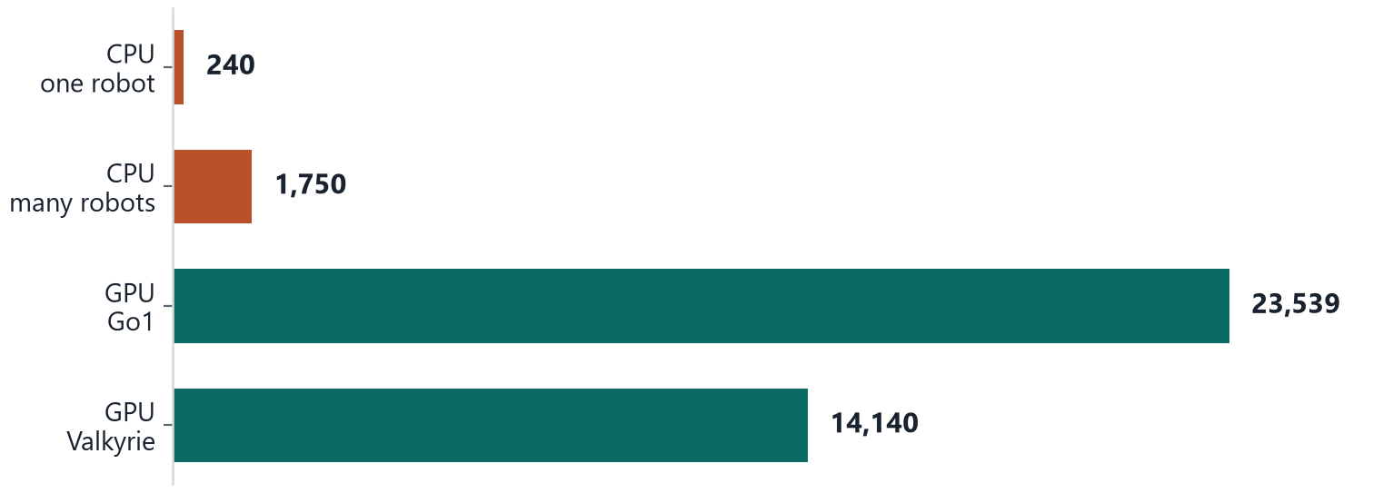
12
The GPU changed how fast we could train
Steps of simulation per second
30,138
steps a second
in our best run
22.7 min
to train the Go1
for 40 million steps
A longer bar is better. The GPU simulates about a hundred times more steps per second than the CPU did,
and better setups took us from 18,000 to 30,138 steps a second across the GPU runs.

Slide 13
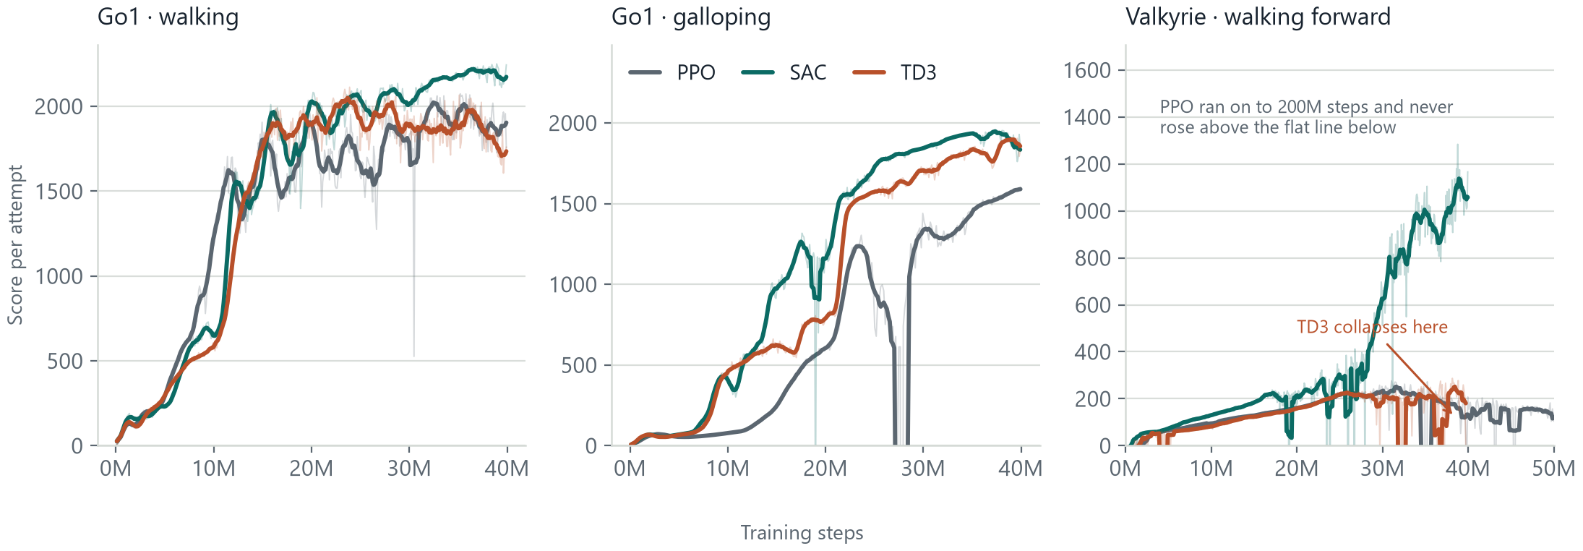
13
All three algorithms on all three tasks
Every task has its own reward, so the three heights are not comparable across the panels.
On the two Go1 robot tasks all three algorithms learn. But on the humanoid robot only SAC does.

Slide 14
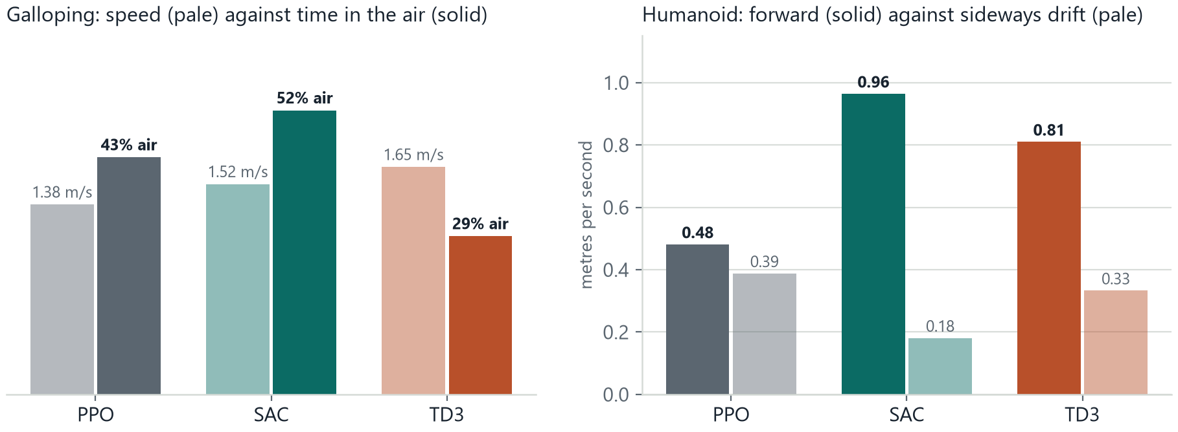
14
A similar score does not mean
the robot did the same thing
On the galloping task TD3 scored within 3% of SAC, and it moves faster, yet it is airborne for 29% of the stride against SAC's 52%: it found a quick trot rather than a gallop.
On the humanoid PPO drifts sideways almost as fast as it walks forward, so its score comes partly from movement that is not the task at all.

Slide 15
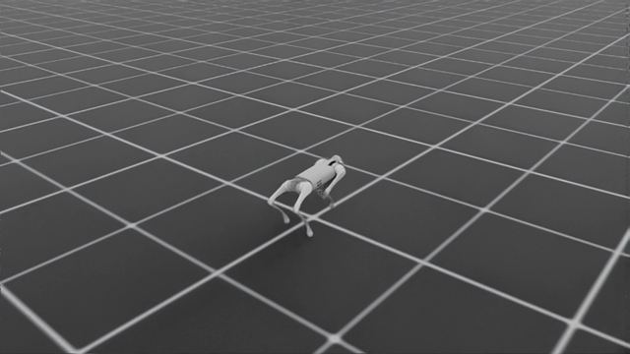
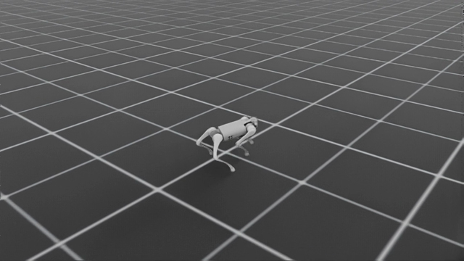
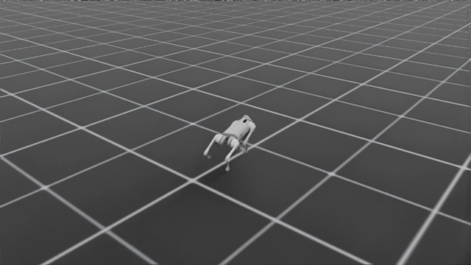
15
Unitree Go1, walking reward
The task is to walk forward and keep its feet on the ground.
PPO
SAC
TD3
Walks 818 steps per attempt. Steady, but stops short of the full attempt.
Walks 995 steps of the 1,000. Most Reward.
Walks 809 steps per attempt, level with PPO.

Slide 16
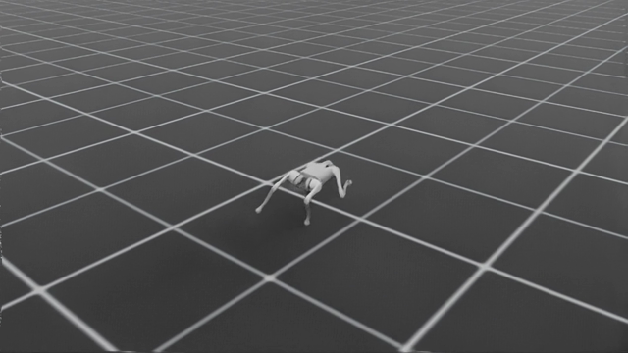
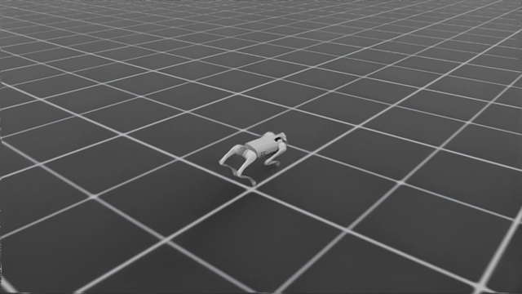
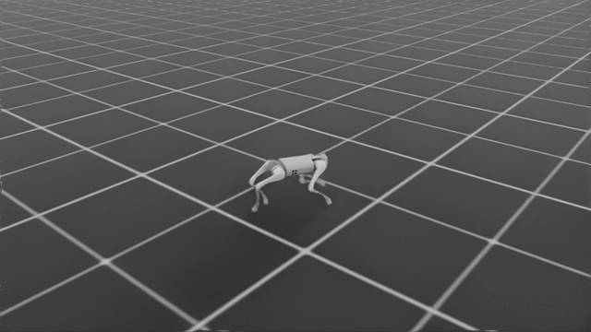
16
Unitree Go1, galloping reward
The task is to leave the ground, not simply to move fast.
PPO
SAC
TD3
1.38 m/s with 43% of the stride airborne. A real gallop.
1.52 m/s and 52% airborne: the clearest gallop we trained.
Fastest at 1.65 m/s, but only 29% airborne. This is a quick trot.

Slide 17
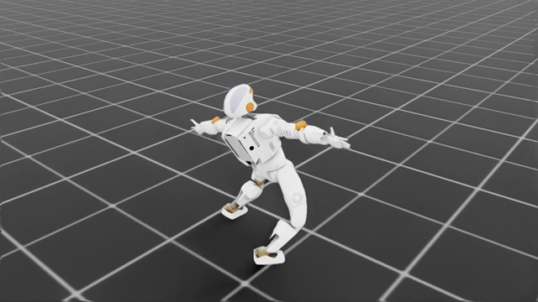
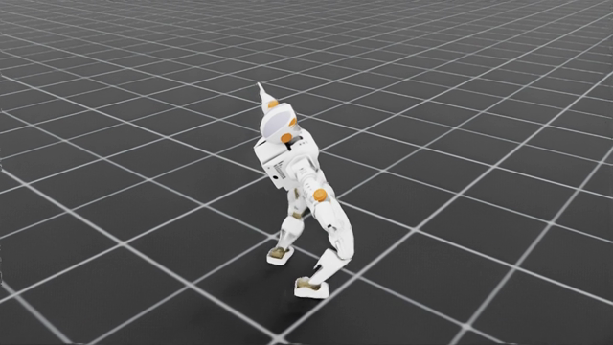
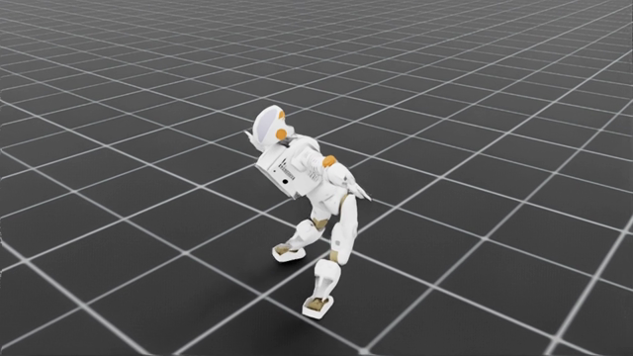
17
Valkyrie humanoid, walking forward
The hardest of the three tasks, and the one that separates the algorithms.
PPO
SAC
TD3
Stalls at 204-step attempts and drifts sideways almost as fast as it walks.
Walks 821 steps at 0.96 m/s. The only humanoid result worth showing.
Reaches 206 steps, then the run breaks down numerically.

Slide 18
18
Conclusion
Academic value
Commercial value
Project proof
A repeatable way to teach reward design and compare training runs, without spending the class on setting tools up.
A faster way to get from a robot file to a working robot, before spending time on real hardware.
A galloping Go1, a walking Go1, early humanoid walking, and a comparison of three algorithms that made SAC our default.
EasyRTG turns robot training from a pile of tools into a simple process you can follow.

