Slide 1





Career Analysis System: A Comprehensive Guide
Prepared By
Name: shivam shukla
Enrollment No: 23002170510041
Branch: A.I.D.S
Batch: A1

Slide 2
Career Analysis System
The Career Analysis System is a Java console-based application designed to empower users in their career journeys. It provides a comprehensive set of features, including job searching, resume building, application tracking, skill and personality assessments, career guidance, and profile management. These tools are tailored to help users enhance their career prospects, manage their professional profiles, and make informed decisions about their future. Whether you're refining your resume, assessing your skills, or seeking career advice, this system offers the resources you need to succeed.

Slide 3


Key Functionalities
Career Guidance: Provides personalized recommendations for career paths based on your skills, interests, and market demand.
Assessment: Includes skill assessment to identify strengths and areas for improvement, as well as personality assessment to match you with suitable roles.
Resume Building: Assists in creating a professional and compelling resume that highlights your qualifications.
Job Searching: Allows you to search for relevant job openings and apply directly through the platform.
Job Application Tracking: Enables you to monitor the status of your job applications and receive updates on the hiring process.

Slide 4
The Algorithm: Guiding Your Journey
Main Menu:
Display options: "User Account", "Recruiter Account".
Get user choice.
Call UserMenu for "User Account".
Call RecruiterMenu for "Recruiter Account".
UserMenu:
Display options: "Sign Up", "Login", "Return".
Based on choice:
Sign Up:
Input email, validate, and create user if not exists.
Gather user details, assign skills, and save to DB.
Proceed to userMenu.
Login:
Input email, validate, and authenticate.
Retrieve and validate password.
Load user data and proceed to userMenu.
Return: Exit menu.
userMenu:
Display options: "Profile", "Assessments", "Career Matching", "Resumes", "Search User", "Search Jobs", "Log out".
Perform actions based on choice.

Slide 5
Handle logout.
RecruiterMenu:
Display options: "Sign Up", "Login", "Return".
Based on choice:
Sign Up:
Input email, validate, and create recruiter if not exists.
Gather recruiter details and save to DB.
Proceed to recruiterMenu.
Login:
Input email, validate, and authenticate.
Retrieve and validate password.
Load recruiter data and proceed to recruiterMenu.
Return: Exit menu.
recruiterMenu:
Display options: "Profile", "Add Job Listings", "Search User", "View Applications", "View Posted Job Listings", "Log out".
Perform actions based on choice.
Handle logout.

Slide 6
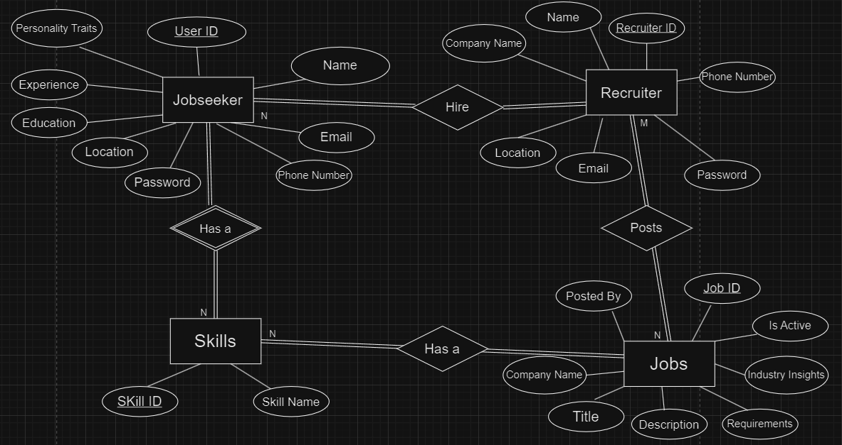
ER Diagram

Slide 7
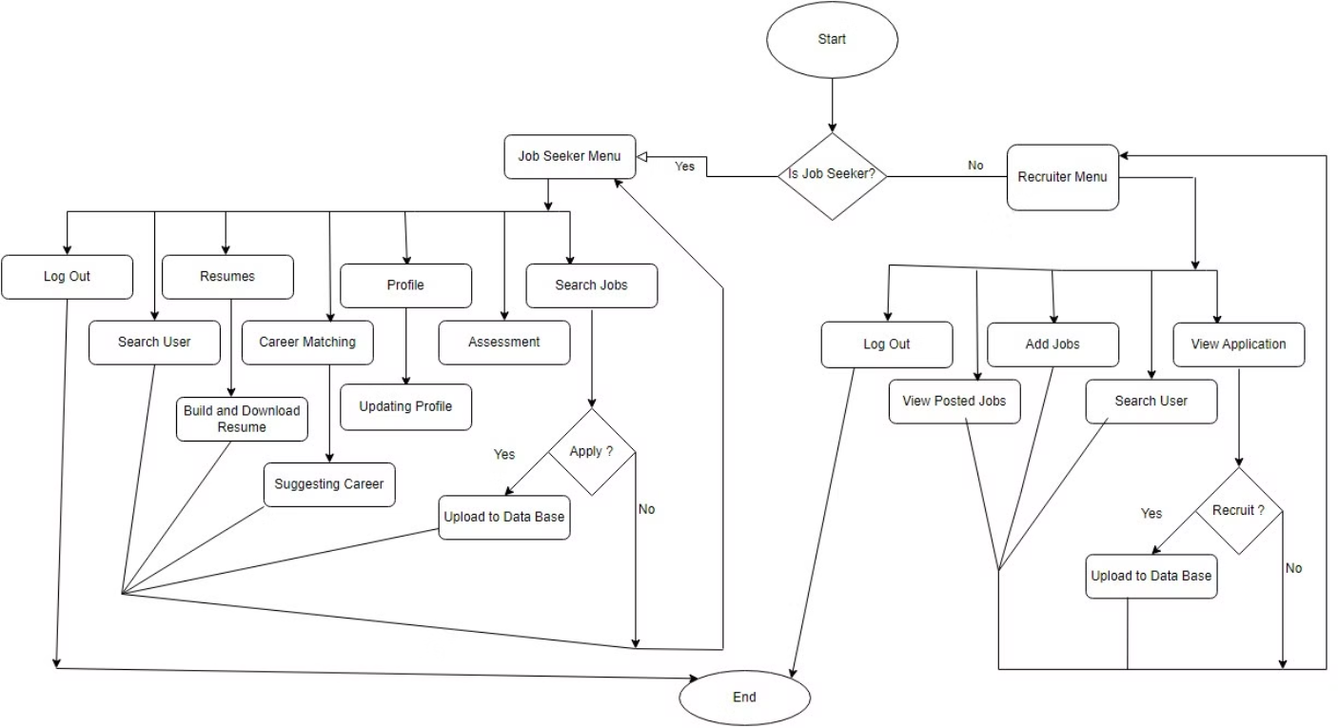
Flow Chart

Slide 8
Java Integration
1
Inheritance
2
File I/O
Leveraging inheritance to create a hierarchy of user and recruiter classes.
Implementing File I/O to Preview and download user resume files.
3
Encapsulation
4
Abstraction
Encapsulating data and logic within classes to ensure data integrity.
Using Interfaces to define a contract that implementing classes must fulfill, specifying what methods a class should provide without dictating how they should be implemented.
5
Generics
6
Multithreading
Utilizing Java generics to create reusable data structures and methods.
Applying multithreading concepts to improve performance and responsiveness.
Data Structures Integration
1
ArrayList
2
Stack
Storing and managing user resumes and other dynamic data.
Implementing LIFO functionality for Assessment Result Log.
3
Queue
4
LinkedList
Handling and Managing Skills of User.
Implementing other data structures.

Slide 9
DBMS Integration
1
Transaction Handling
2
Primary and Foreign Keys
3
Junction Tables
Implementing commit and rollback operations to ensure Apply and Recruit functionality.
Modeling many-to-many relationships, such as users and their skills.
Establishing relationships between user profiles, job postings, Skills and other entities.
4
Stored Procedures
5
JDBC
Encapsulating complex database operations for efficient data access.
Utilizing the Java Database Connectivity API to interact with the underlying database.

Slide 10
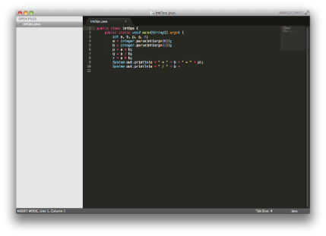



Core Technologies Used
Java
Database
JDBC
The backbone of the system, providing the framework for application logic, data handling, and user interface.
Stores user data, job postings, skill information, and other relevant data for analysis and retrieval.
Used to connect the Java application to the database, allowing seamless data transfer and manipulation.

Slide 11


Benefits and Challenges
Benefits
Challenges
Provides personalized career insights, simplifies the job search process, Resume Building, helps identify skills gaps, and offers valuable career guidance.
Requires accurate data input from users, time complex, and could be challenging for users unfamiliar with data-driven tools.

Slide 12
Future Scope
1
Code Execution Engine
2
Advanced Features
Add a Compiler/Interpreter to solve coding
problems like leetcode.
Implement user authentication, virtual interview practice and real-time notifications.
3
Performance Tuning
4
Mobile App
Optimize database queries and file operations.
Develop a mobile version of the app.

Slide 13

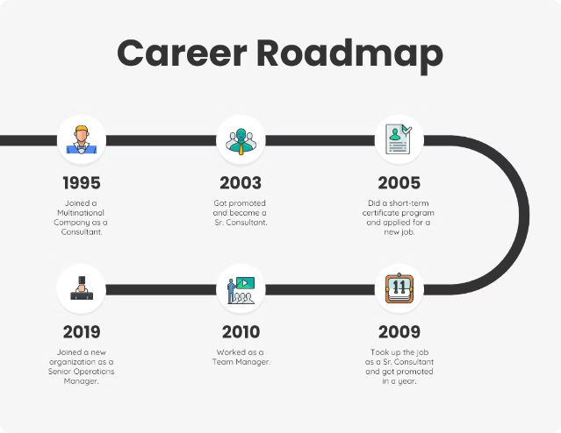
Conclusion
The Career Analysis System is a powerful tool for individuals seeking to make informed career decisions. By combining data analysis with user input, the system provides valuable insights, recommendations, and support to navigate the complex world of careers. As technology continues to evolve, the system can be enhanced with AI capabilities, virtual interview practice, and networking integration, making it even more comprehensive and beneficial for career development.

Slide 14
Thank You!

