Slide 1
Capstone Project - 2
Retails Sales Prediction Regression
Shivam Pandey
(Cohort : Enlighten)

Slide 2
Project Name
Problem Statement
Data Summary
Data wrangling
Exploratory Data Analysis
Data Pre-Processing
Feature Manipulation & Selection
Model Implementation
Conclusion
Contents

Slide 3
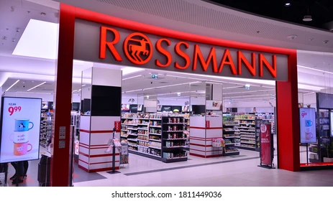
Problem Statement
Rossmann operates over 3,000 drug stores in 7 European countries. Currently, Rossmann store managers are tasked with predicting their daily sales for up to six weeks in advance.
The objective of the project is to come with a machine learning model to predict sales.
Img. Source - Google

Slide 4
Data Summary
There are two Datasets present . They are :-
Rossmann Stores Data.csv - Historical data including Sales.
store.csv - Supplemental information about the stores.
Details of Dataset
• Rossmann stores Data.csv has 9 feature and 1017209 observations.
• Store.csv has 10 feature and 1115 observations

Slide 5
Important Variables
1. Sales - The turnover for any given day (this is what we are predicting).
2. Open - An indicator for whether the store was open or closed. 0 = closed, 1 = open.
3. Store type - Differentiates between 4 different store models (a, b, c & d).
4. Assortment - Describes an assortment level: a = basic, b = extra, c = extended.
5. Promo - Indicates whether a store is running a promo on that day
6. Promo2 - Promo2 is a continuing and consecutive promotion for some stores.

Slide 6
Contd...
7. Store - A unique Id for each store.
8. Customer - The number of customers on a given day.
9. Competition Distance - Distance in meters to the nearest competitor store.
10. Promo Interval - Describes the consecutive intervals Promo2 is started, naming the months the promotion is started a new.
11. Promo2Since [Year/week] - Describes the year and calendar week when the store started participating in Promo2.
.

Slide 7
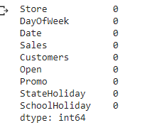
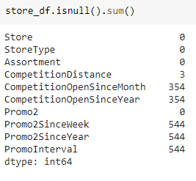
DATA WRANGLING
Missing Values
Looking for missing values in Rossmann.csv
Looking for missing values in Store.csv
.

Slide 8
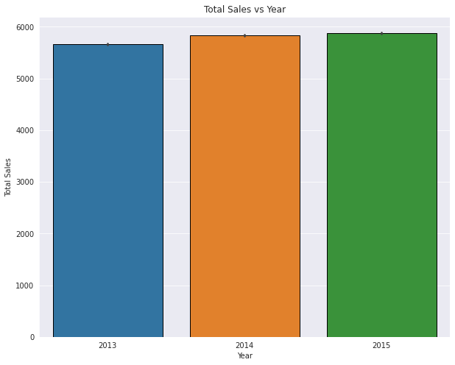
DATA VISUALIZATION
Sales Within Years
The Sales Is Increasing Continuosly
There is apprx. Average sale in the years 2014 & 2015.

Slide 9
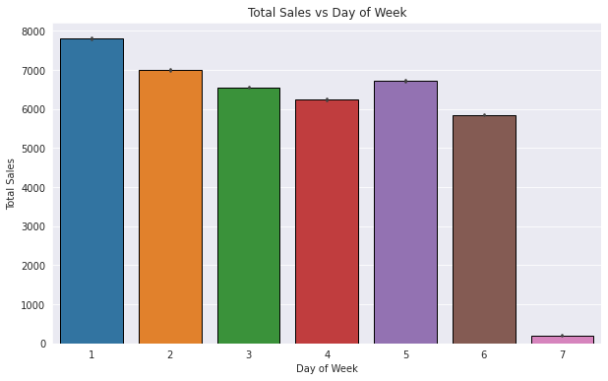
Sales According To Day Of Week

Slide 10
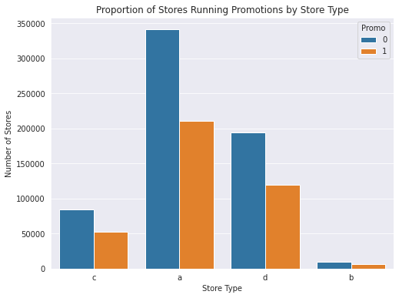
Sales vs Store Types
Store type a has the highest number of stores running promotions, followed by store type d, c, and b.
For store types a, b, and d, the number of stores running promotions is higher than the number of stores not running promotions.
For store type c, the number of stores running promotions is roughly the same as the number of stores not running promotions.

Slide 11
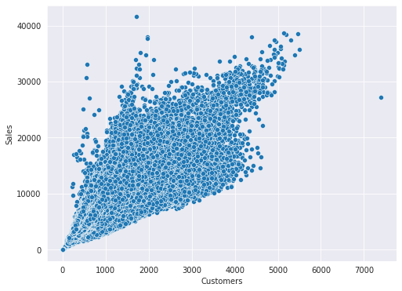
Sales vs. Customers
This above scatterplot show a positive correlation between 'Sales' and 'Customers
As the number of customers increases, the sales also tend to increase.
This positive correlation is a good indicator that the store is effectively engaging with customers and meeting their needs.

Slide 12
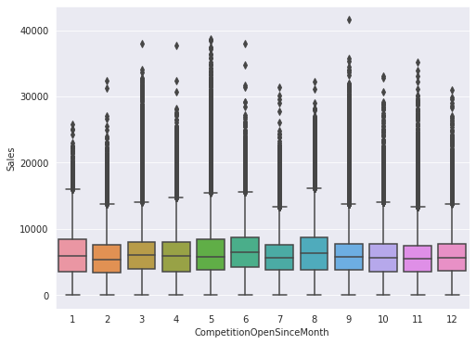
Sales Vs Competition Open Since Month
The moths of January, February, and June all have relatively low medians, suggesting that these months may be more challenging for existing stores when facing new competition
On the other hand, the boxes for April and November have higher medians, suggesting that existing stores may be more resilient to new competition during these months.
Additionally, there are some outliers in the data, such as the high sales values in September, that may be worth investigating further to understand what factors contributed to those sales.

Slide 13
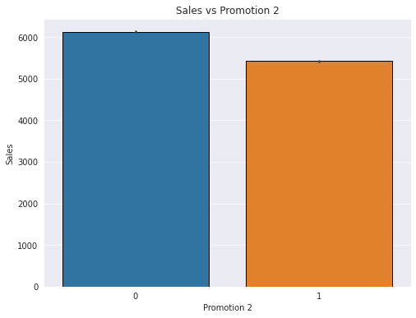
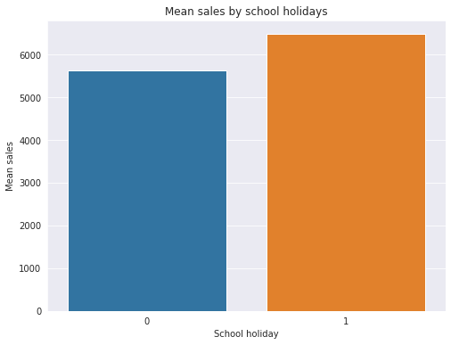
Sales Vs Promo2
Sales Vs SchoolHolidays
Sales tend to be higher during non-School Holiday periods compared to School Holidays, indicating that School Holidays may have a negative impact on sales.
The bar plot comparing the average sales by Promo2 shows that stores with Promo2 have slightly higher average sales than stores without Promo2.
This suggests that Promo2 has a positive impact on sales, but the difference in sales may not be significant.

Slide 14
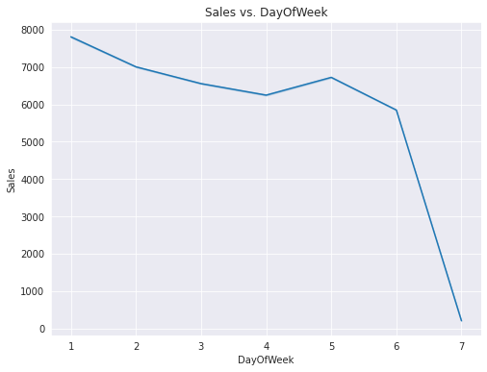
Analysis of Sales over Weekdays
The line plot may show that sales are generally higher on Saturdays and Sundays compared to weekdays.
The line plot may also show a peak in sales around the middle of the week, on Wednesdays or Thursdays.
The line plot may also reveal that sales are consistently lower on certain weekdays, such as Mondays or Tuesdays

Slide 15
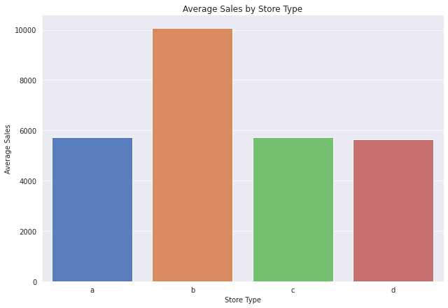
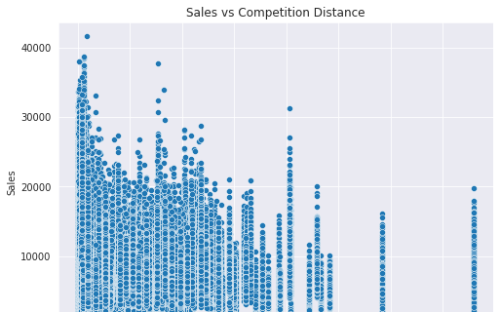
Average Sales By Store Type
The scatter plot shows that there is a weak negative correlation between the two variables.
The scatter plot also shows that there are a few outliers in the data.
Store type B has the highest average sales
Store types A and C have relatively similar average sales
Store type D has the lowest average sales of all store types,
Sales By Competition Distance
Notes:
Matches won and no of 200+ scores

Slide 16
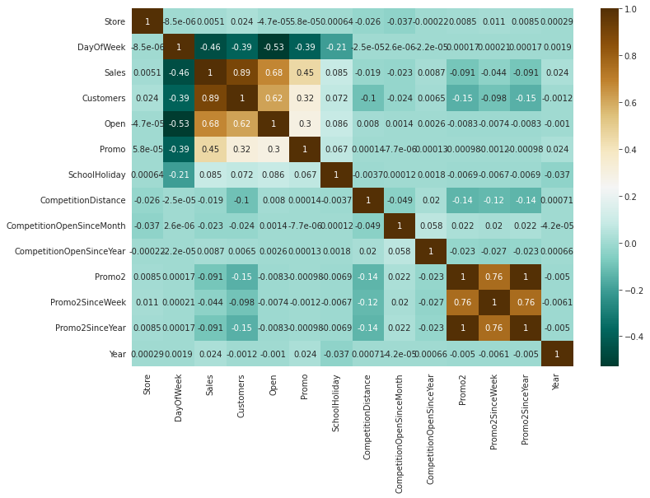
Correlation Of All Features
Notes:
Matches won and no of 200+ scores

Slide 17
Feature Engineering

Slide 18
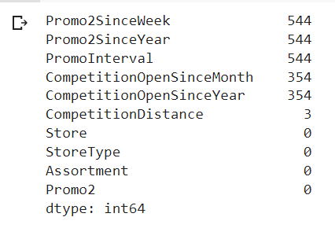
Replacing Missing values
As a part fo Data Wrangling,
In **Rossmann Dataset** : There is no null value in this datset.
In **Store Dataset** : In this section I had devided into three parts.
Fisrt part i.e. **Promo2SinceWeek**, **Promo2SinceYear** and **PromoInterval**. flled with 0.
Second part i.e.**CompetitionOpenSinceMonth** and **CompetitionOpenSinceMonth** is filled with mode.
Third part i.e. **CompetitionDistance** is filled with median.

Slide 19
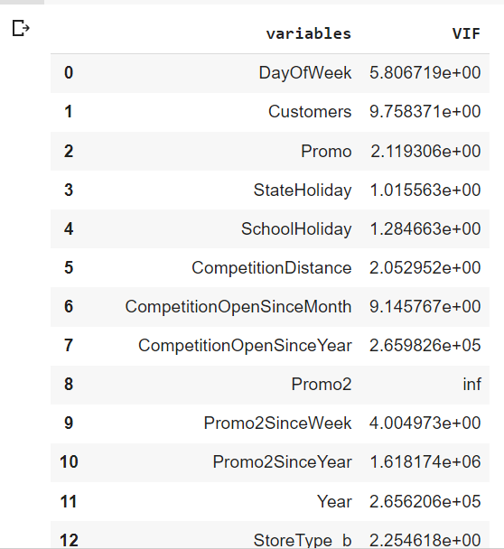
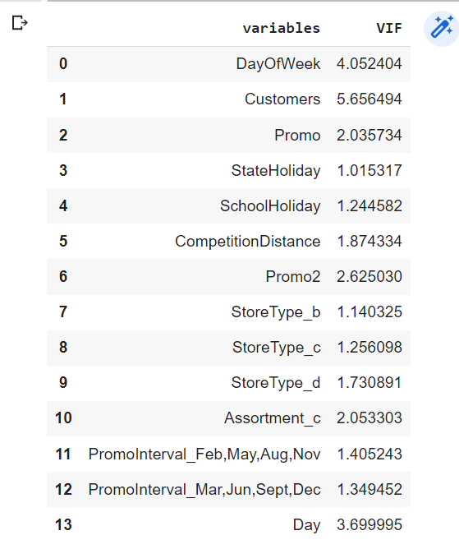
Multicollinearity

Slide 20
Model Implementation

Slide 21
Here are the regression algorithm used.
1. Linear Regression
2. Linear Regression with Regularization (L1,L2 and Elastic Net).
3. Decision Tree
4. Random Forest
Algorithm used

Slide 22
Evaluation Metrics For Regression
Following are the evaluation metrics for regression.
1. Mean Absolute Error(MAE)
2. Mean Squared Error(MSE)
3. Root Mean Squared Error(RMSE)
4. R Squared (R2)
5. Adjusted R Squared •
On the basis of R Squared we evaluate our model performance on both train or test set.

Slide 23
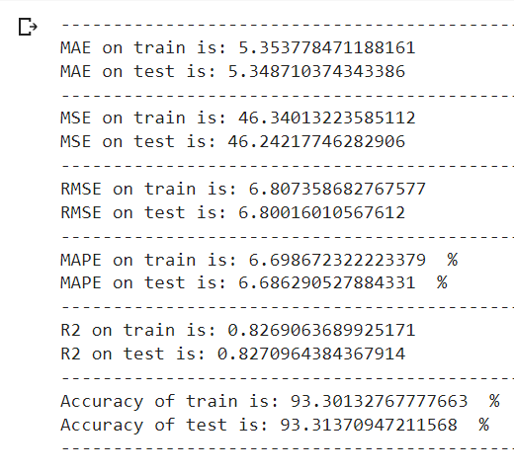
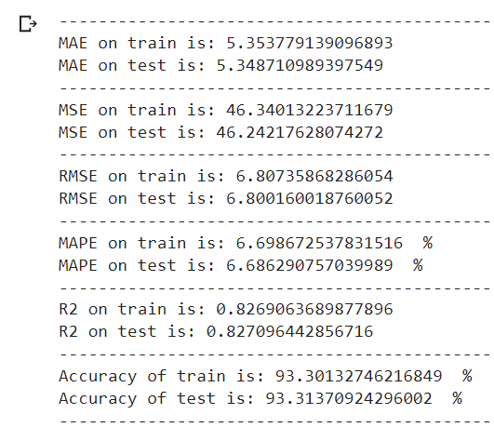
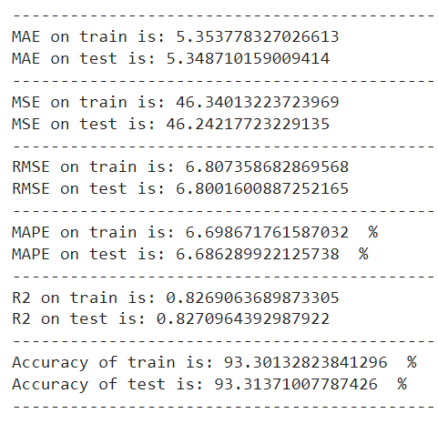
Linear Regr Ridge Regr Lasso Regr

Slide 24
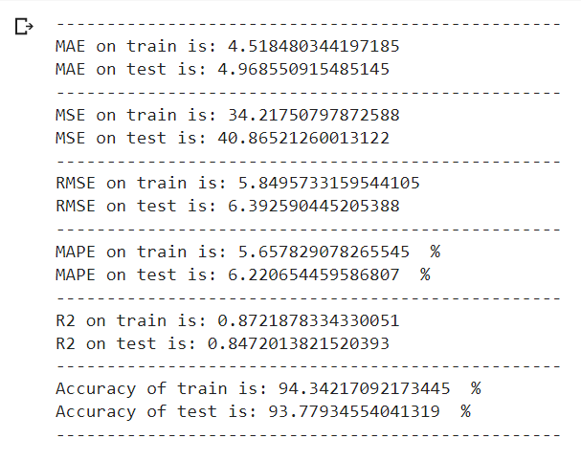
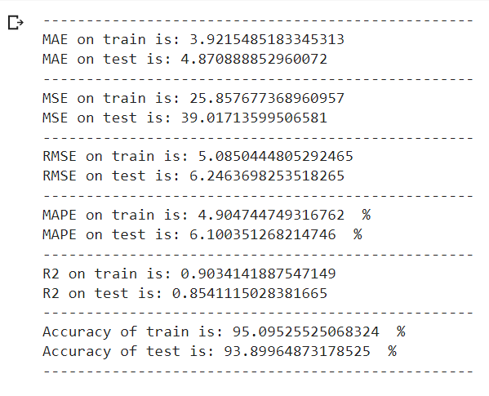
Decision Tree Model Random Forest Model

Slide 25
Selection of Model
By looking both Model MSE, RMSE, RMPSE and R2 values we decided to go with 3rd Model in which took whole dataset are present.
Also in Model we did various Algorithms such as Decision Tree, Random Forest , Linear regression, Ridge and Lasso.
But above all algorithms we get very good result in Random Forest Algorithm.
So we decided to choose Random Forest Algorithm of the model.

Slide 26
Conclusions
From plot sales and competition Open Since Month shows sales go increasing from November and highest in month December.
From plot Sales and day of week, Sales highest on Monday and start declining from Tuesday to Saturday and on Sunday Sales almost near to Zero.
Plot between Promotion and Sales shows that promotion helps in increasing Sales.
Type of Store plays an important role in opening pattern of stores. All Type ‘b’ stores never closed except for refurbishment or other reason.

Slide 27
Contd..
All Type ‘b’ stores have comparatively higher sales and it mostly constant with peaks appears on weekends.
Assortment Level ‘b’ is only offered at Store Type ‘b’.
We can observe that most of the stores remain closed during State Holidays. But it is interesting to note that the number of stores opened during School Holidays were more than that were opened during State Holidays.

Slide 28
THANK YOU

