Slide 1


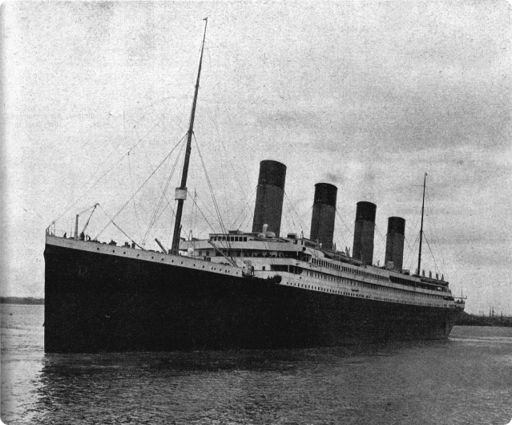

Titanic Survival Prediction: A Machine Learning Approach
This presentation outlines a machine learning approach to predict the survival of passengers on the Titanic. We will explore the data, perform feature engineering, and build a model using Random Forest Classifier to predict survival based on various factors.
by Python Anaconda

Slide 2

Data Exploration
1
Target Variable
The target variable is 'survived', indicating whether a passenger survived (1) or not (0). The distribution of the target variable shows that 61.6% of passengers did not survive, while 38.4% survived.
2
Numerical Features
We have two numerical features: 'age' and 'fare'. Boxplots reveal outliers in both features, indicating the need for outlier handling.
3
Categorical Features
Categorical features include 'pclass', 'sex', and 'embarked'. Countplots visualize the distribution of these features, providing insights into the passenger demographics.
4
Family Size
A new feature 'family' is created by combining 'sibsp' and 'parch' to represent the size of the passenger's family. This feature will be used in the model to assess the impact of family size on survival.

Slide 3

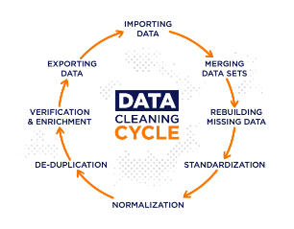
Data Cleaning
1
2
3
4
Column Dropping
Renaming Columns
Family Feature Creation
Dropping Redundant Columns
Columns 'passengerid', 'name', 'ticket', and 'cabin' are dropped as they are not relevant for survival prediction. These columns are considered irrelevant for the model.
All column names are converted to lowercase for consistency and ease of use. This ensures that all column names are in a standard format.
A new feature 'family' is created by adding 'sibsp' and 'parch' columns. This feature represents the total number of family members on board.
Columns 'sibsp' and 'parch' are dropped as they are now incorporated into the 'family' feature. This avoids redundancy and simplifies the data.

Slide 4
Feature Engineering
Age
Fare
Embarked
The 'age' feature is imputed with the median value, outliers are capped using a Gaussian method, and the feature is standardized. This ensures that missing values are handled, outliers are mitigated, and the feature is scaled for optimal model performance.
The 'fare' feature is capped using the IQR method to handle outliers, and then standardized. This approach addresses outliers while maintaining the distribution of the feature.
The 'embarked' feature is imputed with the most frequent value, encoded using count frequency encoding, and scaled using MinMaxScaler. This process handles missing values, transforms categorical values into numerical values, and scales the feature for consistent range.

Slide 5


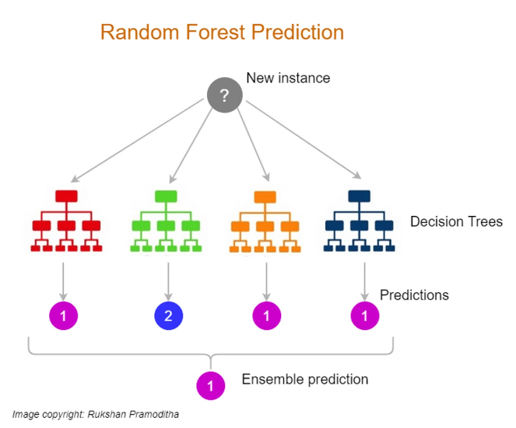



Model Building
Column Transformation
A ColumnTransformer is used to apply different transformations to different features. This allows for tailored preprocessing based on the characteristics of each feature.
Model Selection
Overview of classification models used: Logistic Regression, Naive Bayes, SVM, and Random Forest. Integration of preprocessing pipelines with classifiers using Pipeline.
Model Training
The model is trained on the transformed training data. This step involves fitting the model to the data and learning the relationships between features and the target variable.
Model Evaluation
The model is evaluated on the transformed testing data. This step assesses the model's performance on unseen data, providing insights into its generalization ability.

Slide 6
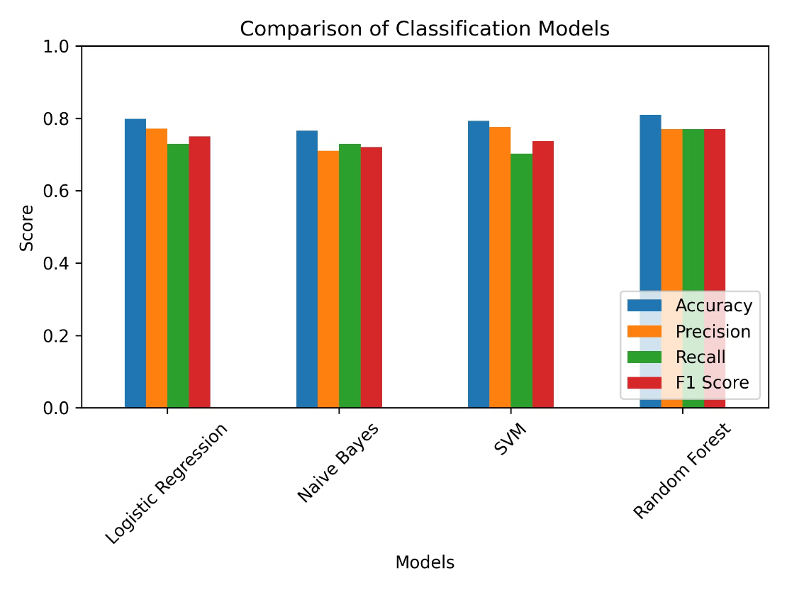
Model Comparison

Slide 7
Model Evaluation Metrics
Metric
Description
Accuracy : 0.8101
The proportion of correctly classified instances.
The proportion of correctly predicted positive instances among all predicted positive instances.
Precision : 0.7703
Recall : 0.7703
The proportion of correctly predicted positive instances among all actual positive instances.
The harmonic mean of precision and recall, providing a balanced measure of model performance.
F1-Score : 0.7703

Slide 8
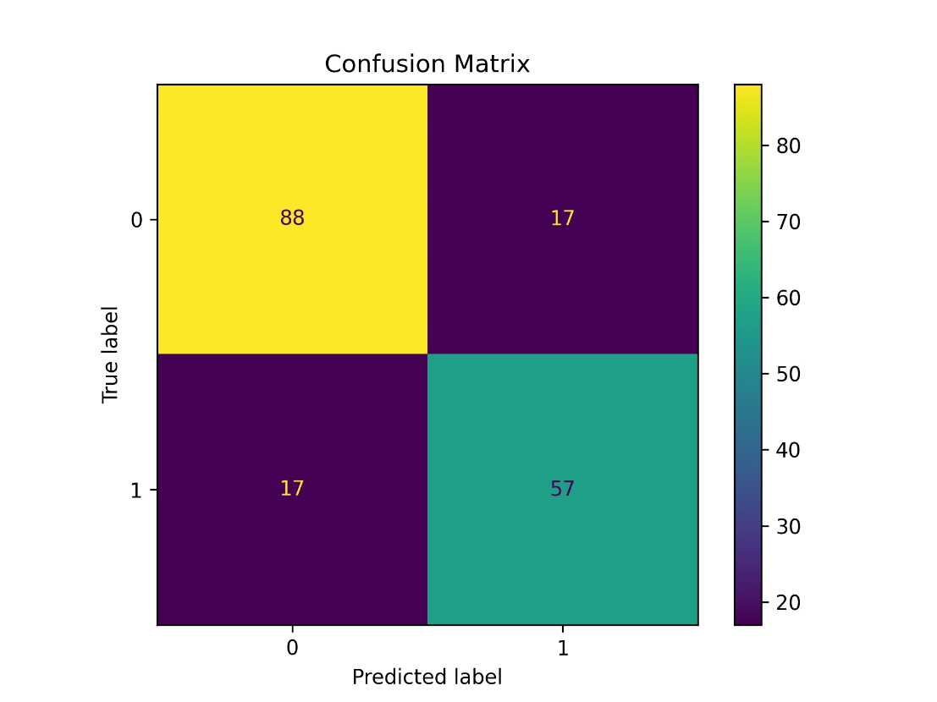
Confusion Matrix

Slide 9
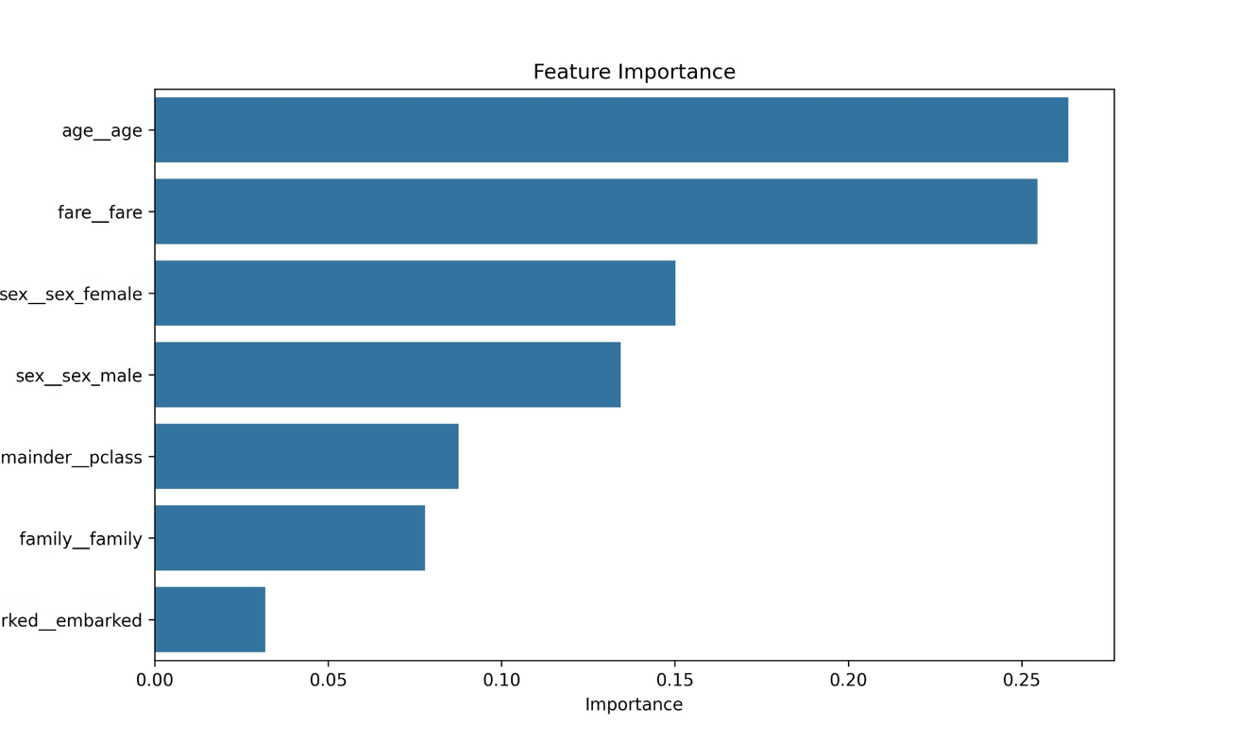
Feature Importance

Slide 10

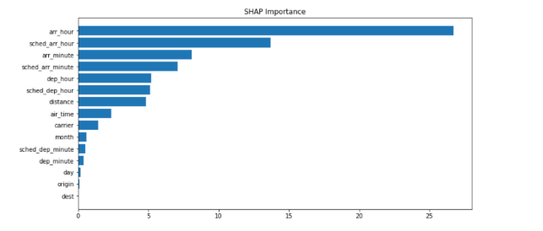



Model Interpretation
Feature Importance
Confusion Matrix
Performance Metrics
Feature importance analysis helps identify the most influential features in predicting survival. This information provides insights into the factors that significantly contribute to the model's predictions.
A confusion matrix visualizes the model's performance by showing the number of correctly and incorrectly classified instances for each class. This provides a detailed understanding of the model's strengths and weaknesses.
Various performance metrics, such as accuracy, precision, recall, and F1-score, are used to evaluate the model's overall performance. These metrics provide a comprehensive assessment of the model's effectiveness.

Slide 11


Conclusion
This machine learning approach successfully predicts the survival of passengers on the Titanic. By leveraging feature engineering and a Random Forest Classifier, we achieved a robust model with high accuracy and interpretability. The insights gained from feature importance analysis and confusion matrix provide valuable information for understanding the factors that influenced survival.

