Slide 1

BeRight AI
The Intelligence Layer for Prediction Markets
$18B
9x
Monthly Volume
Growth Rate
Current market size
In 6 months
The best forecasters can't prove their skill. Investors can't access their alpha. We fix that.

Slide 2


Prediction Markets Are Broken
No Track Records
Platforms keep data internal and siloed. Your performance history dies when you leave.
No Portability
Your skill dies on each platform. No way to prove expertise across markets.
No Delegation
Skilled forecasters capped at personal capital. Can't scale impact.
Result: Billions idle. Skill unrewarded.

Slide 3




The Solution
BeRight = Intelligence + Capital Layer
Swipe-to-Predict
On-Chain Reputation
30-second decisions with AI fact-check. Make predictions faster than the market moves.
Brier scores on Solana—verifiable, immutable, portable across all platforms.
Staking Pools
Invest in forecasters, not predictions. Turn skill into capital.
"Don't just say it. Bet it. Prove you're right."

Slide 4


Two Interfaces. One Edge.
Terminal (Power Users)
Swipe (Mobile)
Market card appears instantly
AI fact-check in milliseconds
Swipe YES/NO decision
Aggregates 6+ platforms instantly
"Find arbitrage" → Scout responds in <2s
"How much to bet?" → Kelly-optimal sizing
Bloomberg Terminal in your pocket

Slide 5




Technology Stack
Three-Layer Architecture
Interface Layer
Swipe, Terminal, Telegram bot
AI Agents
Scout, Analyst, Trader, xDegen
On-Chain Layer
Solana PDAs, Brier commits, Staking pools
Built with: Next.js · Solana · Mistral/Claude · Jupiter · Jito

Slide 6
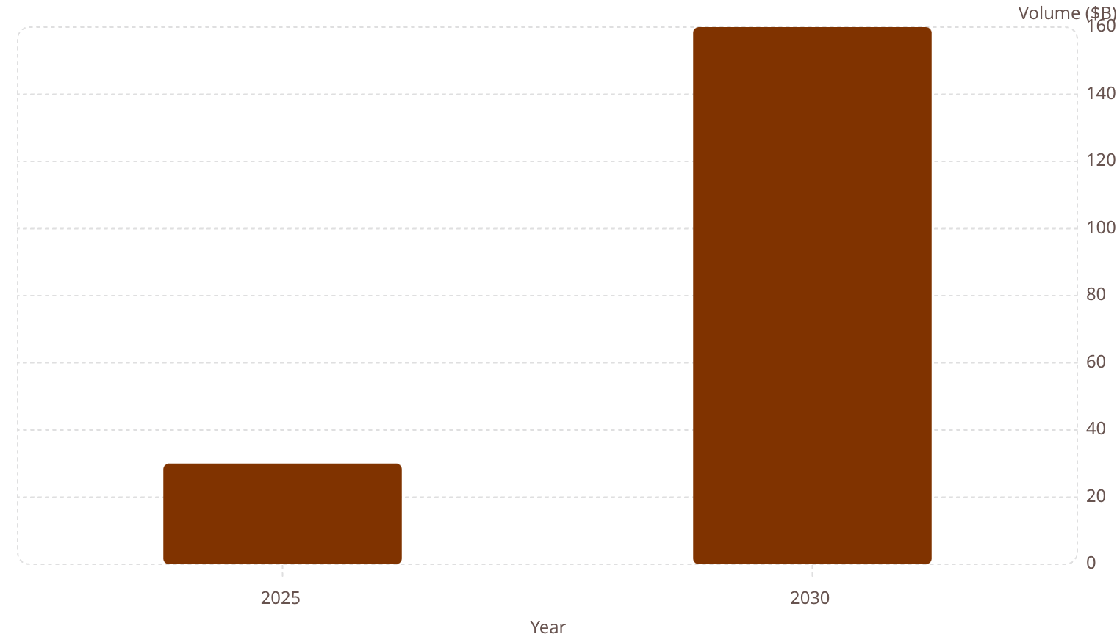
Market Opportunity
$17.9B Monthly. Growing 9x Year-On-Year.
Target Users
Traders needing alpha
Forecasters monetising skill
Allocators seeking exposure
Positioning: aiXBT for prediction markets

Slide 7
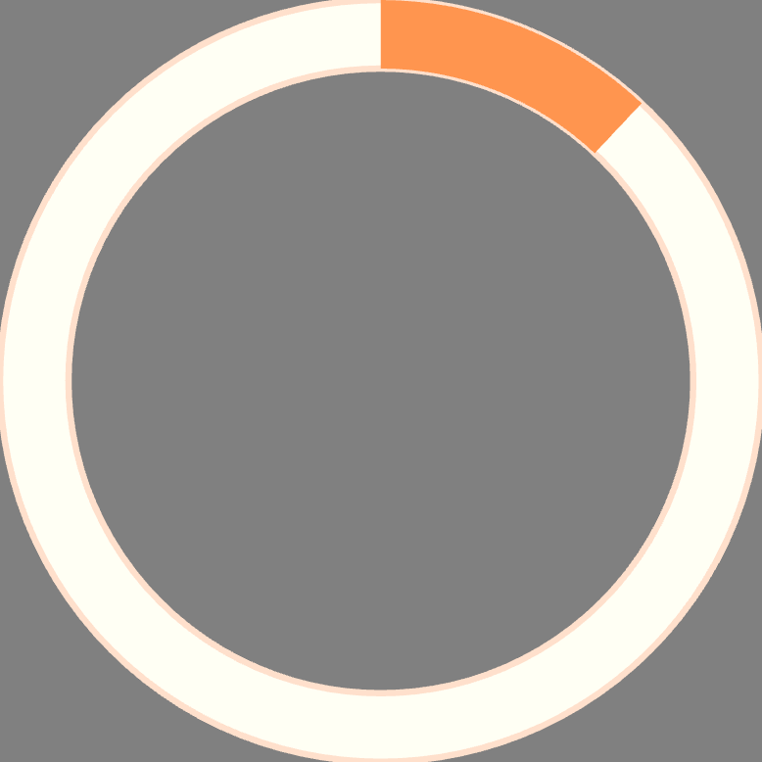
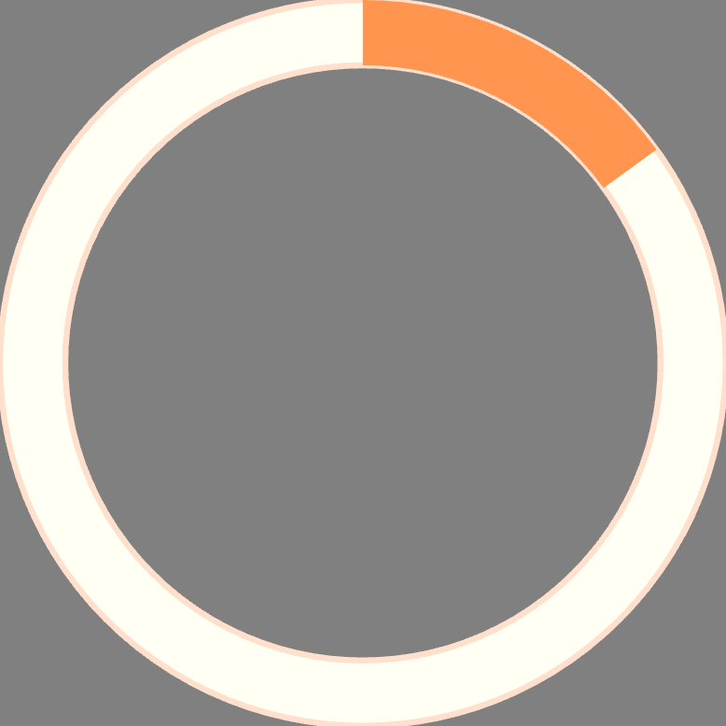

Business Model
Three Revenue Streams
SaaS Tiers
Protocol Fees
Data Licensing
Free · $9.99 Pro · $49.99 Whale
20% performance · 2% management
API to institutions
12:1
$15
$180
LTV:CAC Ratio
CAC
LTV
Unit economics
Customer acquisition
Lifetime value

Slide 8


Traction
Live on Solana Mainnet
01
Swipe UI
Live
02
Multi-Agent Terminal
Live
03
Jupiter Integration
Production
04
Staking Contracts
Deployed
Growth Channels
Twitter alpha dissemination
Competitions and leaderboards
Viral prediction cards

Slide 9

Roadmap
1
Now
Swipe + Terminal + Jupiter live
2
Q3 2026
Staking pools · Mobile app · API
3
Q4 2026
Reputation aggregation · Governance token
4
2027
Enterprise · Global expansion

Slide 10
Team & Ask
Team
Crypto/AI/Prediction markets background
Superteam hackathon experience
Raising: Seed Round
60%
25%
15%
Engineering
Growth
Operations
"The winners build the intelligence layer that makes forecasting skill tradeable. BeRight is that layer."
Demo: beright.ai | Twitter: @beright_ai

