Slide 1


Multi-Class Animal Recognition for wildlife conservation - AI
NAME : MAMILLA SHIVA KRISHNA
AICTE ID : INTERNSHIP_173855432067a03bd0ddfb6

Slide 2

Learning Objectives
Use of CNN model / Architecture w.r.t Animal Recognition.
Learn to use mobileNETV2.
Explore and built the model for 90 Animal class recognition.
Accuracy for Analysed.
Understand real world application, conquering , monitoring and
surveillance of wildlife.
Leveraging GPU acceleration for faster model training.
Applying transfer learning with a pre-trained CNN (MobileNetV2)
to improve training efficiency and accuracy.
GOAL

Slide 3
Tools and Technology used
Kaggle Hub - Used to download datasets directly from Kaggle.
Env:- google colab
Python:- programming language
NumPy:- For numerical operations and array handling.
Matplotlib, Seaborn :- for visualizing data
TensorFlow & Keras:- Used for building and training
Scikit-learn :- For evaluation metrics
Pretrained model:- Mobile Net-V2 , CNN model
GPU Acceleration: The code includes GPU configuration to accelerate training.

Slide 4
Methodology
Data collection/ Dataset Acquisition
Data Preprocessing/ processed the data
Model Selection
Transfer Learning Setup
Model Compilation
Model Training
Model Evaluation
Hardware Optimization / Testing

Slide 5
Problem Statement:
1. How can we accurately classify images of 90 different animal species using deep learning techniques?
2. Can transfer learning with MobileNetV2 improve animal image classification performance on a diverse dataset?
3. What is an efficient way to build a multi-class image classifier for animal species using limited labeled data?

Slide 6
Solution:
We used a deep learning model based on MobileNetV2 and trained it on a dataset of 90 animal species. The model leveraged powerful feature extraction and achieved high accuracy in multi-class classification.
Yes, by applying transfer learning with MobileNetV2, we reused pre-trained weights from ImageNet, reducing training time and improving classification performance, even with limited data.
We used image augmentation and a pre-trained MobileNetV2 model to efficiently train a classifier that generalizes well on unseen animal images, despite limited labeled samples.

Slide 7
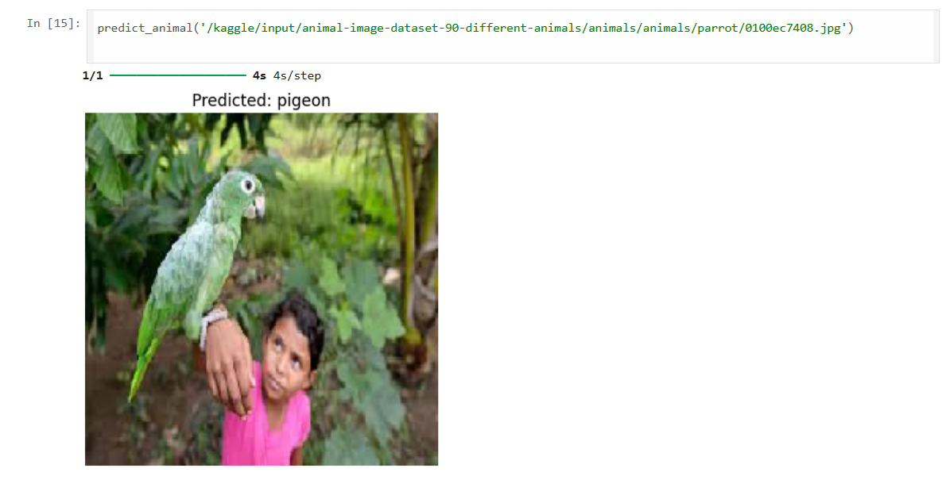
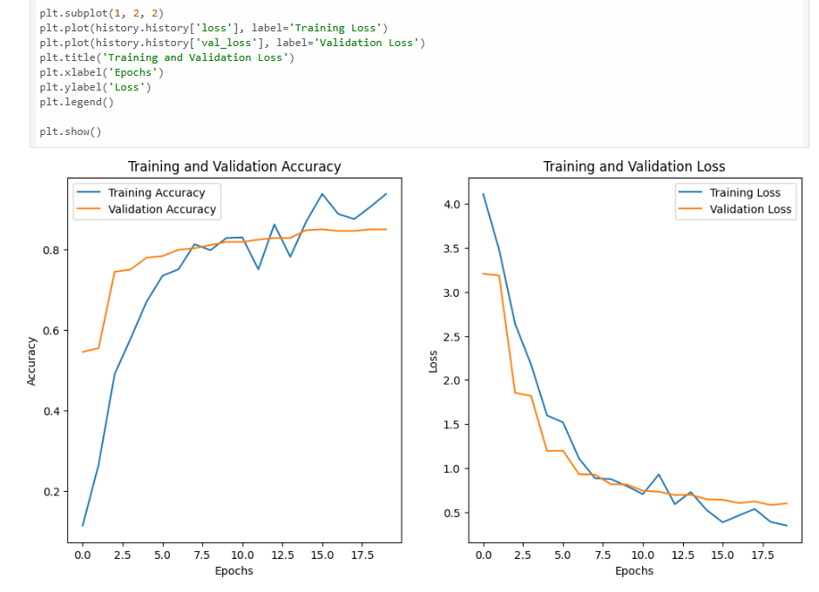
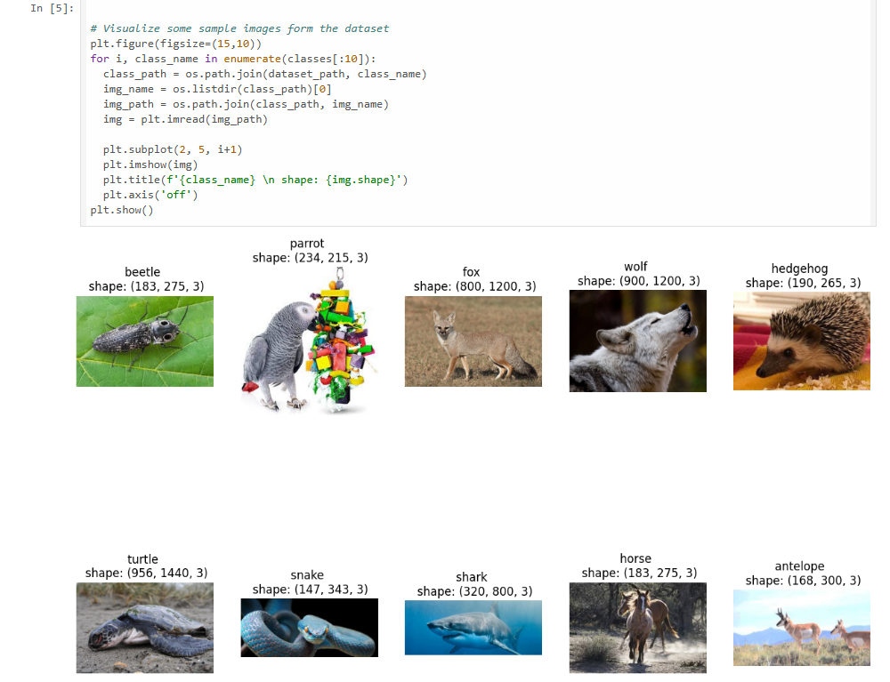
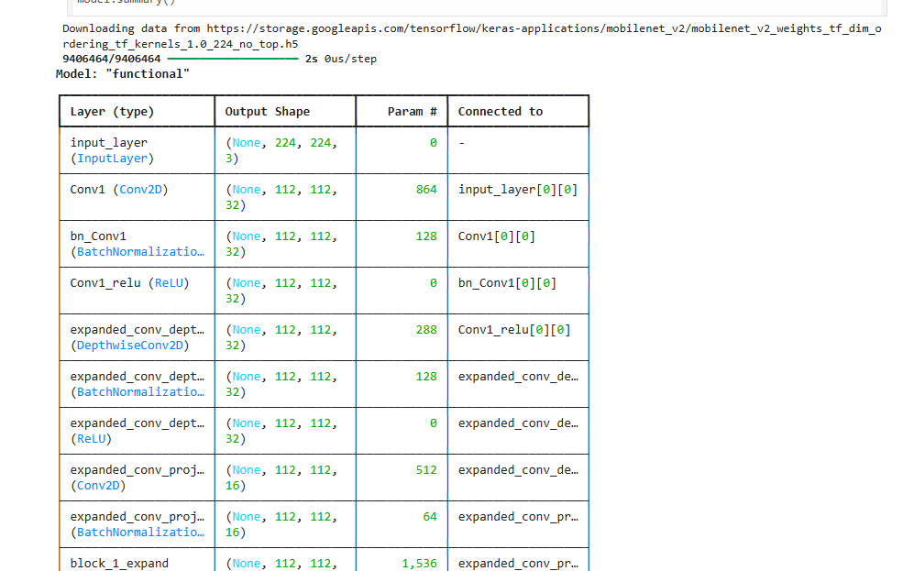
Screenshot of Output:

Slide 8
Conclusion:
In this project, we successfully developed (accuracy 86%) an image classification model capable of recognizing 90 different animal species using transfer learning with MobileNetV2. By leveraging a pre-trained model and applying data augmentation techniques, we achieved efficient training and strong classification performance, even with limited labeled data. The approach demonstrated that deep learning, combined with transfer learning, is a powerful solution for complex multi-class image recognition tasks and can be extended to similar real-world applications in wildlife monitoring and biodiversity research.
Git-Hub:-
https://github.com/shivamamilla7569/Final-project-submission-week3.git
Model link:-
https://drive.google.com/file/d/1pRfbMTJjJu9e_-dGFNH4sIQehXa0gv2J/view?usp=sharing

