Slide 1
Problem Statement
The problem statement is to predict the outcome of a cricket match between India and any given country.
We would be taking as input,
Opposition team
Venue
Country Venue
Team batting First
Day-Day/night
Given above inputs, our target is to predict which team will emerge as a winner in a 50 overs ODI match.

Slide 2
Motivation
India is a cricket crazy nation, where people are often found predicting the outcomes of a match whether its IPL, World Cup or bilateral series. But these predictions are based mostly on intuition and emotions.
Betting industry has grown manifold, with cricket being a major part of it. Betting sites like www.bet365.com.au have become common platform for bookies and punters. Predicting the outcomes of sporting events based on a computer driven process will benefit both.

Slide 3
Data Collection
Dataset was collected from website www.howstat.com.au/cricket/home.asp
We scrapped following data:
Match-wise performance of Indian team
March-wise performance of opposition team against India
Venue of each match
Day-Day/Night
Toss

Slide 4
Techniques/Approaches
OLD APPROACH: We used following parameters as features, Average runs scored by India, Average runs scored by India in last 10 matches , Venue , Average runs scored by India against a particular opposition, Average runs scored in last 10 matches against a particular opposition, Average runs scored by a opposition against India, Day-Day/Night, Toss. The model developed using these features had an MSE of around 45%.
NEW TECHNIQUE: We introduced new features which are as follows:
Win percentage overall, in last 10 matches, against an opposition, in last 10 matches against an opposition
Win percentage batting 1st /2nd
In venue, we introduced a new level, country venue. This will help in prediction when a match is played on a new ground.

Slide 5
Features vs MSE

Slide 6
Challenges
Due to unavailability of ready made dataset for this project, we had to employ some technique to the desired data from websites. The choice of website was not easy as many websites did not have the link to all matches in one webpage. We selected www.howstat.com.au/cricket/home.asp because of simplicity.
Initially, we tried to get the data manually, but it was very time consuming and inhuman task. So, we switched to data mining techniques to get the desired data from websites. 2 python scripts were used, one to get the URL of of each match and other to get the raw data from these URLs. BeautifulSoup, a package in python to handle html, was put to use.
Feature Extraction: Difficulty to decide which features to take in order to minimize MSE.

Slide 7
Results

Slide 8
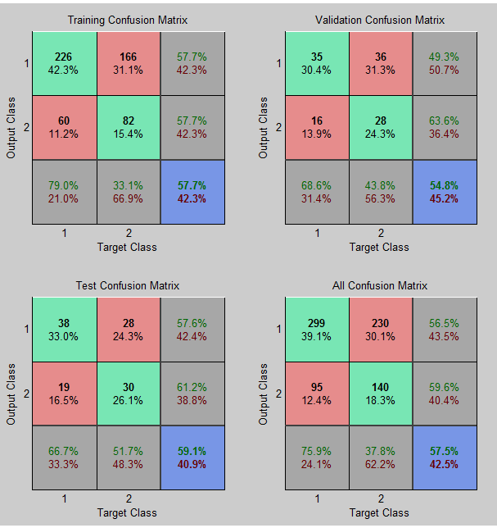
Confusion Matrix
Diagonal Elements correspond to correct prediction

Slide 9
Conclusion
As with all sports, the games are played on the field and are not simply simulations based on statistics. One can never expect perfect predictions. However, this project has demonstrated that machine learning techniques can produce results of significant quality.
For further improvement on MSE, we can include individual player performance of each team and their current form. We can also include another level in venue, continent level. This has a major effect as pitches in sub-continent are completely different than those of English or Australian pitches.

Slide 10
Study Done
After reading the papers and reports related to game result prediction we found out answers to few of the basic questions listed below:
How to get data and to code in which language?
After extensive research we found that best way to get the desired data was by scraping the webpages from cricket websites like cricinfo.com, howstat.com etc.
Many had preferred python as their coding environment because of the extensive availability of mathematical and machine learning libraries. So, we also opted python and used BeautifulSoup, a package in python to handle HTML files.

Slide 11
Which features to select? Feature extraction from data and data analysis.
Most of the papers we read dealt with the predicting the outcome of a football match. The features selected in the papers were generally the form of the teams and the head-to-head record (previous matches between the two teams). In these few papers general match statistics such as ball possession, shots on goal and fouls committed were considered.
Few papers dealt with the performance of individual players for the team, playing position of some specific players was also analyzed.
So, with this study we decided to use Concept of runs conceded etc. Overall form of team, current form of team(last 10 match)

Slide 12
Many people implemented multi-class classifier as there are three classes for the result to be classified into (home win, draw, and away win)as opposed to a binary classifier that can only classify instances into two classes.
But as opposed to football, the odds of a tie or a draw are very low in cricket, therefore we haven’t considered draw as one of the outcomes of our predictor, which further helped in simplification of our model. Now we required only a binary classifier
Which method to use and which algorithm?
Almost all of the papers had implemented multiple machine learning methods to create and test their prediction model e.g. neural networks, linear regression, support vector classifier, random forest classifier etc. Best MSE corresponding to a method varied from paper to paper. Although majority showed that neural networks gave best results

Slide 13
We decided to deploy techniques like Neural networks, Random forest classifier and support vector classifier.
Random Forest Classifier and SVC were deployed in python whereas, Neural networks was deployed in MATLAB.
What to add for improvement/Future work?
For future work all the papers aimed at increasing the nos. of features by taking into account other minute details which influence the match outcome to increase the prediction power of their model. Some have decided to put their prediction engine to commercial use and make some money.
For further improvement on MSE, we aim to include individual player performance of each team and their current form. We are also thinking to add draw or a tie as the third outcome. The influence of weather conditions on a match can also being pondered upon.

Slide 14
References
“Predicting Fantasy Football - Truth in Data”, Matt Bookman,December 14, 2012
“Predictions and Rankings in College Football”,Dennis Qin,10th December 2009
“Predicting Fantasy Football Performance with Machine Learning Techniques”, Nitin Kapania
K.-Y. Huang and W.-L. Chang, “A neural network method for prediction of 2006 world cup football game,” in Neural Networks (IJCNN), The 2010 InternationalJoint Conference on, July 2010,pp. 1 –8.
R.-K. Balla, “Soccer match result prediction using neural networks,” Aug 2007.
“CricAI: A Classification Based Tool to Predict the Outcome in ODI Cricket”,Amal Kaluarachchi, Aparna S. Varde,Department of Computer Science,Montclair State University, Montclair, NJ, USA
A. Joseph, N. E. Fenton, and M. Neil, “Predicting football resultsusing bayesian nets and other machine learning techniques,” Know.-Based Syst., vol. 19, pp. 544–553, November 2006. [Online]. Available:http://dl.acm.org/citation.cfm?id=1222216.1222263
“A Neural Network Method for Prediction of 2006 World Cup,Football Game”,Kou-Yuan Huang, Senior Member, IEEE and Wen-Lung Chang
J. Hucaljuk and A. Rakipovic, “Predicting football scores using machine learning techniques,” in MIPRO, 2011 Proceedings of the 34th International Convention,May 2011, pp. 1623–1627.
A. Joseph, N. E. Fenton, and M. Neil, “Predicting football results using bayesian nets and other machine learning techniques,” 2005.[Online].Available: http://www.dcs.qmw.ac.uk/norman/papers/Spurs-2.pdf

