Slide 1
Real Estate Price Analysis
14,223
property listings analysed
Python data analysis with pandas, matplotlib and seaborn
Shivam · Delhi Technological University

Slide 2
Project overview
1
2
3
Objective
Data
Tools
Understand what drives property prices in Gurugram: which localities, property types and builders are costliest, and whether RERA, status or size add a premium.
14,223 listings × 12 columns (price, area, locality, BHK, RERA, builder and more) from clean_data.xlsx, with no missing values after cleaning.
Python with pandas and numpy for analysis; matplotlib and seaborn for charts; Excel for the cleaned dataset.

Slide 3
About the dataset: 12 columns
Column | Type | Meaning
price | int | Property price (₹)
status | text | Ready to move / under construction
area | int | Size in sqft
rate_per_sqft | int | Price per sqft (₹)
property_type | text | Type of property
locality | text | Neighbourhood
Column | Type | Meaning
builder_name | text | Builder
rera_approval | bool | RERA approved or not
bhk_count | int | Number of BHK
society | text | Society / project name
company_name | text | Company
flat_type | text | Apartment / Floor / Plot/Villa/Penthouse/Houses
14,223 rows · no missing values · 1 bool, 4 int, 7 text columns

Slide 4
10 questions we answer
1
Costliest flat
6
Area vs price
2
Highest avg price by locality
7
BHK vs rate
3
Highest rate per sq feet by locality
8
Costliest Property type
4
Is ready-to-move property more costlier than under-construction property
9
Higher prices of Builders / companies
5
RERA premium
10
Area vs rate

Slide 5
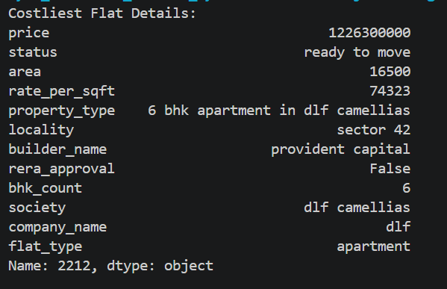
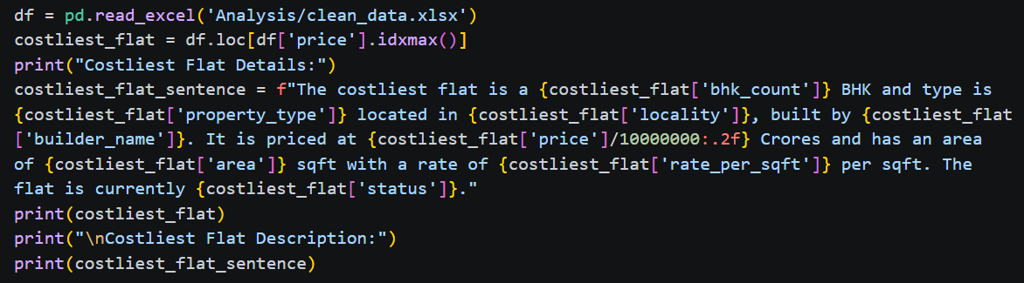
Q1. Which is the costliest flat in the dataset?
PYTHON CODE
OUTPUT / CHART
ANSWER
The costliest flat is a 6 BHK and type is 6 BHK apartment in DLF camellias located in sector 42, built by provident capital. It is priced at 122.63 Crores and has an area of 16500 sq-feet with a rate of 74323 per sq-feet. The flat is currently ready to move.

Slide 6
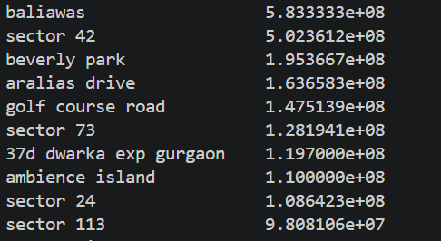
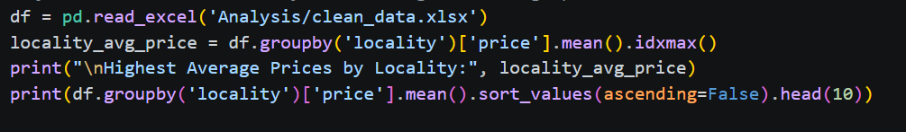
Q2. Which locality has the highest average price?
PYTHON CODE
OUTPUT / CHART
ANSWER
Highest Average Prices by Locality in baliawas

Slide 7
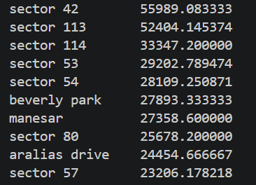
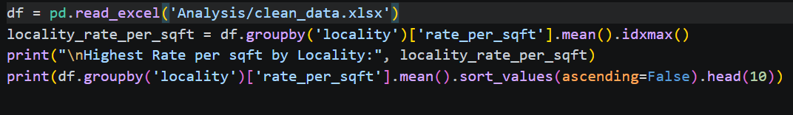
Q3. Which locality has the highest rate per sqft?
PYTHON CODE
OUTPUT / CHART
ANSWER
Highest Rate per square feet by Locality is sector 42

Slide 8
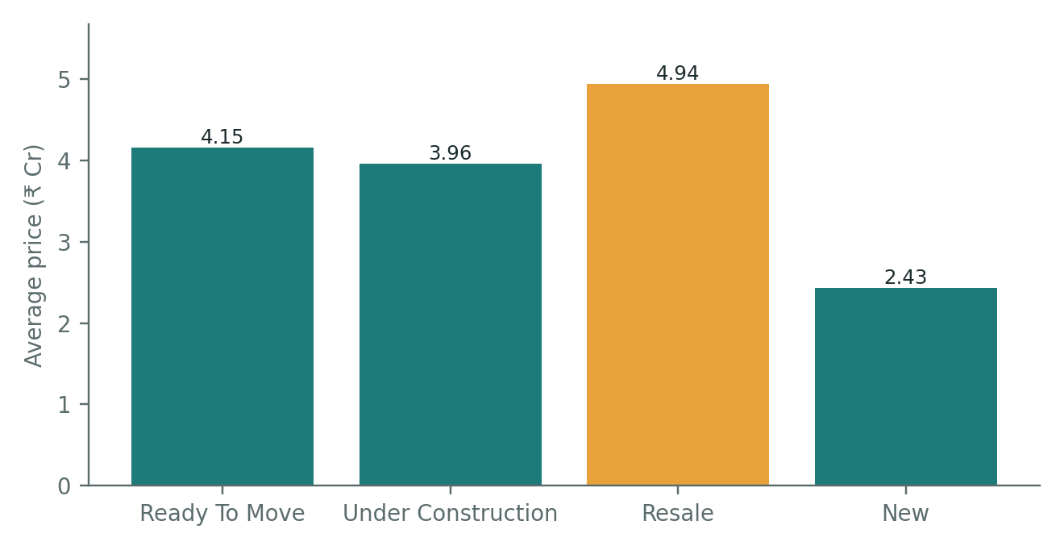
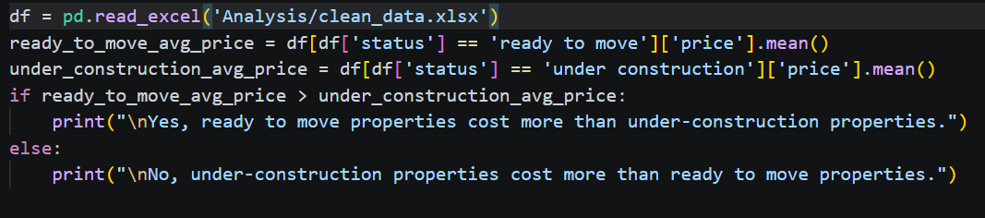
Q4. Do ready to move properties cost more than under-construction ones?
PYTHON CODE
OUTPUT / CHART
ANSWER
Yes, ready to move properties cost more than under-construction properties.

Slide 9
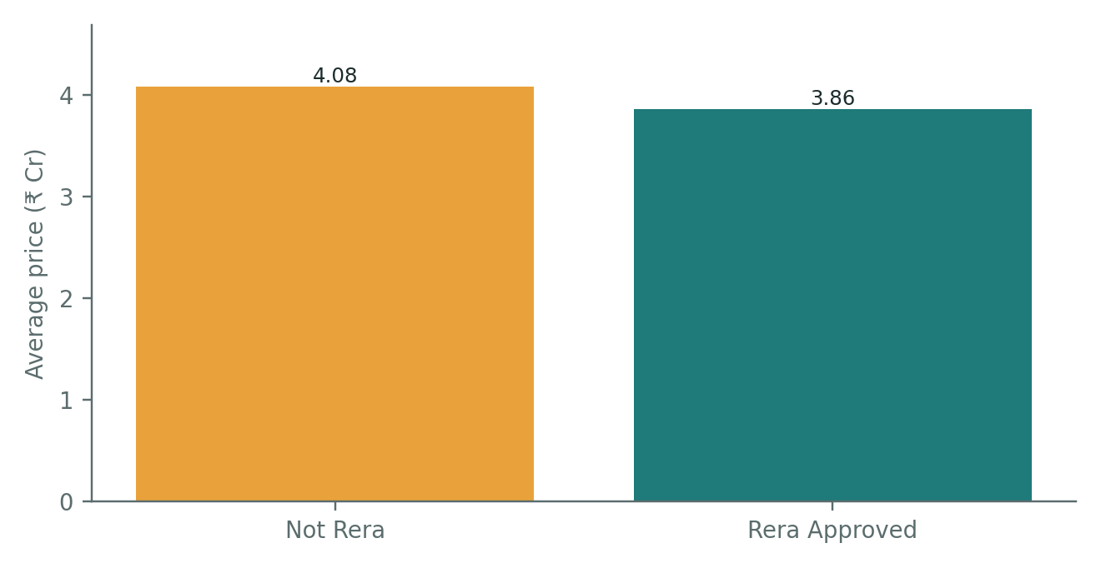
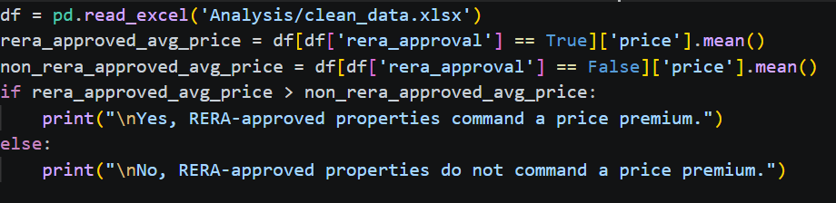
Q5. Do RERA-approved properties command a price premium?
PYTHON CODE
OUTPUT / CHART
ANSWER
No, RERA-approved properties do not command a price premium.

Slide 10
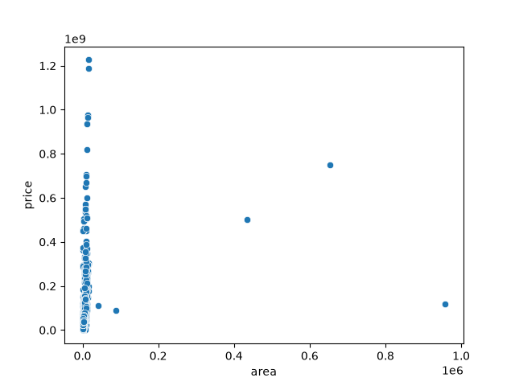
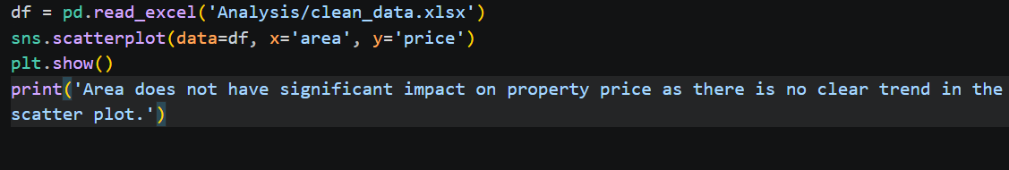
Q6. How does area (sqft) impact property price?
PYTHON CODE
OUTPUT / CHART
ANSWER
Area does not have significant impact on property price as there is no clear trend in the scatter plot..

Slide 11
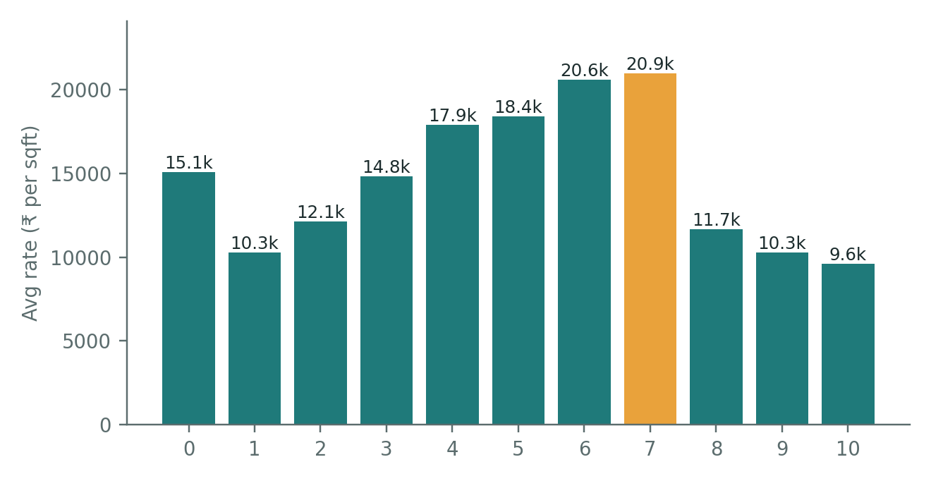
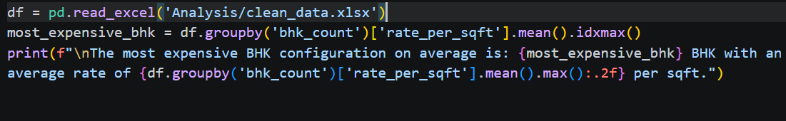
Q7. Which BHK configuration is the most expensive per sqft?
PYTHON CODE
OUTPUT / CHART
ANSWER
The most expensive BHK configuration on average is: 114 BHK with an average rate of 33347.20 per square feet.

Slide 12
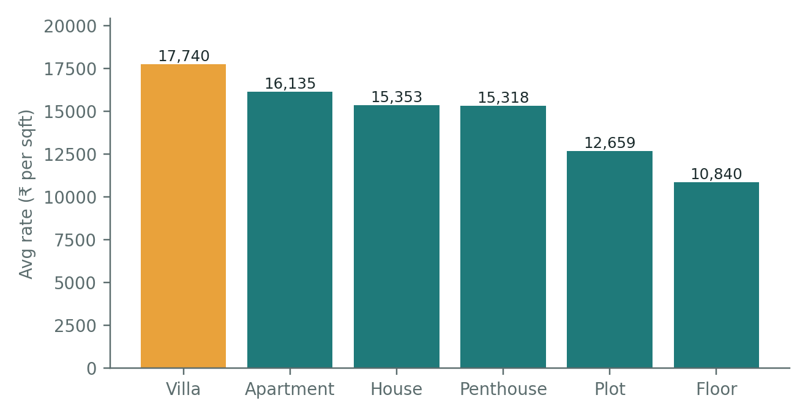
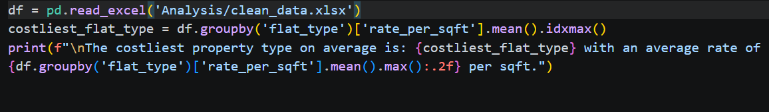
Q8. Which property type (Apartment, Floor, Plot) is the costliest?
PYTHON CODE
OUTPUT / CHART
ANSWER
The costliest property type on average is villa with an average rate of 17740.21 per square feet.

Slide 13
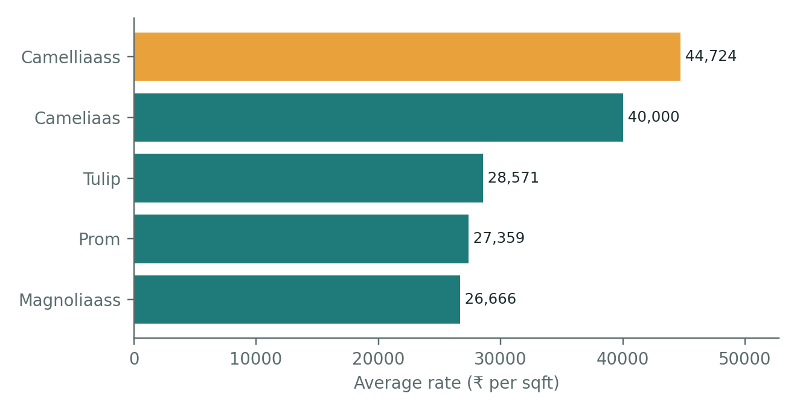
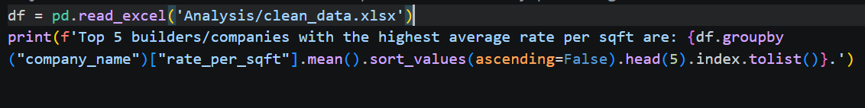
Q9. Do certain builders or companies consistently price higher?
PYTHON CODE
OUTPUT / CHART
ANSWER
Top 5 builders/companies with the highest average rate per sqft are: ['camelliaass', 'cameliaas', 'tulip', 'prom', 'magnoliaass'].

Slide 14
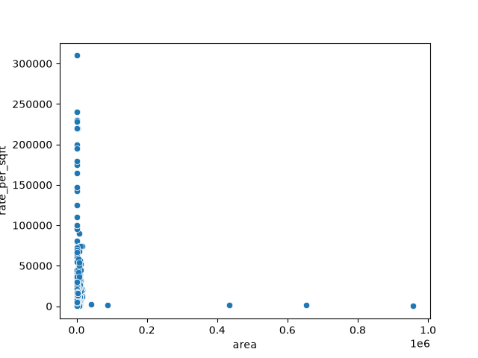
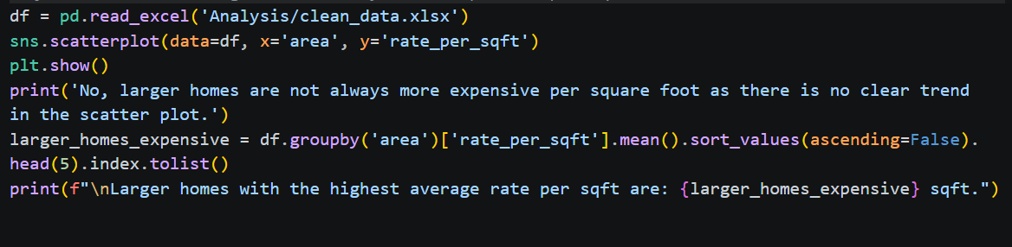
Q10. Are larger homes always more expensive per square foot?
PYTHON CODE
OUTPUT / CHART
ANSWER
No, larger homes are not always more expensive per square foot as there is no clear trend in the scatter plot.
Larger homes with the highest average rate per square feet are: [208, 204, 263, 173, 267] square feet.

Slide 15
Key findings at a glance
# | Topic | Finding
1 | Costliest flat | 6 BHK in DLF Camellias, Sector 42: ₹122.63 Cr
2 | Locality by price | Baliawas (₹58.3 Cr, 3 listings); Sector 42 next at ₹50.2 Cr
3 | Locality by rate | Sector 42: ₹55,989/sqft; Sector 113 next at ₹52,404
4 | Status vs price | Yes, slightly: ₹4.15 Cr vs ₹3.96 Cr
5 | RERA premium | No: RERA ₹3.86 Cr vs non-RERA ₹4.08 Cr
6 | Area vs price | Yes, positive link (≈ 0.63 after removing 5 area outliers)
7 | BHK vs rate | 7 BHK at ₹20,946/sqft (114 BHK rows are plot data errors)
8 | Property type | Villa per sqft (₹17,740); penthouse by total price (₹13.8 Cr)
9 | Builders / companies | Yes: Camelliaass, Cameliaas and Tulip lead (₹28k–45k/sqft)
10 | Area vs rate | No: area and rate per sqft are barely correlated (≈ 0.08)

Slide 16
Conclusion and next steps
What we learned
Next steps
Price is driven by location and size, not RERA status. Sectors 42 and 113 command the highest rates, villas lead per sqft, and ready-to-move homes cost slightly more than under-construction ones.
Merge spelling variants of company names. Then build a price prediction model and compare with more cities.
Thank you · Questions?

