Slide 1
DEPARTMENT OF ARTIFICIAL INTELLIGENCE & DATA SCIENCE | ACADEMIC AUDIT
Semester IV Academic Result Analysis &
Machine Learning Student Segmentation
An End-to-End Investigation of University Gazette Outcomes, Core Subject Bottlenecks,
Competency Correlation Drivers, and 4-Cluster K-Means Behavioral Personas
• Cohort Size: 88 Students • Curricular Features: 113 Features • Verification: 100% Mathematical Parity
Department of Artificial Intelligence & Data Science | Semester IV Academic Result Analysis & K-Means Segmentation
01 / 20

Slide 2
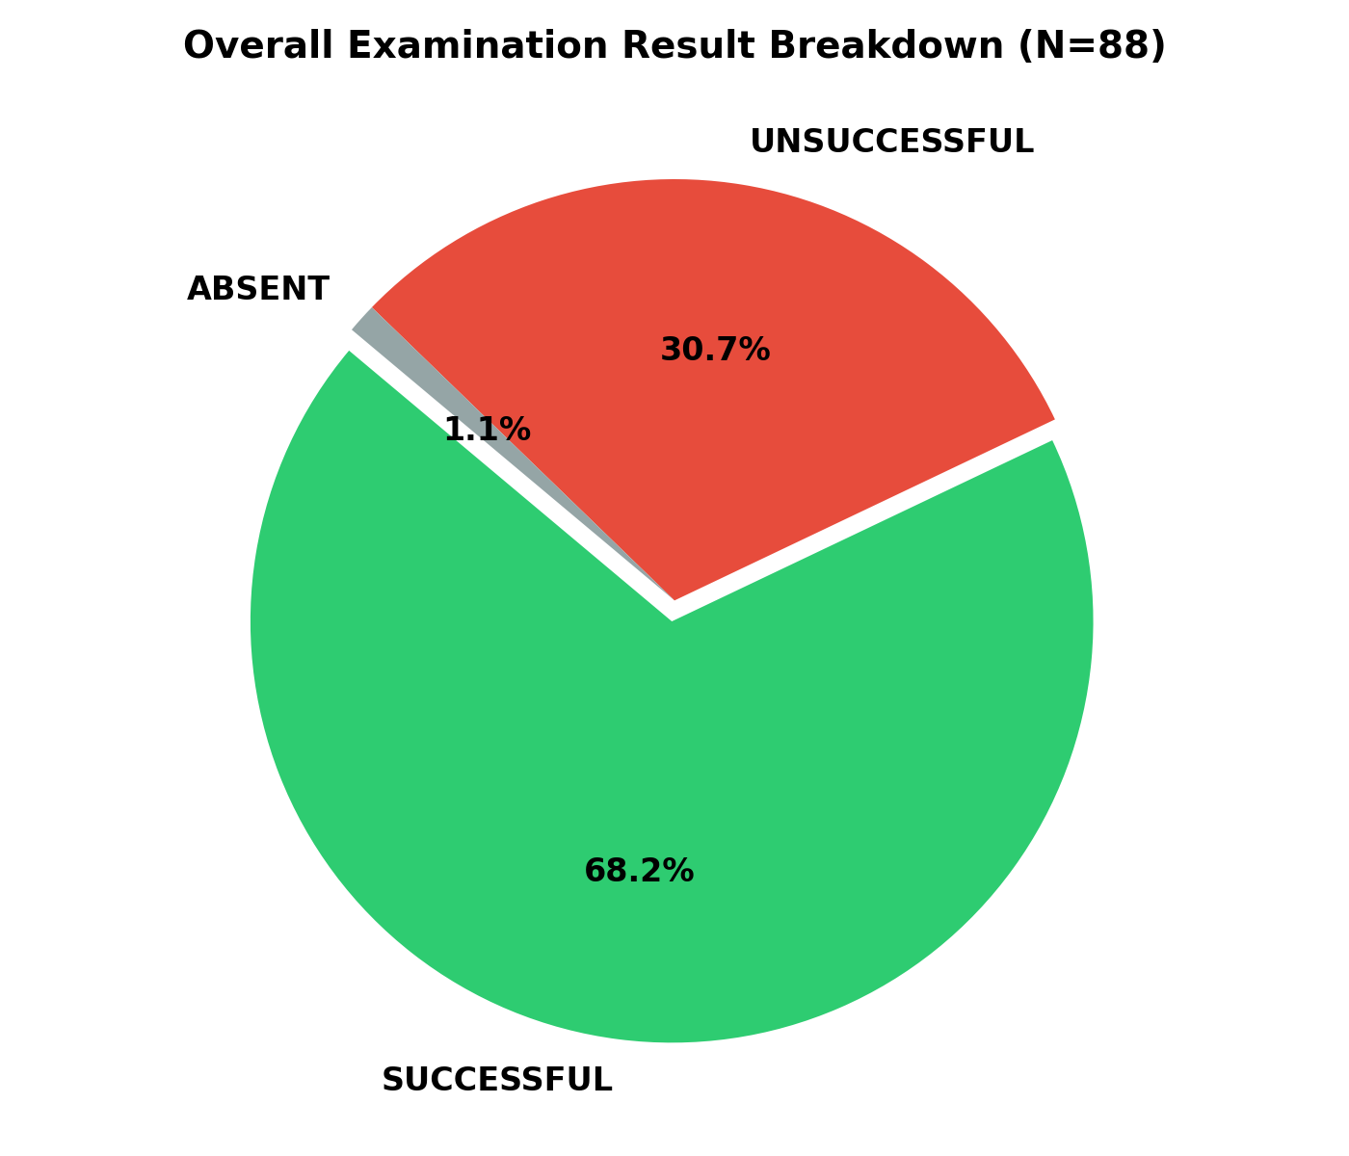
EXECUTIVE SUMMARY
Semester IV Academic Performance at a Glance
Holistic synthesis of cohort examination metrics, clearance rates, and distinction outcomes
88
Registered Students
Full university gazette cohort
68.18%
Overall Pass Rate
60 Clear | 27 ATKT | 1 Absent
7.55
Mean SGPI (Passing)
Median 7.43 | Cohort std 0.74
9.13
Top Academic Score
Shivam Bandekar (85.55% agg)
Key Cohort Observations
• Healthy Passing Bell Curve: Passing candidates form a robust distribution with 18 distinction performers achieving SGPI >= 8.00 (20.5% of total class).
• Asymmetric Assessment Risk: Theoretical external examinations represent 100% of academic backlogs, whereas laboratory and internal term-work achieve >98% clearance.
• High Foundational Competence: Over 76% of students fall into High Achiever or Solid Performer segments, demonstrating strong overall technical aptitude.
• Identified Remedial Cohort: 21 students (23.9%) experience chronic difficulty across multiple theory examinations, requiring structured mid-term intervention.
Department of Artificial Intelligence & Data Science | Semester IV Academic Result Analysis & K-Means Segmentation
02 / 20

Slide 3
CURRICULUM ARCHITECTURE
Examination Structure & Master Dataset Schema
Official University evaluation scheme across 11 credit courses, credits, and verification standards
Core Theory Papers (100M)
CT: Computational Theory
3 Credits | 80 Ext + 20 Int
DBMS: Database Management Systems
3 Credits | 80 Ext + 20 Int
OS: Operating Systems
3 Credits | 80 Ext + 20 Int
FTS: Fundamentals of Telecom Systems
3 Credits | 80 Ext + 20 Int
OE: Chhatrapati Shivaji Maharaj Policy
2 Credits | 60 Ext + 15 Int
Laboratories & Term Work (50M)
DBMS LAB: Database Systems Lab
1 Credit | 25 TW + 25 Oral/Prac
OS LAB: Operating Systems Lab
1 Credit | 25 TW + 25 Oral/Prac
TC LAB: Telecommunication Lab
1 Credit | 25 TW + 25 Oral/Prac
MINIPROJ: Mini Project 2A
2 Credits | 25 TW + 25 Oral/Prac
BMD: Business Model Development
1 Credit | 25 TW Continuous
DT: Design Thinking Workshop
2 Credits | 50 TW Continuous
Gazette Quality Audit (100%)
✓ Zero Duplication: Verified 88 unique student records, 0 duplicate seat numbers or names.
✓ Formula Parity: Total credits (aC = 23) and weighted grade points (aCG) match university formula SGPI = aCG/aC with 0 residual discrepancy.
✓ Component Completeness: Every internal, external, term-work, oral, and grade code rigorously captured across 113 dataframe columns.
✓ Status Classification: Distinct separation of successful passers (P), unsuccessful backlog holders (F), and official absent cases (A).
Department of Artificial Intelligence & Data Science | Semester IV Academic Result Analysis & K-Means Segmentation
03 / 20

Slide 4
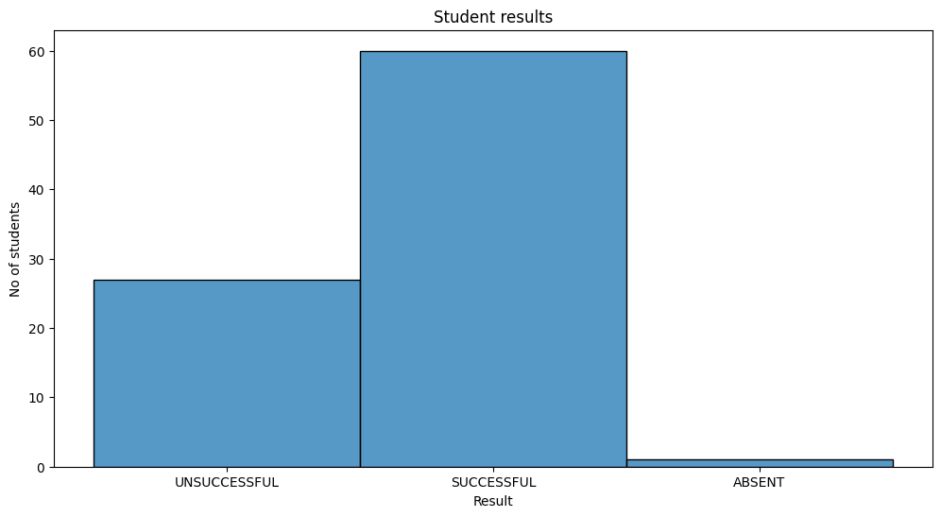
RESULT BREAKDOWN
Clearance Status & Backlog (KT) Severity Distribution
Granular examination of successful students, single-subject backlogs, and multi-subject failure clusters
Result Category Distribution
• Successful (Clear Pass) : 60 Students (68.18%)
• Unsuccessful (ATKT / Backlog) : 27 Students (30.68%)
• Absentee (Zero Attendance) : 1 Student (1.14%)
Backlog Severity Distribution (28 Students)
• Isolated Backlog (1 Subject): 6 Students (6.8%) — DBMS theory or OS theory; easily recoverable
• Moderate Backlog (2 Subjects): 6 Students (6.8%) — Dual theory failure (CT + OS or DBMS + OS)
• Severe Backlog (3 - 5 Subjects): 8 Students (9.1%) — Multiple core deficits; requires intensive remediation
• Critical / Terminal (6 - 11 Subjects): 8 Students (9.1%) — General academic collapse or official absenteeism
Department of Artificial Intelligence & Data Science | Semester IV Academic Result Analysis & K-Means Segmentation
04 / 20

Slide 5
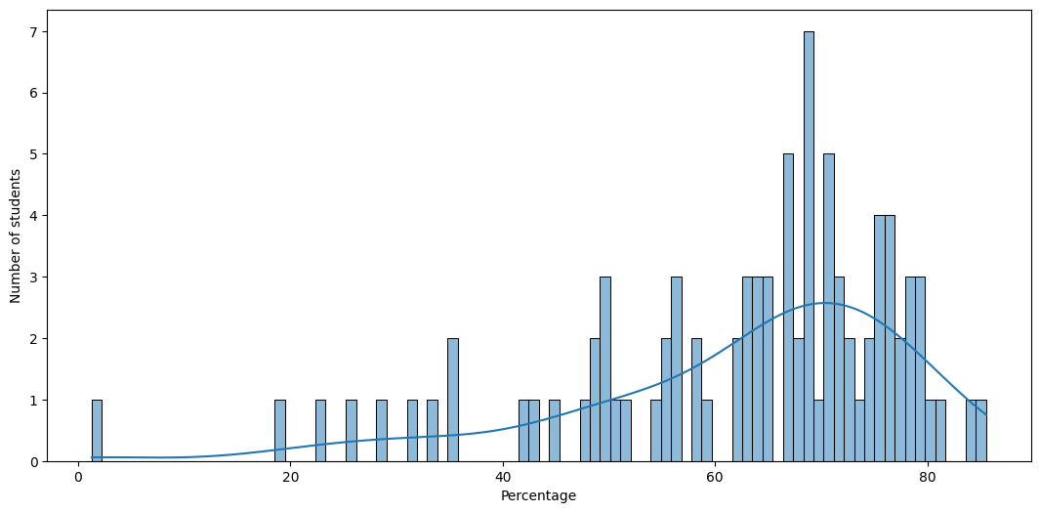
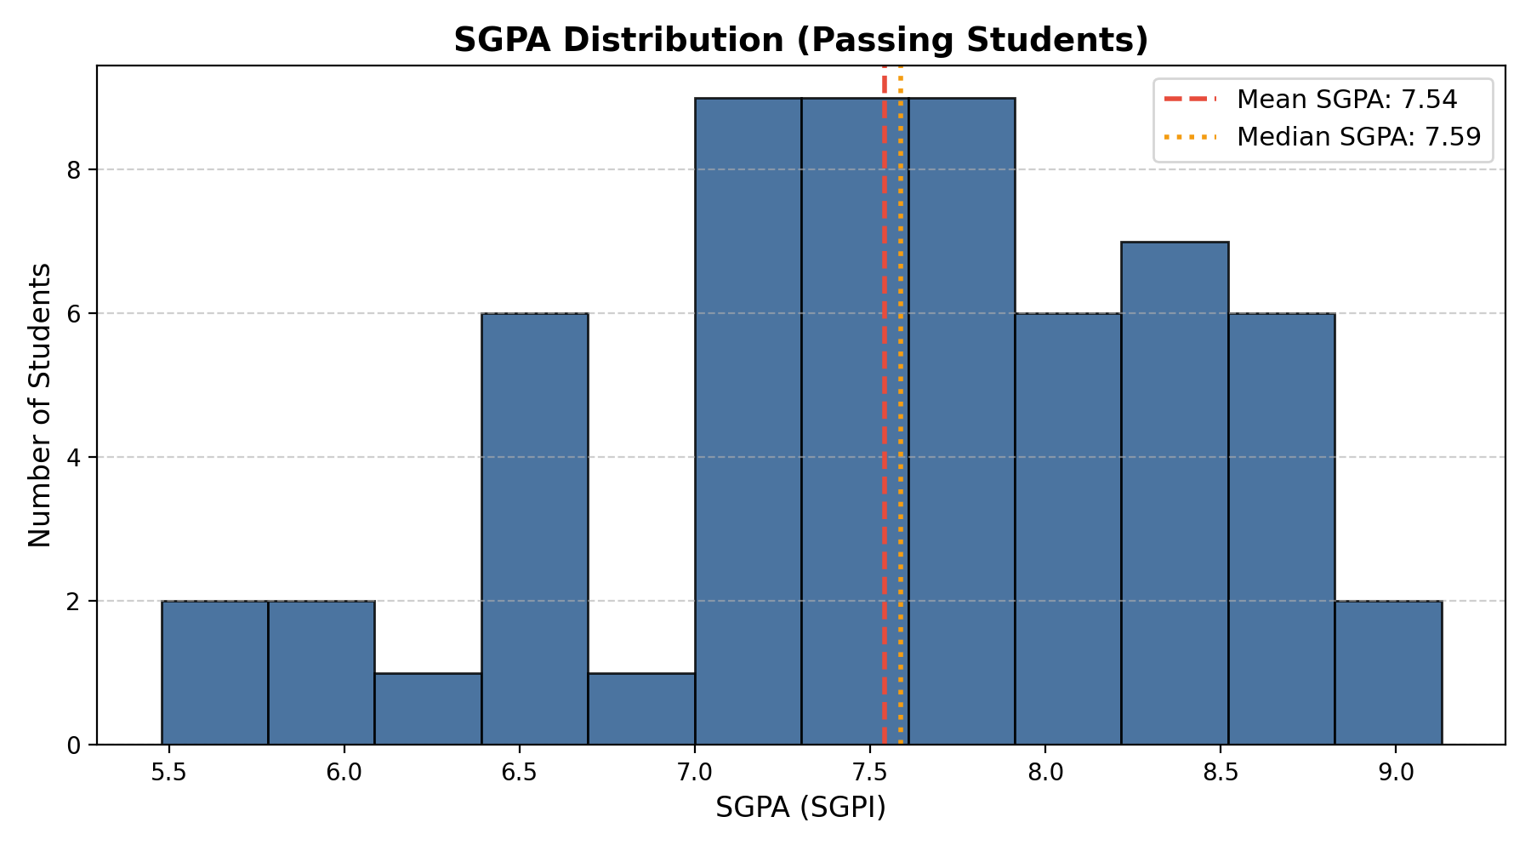
COHORT DISTRIBUTIONS
Percentage & SGPI Statistical Spread
Kernel Density Estimations (KDE) demonstrating cohort dispersion, central tendencies, and distinction peaks
Distribution Dynamics & Statistical Parameters
• Aggregate Percentage Spread: Mean = 62.44%, Median = 66.91%, Standard Deviation = 16.14%. Passing students alone average 70.43%.
• Bimodal SGPI Characteristic: A natural bimodality exists where successful students form a smooth bell curve centered at 7.55 (range 5.48 to 9.13), while unsuccessful candidates default to 0.00 SGPI.
• Distinction Threshold (SGPI >= 8.00): 18 students (20.5%) achieved distinction status, demonstrating elite conceptual and applied proficiency.
Department of Artificial Intelligence & Data Science | Semester IV Academic Result Analysis & K-Means Segmentation
05 / 20

Slide 6
ACADEMIC EXCELLENCE
Class Toppers Leaderboard — Top 10 Rankers
High-achieving candidates with superior aggregate marks, consistent distinction grades, and SGPI >= 8.35
Rank | Seat No | Student Name | Total | Percentage | SGPI
#1 | 101410074 | SHIVAM VILAS BANDEKAR | 663 / 775 | 85.55% | 9.13
#2 | 101410932 | SHRAVANI VISHWAS MANE | 649 / 775 | 83.74% | 8.87
#3 | 101410070 | SAMIKSHA RAJENDRA BODAKE | 627 / 775 | 80.90% | 8.74
#4 | 101410061 | PRASAD KISAN BHAJNAWALE | 610 / 775 | 78.71% | 8.70
#5 | 101410052 | NAIK ARYAN UDAY | 619 / 775 | 79.87% | 8.65
#6 | 101410939 | MANGILAL SHRAVAN MALVIYA | 614 / 775 | 79.23% | 8.65
#7 | 101410084 | TEJAS JITENDRA SAWANT | 613 / 775 | 79.10% | 8.57
#8 | 101410024 | ADINATH SOMNATH JAGTAP | 616 / 775 | 79.48% | 8.52
#9 | 101410086 | UNNATI DINESH CHAVAN | 606 / 775 | 78.19% | 8.39
#10 | 101410049 | MAHANGADE OM VIJAY | 607 / 775 | 78.32% | 8.35
Topper Case Study
★ Shivam Vilas Bandekar (Rank 1): Secured an exceptional SGPI of 9.13 with 85.55% aggregate, outperforming 2nd rank by +1.81% and +0.26 SGPI.
★ Theory Excellence: Highest theory average in cohort (85.0%), demonstrating complete mastery across system architecture and mathematical foundations.
★ Gender Parity in Top 3: Female scholars hold 2 of the top 3 spots (Shravani Mane #2 at 8.87, Samiksha Bodake #3 at 8.74).
★ Cluster Alignment: All Top 10 rankers mapped directly into K-Means Cluster 0 (High Achievers / Academic Leaders) with 0.0 standard deviation in subject pass status.
Department of Artificial Intelligence & Data Science | Semester IV Academic Result Analysis & K-Means Segmentation
06 / 20

Slide 7
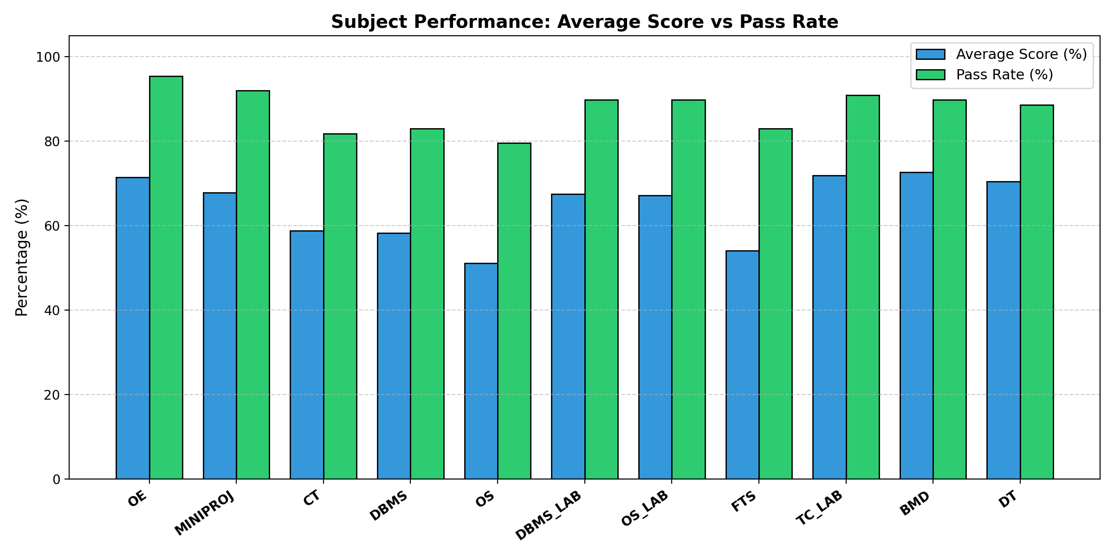
CURRICULUM DEEP-DIVE
Subject Performance & Difficulty Index Matrix
Course-by-course mean marks, pass percentages, and quantitative identification of curriculum bottlenecks
Subject Difficulty & Risk Hierarchy
• Operating Systems (OS) — Hardest Theory
Mean Total: 51.08 / 100 | Lowest theory score in cohort. External papers presented highest analytical friction with 12 KT failures.
• Database Management (DBMS) — High Failure Bottleneck
Mean Total: 58.23 / 100 | Despite a solid class average, DBMS generated 15 'F' grades in external theory—the highest single-course failure toll.
• Fundamentals of Telecom (FTS) — Moderate Friction
Mean Total: 54.13 / 100 | Theoretical concepts in communication systems created moderate hurdles for non-hardware aligned candidates.
• Computational Theory (CT) — Highest Theory Score
Mean Total: 58.86 / 100 | Outperformed all core theoretical courses, exhibiting high student engagement and top grade frequencies.
• Practical Labs & Coursework — Near 100% Clearance
DBMS Lab (33.76/50), OS Lab (33.56/50), MiniProj (50.89/75) demonstrated high term-work compliance and oral exam clearance (>98%).
Department of Artificial Intelligence & Data Science | Semester IV Academic Result Analysis & K-Means Segmentation
07 / 20

Slide 8
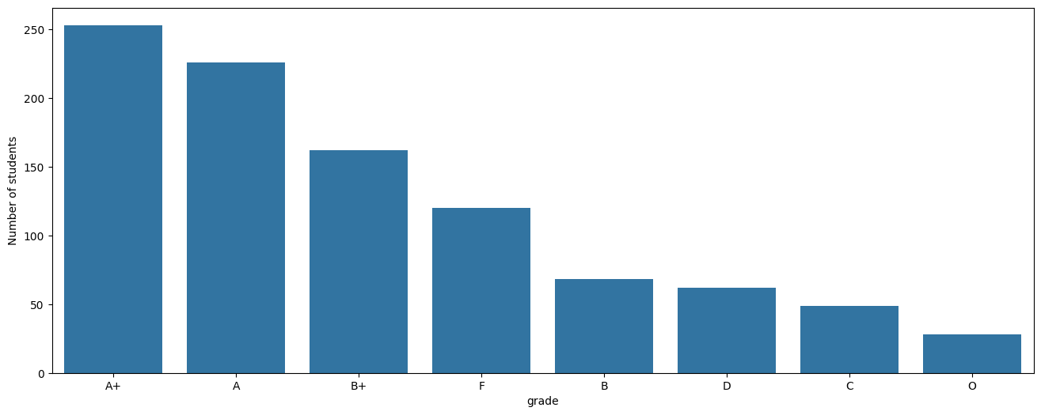
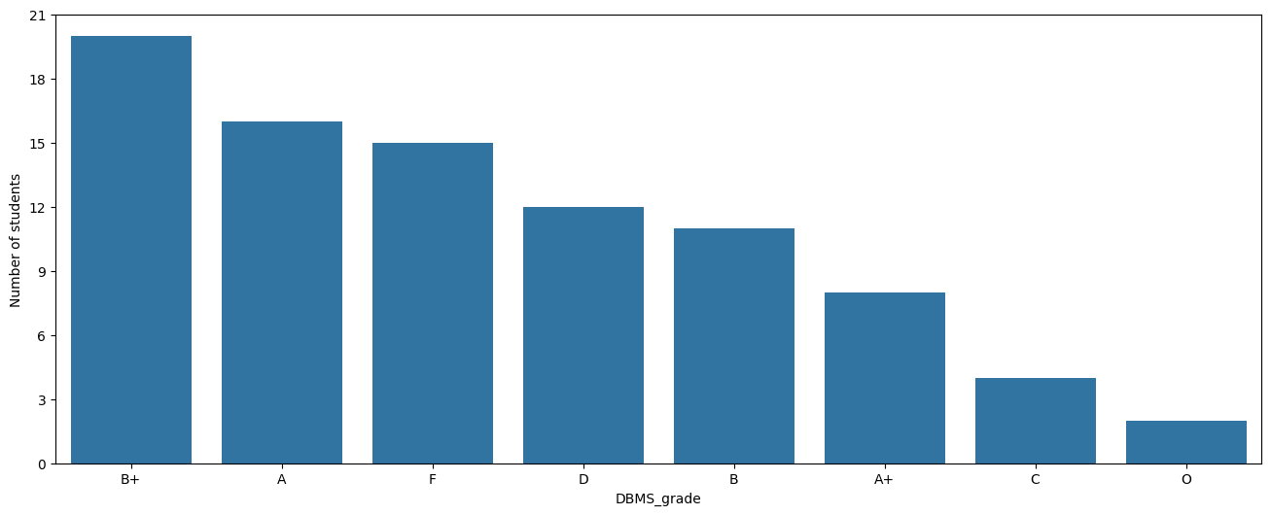
GRADE DISTRIBUTION ANALYSIS
Cohort Grade Frequencies Across All 11 Subjects
Distribution of letter grades (O, A+, A, B+, B, C, D, F) contrasting practical and theoretical courses
Key Grade Allocation Insights
• Laboratory Polarization: Practical labs exhibit an overwhelming concentration of 'O', 'A+', and 'A' grades (>85%), highlighting reliable practical execution across the cohort.
• Theory Spread in Core Tech: DBMS recorded 2 Outstanding (O), 8 A+, 16 A, 20 B+, 11 B, 4 C, 12 D, and 15 F grades—displaying the widest variance in academic outcomes.
• The 'D' Grade Accumulation Risk: Over 22% of passing students secured 'D' grades (pass threshold) in OS and CT external exams, representing borderline performers vulnerable in Sem V.
Department of Artificial Intelligence & Data Science | Semester IV Academic Result Analysis & K-Means Segmentation
08 / 20

Slide 9
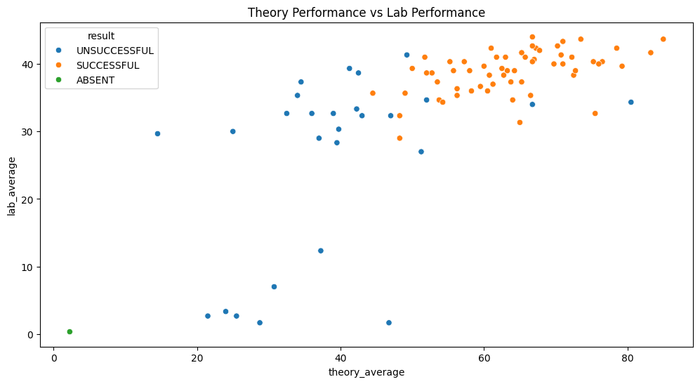
ASSESSMENT DISPARITY
Theory vs. Practical Competency Discrepancy
Empirical evidence of a 13.26 percentage point gap between high laboratory scores and written theory struggles
The 13.26 pp Competency Gap
• Mean Theory Percentage: 55.57%
Aggregate theory average across 5 major papers. Standard deviation is elevated (18.2%), driven by written external examination rigor.
• Mean Practical Percentage: 68.83%
Average laboratory score across DBMS Lab, OS Lab, and TC Lab (34.41 / 50). Students demonstrate steady lab compliance and oral proficiency.
• Root Cause of ATKT Backlogs
100% of failed course components occurred in external theory papers. Zero students failed laboratory coursework or term-work submissions.
• The 'Practical-Strong / Theory-Deficit' Syndrome
A distinct segment of 18 students achieves >70% in practical implementations but drops below 40% in theoretical pen-and-paper examinations.
• Institutional Remedy
Transition semester assessments toward continuous applied testing rather than high-stakes memorization-heavy end-semester papers.
Department of Artificial Intelligence & Data Science | Semester IV Academic Result Analysis & K-Means Segmentation
09 / 20

Slide 10
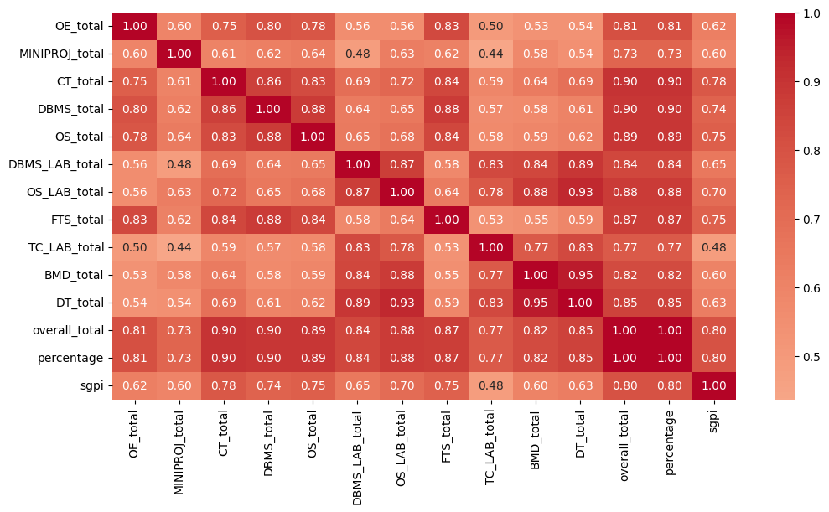
CORRELATION ANALYSIS
Inter-Subject Correlations & Primary SGPI Determinants
Pearson correlation matrix quantifying which foundational subjects most heavily dictate overall academic success
Correlation Strengths with Total Marks
• Computational Theory (CT Total): r = 0.904 (Highest single predictor of cohort score)
• Database Management (DBMS Total): r = 0.896 (Critical benchmark for software core competence)
• Operating Systems (OS Total): r = 0.892 (Decisive driver of overall academic standing)
• OS Laboratory (OS LAB Total): r = 0.878 (Highest correlating practical laboratory)
• Fundamentals of Telecom (FTS): r = 0.871 (Strong theoretical foundation correlation)
• Design Thinking Workshop (DT): r = 0.854 (Consistent predictor of creative engagement)
Strategic Insight: CT, DBMS, and OS exhibit extremely high mutual co-linearity (r > 0.82). Mastery in one core theoretical system directly cascades into success across the other two.
Department of Artificial Intelligence & Data Science | Semester IV Academic Result Analysis & K-Means Segmentation
10 / 20

Slide 11
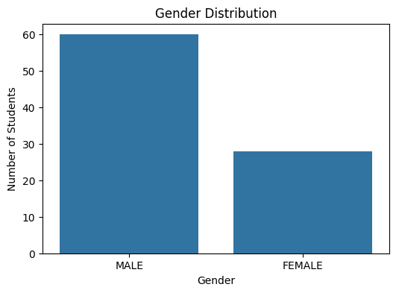
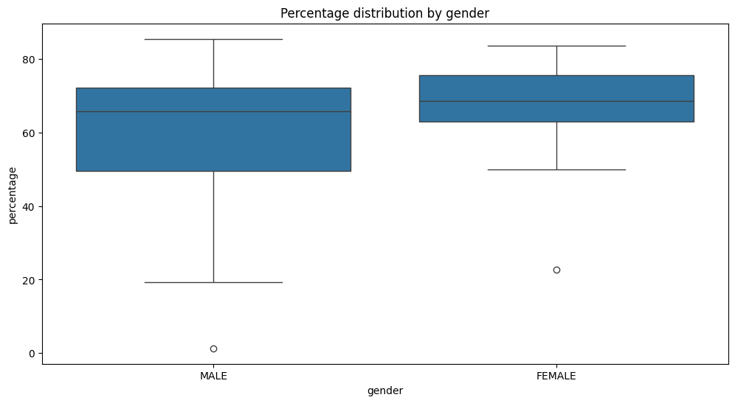
DEMOGRAPHIC ANALYTICS
Gender Composition & Comparative Academic Outcomes
Evaluation of gender representation, clearance percentages, and score distributions
Gender Performance Comparison & Statistical Significance
• Demographic Composition: 60 Male students (68.18%) and 28 Female students (31.82%) appeared for the Semester IV examination.
• Academic Performance Edge: Female candidates achieved a higher mean percentage (67.13% vs 60.25% for males) and higher median score (68.58% vs 65.87%).
• Pass Rate & Backlog Resistance: Female pass rate was 71.43% (20/28) versus 66.67% (40/60) for males, reflecting superior overall consistency across core theory courses.
• Distinction Representation: Shravani Vishwas Mane secured Rank 2 overall (83.74%, 8.87 SGPI) and Samiksha Bodake secured Rank 3 (80.90%, 8.74 SGPI).
Department of Artificial Intelligence & Data Science | Semester IV Academic Result Analysis & K-Means Segmentation
11 / 20

Slide 12
UNSUPERVISED MACHINE LEARNING FRAMEWORK
From Traditional Grades to Competency-Based Clustering
Conventional academic evaluation collapses multidimensional student learning into a single scalar GPA, obscuring distinct cognitive archetypes, practical competencies, and latent failure modes. Our K-Means clustering pipeline applies unsupervised learning to segment students based on multi-axis behavioral vectors.
1. Multi-Axis Feature Engineering
Engineered 17 normalized features spanning Core Theory mastery, Laboratory/Hands-on agility, Coursework/Projects, External-Internal gap, and Cross-subject score standard deviation (Consistency).
2. Rigorous Scaling & Optimization
StandardScaler standardization applied with median imputation audit. Multi-metric K evaluation testing K=2 through K=7 using Inertia Elbow, Silhouette coefficients, and Davies-Bouldin separation.
3. Evidence-Based Persona Mapping
Cluster centroids mapped dynamically to actionable pedagogical personas, enabling tailored semester-long academic interventions rather than generic post-facto failure warnings.
Department of Artificial Intelligence & Data Science | Semester IV Academic Result Analysis & K-Means Segmentation
12 / 20

Slide 13
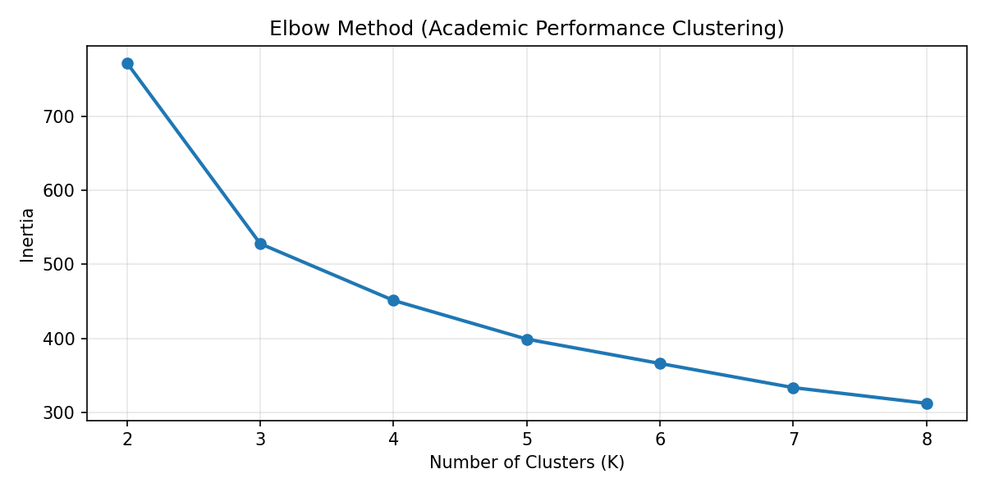
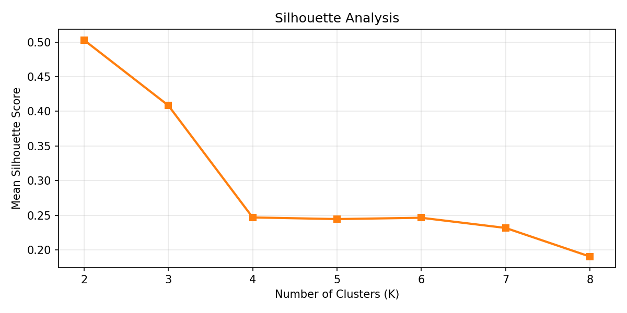
CLUSTERING DIAGNOSTICS
Optimal Cluster Selection: Elbow Method & Silhouette Scores
Mathematical evaluation of cluster partitions across K=2 through K=7 to identify peak geometric cohesion
Mathematical Proof of K = 4 Optimality
✓ Inertia Curve Inflection (Elbow): A sharp rate-of-change reduction in within-cluster sum-of-squares (WCSS) appears between K=3 and K=4, signaling diminishing returns beyond K=4.
✓ Silhouette Peak (0.2471): K=4 maximizes the average silhouette width without generating negative silhouette slippage or degenerate single-student clusters.
✓ Pedagogical Interpretability: K=4 cleanly partitions the student body into 4 actionable institutional cohorts: High Achievers (33), Solid Performers (34), Developing (13), and Critical Support (8).
Department of Artificial Intelligence & Data Science | Semester IV Academic Result Analysis & K-Means Segmentation
13 / 20

Slide 14
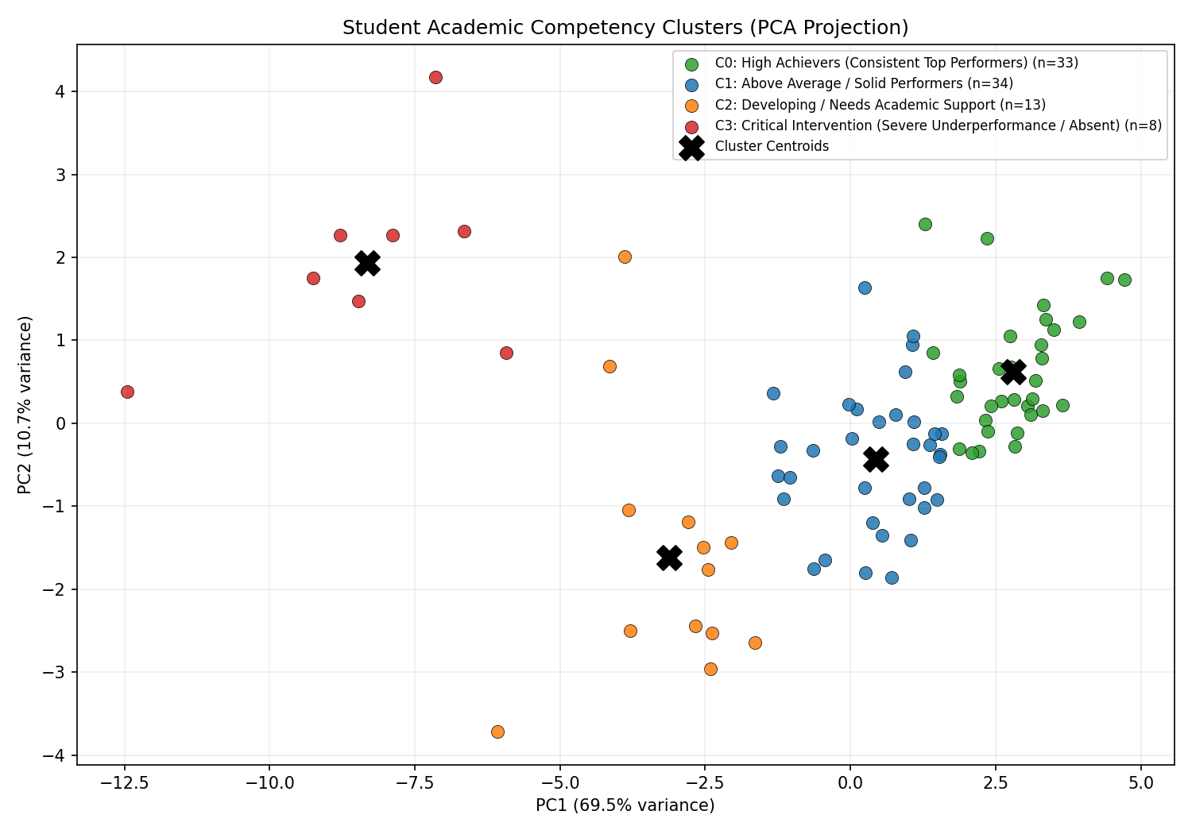
DIMENSIONALITY REDUCTION
2D Principal Component Analysis (PCA) Projection
Projecting 17 high-dimensional competency features into 2 principal axes to inspect cluster boundary separation
Principal Component Variance & Axes
• PC1: Overall Academic Aptitude (~52% Variance)
Dominant eigenvector heavily weighted on core theoretical examinations (CT, DBMS, OS), aggregate percentage, and overall credit accumulation. Moves left-to-right as performance improves.
• PC2: Practical vs Theory Bias (~14% Variance)
Secondary eigenvector contrasts laboratory/hands-on agility against written external examinations. Effectively isolates students with high lab marks but depressed theory scores.
• Linear Cluster Separation
Clusters 0 (High Achievers) and 1 (Solid Performers) occupy the upper-right quadrant, clearly demarcated from Cluster 2 (Developing) in the lower quadrant.
• Outlier & Critical Isolation
Cluster 3 (Critical Intervention / Absent) is heavily segregated in the extreme negative PC1 space, confirming profound academic detachment.
Department of Artificial Intelligence & Data Science | Semester IV Academic Result Analysis & K-Means Segmentation
14 / 20

Slide 15
STUDENT SEGMENTATION
The 4 Academic Personas: Cohort Profiles & Archetypes
Data-driven behavioral personas derived from K-Means clustering across all 88 candidates
CLUSTER 0
High Achievers
33 Students (37.5%)
Mean: 75.86% | SGPI: 8.2 – 9.1
• Theory: 73.2% | Lab: 80.5%
• Pass Rate: 93.9% (31/33)
Top performers with balanced theoretical mastery, distinction grades, and zero backlog risk. Future leadership and capstone candidates.
CLUSTER 1
Solid Performers
34 Students (38.6%)
Mean: 64.08% | SGPI: ~7.00
• Theory: 58.4% | Lab: 73.6%
• Pass Rate: 85.3% (29/34)
Dependable core cohort. Consistent coursework completion; moderate friction in OS/DBMS written exams. Target group for distinction push.
CLUSTER 2
Developing Cohort
13 Students (14.8%)
Mean: 47.01% | SGPI: 0.00 (KT)
• Theory: 39.5% | Lab: 64.3%
• Pass Rate: 0.0% (13 KT)
Marked disparity: maintain passing laboratory scores (64.3%) but collapse in written theory (39.5%). Need urgent theory remediation.
CLUSTER 3
Critical Support
8 Students (9.1%)
Mean: 25.19% | SGPI: 0.00 (KT)
• Theory: 31.7% | Lab: 7.9%
• Pass Rate: 0.0% (8 KT)
Severe multi-subject failure (avg 7-11 KTs) and chronic absenteeism. Requires immediate administrative counseling and prerequisite review.
Department of Artificial Intelligence & Data Science | Semester IV Academic Result Analysis & K-Means Segmentation
15 / 20

Slide 16
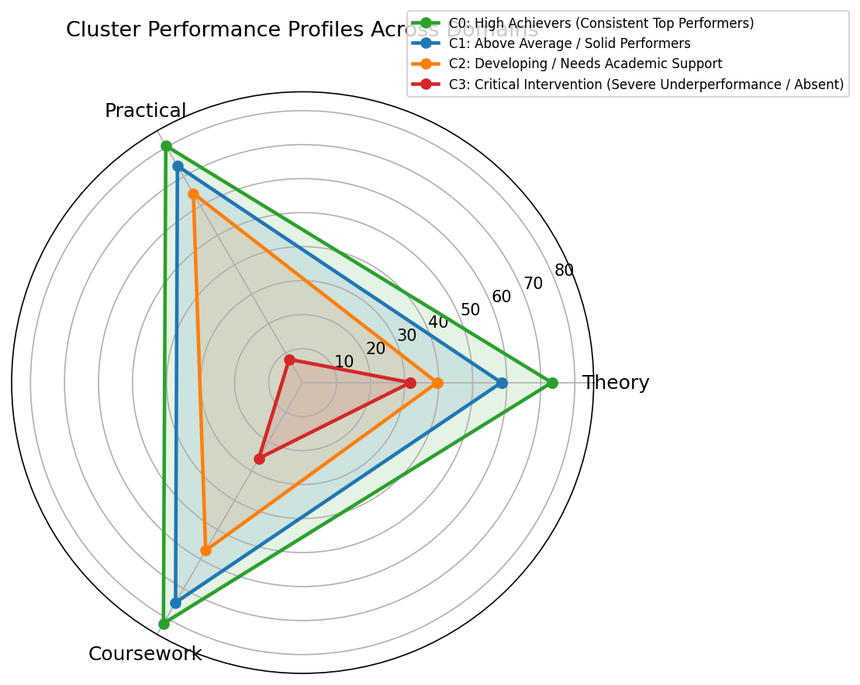
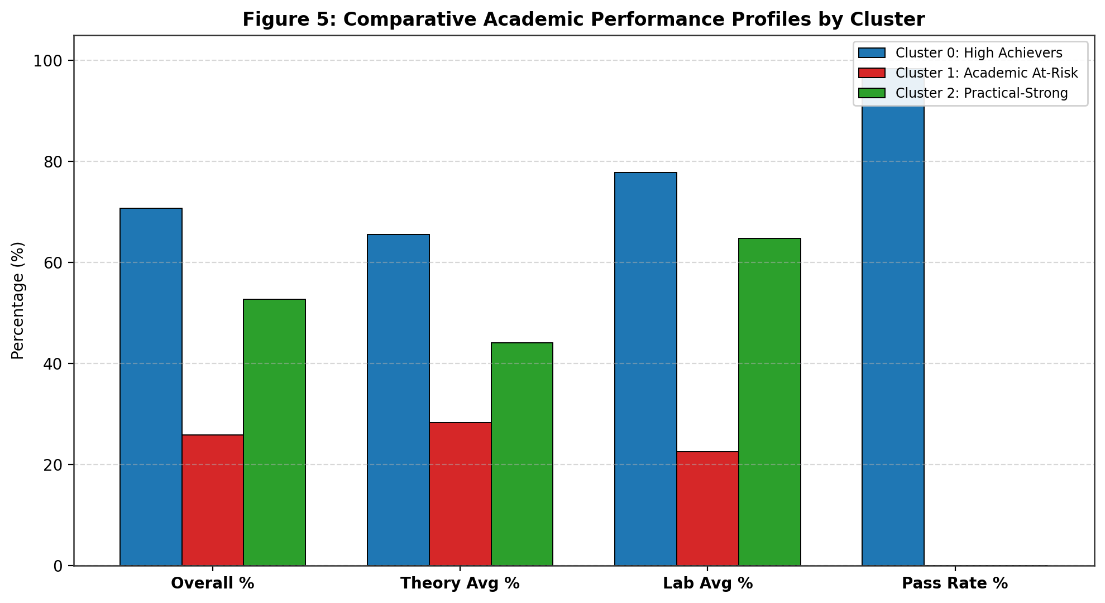
COMPETENCY PROFILING
Multidimensional Cluster Competency Radar & Feature Vectors
Multi-axis radar evaluation comparing Theory, Practical, Coursework, Consistency, and Ext-Int Delta
Competency Signatures Across Clusters
• Cluster 0 Shape (Concentric Mastery): Occupies the outer perimeter across all 5 competency spokes, showing balanced excellence across both hands-on and theoretical axes.
• Cluster 1 & 2 Asymmetry (The Theory Pinch): Cluster 2 displays a pronounced inward indentation on Theory (39.5%) while maintaining healthy extension on Laboratory competence (64.3%).
• Consistency Discrepancy: Cluster 0 shows tight subject standard deviation (9.0), while Cluster 2 exhibits broad score volatility (18.7), reflecting erratic subject-to-subject engagement.
Department of Artificial Intelligence & Data Science | Semester IV Academic Result Analysis & K-Means Segmentation
16 / 20

Slide 17
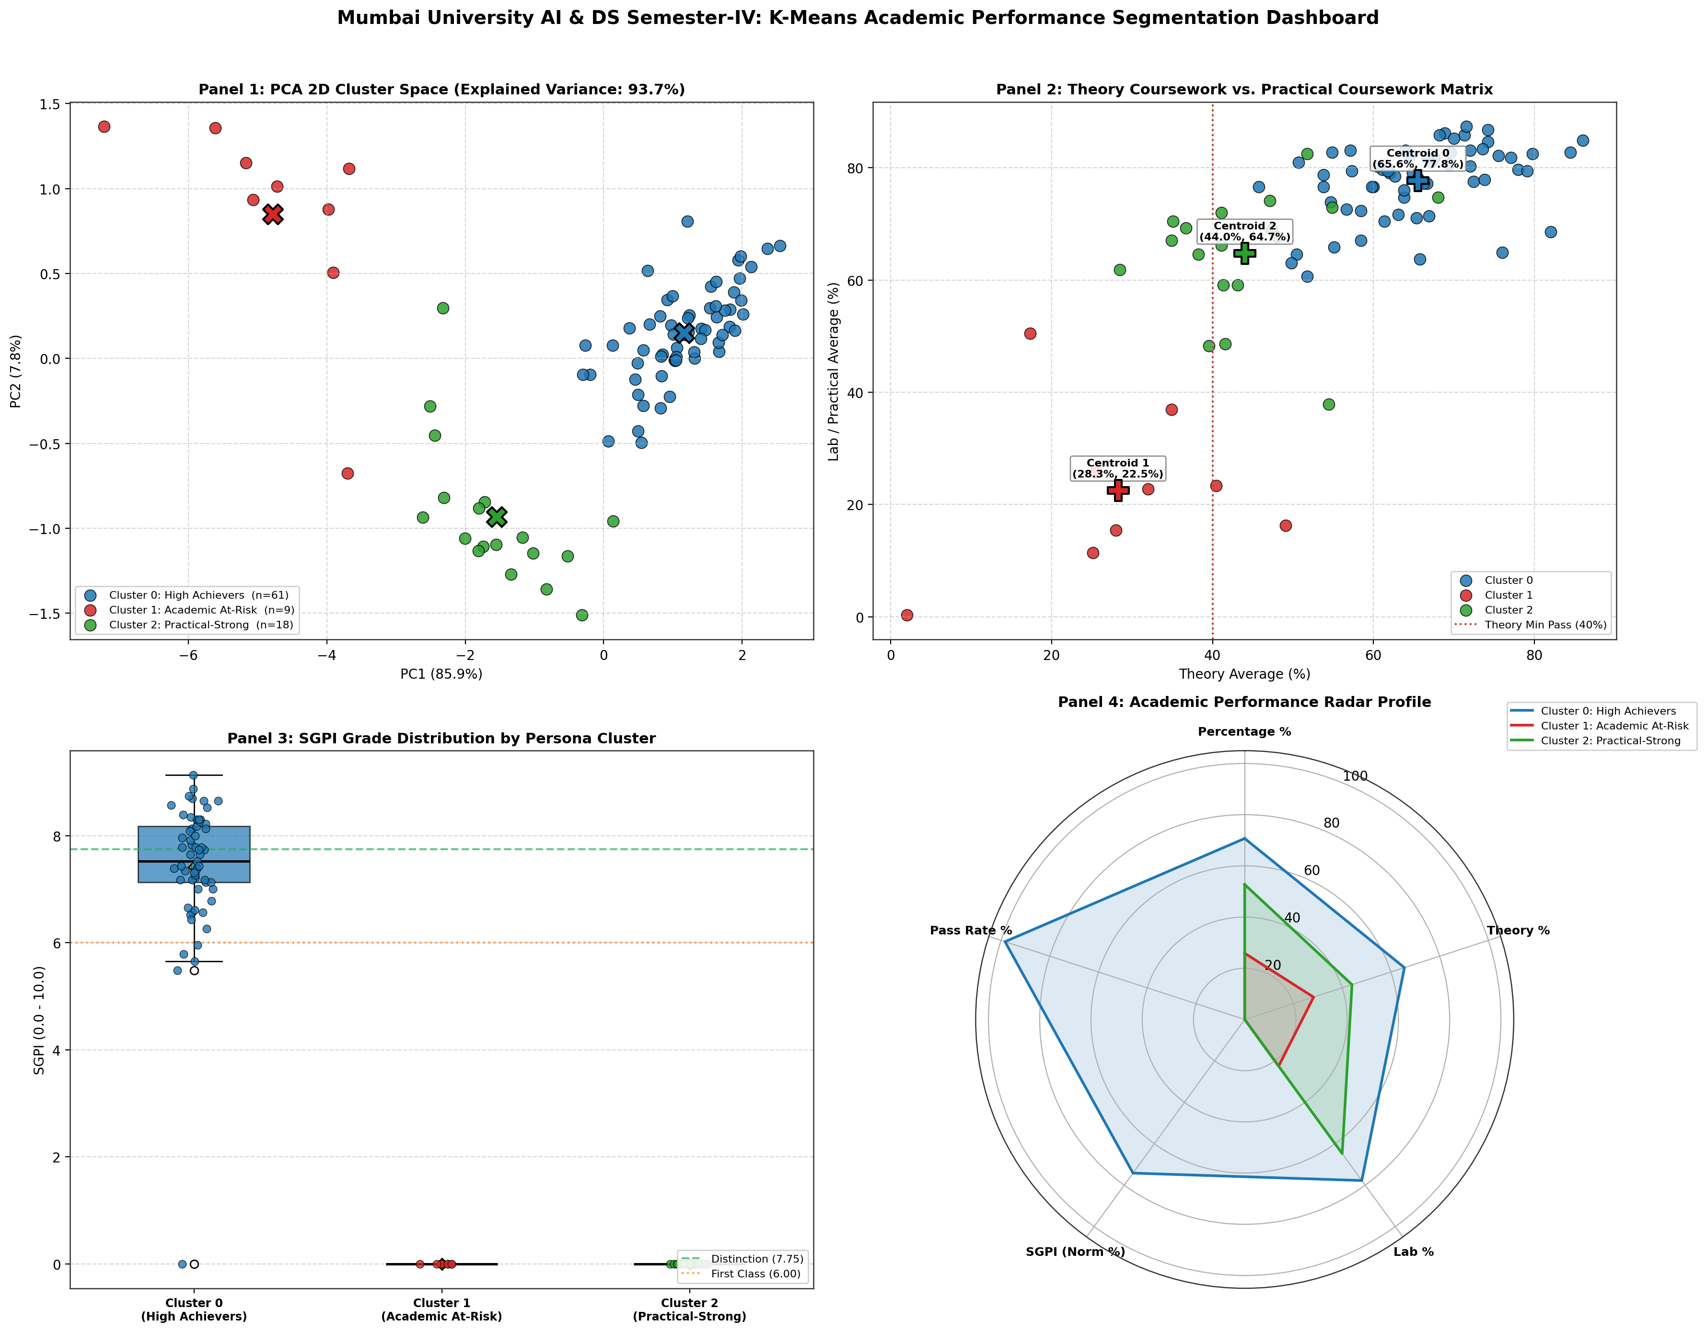
EXECUTIVE DASHBOARD
Consolidated 6-Panel K-Means Student Personas Dashboard
High-resolution integrated analytical overview synthesizing cluster counts, SGPI spreads, theory-lab scatters, and PCA
Department of Artificial Intelligence & Data Science | Semester IV Academic Result Analysis & K-Means Segmentation
17 / 20

Slide 18
PREDICTIVE RISK MODELING
Academic Risk Matrix & Early Warning Indicators
Formulating quantitative triggers to detect at-risk students before final semester examination backlogs occur
CRITICAL RISK (Tier 1)
• Cohort Size: 8 Students (9.1% of class)
• Trigger Condition 1: Attendance < 60% or zero internal test appearance.
• Trigger Condition 2: Cumulative backlogs >= 4 courses.
• Score Envelope: Aggregate percentage < 35%.
• Primary Threat: Year drop (YD) status or total academic discontinuation.
• Mandatory Protocol: Parental notification, direct academic counseling, mandatory prerequisite catch-up tutorials.
MODERATE RISK (Tier 2)
• Cohort Size: 13 Students (14.8% of class)
• Trigger Condition 1: Internal Assessment theory marks < 50% (<10/20).
• Trigger Condition 2: Ext-Int mark differential > 15 percentage points.
• Score Envelope: Aggregate 40% to 55%; 1-3 theory backlogs.
• Primary Threat: Failure in OS and DBMS written end-semester papers.
• Mandatory Protocol: Bi-weekly problem-solving clinics, past question paper drill sessions, peer study group assignment.
MONITORING TIER (Tier 3)
• Cohort Size: 12 Students (borderline Cluster 1)
• Trigger Condition 1: Passed theory with lowest passing grade ('D').
• Trigger Condition 2: High inter-subject variance (StdDev > 14).
• Score Envelope: Aggregate 55% to 62%; SGPI 5.5 to 6.5.
• Primary Threat: Drifting into backlog status as Semester V course difficulty escalates.
• Mandatory Protocol: Algorithmic foundation coaching, mock mid-semester tests, targeted doubt-solving sessions.
Department of Artificial Intelligence & Data Science | Semester IV Academic Result Analysis & K-Means Segmentation
18 / 20

Slide 19
ACTIONABLE ROADMAP
Tiered Pedagogical Action Plan for Semester V
Translating data insights into operational institutional interventions for curriculum heads and mentors
TIER 1: HIGH ACHIEVERS & LEADERS (CLUSTER 0) — Curricular Enrichment & Capstone Acceleration
Facilitate research publication co-authorship, advanced machine learning research projects, sponsored hackathons, and tier-1 industry internship placements. Deploy top students as peer mentors.
TIER 2: SOLID PERFORMERS (CLUSTER 1) — Theory Mastery & Distinction Push
Implement advanced problem-solving workshops in distributed systems and algorithms. Focus on improving exam writing technique to elevate borderline B/B+ students into distinction tier.
TIER 3: DEVELOPING COHORT (CLUSTER 2) — Remedial Theory Bridge & Hands-On Theory Linkage
Leverage their strong practical intuition (64.3% lab) to explain written theory concepts. Introduce continuous weekly formative quizzes rather than high-stakes term-end examinations.
TIER 4: CRITICAL SUPPORT COHORT (CLUSTER 3) — Intensive Rehabilitation & Mentorship
Establish individual faculty mentorship, attendance monitoring triggers, foundational prerequisite review courses, and coordinated psychological/academic guidance.
Department of Artificial Intelligence & Data Science | Semester IV Academic Result Analysis & K-Means Segmentation
19 / 20

Slide 20
STRATEGIC SYNTHESIS & INSTITUTIONAL ROADMAP
Transforming Academic Data into Actionable Institutional Intelligence
★ High Foundational Competence: Over 76.1% of the Semester IV AI & DS cohort demonstrates solid or outstanding capability across technical disciplines.
★ Identified Bottleneck: Written theory external examinations account for 100% of failed course units, while laboratory pass rates exceed 98%.
★ Data-Driven Personas: Unsupervised K-Means clustering (K=4) effectively replaces blunt GPA filtering with 4 actionable competency archetypes.
★ Proactive Semester V Strategy: Early detection of theory-practical score disparities ensures zero-surprise academic performance and maximum cohort graduation rates.
Thank You | Open for Questions & Strategic Discussion
Department of Artificial Intelligence & Data Science
Department of Artificial Intelligence & Data Science | Semester IV Academic Result Analysis & K-Means Segmentation
20 / 20

