Slide 1
Academic Result Analysis
AI & Data Science, Semester IV
Exploratory analysis, subject diagnostics, and K-means student segmentation
88 students 11 courses 113 source fields
Prepared from the validated master results dataset and analytical notebooks
Notes:
Sources: notebooks/01_exploratory_data_analysis.ipynb; data/processed/AI_DS_SEM4_MASTER_RESULTS.csv; clustering outputs in data/processed and reports/.

Slide 2
Executive snapshot
The cohort shows a strong upper segment alongside a material academic-support population
88
68.2%
62.4%
7.15
Students analysed
Successful result rate
Mean percentage
Median SGPI
What the analysis shows
Decision focus
Results are complete and unique across all 88 students
DBMS marks show the strongest association with overall total (r = 0.896)
K-means V2 separates 21 students into support and critical-intervention groups
Original clustering confirms a practical-strong, theory-deficit segment
Prioritize theory reinforcement for developing learners, intensive recovery plans for the critical group, and enrichment opportunities for high achievers.
AI & DS Semester IV: Academic Result Analysis
02
Notes:
Sources: 01_exploratory_data_analysis.ipynb cells 7, 13, 17, 25, 31-32, 65, 68; V2 summary.

Slide 3
Data foundation and quality
A clean academic record supports reliable descriptive analysis and clustering
Dataset | AI_DS_SEM4_MASTER_RESULTS.csv
Coverage | 88 students × 113 columns
Courses | 11 assessed courses
Completeness | 0 missing values
Uniqueness | 0 duplicate students or rows
Analytical scope
Cohort composition and result status
Percentage and SGPI distributions
Course-level averages, grades, and correlations
Theory versus lab performance
Two K-means segmentation models
Caveat: The dataset represents one semester and one cohort. Clusters are descriptive groups, not individual predictions.
AI & DS Semester IV: Academic Result Analysis
03
Notes:
Sources: 01_exploratory_data_analysis.ipynb cells 4, 7-18; README.md.

Slide 4
Result profile
60 students succeeded, while 28 need follow-up or remediation
Distribution highlights
Mean total
483.9 / 775
Median percentage
66.91%
Range
1.29% to 85.55%
The SGPI distribution includes zeros for unsuccessful and absent outcomes, so median performance better describes the successful core than the overall mean.
AI & DS Semester IV: Academic Result Analysis
04
Notes:
Sources: 01_exploratory_data_analysis.ipynb cells 24-25, 28, 31-33, 44-47.

Slide 5
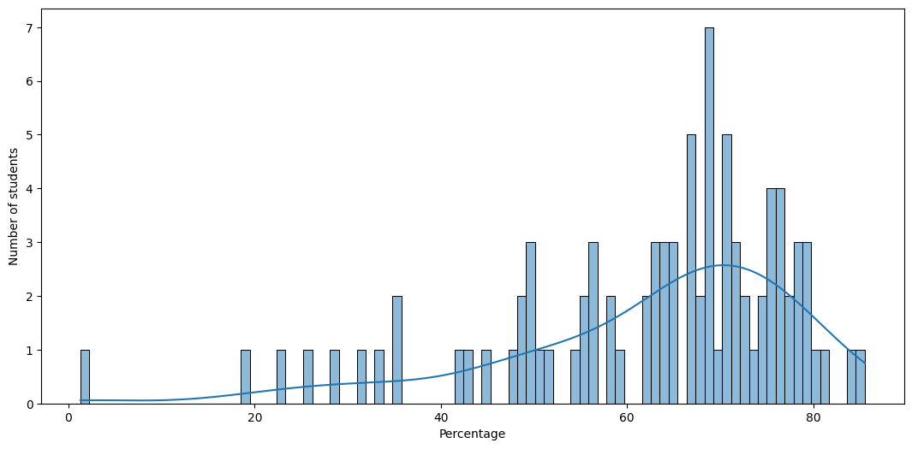
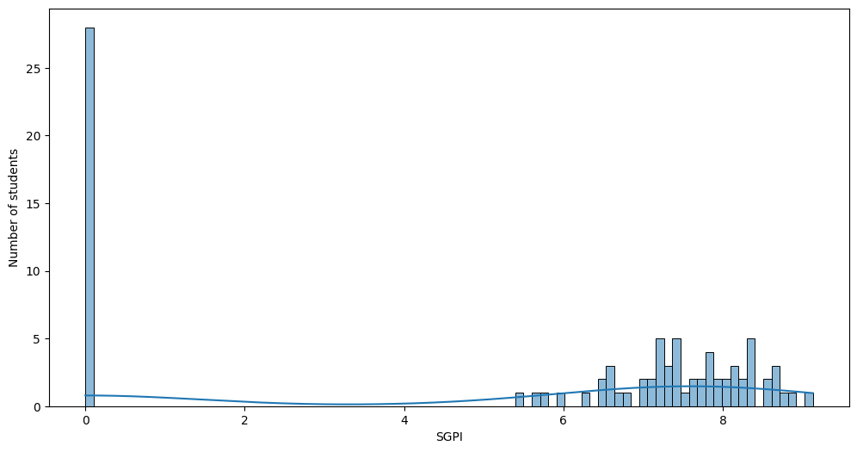
Performance distributions
The cohort concentrates in the mid-to-high range, with a distinct lower-performing tail
Percentage distribution
SGPI distribution
The lower tail reflects the 27 unsuccessful outcomes and one absence. These students should not be treated as a homogeneous group: the V2 model separates developing learners from severe underperformance.
AI & DS Semester IV: Academic Result Analysis
05
Notes:
Source: notebooks/01_exploratory_data_analysis.ipynb cells 31-37. Charts are notebook outputs.

Slide 6
Subject diagnostics
DBMS aligns most closely with total marks, while theory performance needs the closest attention
Course | Mean | F grades
DBMS | 59.1 / 100 | 15
OS | 57.2 / 100 | 16
FTS | 56.1 / 100 | 17
CT | 58.0 / 100 | 15
DBMS Lab | 37.6 / 50 | 8
DBMS has the highest observed correlation with overall total (r = 0.896). The course-level view points to broad theory reinforcement rather than a single-course intervention.
Correlation with overall total
AI & DS Semester IV: Academic Result Analysis
06
Notes:
Sources: 01_exploratory_data_analysis.ipynb cells 63-68; calculations from data/processed/AI_DS_SEM4_MASTER_RESULTS.csv. Course grades/means computed from source data.

Slide 7
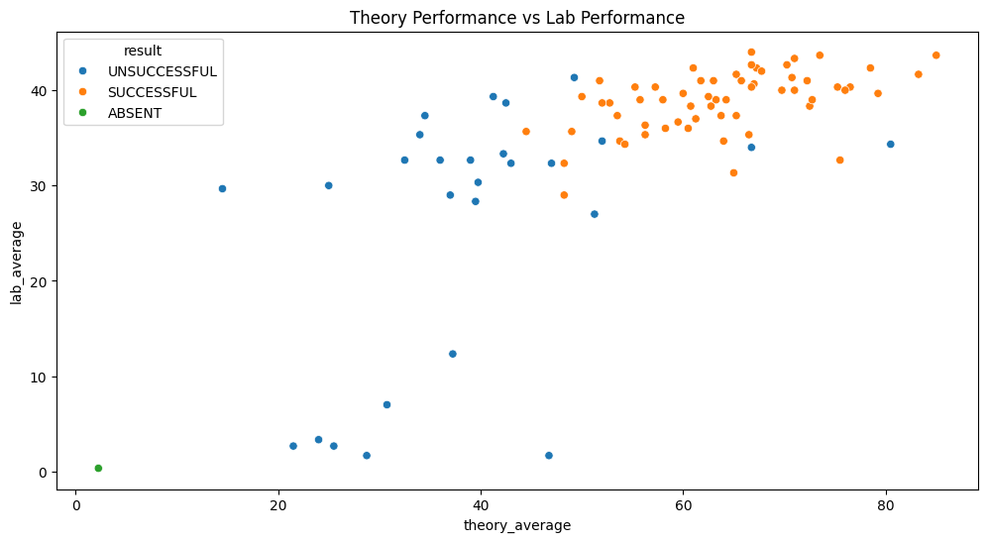
Theory and lab performance
Average theory performance lags lab performance when measured against their different marking scales
Cohort averages
55.6
Mean theory score
(out of 100)
34.4
Mean lab score
(out of 50)
Interpretation
Practical marks are generally stronger. This pattern becomes central to the original K-means model, which identifies a practical-strong group with clear theory deficits.
AI & DS Semester IV: Academic Result Analysis
07
Notes:
Sources: 01_exploratory_data_analysis.ipynb cells 81-94.

Slide 8
Original K-means segmentation
A compact model uses four performance signals to distinguish high achievement, theory deficit, and multi-subject risk
Model inputs
Three cluster profiles
Theory average %
Lab average %
Failed subjects count
Overall percentage
Profile | Students | Mean % | Pass rate
Academic Leaders | 62 | 70.7% | 96.8% pass
Practical-Strong / Theory-Deficit | 18 | 50.5% | 0% pass
At-Risk / Multi-Subject Deficit | 8 | 25.2% | 0% pass
Why this model matters
It avoids treating a zero SGPI as a complete picture of competency. Students with practical strength but theory failures receive a distinct profile rather than being grouped with severe underperformance.
AI & DS Semester IV: Academic Result Analysis
08
Notes:
Sources: src/ml/clustering.py; data/processed/AI_DS_SEM4_CLUSTERED_STUDENTS.csv.

Slide 9
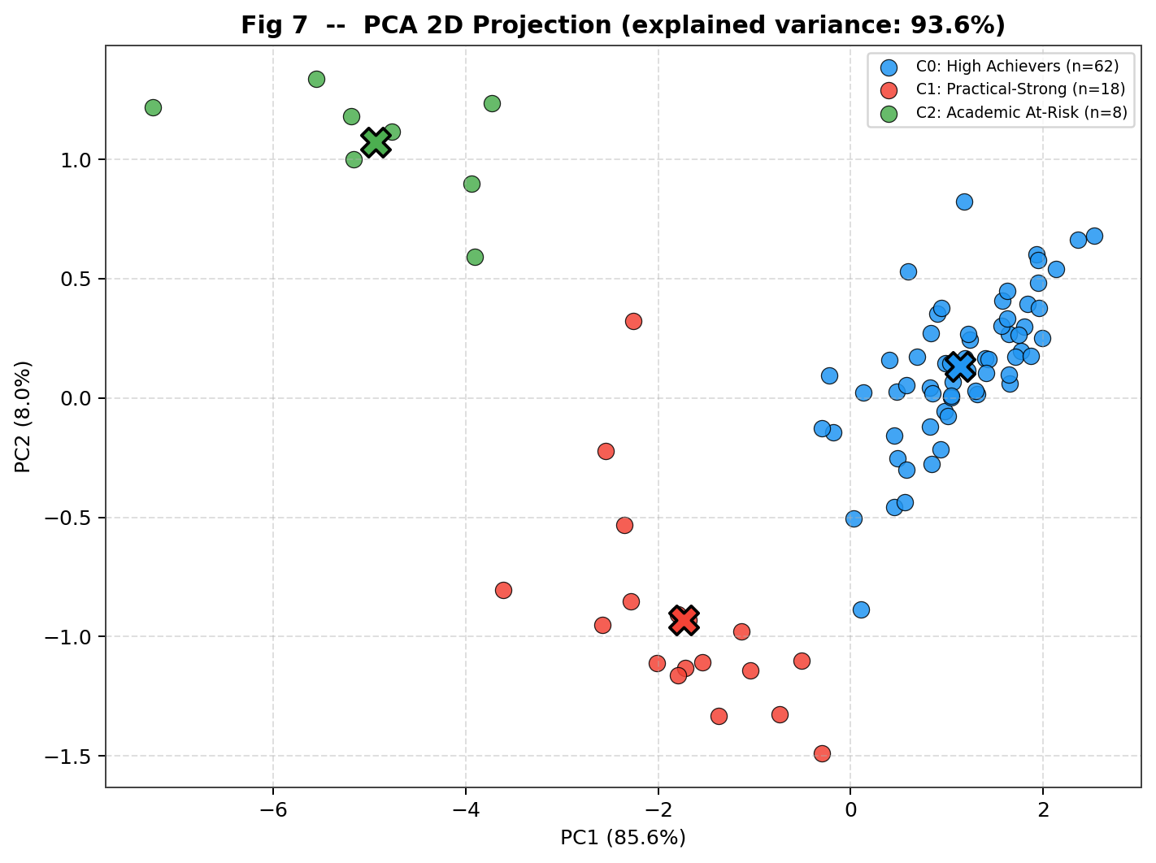
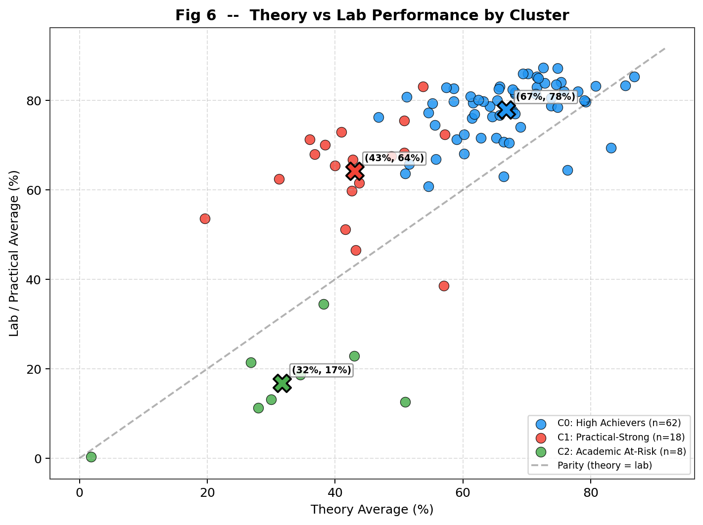
Original model evidence
The first model isolates a broad high-achiever group, a theory-deficit group, and a small critical-risk group
PCA projection
Theory versus lab by cluster
The practical-strong segment provides the key operational insight: academic support should target theory recovery without assuming weak lab competency.
AI & DS Semester IV: Academic Result Analysis
09
Notes:
Sources: reports/figures/clustering_v1/kmeans_07_pca_2d.png and kmeans_06_theory_vs_lab.png; src/ml/clustering.py.

Slide 10
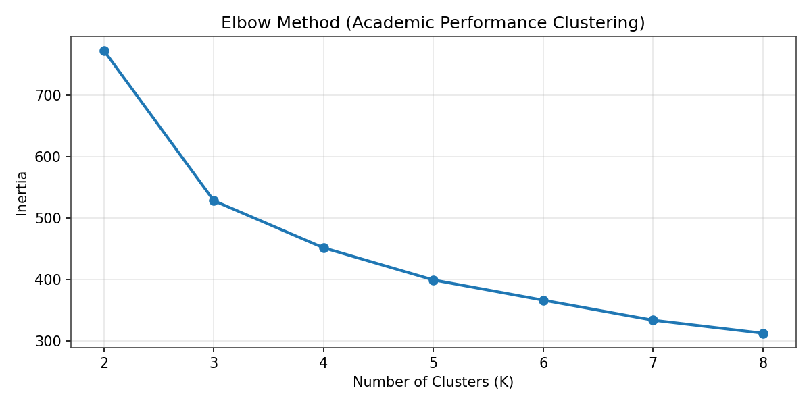
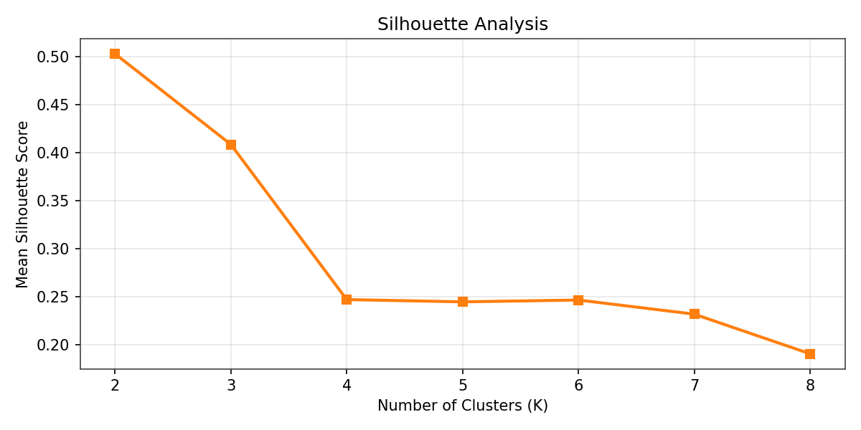
K-means V2: competency-based segmentation
V2 uses 17 features to separate performance level, learning mode, consistency, and assessment balance
Feature groups
Model selection
11 course-level percentages
Theory, practical, and coursework averages
Subject-level consistency
External–internal assessment gap
Cumulative percentage
K = 4
Selected clusters
Silhouette = 0.2471
Separation is modest, so use personas as a planning lens rather than rigid labels.
AI & DS Semester IV: Academic Result Analysis
10
Notes:
Sources: scripts/student_clustering_v2.py; reports/summaries/clustering_v2_summary.txt; figures clustering_v2_elbow.png and clustering_v2_silhouette.png.

Slide 11
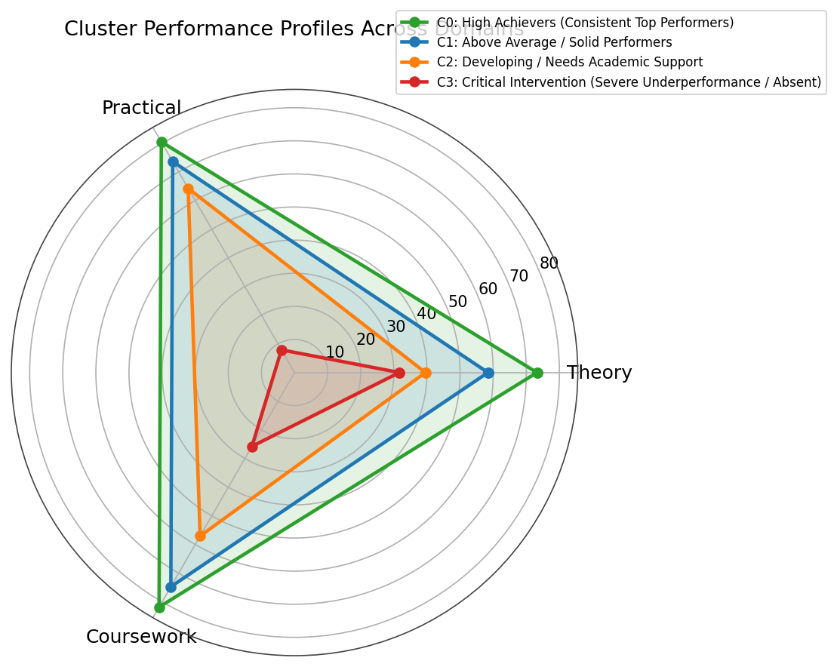
K-means V2 personas
V2 splits the original middle-to-lower segment into a focused support group and a critical intervention group
Persona | Students | Mean % | Theory | Practical
High achievers | 33 | 75.86% | 73.2% | 80.5%
Solid performers | 34 | 64.08% | 58.4% | 73.6%
Developing support | 13 | 47.01% | 39.5% | 64.3%
Critical intervention | 8 | 25.19% | 31.7% | 7.9%
Planning implication
The 13 developing learners retain practical strength and need theory reinforcement. The 8 critical learners need broader attendance, practical, and multi-subject recovery support.
AI & DS Semester IV: Academic Result Analysis
11
Notes:
Sources: reports/summaries/clustering_v2_summary.txt; reports/figures/clustering_v2/clustering_v2_radar.png.

Slide 12
From segmentation to academic support
Use V2 for differentiated planning, with the original model retained as a clear diagnostic baseline
Original model
V2 model
3 groups
4 derived indicators
Highlights practical strength versus theory deficit
Best for a simple risk and competency view
4 groups
17 competency and consistency features
Separates developing support from critical intervention
Best for targeted cohort planning
Recommended academic response
High achievers (33)
Enrichment, peer tutoring, advanced project opportunities
Solid performers (34)
Targeted theory practice to improve consistency
Developing support (13)
Structured theory recovery with weekly checkpoints
Critical intervention (8)
Individual remediation plan and attendance follow-up
Next step: validate interventions with the next semester’s outcomes before using the segments operationally.
AI & DS Semester IV: Academic Result Analysis
12
Notes:
Sources: original and V2 clustering outputs. Recommendations are analytical interpretations based on observed cohort profiles, not causal findings.

