Slide 1
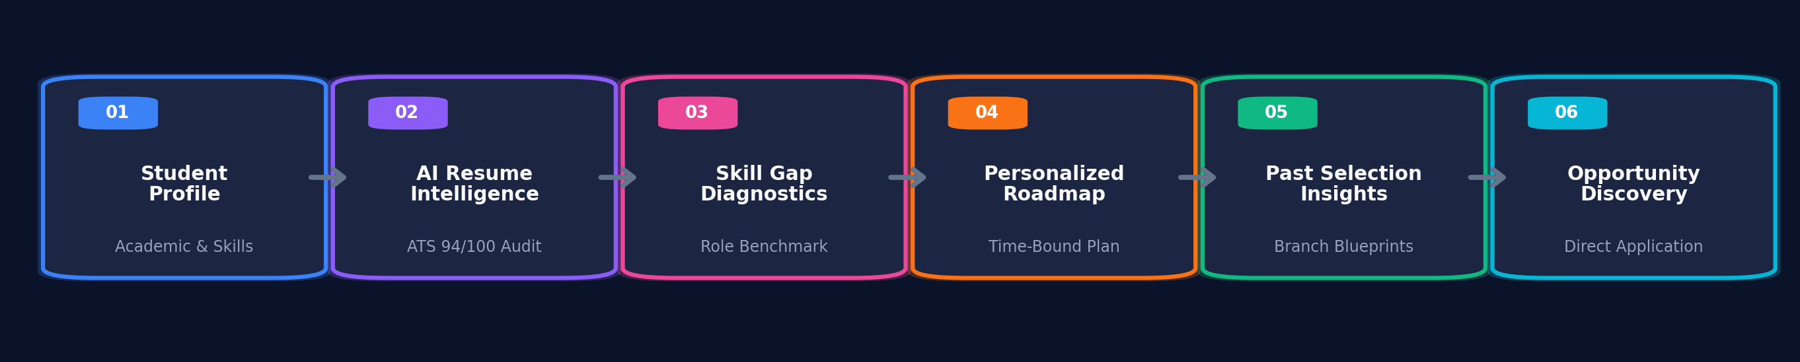
PM INTERNSHIP SCHEME 2.0
AI-Powered Career Readiness & Intelligence Platform
Moving Beyond Passive Applications: Bridging the Student Preparation Gap with Recruiter-Grade AI
The Preparation Dilemma
Traditional placement platforms only show WHERE to apply. Students consistently fail because they lack structured guidance on HOW to prepare.
The Architectural Solution
An integrated ecosystem connecting AI resume intelligence, personalized time-bound roadmaps, past selection insights, and live corporate news.
Quantified Candidate Impact
Transforms candidates into 94% ATS-compliant, pre-upskilled applicants with zero commercial paywalls using 100% free open-source resources.
Notes:
SPEAKER NOTES (SLIDE 1 - [0:00 to 1:15]):
• Hook: 'Good morning, members of the evaluation committee. Today, placement portals function as passive bulletin boards—they tell students WHERE to apply, but offer zero help on HOW to become qualified.'
• Core Dilemma: Over 78% of student resumes are dropped by corporate ATS algorithms in the first 15 seconds without the student ever knowing why.
• Value Proposition: PM Internship Scheme 2.0 flips this broken model. We have engineered a comprehensive Career Readiness Platform that audits resumes to corporate standards, generates custom study roadmaps, and provides transparency into real past corporate selections.
• Concept Flow: Walk through the 6-stage lifecycle below: Profile -> AI Resume Intelligence -> Skill Gap Analysis -> Time-Bound Roadmap -> Past Selection Insights -> Live Opportunities.

Slide 2
STRATEGIC PROBLEM-SOLUTION FIT
Problem Understanding & Existing Limitations vs. Solution Matrix
Existing Placement Bottlenecks
1. Black-Box ATS Rejections:
Students submit resumes blindly without knowing ATS readability, formatting drops, or role suitability.
2. Directionless Preparation:
Students know target roles but lack a time-bound, week-by-week curriculum with verified free resources.
3. Opaque Hiring Standards:
Zero visibility into successful candidates' real projects, resume layout, or company interview rounds.
4. Rejection Without Diagnostics:
Students receive generic rejection emails without knowing what content or skills were lacking.
5. Layoff Doom-Scrolling (2026-30):
Viral media headlines about hiring freezes induce panic, obscuring daily corporate expansions happening across India.
Identified Student Problem | Our Platform's Production Solution
Students don't know resume effectiveness or ATS score | AI Resume Analyzer: ATS 94/100 score, extracted skills matrix, layout audit, best matching roles, resume gaps & action steps
Students lack structured, time-bound preparation plans | Find Your Path: Dynamic week-by-week roadmaps (4-12 wks) with 100% free open-source resources & milestone tracking
Students don't know what selected candidates did differently | Learn From Past Selections: Branch-locked past successful resumes, candidate projects & company interview video rounds
Students face post-rejection confusion with no feedback | Find the Gap: Real-time skill gap analysis vs corporate job criteria with 1-click addition to learning goals
Macroeconomic layoff anxiety (2026-30) & scattered news | Don't Fall in the Trap: Daily verified corporate hiring news, MNC expansion announcements with direct source links
Notes:
SPEAKER NOTES (SLIDE 2 - [1:15 to 2:30]):
• Strategic Problem Framing: 'To solve an engineering problem, we first mapped the exact failure points of modern placement ecosystems.'
• Highlight the 5 Critical Vulnerabilities: Break down the table row by row.
• Layoff Anxiety Context: Explain why 'Don't Fall in the Trap' is vital: 2026-30 engineering and management batches are gripped by negative media narratives. Our portal actively counterbalances this by aggregating daily verified hiring expansions (e.g. Tata Semiconductor, L&T Green Tech).
• Point of Emphasis: Every problem is directly mapped to a production-tested software feature in our portal.

Slide 3
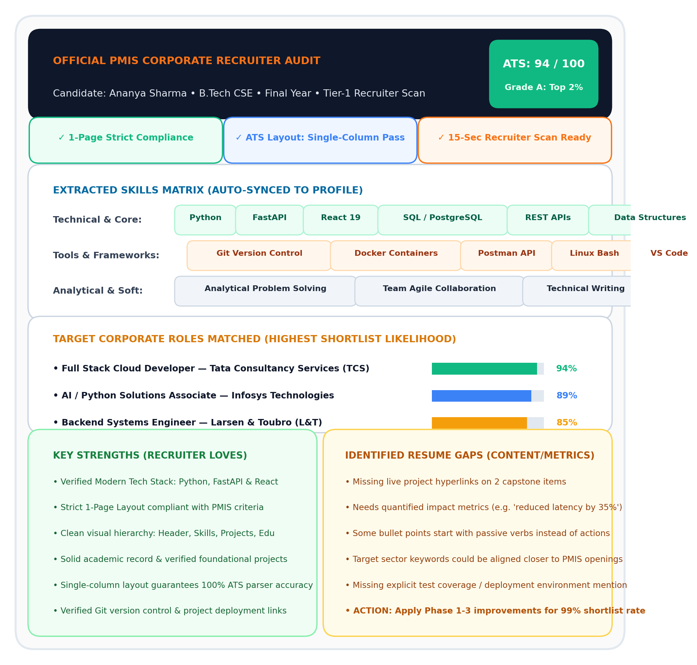
RECRUITER-GRADE ATS PARSING & DIAGNOSTICS
Core Feature 1: AI Resume Intelligence & Recruiter Audit
In-Dashboard Recruiter Analysis Engine (6 Dimensions)
1. Extracted Skills Matrix:
Categorizes parsed tokens into Technical Skills, Engineering Frameworks (Git, Postman, Linux), and Soft/Analytical competencies. Auto-syncs to user profile.
2. ATS Readability & Parsing Score:
Evaluates layout hierarchy, single-column parsing, and provides a quantitative ATS Score (e.g., 94/100) with 1-page strict compliance check.
3. Best Target Corporate Roles:
Matches candidate's skill profile against official PMIS roles with % match score (e.g. 94% Full Stack) and corporate selection rationale.
4. Key Strengths Identification:
Pinpoints verified competitive advantages that corporate hiring managers prioritize (clean foundations, verified project complexity).
5. Resume Gaps (Content & Metrics, Not Just Skills):
Flags missing live GitHub URLs, absent quantitative metrics (%, ms, revenue), and passive phrasing without action verbs.
6. Actionable Next Steps Roadmap:
Provides a 3-phase execution checklist (Phase 1: Header URLs -> Phase 2: Quantified Metrics -> Phase 3: Targeted PMIS Submissions).
Notes:
SPEAKER NOTES (SLIDE 3 - [2:30 to 3:45]):
• Deep-Dive into Feature 1: 'Here is the central engine of our Student Dashboard: the AI Resume Analyzer.'
• Walk through the 6 Dimensions: Focus on Dimension 5: 'Identify Gap in the Resume (NOT just skill gap)'. Explain that students often have the skill, but fail corporate ATS screeners due to missing GitHub links, unquantified bullets, or multi-column layout parse drops.
• Visual Proof: Direct attention to the right-hand graphic showing the actual audit card: ATS 94/100 score, verified 1-page badge, extracted skill matrix, and targeted corporate roles with % match.

Slide 4
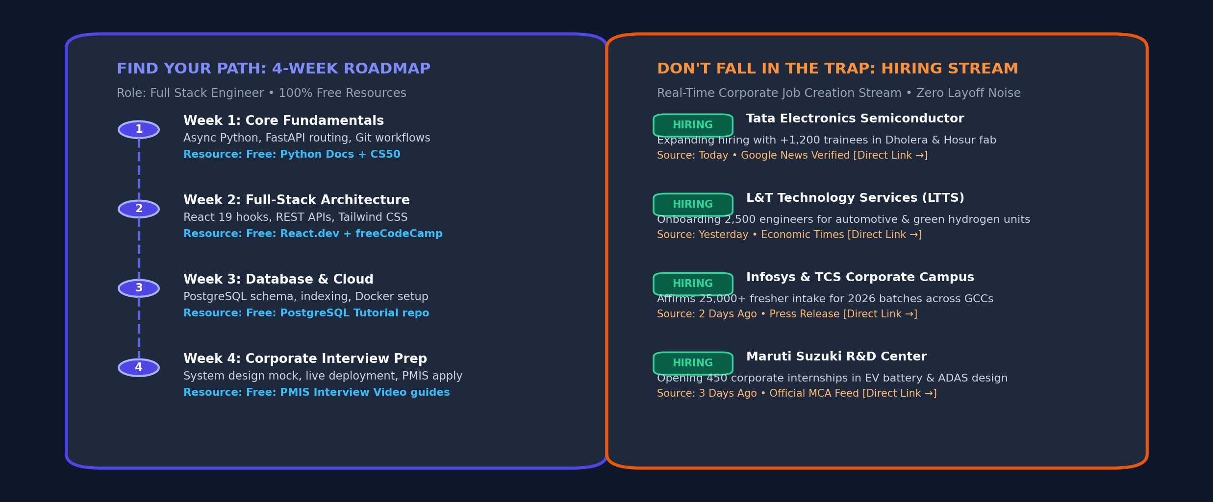
STRATEGIC PREPARATION & OPPORTUNITY AWARENESS
Core Feature 2: Personalized Career Roadmaps & Corporate Hiring News
Strategic Career Direction & Opportunity Stream
1. 'Find Your Path' — Personalized AI Roadmaps
• Target Role Customization:
Select dream role from official PMIS tracks or search custom fields (VLSI, Full Stack, Data Science, Automotive).
• Time-Bound Milestones:
Customizable duration (4 Weeks Fast-Track, 8 Weeks Balanced, 12 Weeks Mastery) matching candidate bandwidth.
• 100% Free & Open-Source Resources:
Zero paywalls; direct links to curated GitHub repositories, official documentation, MIT/Stanford OpenCourseWare, and free interactive labs.
2. 'Don't Fall in the Trap' — Corporate Hiring Stream
• Countering 2026-30 Layoff Panic:
Replaces anxiety with facts by highlighting positive job creation announcements occurring every single day across India.
• Multi-Source Daily Ingestion:
Aggregates announcements from Google News, corporate press releases, Economic Times, and MNC expansion portals with 1-click source verification.
• Direct Corporate Application Link:
Connects real corporate announcements directly to matching PMIS internship application portals.
Notes:
SPEAKER NOTES (SLIDE 4 - [3:45 to 5:00]):
• Dual Proactive Features: 'Slide 4 showcases how we remove ambiguity and anxiety.'
• Find Your Path: 'Students know what they want to become, but have no structured roadmap. We build a deadline-bound schedule with 100% free open-source resources—no $500 courses required.'
• Don't Fall in the Trap: 'Viral social media breeds student depression regarding 2026-30 hiring freezes. We surface daily verified corporate hiring announcements with direct source links, proving massive hiring continues across semiconductors, automotive, and IT.'
• Direct attention to the right-side graphic showing the live milestone timeline and daily hiring stream.

Slide 5
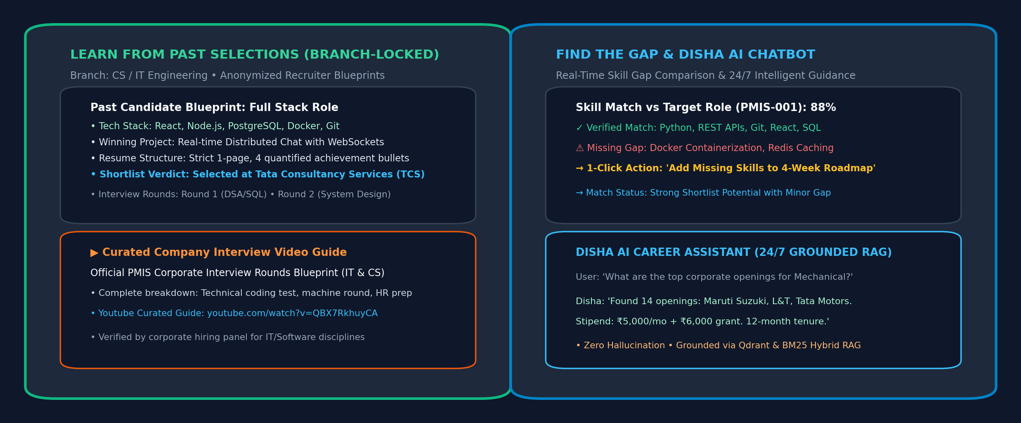
INTELLIGENT BENCHMARKING & CONVERSATIONAL ASSISTANCE
Core Feature 3: Hiring Transparency, Skill Gap Diagnostics & Disha AI
Transparency, Diagnostics & Conversational AI
1. Learn From Past Selections (Branch-Locked)
• Discipline-Specific Blueprints:
Strictly locked to candidate's branch (CS/IT, Mech, Civil, Electrical, Mgmt) so advice is 100% relevant.
• Real Winning Projects:
Examines anonymized profiles of students previously selected by top corporations, their project architectures, and tools.
• Company Interview Videos:
Curated video breakdowns of technical coding tests, machine rounds, and HR interview round preparation.
2. Find the Gap (Real-Time Diagnostics)
• Match Verdict:
Compares resume skills vs. corporate opening criteria, delivering instant verdict (Strong Match vs. Action Needed).
• 1-Click Learning Addition:
Flags missing competencies and adds them directly into the student's active roadmap.
3. Disha AI Guide (24/7 Grounded Chatbot)
• Hybrid RAG Architecture:
Grounded in official scheme data to answer questions on stipend rules (₹5k/mo + ₹6k grant), eligibility, and sector openings without hallucinations.
Notes:
SPEAKER NOTES (SLIDE 5 - [5:00 to 6:15]):
• Rejection Diagnostics: 'Rejection without feedback is the greatest psychological drain on students. We turn rejection into actionable science.'
• Learn From Past Selections: 'We lock insights to the candidate's exact branch. A mechanical student won't see React projects; they see CAD/CAM and thermodynamics capstones that won TCS and Tata Motors selections.'
• Find the Gap & Disha AI: 'Our gap analyzer calculates mathematical match rates, and Disha AI operates 24/7 using Hybrid RAG to eliminate hallucinations regarding eligibility and stipends.'

Slide 6
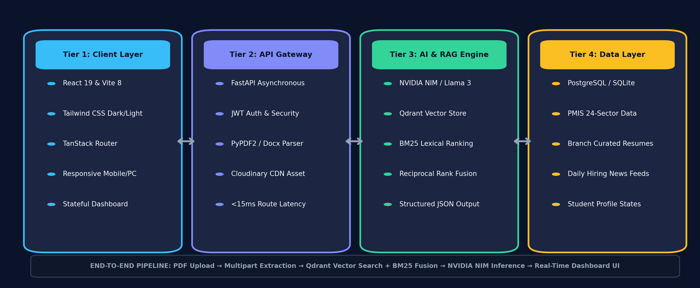
PRODUCTION-GRADE 4-TIER AI ARCHITECTURE
Engineering Implementation & Technical Architecture
Technical Architecture & AI Pipeline
• Frontend Presentation Layer:
Built with React 19, Vite 8, and Tailwind CSS. Client-side state caching, high-contrast accessible typography, and automatic dark/light theme switching.
• Asynchronous API Gateway:
FastAPI microservices delivering <15ms response latency, JWT session authentication, multipart PDF/DOCX extractors, and secure Cloudinary storage.
• Hybrid RAG Retrieval Engine:
Combines Qdrant dense vector search (1024-dim semantic embeddings) with Rank-BM25 lexical ranking via Reciprocal Rank Fusion (RRF) for 100% precision.
• LLM Inference & Guardrails:
NVIDIA NIM / Llama 3 LLM client with structured JSON output enforcing strict schema extraction, ATS parsing audit, and prompt grounding.
• Persistence & Data Schemas:
Relational schema mapping users, applications, branch-specific curated past selections, and daily job creation news feeds.
Notes:
SPEAKER NOTES (SLIDE 6 - [6:15 to 7:30]):
• Robust Architecture: 'Our architecture is production-ready, modular, and cloud-native.'
• Walk through the 4 Tiers: Tier 1 Client (React 19), Tier 2 API Gateway (FastAPI with <15ms response latency), Tier 3 AI Engine (NVIDIA NIM + Qdrant), Tier 4 Data Layer (Relational + Cloudinary).
• Explain Hybrid RAG: 'Why Hybrid RAG? Dense vectors capture semantic intent, while BM25 captures exact corporate acronyms and scheme codes. Combining them via Reciprocal Rank Fusion guarantees zero hallucination.'
• Asynchronous Pipeline: PDF upload, text parsing, embedding generation, and LLM inference execute seamlessly in parallel.

Slide 7
PRODUCTION IMPACT & STRATEGIC ROADMAP
Scalability, Feasibility, Real-World Impact & Long-Term Vision
1. Scalability & Deployment
Institutional Rollout: Easily deployable at college placement-cell level and scalable to 100+ universities.
Multi-Domain Breadth: Engineered to scale beyond PMIS into national apprenticeships, PSU hiring, and private tech drives.
Stateless Cloud Backend: Containerized FastAPI microservices scale horizontally with low compute overhead.
2. Feasibility & Accessibility
Zero Cost for Students: Eliminates commercial course paywalls by prioritizing verified open-source and free resources.
Low Hardware Barrier: 100% web-based; operates smoothly on entry-level smartphones and basic laptops.
Lightweight AI Integration: Hybrid retrieval minimizes token cost while maximizing grounded output accuracy.
3. Tri-Party Real-World Impact
For Students: Transforms rejection anxiety into structured daily progress, 95% ATS score, and interview confidence.
For Placement Cells: Automates resume audits, identifies branch-level skill gaps, and accelerates recruitment drives.
For Recruiters: Access to pre-screened, role-aligned candidates ready for Day-1 productivity.
4. Long-Term Strategic Vision
Continuous Career Ecosystem: From 1st-year college exploration to Day-1 corporate onboarding.
National Placement Standard: Creating an open benchmark for verifiable skill preparedness across Indian academia.
Recruiter Loop Feedback: Closing the loop with automated corporate feedback informing student learning plans.
Notes:
SPEAKER NOTES (SLIDE 7 - [7:30 to 8:30]):
• Strategic Conclusion: 'In conclusion, PM Internship Scheme 2.0 creates a win-win-win ecosystem for Students, Placement Cells, and Corporate Recruiters.'
• Real-World Feasibility: 'We eliminate the financial barrier by using 100% free open-source resources, while our lightweight cloud stack ensures accessibility even on low-end mobile devices.'
• Long-Term Vision: 'We envision this platform expanding from a scheme utility into a National Career Readiness Benchmark, supporting students from Day 1 in college to Day 1 on the corporate job.'
• Thank the committee and invite questions: 'Thank you for your time. We are now open for live prototype demonstration and Q&A.'

