Slide 1


Name : Kanav Goyal
Salary code : 41025936
SID : 23103092
Internship Project Presentation
Internship at Trident Limited
Industrial Web Application Development and Server
Monitoring System
Faculty coordinator: Dr. Shailendra Singh
Industry coordinator : Mr Sonu
Industry Mentor : Mr Gaurav Singla

Slide 2
The Projects Assigned at
Trident :
Server Monitoring System
Energy Production Data Entry

Slide 3


Server Monitoring Dashboard
Problem Statement:
Organizations manage multiple servers across different departments, but manual monitoring is time-consuming and inefficient. Without a centralized system to monitor real-time server health, failures are detected too late, affecting operations and causing critical data loss.
Trident-Specific Challenge
Multiple servers across Paper Production, Sheeting, Towel, and Energy & Chemicals departments. When servers go down, data fails to transfer to the database, disrupting operations.

Slide 4
Project Objectives
Centralized Dashboard
Automated Ping Mechanism
Develop web-based interface for server monitoring
Automatically check server availability using ping
Real-Time Status Display
Enhanced Reliability
Show UP/DOWN status in real-time
Handle database connection failures gracefully
Dynamic Connectivity
Search & Filter
Implement dynamic database connections
Enable easy data analysis capabilities
Automated Scheduling
Operational Efficiency
Run monitoring automatically on schedule
Reduce manual effort and increase productivity

Slide 5
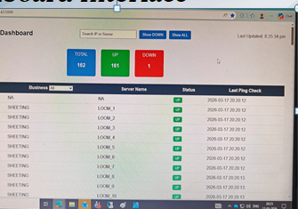
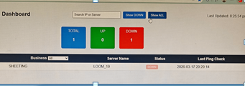
Dashboard Interface

Slide 6

System Workflow
1)Server details are stored in the database
2)Python-based monitoring script runs periodically
3)Sends ping requests to each server
4)Determines server status (UP/DOWN)
5)Updates the database
6)Flask backend fetches updated data on every request
7)Dashboard displays real-time server information with search and filtering
Performance Optimization
The python ping check script uses multi-threading to ping multiple servers simultaneously, which reduces total execution time significantly.
Scheduler. ——>
Python Script. ——>
Ping Servers. ——>
——> Update Database
——> Flask API
——> Dashboard UI

Slide 7
Technologies & Features
Core Technologies
Key Features
Python programming language
Flask backend framework
HTML, CSS, JavaScript frontend
SQL Server database
PyODBC connectivity
Windows Task Scheduler
Python Threading (for parallel execution)
UP/DOWN status visualization
Server count display along with Business-wise filtering
Search by IP or server name
Faster server status checking using multi-threading
Reduced delay in dashboard updates
Scheduled background execution
Auto-refresh data mechanism

Slide 8
Challenges & Solutions
Database Connection Timeout
Incorrect Status Display
No Auto-Reconnection
Ensured accurate real-time data fetching and proper status determination
Implemented automatic reconnection logic to maintain continuous monitoring
Established fresh database connection for each API call and added error handling with retry mechanism
Scheduler Issues
EXE Deployment
Configured Windows Task Scheduler properly for reliable automation
Converted Python script to EXE with proper path configuration

Slide 9
Energy Production Data Entry Dashboard
Problem Statement :
During my internship at Trident, I worked on an energy monitoring system where power generation data from multiple meters is recorded and stored in a centralized database to support operational decision-making.
The Challenge
Project Objectives
Energy meters frequently fail to send
daily readings automatically.
Typically 2-3 meter readings are
missing each day.
System lacks manual entry
provisions; fields are locked.
Dependency on IT for manual
database updates.
Resulting in operational delays and
increased data error risks.
Enable Manual Data Entry
Secure Role-Based Access
Data Validation & Quality
Real-Time System Updates
Full Audit Trail
Reduce IT Dependency

Slide 10





Proposed Solution
Solution Overview
A web-based Energy Production Dashboard was developed using .NET framework and deployed over
the IIS server within the Trident network.
Key Features Implemented
User-friendly interface for manual entry of missing meter readings.
Flexible selection options for Plant (TE01, TE02, TE03), Date, and Shift.
Direct integration for storing entries with a "Save All" functionality.
Technical Implementation
Results & Benefits
Framework: ASP.NET (.NET)
Deployment: IIS (Internet Information Services)
Database: Microsoft SQL Server
Security: Secure database connectivity & validation
Eliminated IT dependency for updates
Enabled real-time manual data entry
Reduced operational downtime
Improved overall system reliability

Slide 11
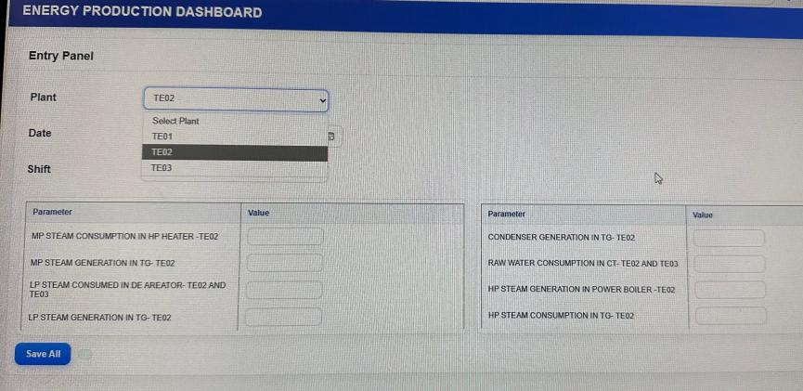
Dashboard Interface & Implementation:

Slide 12
