Slide 1
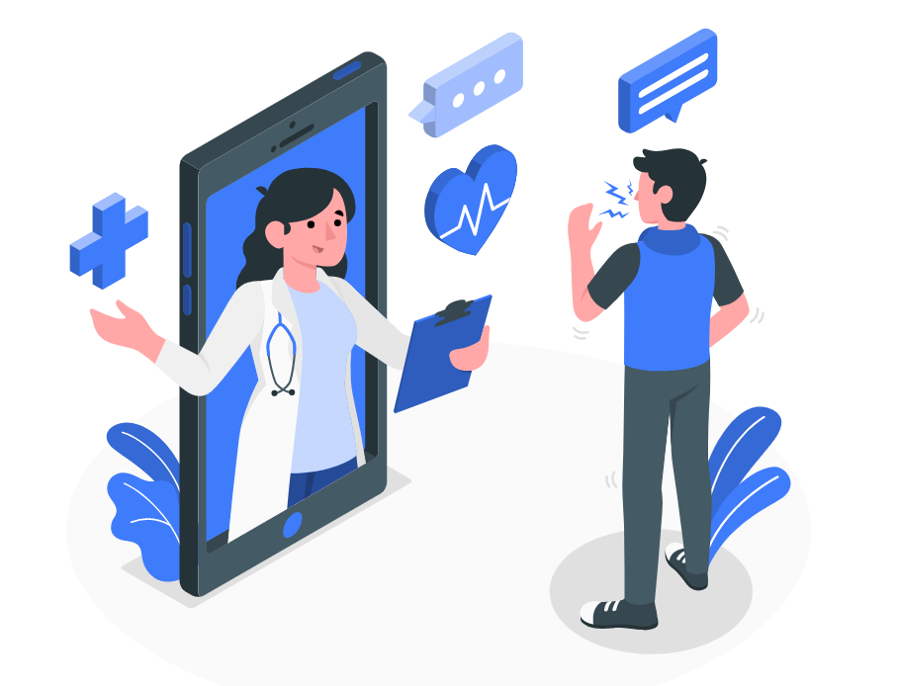


Final Project Demonstration
Group: 6
Professor: Dr. Tushar Sharma
TA: Ruchi Shinde

Slide 2
Team
Development Team – Group 6
Sai Chinthirla (B00911631)
Shivam Bhojani (B00895637)
Naga Pavan Srivathsav Chevuru (B00893685)
Bijitashya Birinchi (B00894879)
Heli Bhavsar (B00873208)
Client Team – Group 14
Dharminsinh Pankajsinh Rathod (B00908277)
TejaswiniRallapalli (B00888478)
SparshPurwar (B00885683)
Nirav Radadiya (B00909651)
ShivamRank (B00897772)

Slide 3
Summary
CareU is an appointment scheduler with doctor for both online and offline consult.
This provides various filters to search from a multitude of options of doctors to get the best fit for patient's needs.
Provides Email alerts to patients regarding the prescription by the doctor.
Doctors can vary the availability times based on their schedule.
Patients can book appointments as well as cancel their appointments with doctors.

Slide 4
Project Dashboard
JIRA Statistics
Total Number of JIRA tickets = 80
Total Number of User Stories = 25
Total Number of Task = 44
Total Number of Bugs = 11
Task Completed by each member:
Member Name | User Stories | Task | Bugs | Total
Naga Pavan Srivathsav Chevuru | 6 | 7 | 2 | 15
Bijitashya Birinchi | 9 | 5 | 1 | 15
Heli Bhavsar | 3 | 13 | 1 | 17
Shivam Bhojani | 5 | 9 | 3 | 17
Sai Chinthirla | 3 | 7 | 4 | 14

Slide 5
Demo
Heroku Test Environment: https://careu-staging.herokuapp.com/
Heroku Production Environment: https://careu-web.herokuapp.com/

Slide 6
Project Status
Given By | Goals | Status
Client | Doctor Sign Up / Login | ✅
Client | Patient Sign Up / Login | ✅
Client | Gmail Login | ✅
Client | Doctor can upload license proof | ✅
Client | Appointment scheduling by patient user | ✅
Client | Doctor can give prescription for each scheduled appointment | ✅
Client | Alert patients via email when doctor writes prescription | ✅
Client | Generate Bills at the end of Appointment Booking | ✅
Client | Patient can see their Past, Current and Future booked appointments | ✅
Client | Doctor user can edit his/her details | ✅
Client | Patient user can edit his/her details | ✅
Client | Patient can give feedback on Past Appointments | ✅
Client | Search Doctor based on various filter options | ✅
Suggested by Dev team | Payment feature: Patient can pay online at the time of booking appointment | ✅
Suggested by Dev team | Doctor can set their availability from the portal | ✅
Suggested by Dev team | Patient’s diseases data is encrypted, respecting the privacy of users. | ✅

Slide 7
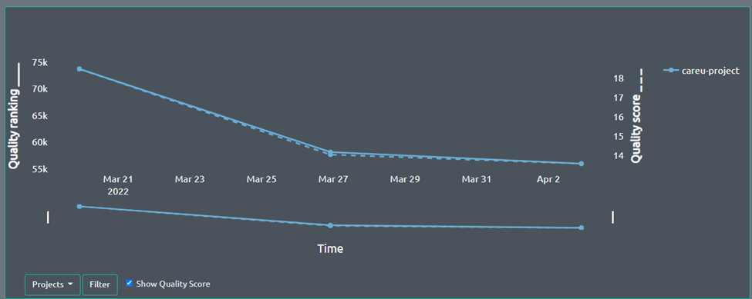
QScored Quality Graph

Slide 8
Learnings
Learnings:
Experienced the simulated Client and Development environment similar to real industry standards.
Explored new framework.
Experienced the whole SDLC.
Team work
If we get chance to repeat the project:
Would focus more on the UI to increase the user experience and making it easy to understand.
Making the product compliant with various medical policy and compliance.
Enhance the payment feature with refund policy as per the business requirement.

Slide 9

Questions

Slide 10


