Slide 1




























Student performance Analysis
IBM3077
Operatives
Panipat Institute Of Engineering & Technology

Slide 2


Mohan Jha
Shivam
Isha Khurana
Anurag Saikia
Nikhil Bhola
Harsh

Slide 3

Overview of the Project
The project aims to analyze factors influencing student performance, focusing on attendance records, demographic information, Parental Support,etc. By leveraging data from sources such as Kaggle, the project will identify key determinants of academic success, develop predictive models, and propose targeted interventions to improve educational outcomes, aligning with SDG 4: Quality Education. Visualizations will effectively communicate findings and inform policy recommendations.

Slide 4
Objective
The project aims to analyze key factors influencing student academic performance, focusing on Extracurricular activities ,Educational status , parental support, region and culture. Using data from sources like Kaggle, it seeks to develop predictive models and generate actionable insights. These insights will guide targeted interventions and policy recommendations to enhance educational outcomes and promote equity in education, aligning with SDG 4: Quality Education.
Identify Key Factors
Data Analysis
Predictive Modeling
Intervention Strategies
Policy Recommendations
Visualization
Global Impact

Slide 5


Problem Statement
The academic performance of high school students is influenced by a complex interplay of factors, ranging from personal characteristics to environmental influences. Understanding these factors is crucial for educators, policymakers, and parents to effectively support student success. However, the relative impact of various elements such as study habits, parental education, extracurricular activities, and demographic factors on student GPA remains unclear. This project aims to analyze a dataset of 2391 high school students to identify and quantify the key determinants of academic performance. By uncovering these relationships, we seek to provide insights that can inform targeted interventions and strategies to improve overall student achievement in secondary education.

Slide 6
Significance of the Problem
1. Educational Equity: Identifying factors influencing academic performance can help address disparities and promote equal opportunities for all students.
2. Resource Allocation: Understanding key determinants of student success allows for more efficient and effective allocation of educational resources and support services.
3. Policy Development: Insights from this analysis can inform evidence-based education policies and targeted intervention programs.
4. Student Well-being :Recognizing the impact of various factors on academic performance can lead to more holistic approaches to student development and mental health.
5. Economic Impact: Improving academic outcomes can lead to a more skilled workforce, potentially boosting economic growth and innovation in the long term.

Slide 7
Relevant SDGs
SDG 4: Quality Education
Overview: SDG 4 aims to ensure inclusive and equitable quality education and promote lifelong learning opportunities for all. It recognizes that education is essential for improving people's lives and sustainable development. Achieving this goal involves providing quality education at all levels, increasing access to education, and addressing disparities in educational opportunities.
Our project focuses on analyzing and identifying key factors that influence student academic performance, particularly looking at Extracurricular activities ,Educational status , parental support, region and culture.

Slide 8


Sources Of Data
Kaggle
For this project, our sole source of data is Kaggle. Kaggle provides a comprehensive and diverse set of educational datasets, which we leveraged to analyze the key factors influencing student academic performance. By using Kaggle's datasets, we ensured access to high-quality, structured data that allowed us to develop predictive models and generate actionable insights. This focused approach facilitated a robust analysis aligned with our project objectives and SDG 4: Quality Education.

Slide 9
Data description
Student ID
StudentID: A unique identifier for each student (1001 to 3392).
Demographic Details
Age: Students' ages, ranging from 15 to 18 years.
Gender: Gender of the students (0 = Male, 1 = Female).
Ethnicity: The ethnicity of the students,
ParentalEducation: Education level of the parents.
Study Habits
StudyTimeWeekly: Weekly study time (0 to 20 hours).
Absences: Number of absences during the school year (0 to 30).
Tutoring: Tutoring status (0 = No, 1 = Yes).
Parental Involvement
ParentalSupport: Level of parental support.

Slide 10
Data description
Extracurricular Activities
Extracurricular: Participation in extracurricular activities (0 = No, 1 = Yes).
Sports: Participation in sports (0 = No, 1 = Yes).
Music: Participation in music activities (0 = No, 1 = Yes).
Volunteering: Participation in volunteering (0 = No, 1 = Yes).
Academic Performance
GPA: Grade Point Average (2.0 to 4.0), influenced by study habits, parental involvement, and nk extracurricular activities.
Target Variable: Grade Class
GradeClass: Classification of students' grades based on GPA.

Slide 11


1. Import Data
- Load dataset into analysis tool (e.g., Python, Excel, R).
2. Check for Missing Values
- Identify: Detect null or empty cells.
- Strategy:
- Imputation: Fill with mean, median, or mode.
- Removal: Drop rows/columns with insignificant missing values.
3. Handle Outliers
- Identify: Use box plots or z-scores.
- Address:
- Remove: Exclude values outside a defined range.
- Cap: Limit values to a specific percentile.
4. Encode Categorical Variables
- One-Hot Encoding: Create binary columns for each category.
- Label Encoding: Assign numerical values to categories.
5. Normalize/Standardize Numerical Variables
- Normalize: Scale values to a 0-1 range.
- Standardize: Adjust values to a mean of 0 and standard deviation of 1.

Slide 12
Data Cleaning Part in Project:-
After thoroughly reviewing the student performance dataset, we found no issues requiring data cleaning. The dataset is complete, with no missing values, outliers, or inconsistencies. Additionally, all categorical and numerical variables are well-defined and within expected ranges. Thus, the data is ready for analysis without further preprocessing.
Label Encoding:-
We applied label encoding to several categorical columns to prepare the data for linear regression analysis. Specifically, the columns ethnicity, gender, parental education, and parental support were converted into numerical values. This encoding ensures that these categorical variables can be effectively used in the linear regression model, helping to quantify their impact on student performance.

Slide 13



Analytical Tools and Methods used
Tools:
scikit learn
Matplotlib
Seaborn
Plotly
Methods:
Descriptive statistics
Exploratory Data Analysis (EDA)
Regression Analysis
Classification
Clustering
Correlation Analysis

Slide 14
Key Findings
Accuracy: 0.97
Precision
(Class 0): 0.99
(Class 1): 0.96
(Class 2): 0.98
Recall:
(Class 0): 0.98
(Class 1): 0.98
(Class 2): 0.96
IV. F1-Score:
(Class 0): 0.98
(Class 1): 0.97
(Class 2): 0.97

Slide 15
Insights derived
Accuracy:
This represents the percentage of correctly classified instances out of all instances. An accuracy of 97% suggests that the model performs exceptionally well on classification tasks.
Precision
Precision measures the proportion of true positive predictions among all positive predictions made by the model. The model is highly precise for all classes, with the highest precision for Class 0.
Recall:
Recall measures the proportion of actual positives correctly identified by the model. The model has high recall for all classes, indicating it successfully identifies most of the true positives.
IV. F1-Score:
The F1-score is the harmonic mean of precision and recall. High F1-scores across all classes suggest a balanced performance between precision and recall, indicating the model's robustness.

Slide 16


Formulated Hypothesis: "Students who engage in extracurricular activities (sports, music, or volunteering) will have higher GPAs compared to those who do not participate in such activities."
Rationale Behind the Hypothesis: Extracurricular activities can develop time management skills, discipline, and cognitive abilities that may translate to improved academic performance. They also provide stress relief and social connections that could positively impact overall well-being and, consequently, academic achievement.
Method for Testing the Hypothesis:
Conduct a statistical analysis comparing the mean GPAs of students involved in extracurricular activities versus those who are not.
Use t-tests or ANOVA to determine if there's a significant difference between the groups.
Control for other variables like study time, parental education, and absences to isolate the effect of extracurricular activities.

Slide 17
Data Preparation:
- Created binary variables for participation in sports, music, and volunteering.
- Calculated a composite score for "extracurricular involvement."
Statistical Analysis:
- Conducted t-tests to compare GPA means between participants and non-participants in extracurricular activities.
- Performed a multiple regression analysis with GPA as the dependent variable and extracurricular involvement as an independent variable, controlling for other factors.
Visualization:
- Produced box plots showing GPA distributions for each extracurricular activity.
- Created a scatter plot of the extracurricular involvement score versus GPA.
Alignment with SDGs:
- The research supports SDG 4 (Quality Education) by exploring factors that may enhance academic outcomes and SDG 3 (Good Health and Well-being) by promoting holistic student development through extracurricular activities.
Solution and Recommendations:
- If results support the hypothesis, advocate for more funding and opportunities for extracurricular activities.
- If not, investigate alternative factors influencing academic performance.
- Develop programs integrating academic and extracurricular skills.
- Raise awareness among parents and educators about the benefits of balanced extracurricular involvement.

Slide 18


Data Visualization techniques used
Histogram
Boxplot
KDE plot
Barplot
Contingency Table heatmap
Heatmap
Scatter Plot
Jointplot
Faceplot
PairPlot

Slide 19
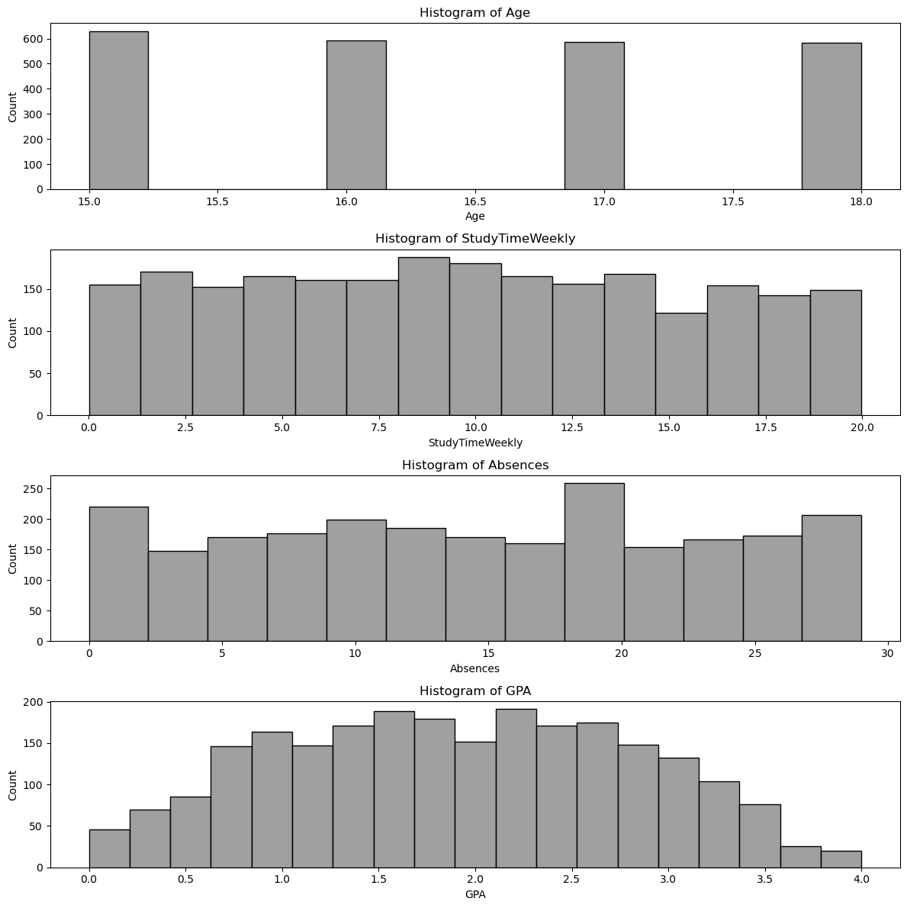
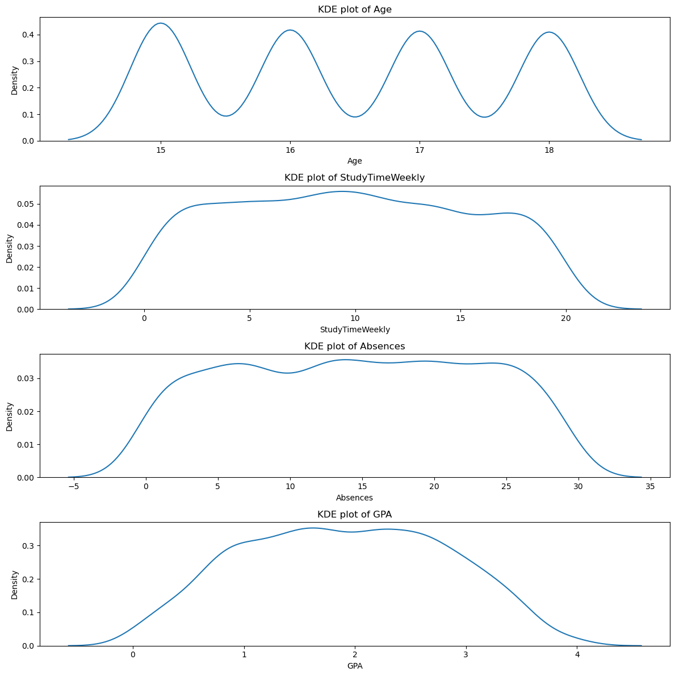
Charts, Graphs, Plots

Slide 20
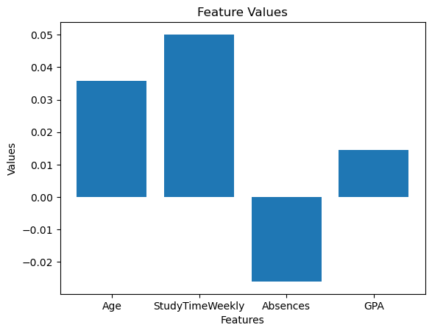
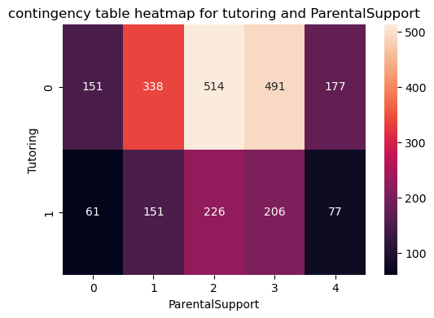
Charts, Graphs, Plots

Slide 21
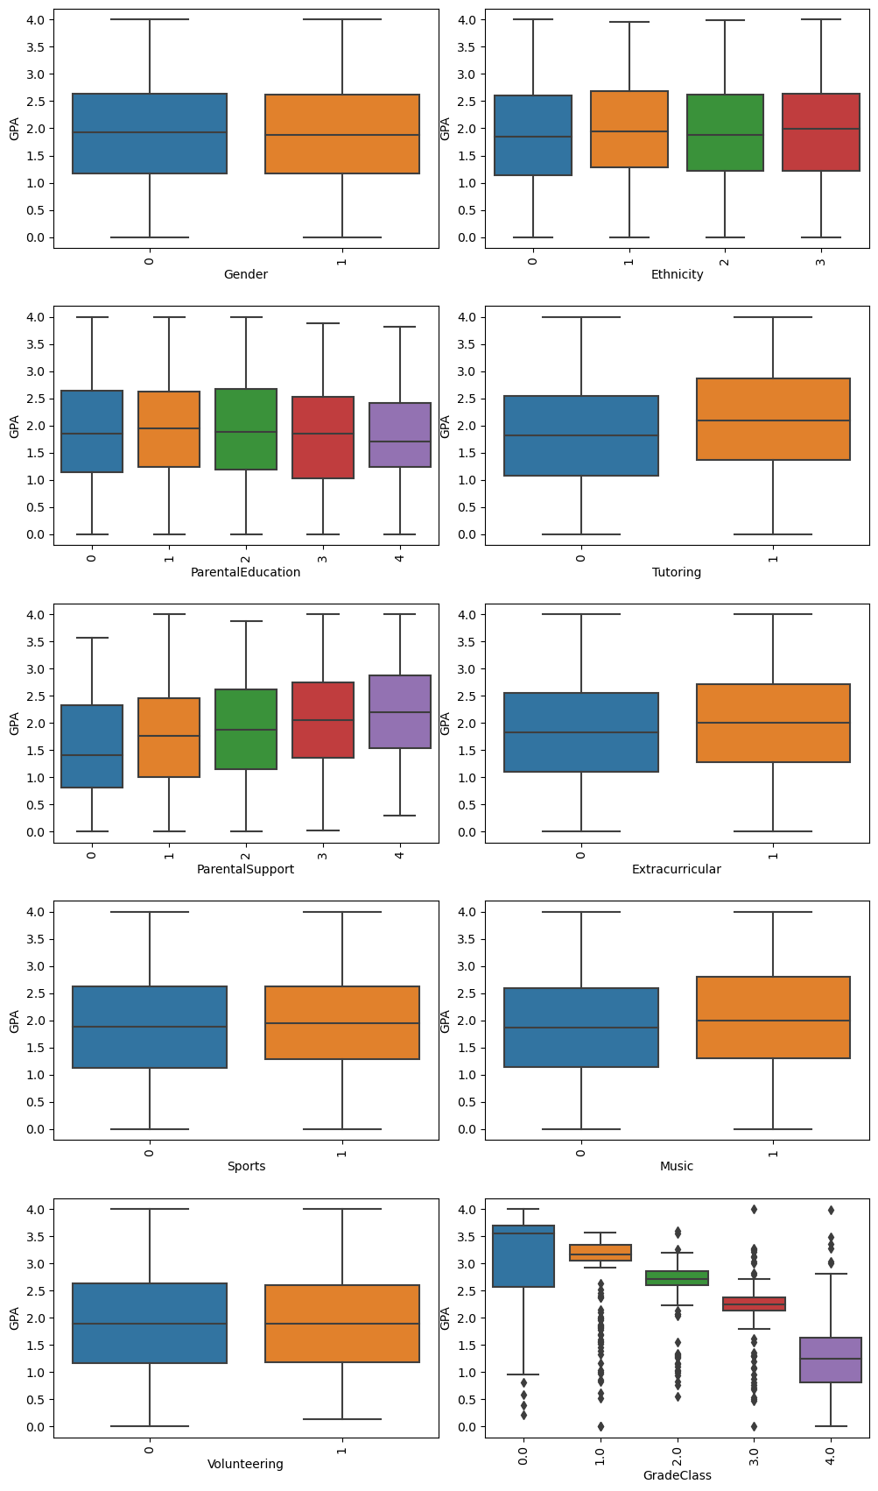
Charts, Graphs, Plots

Slide 22
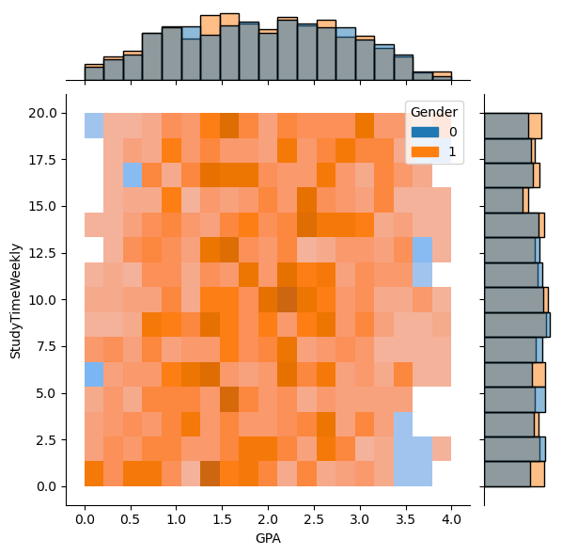
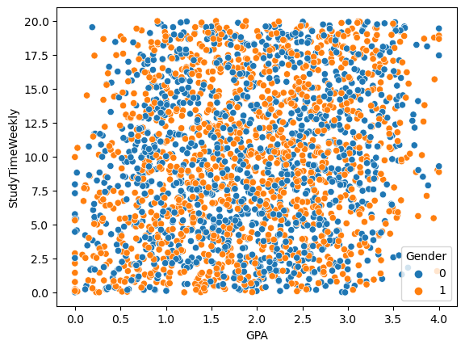
Charts, Graphs, Plots

Slide 23
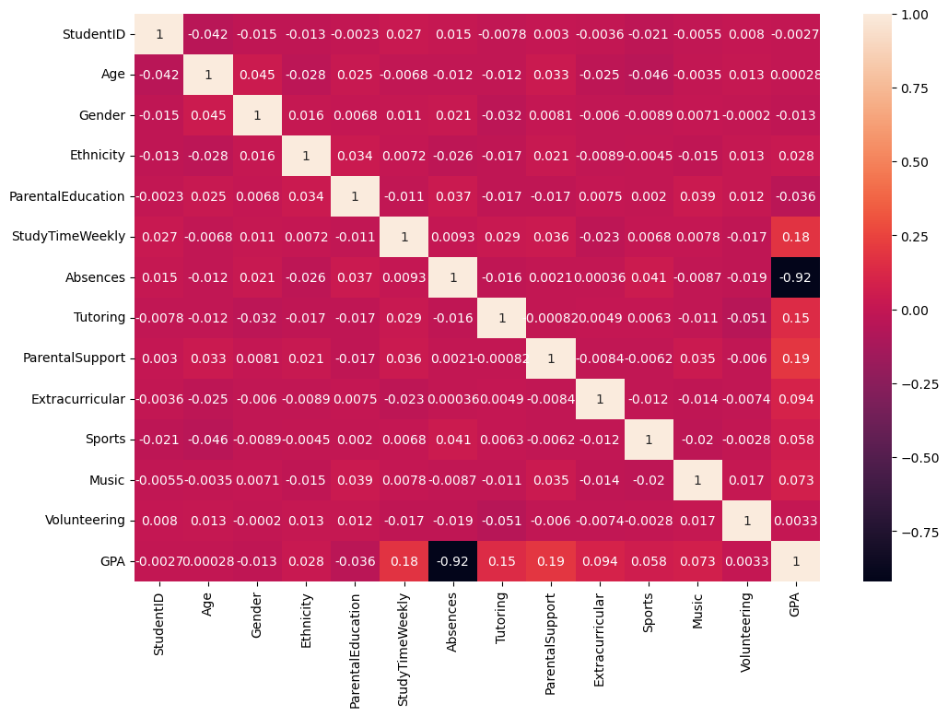
Charts, Graphs, Plots

Slide 24
Key Visual Insights
Important features:
Important features are StudyTimeWeekly, Tutoring, Parentalsupport, ooooextracuriicular, music,sports

Slide 25

Data Sources:
Kaggle
For this project, our sole source of data is Kaggle. Kaggle provides a comprehensive and diverse set of educational datasets, which we leveraged to analyze the key factors influencing student academic performance. By using Kaggle's datasets, we ensured access to high-quality, structured data that allowed us to develop predictive models and generate actionable insights. This focused approach facilitated a robust analysis aligned with our project objectives and SDG 4: Quality Education.

Slide 26
Tools and Softwares used:
Tools:
scikit learn
Matplotlib
Seaborn
Plotly
Tools:
scikit learn
Matplotlib
Seaborn
Plotly
Software:
Jupyter notebook

Slide 27
Additional References:
OpenAI
Google
Kaggle: Your Machine Learning and Data Science Community

Slide 28

Summary of Findings:
- GPA Distribution: Average GPA is 2.01, with a wide range.
- Study Time Impact: Moderate positive correlation with GPA.
- Parental Education: Slight GPA increase with higher education levels.
- Absences: Strong negative correlation with GPA.
- Extracurricular Activities: Positive association with sports and music; no significant impact from volunteering.
Impact of Proposed Solutions:
- Targeted Study Programs: Potential GPA increase by 0.3-0.5 points.
- Attendance Improvement: Estimated 0.4 point GPA increase.
- Extracurricular Enhancement: Small GPA boost with increased participation.
- Parental Engagement: Possible 0.1-0.2 point GPA improvement.
Future Work:
- Longitudinal Study, Qualitative Research, Socioeconomic Analysis
- Technology Integration, Mental Health Factors, Peer Influence Study
- Teacher Quality Assessment

