Slide 1

Leadership

Slide 2

What Is Leadership?
Leadership
The ability to influence a group toward the achievement of goals.

Slide 3
LEADERSHIP
Leadership : The ability to influence a group towards the achievement of vision or set of goals.
Leadership is the process of encouraging and helping others to work enthusiastically towards objectives.
Leadership is the relationship in which one person influence others to work together willingly on related task to attain goals.

Slide 4
TRAIT THEORY
Innate qualities are those which are possessed by various individuals since their birth. These qualities are natural and often known as god-gifted.
PHYSICAL FEATURES
INTELLIGENCE
Acquirable qualities are those which can be acquired and increased through various process.
Emotional stability
Human relations
Empathy
Objectivity
Motivating skills
Technical skills
Communicative skills
Social skills

Slide 5
CRITICAL ANALYSIS OF TRAIT THEORY
Limitations:
It does not identify the traits that are most important and that are least important for a successful leader.
Some traits may not be inherited, but can only be acquired by training.
No universal traits found that predict leadership in all situations.
Unclear evidence of the cause and effect of relationship of leadership and traits.
Better predictor of the appearance of leadership than distinguishing effective and ineffective leaders.

Slide 6
BEHAVIORAL THEORY
Beginning in 1940 to 1960s…
Theories proposing that specific behaviors differentiate leaders from non-leaders.
Trait theory: Leaders are born, not made.
Behavioral theory: Leadership traits can be taught.

Slide 7
BEHAVIORAL THEORY
Ohio State University Studies:
Identified two major kinds of leadership behaviors or styles
Initiating-structure behavior: The leader clearly defines the leader-subordinate roles so that everyone knows what is expected. The leader also establishes formal lines of communication and determines how tasks will be performed.
The extent to which a leader is likely to define and structure his or her role and those of sub-ordinates in the search for goal attainment.
Consideration behavior: The leader shows concern for subordinates feelings' and ideas. He attempts to establish a warm, friendly and supportive relationship.
The extent to which a leader is likely to have job relationships characterized by mutual trust, respect for subordinate’s ideas, and regard for their feelings.

Slide 8
BEHAVIORAL APPROACH
University of The Michigan Studies:
Led by Rensis Likert,
Broad discussions with both the managers and sub-ordinates,
Two forms of leadership behavior.
Job-centered leadership behavior : focuses on performances and efficient completion of the assigned tasks. explain task procedures and oversee their work.
Employee centered leadership behavior: focuses on, developing a cohesive work group and ensuring that employees are satisfied with their jobs. Thus, the leader's primary concern is the welfare of the subordinates.

Slide 9
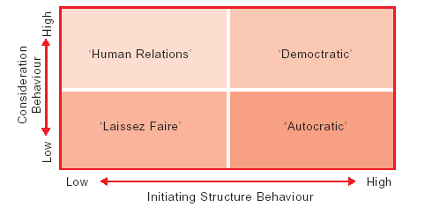
BEHAVIORAL APPROACH

Slide 10
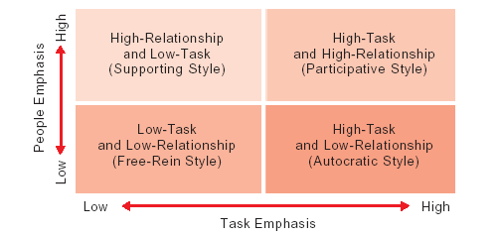
BEHAVIORAL APPROACH

Slide 11
BEHAVIORAL APPROACH
Exploitative-authoritative: The first system of Rensis Likert theory is characterized by decision-making in the upper levels of the organization, with no teamwork and little communication other than threats.
Benevolent-authoritative: This Likert system is based on a master-servant relationship between management and employees, where rewards are the sole motivators and both teamwork and communication are minimal.
Consultative: In this style, managers partly trust subordinates, use both rewards and involvement to inspire motivation, foster a higher level of responsibility for meeting goals, and inspire a moderate amount of teamwork and some communication.
Participative-group: This system is based on managerial trust and confidence in employees; collectively determined, goal-based rewards; a collective sense of responsibility for meeting company objectives; collaborative teamwork and open communication.

Slide 12
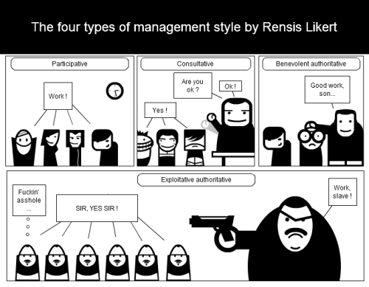
BEHAVIORAL APPROACH

Slide 13
Power orientation theory
Autocratic leadership
Participative
Free-rein

Slide 14
MANAGERIAL GRID THEORY
By: Blake and Mouton
Proposed a managerial grid based on style proposed by Michigan and Ohio state university:
“Concern of People” and “Concern of Production”
Grid identify the five basic style of leadership:
(9,1) Task management [concern about production]
(1,9) Country club management [concern about people]
(5,5) Middle of road management [moderate concern of both]
(9,9) Team management [high concern of both]
(1,1) Improvised management [minimum concern about both]

Slide 15
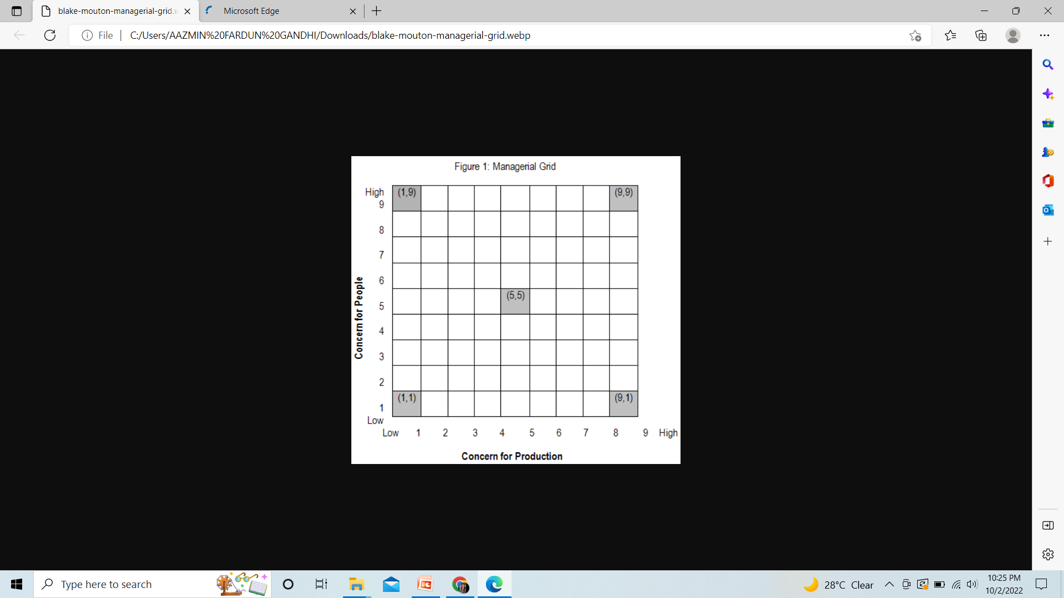

Slide 16
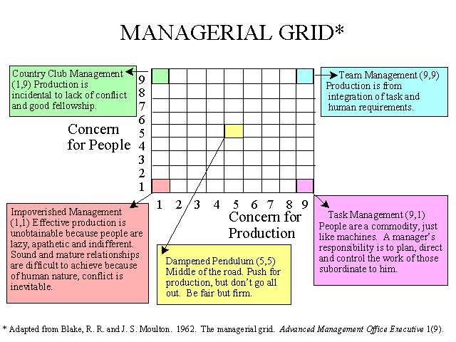

Slide 17
CONTINGENCY APPROACH
Predicting effectiveness on the basis of traits and behavior become more complex:
Contingency / situation:…..
Fiedler’s contingency model
The path goal theory
The situational leadership

Slide 18
FIEDLER’S CONTINGENCY MODEL
The theory that effective groups depend on a proper match between a leader’s style of interacting with subordinates and the degree to which the situation gives control and influence to the leader.
1) Identify the Leadership Style
Least Preferred Co-Worker (LPC) Questionnaire
An instrument that purports to measure whether a person is task- or relationship-oriented.

Slide 19
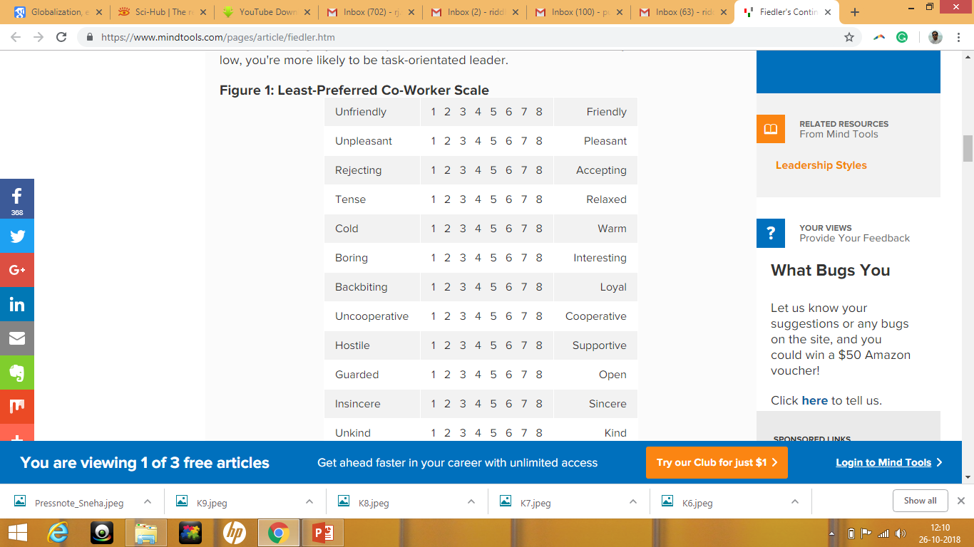
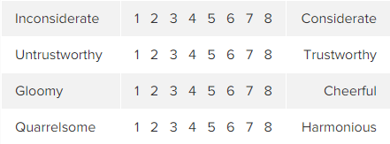

Slide 20
FIEDLER’S CONTINGENCY MODEL
Over all situation determine style of leadership:
Task orientated:
Emphasis on task
Use of power
Task structure
No consultation with subordinates
Relationship orientated:
Good interpersonal relationship
Sensitive to needs and feeling to others
Consolation with others
Open communication with subordinates

Slide 21
2) Defining the Situation
Three typeof situation:
High control situation
Low control situation
Moderate control situation
Leader-Member Relations
The degree of confidence, trust, and respect subordinates have in their leader.
Task Structure
The degree to which the job assignments are procedure.
Position Power
Influence derived from one’s formal structural position in the organization; includes power to hire, fire, discipline, promote, and give salary increases.

Slide 22
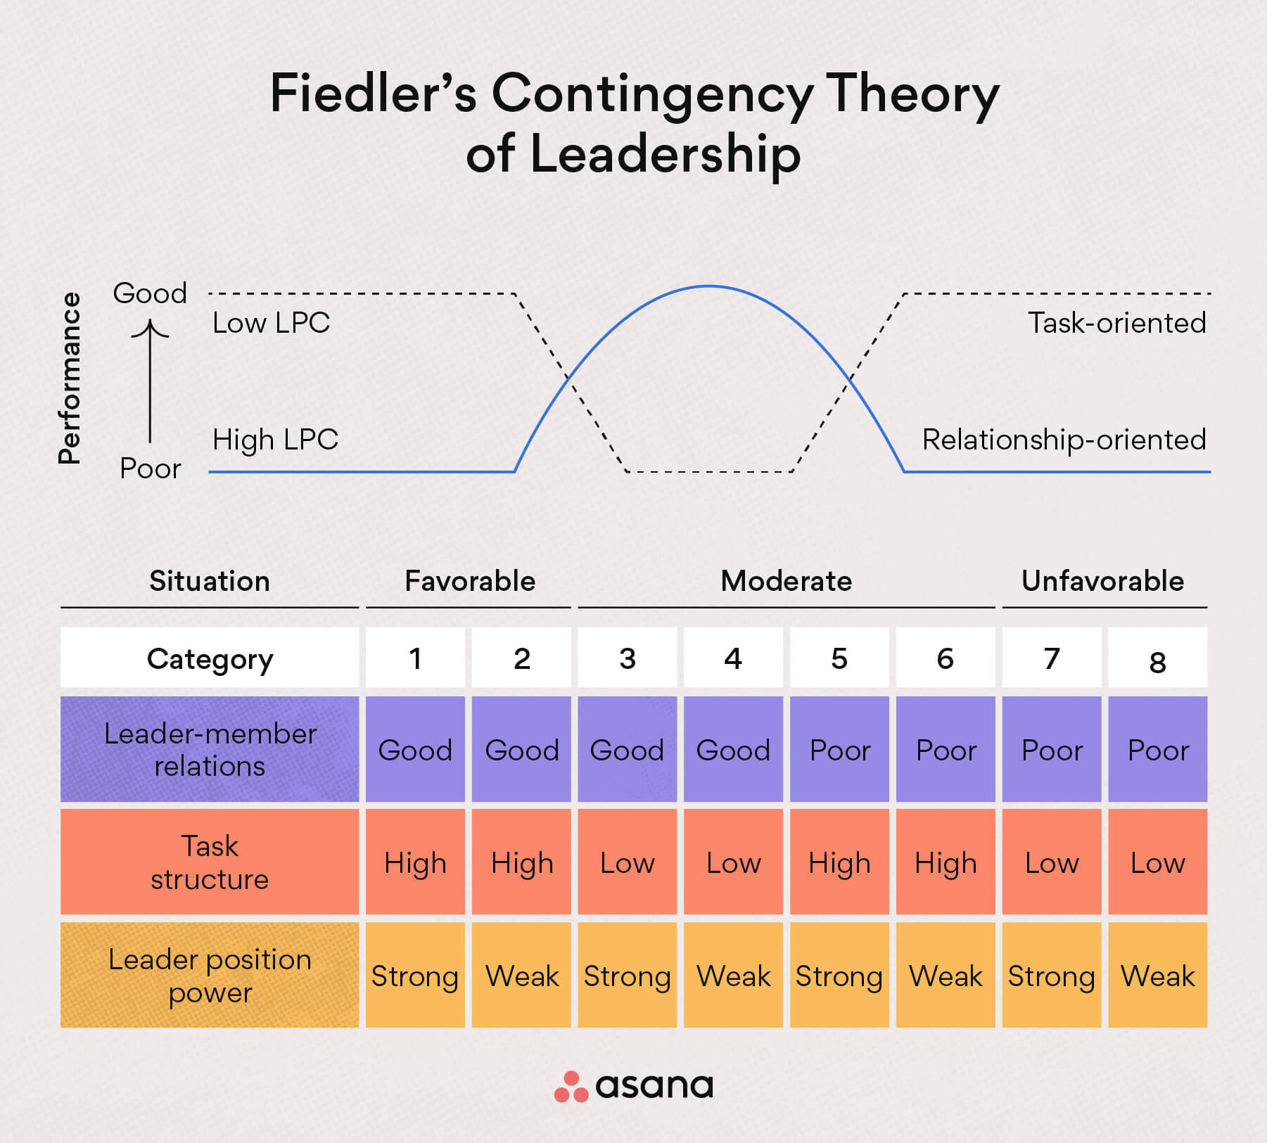

Slide 23
FIEDLER’S CONTINGENCY MODEL
Merits:
Attention to all three variables, leader, situation and subordinates
Provide the solution for improvement and future research
Provide training tool to leader to modify the situation
Demerits:
Difficult to classify task
No proper explanation how and why leader describe LPC
Tool (LPC) to measure is itself criticize: it is a feeling towards worker.
Assume the both leader and subordinates have adequate technical competence.

Slide 24
Path Goal Theory Of Leadership
BY ROBERT HOUSE:
Extracts elements from the Ohio State leadership research on initiating structure and consideration and the expectancy theory of motivation.
leader’s job to provide followers with the information, support, or other resources necessary to achieve their goals.
The term path–goal implies effective leaders clarify followers’ paths to their work goals and make the journey easier by reducing roadblocks.

Slide 25
Path-Goal Theory
Path-Goal Theory
The theory that it is the leader’s job to assist followers in attaining their goals and to provide them the necessary direction and/or support to ensure that their goals are compatible with the overall objectives of the group or organization.

Slide 26
Path Goal Theory Of Leadership
Leader must clarify the goal and clear the path for realizing the goal.
How leader influence the subordinate behavior related to work goal, personal goal and path to goal attainment.
LEADER MOTIVATING:
By increasing availability and attractiveness of rewards
By strengthening the expectancy that efforts can result in performance
Performance can result in rewards…

Slide 27
The Situational Leadership Theory
By Paul Hersey and Kenneth Blanchard
Add maturity as contingency variable…….
Leadership style depend on maturity level of subordinates
Maturity in this context means,
Desire for achievements
Willingness to accept responsibility
Task related ability
Experience
Leader and subordinates move through four stages.
Telling
Selling
Participating
Delegating

Slide 28
Hersey and Blanchard’s Situational Leadership Theory
Situational Leadership Theory (SLT)
A contingency theory that focuses on followers’ readiness.
Unable and Unwilling
Unable but Willing
Able and Unwilling
Able and Willing
Follower readiness: ability and willingness
Leader: decreasing need for support and supervision
Directive
High Task and Relationship Orientations
Supportive Participative
Monitoring

Slide 29
Leadership Styles and Follower Readiness (Hersey and Blanchard)
Follower Readiness
Unwilling
Willing
Able
Supportive Participative
Monitoring
Leadership Styles
High Task and Relationship Orientations
Unable
Directive

Slide 30
The Situational Leadership Theory
MERITS:
Recommend leadership style is dynamic
Most popular leadership training model
Special attention to followers and their feeling about the task
Can move followers towards the maturity
DEMERITS:
To assess maturity level is difficult task
Leader are adoptable but it may not be.
Leader treat each employee slightly different way

