Slide 1
MOTIVATION

Slide 2
The processes that account for an individual’s intensity, direction, and persistence of effort toward attaining a goal.
Motivation is the reason for people's actions, willingness and goals. Motivation is derived from the word motive which is defined as a need that requires satisfaction.
Key Elements:-
Intensity- how hard a person tries.
Direction- towards beneficial or goal.
Persistence-how long a person tries.

Slide 3
Motivation has to do with the forces that maintain and alter the direction, quality and intensity of behavior - Kelly (1974)
Motivation refers to ‘the willful desire to direct one’s behavior toward goal’ - Middles mist and Hit (1981)

Slide 4
TYPES OF MOTIVATION:-
1. Intrinsic Motivation- Intrinsic motivation is a type of motivation in which an individual is being motivated by internal desires.
2. Extrinsic Motivation- Extrinsic motivation, on the other hand, is a type of motivation in which an individual is being motivated by external desires.

Slide 5
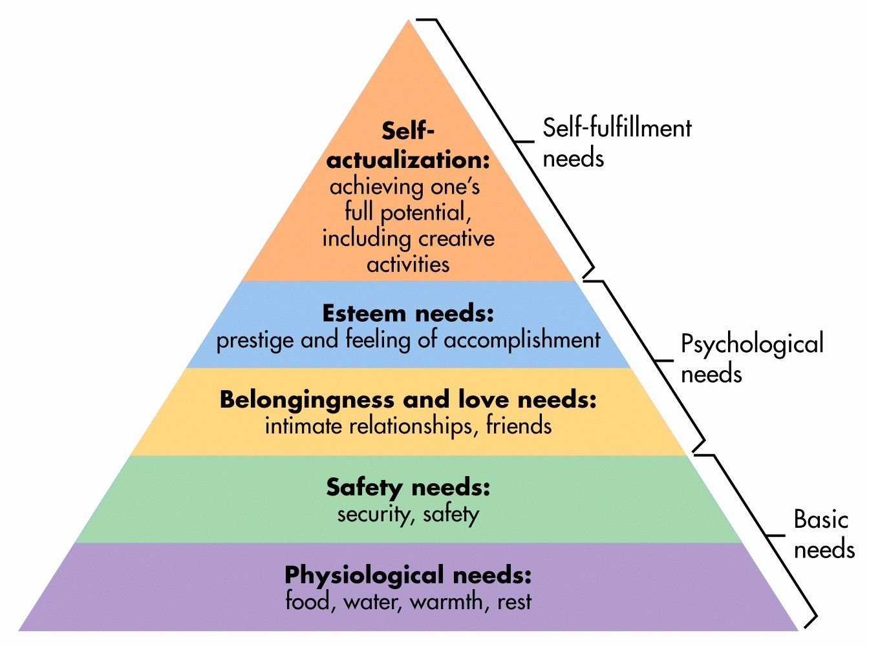
Maslow hierarchy of needs

Slide 6
1.Physiological – these needs must be met in order for a person to survive, such as food, water and shelter.
2. Safety – including personal and financial security and health and wellbeing.
3. Love/belonging – the need for friendships, relationships and family.
4. Esteem – the need to feel confident and be respected by others.
5. Self-actualization – the desire to achieve everything you possibly can and become the most that you can be.

Slide 7
Hertzberg’s Two-Factor Theory
Motivator factors – Simply put, these are factors that lead to satisfaction and motivate employees to work harder. Examples might include enjoying your work, feeling recognized and career progression.
Hygiene factors – These factors can lead to dissatisfaction and a lack of motivation if they are absent. Examples include salary, company policies, benefits, relationships with managers and co-workers.

Slide 8
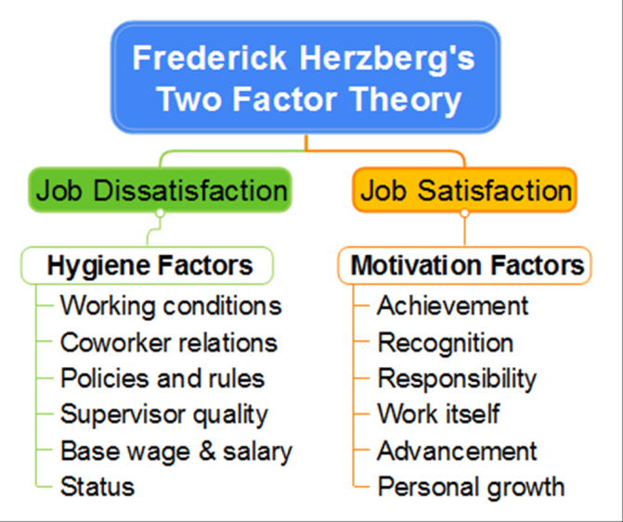

Slide 9
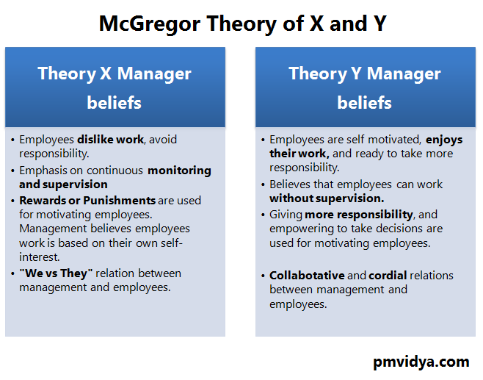
Mc Gregor theory x and theory y

Slide 10
REINFORCEMENT THEORY
For motivating people to engage in desirable behaviour and refraining from undesirable behaviour, managers must use following methods:-
1.Positive reinforcement
2. Negative reinforcement
3. Punishment
4. Extinction
Traditional carrot and stick approach of motivation is based on reinforcement theory.

Slide 11
Theory Z by OUCHI
Trust
Strong bond between organisation and employees
Employee involvement
No formal structure
Coordination of human beings

Slide 12
BENEFITS OF MOTIVATION
1. Need satisfaction
2. Job satisfaction
3. Productivity
4. Learning
5. Discipline

