Slide 1
Planning

Slide 2
What is the Role of Planning in Artificial Intelligence?
Planning is an important part of Artificial Intelligence which deals with the tasks and domains of a particular problem. Planning is considered the logical side of acting.
Everything we humans do is with a definite goal in mind, and all our actions are oriented towards achieving our goal. Similarly, Planning is also done for Artificial Intelligence.
For example, Planning is required to reach a particular destination. It is necessary to find the best route in Planning, but the tasks to be done at a particular time and why they are done are also very important.
That is why Planning is considered the logical side of acting. In other words, Planning is about deciding the tasks to be performed by the artificial intelligence system and the system's functioning under domain-independent conditions.

Slide 3
What is Plan?
We require domain description, task specification, and goal description for any planning system. A plan is considered a sequence of actions, and each action has its preconditions that must be satisfied before it can act and some effects that can be positive or negative.
Two types:
1. Forward State Space Planning (FSSP):- FSSP behaves in the same way as forwarding state-space search. It says that given an initial state S in any domain, we perform some necessary actions and obtain a new state S', called a progression. It continues until we reach the target position. Action should be taken in this matter.
Disadvantage: Large branching factor
Advantage: The algorithm is Sound

Slide 4
Conti.
2. Backward State Space Planning (BSSP):- BSSP behaves similarly to backward state-space search. In this, we move from the target state g to the sub-goal g, tracing the previous action to achieve that goal. This process is called regression (going back to the previous goal or sub-goal). These sub-goals should also be checked for consistency. The action should be relevant in this case.
Advantage: Small branching factor (much smaller than FSSP)
So for an efficient planning system, we need to combine the features of FSSP and BSSP, which gives rise to target stack planning which will be discussed in the next article.
Disadvantages: not sound algorithm (sometimes inconsistency can be found)

Slide 5
Block-world planning problem
The block-world problem is known as the Sussmann anomaly.
The non-interlaced planners of the early 1970s were unable to solve this problem. Therefore it is considered odd.
When two sub-goals, G1 and G2, are given, a non-interleaved planner either produces a plan for G1 that is combined with a plan for G2 or vice versa.
In the block-world problem, three blocks labeled 'A', 'B', and 'C' are allowed to rest on a flat surface.
The given condition is that only one block can be moved at a time to achieve the target.

Slide 6
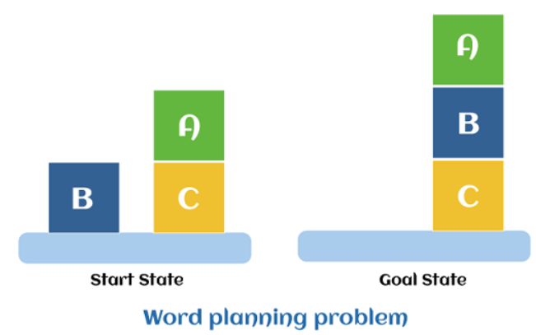
Conti.
The start position and target position are shown in the following diagram.
Components of the planning system
The plan includes the following important steps:
Choose the best rule to apply the next rule based on the best available guess.
Apply the chosen rule to calculate the new problem condition.
Find out when a solution has been found.
Detect dead ends so they can be discarded and direct system effort in more useful directions.
Find out when a near-perfect solution is found.

Slide 7
Target stack plan
It is one of the most important planning algorithms used by STRIPS.
Stacks are used in algorithms to capture the action and complete the target. A knowledge base is used to hold the current situation and actions.
A target stack is similar to a node in a search tree, where branches are created with a choice of action.
The important steps of the algorithm are mentioned below:
Start by pushing the original target onto the stack. Repeat this until the pile is empty. If the stack top is a mixed target, push its unsatisfied sub-targets onto the stack.
If the stack top is a single unsatisfied target, replace it with action and push the action precondition to the stack to satisfy the condition.
iii. If the stack top is an action, pop it off the stack, execute it and replace the knowledge base with the action's effect.
If the stack top is a satisfactory target, pop it off the stack.

Slide 8
Non-linear Planning
This Planning is used to set a goal stack and is included in the search space of all possible sub-goal orderings. It handles the goal interactions by the interleaving method.
Advantages of non-Linear Planning
Non-linear Planning may be an optimal solution concerning planning length (depending on the search strategy used).
Disadvantages of Nonlinear Planning
It takes a larger search space since all possible goal orderings are considered.

Slide 9
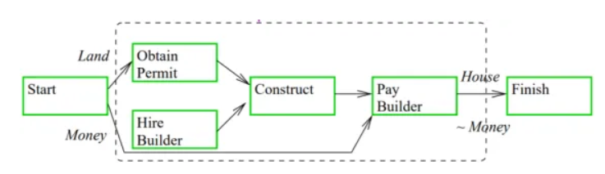
Hierarchical Planning
Here the plans are organized in a hierarchical format. It works on plan decomposition. Complex actions are decomposed into simpler or primitive ones and it can be denoted with the help of links between various states at different levels of the hierarchy. This is called operator expansion.
Primitive tasks- these correspond to the actions of STRIPS,
Compound tasks- these are a set of simpler tasks,
Goal tasks- these correspond to goals of STRIPS.
In Hierarchical Planning, we find a sequence of primitive tasks by decomposition of compound tasks, in order to reach the goal. For example, in case of building a house, hierarchical planning is used as shown below.

Slide 10
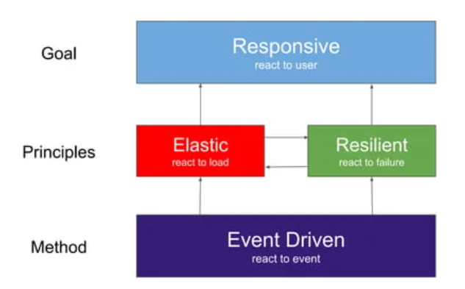
Reactive Systems
Reactive systems are continuously stimulated by the external environment, and their role is to continuously respond to these stimuli.

Slide 11
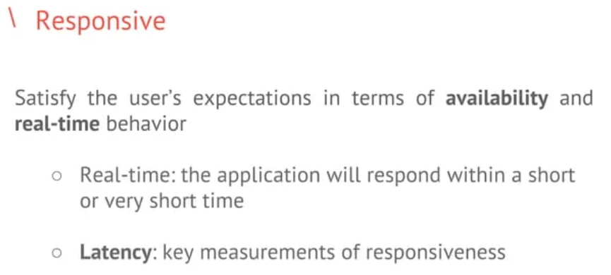

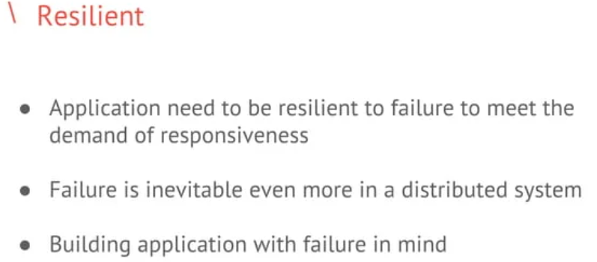
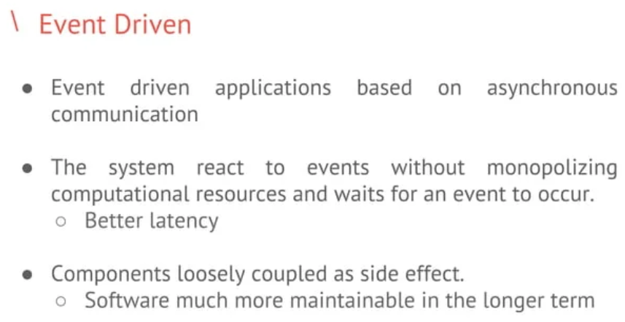
Conti.

Slide 12
Various Planning Techniques
Several planning techniques are described below.
(1) Hierarchical Planning: In hierarchical planning, at each level of hierarchy the objective functions are reduced to a small number of activities at the next lower level. So the computational cost of finding the correct way to arrange these activities for the current problem is small. Hierarchical methods can result in linear time.
(2) Conditional Planning: It deals with the planning by some appropriate conditions. The agents plan first and then execute the plan that was produced. The agents find out which part of the plan to execute by including sensing actions in the plan to test for the appropriate conditions.
(3) Exact Planning: It is also called as conformation planning. It ensures that the plan achieves the goal in all possible circumstances regardless of the true initial state and the actual actions outcome. This planning is based on the idea that the world can be forced into a given state even when the agent has only partial information about the current state.
(4) Replanning: It occurs when there is any wrong information regarding with the planning. The agent can plan the same plan as the conditional planner or some new steps.

Slide 13
Conti.
(5) Continuous Planning: In this planning, the planner at first achieves the goal and then only can stop. A continuous planner is designed to persist over a lifetime. It can handle any unfavorable circumstances in the environment.
(6) Multiagent Planning: In multiagent planning some other new agents may involved with our single agent in the environment. This may lead to a poor performance because dealing with other agents is not the same as dealing with the nature. It is necessary when there are other agents in the environment with which to cooperate, compete or coordinate.
(7) Multibody Planning: This planning constructs joint plans, using an efficient decomposition of joint action descriptions, but must be augmented with some form of co-ordination of two cooperative agents are to agree on which joint plan to execute.

