Slide 1

Music Genre Classification
IE406: Final Project
Group 4
Instructor : Prof. Manjunath Joshi
Group Members :
Rohin Nanavati - 201801108
Shivam Bodiwala – 201801111
Ravi Makwana - 201801461

Slide 2
Problem Statement
We are going to develop a machine learning project to automatically classify different musical genres from audio files.
Input – Audio file(in .wav format)
Output – Genre of given audio file
The idea of combining both music and data sounded very interesting to us. Innovative and famous companies such as Spotify and Jio Saavn have been able to support music data in a clever way to provide amazing services to its users.

Slide 3
Problem Statement (Continued)
We wanted to try our hands at working with audio data and try to build a model that could automatically classify a song by its genre.
There are two major challenges with this problem:-
Musical genres are not very accurately defined. So people are often confused which genre the song belongs to !
It is a not an easy task to extract differentiating features from audio data that could be fed into our model.

Slide 4
Dataset Description
Source :
https://www.kaggle.com/andradaolteanu/gtzan-dataset-music-genre-classification (features_3_sec.csv file)
Description :
This dataset was used for the well known paper in genre classification " Musical genre classification of audio signals " by G. Tzanetakis and P. Cook in IEEE Transactions on Audio and Speech Processing 2002.
The dataset consists of 1000 audio tracks each 30 seconds long. It contains 10 genres, each represented by 100 tracks. The tracks are all 22050 Hz Mono 16-bit audio files in .wav format.

Slide 5
Dataset Description(Continued)
Total number of Training Examples: 9990
Total number of Classes: 10 which are:
Blues
Classical
Country
Disco
Hiphop
Jazz
Metal
Pop
Reggae
Rock
Total number of Features: 57

Slide 6
chroma_stft_mean | chroma_stft_var | harmony_mean | harmony_var
zero_crossing_rate_mean | zero_crossing_rate_var | perceptr_mean | perceptr_var
spectral_centroid_mean | spectral_centroid_var | mfcc1_mean | mfcc1_var
spectral_bandwidth_mean | spectral_bandwidth_var | ……………….. | ……………...
rms_mean | rms_var | mfcc20_mean | mfcc20_var
rolloff_mean | rolloff_var | tempo

Slide 7
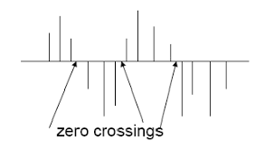
Explanation of some features
Zero crossing rate = (Number of time signal crosses x-axis)/(Total samples-1)
= 3/13
= 0.23
Chroma
Total 12 notes
Accumulation of spectral coefficients of the same harmonic
Because human perceives C0, C1, C2, C3, …, C8 as same
Coefficient of C note= sum of coefficient of notes C0 to C8

Slide 8
Explanation of some features(continued)
Spectral centroid(f_{c}): Indicates at which frequency the energy of spectrum is centered upon
Spectral Bandwidth: Indicated the weighted standard deviation from the spectral centroid
RMS : Represents the average energy of the audio signal
Roll-off: Is the frequency below which a specified percentage of total energy lies. (default percentage=85 in librosa module of python)

Slide 9
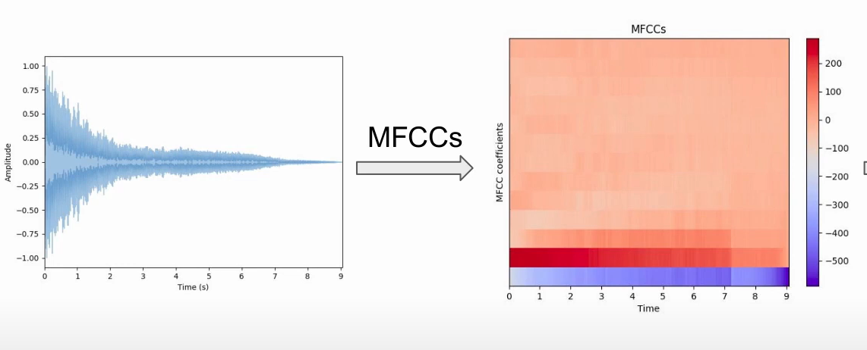
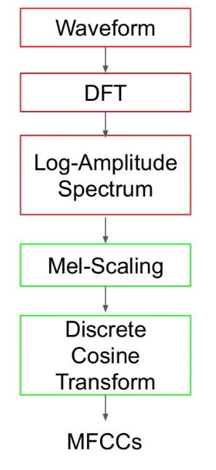
Explanation of some features(continued)

Slide 10
Methodology 1: K-means Algorithm
Cluster No | Number of Datapoint
0 | 269
1 | 2343
2 | 1674
3 | 498
4 | 71
5 | 1255
6 | 2538
7 | 821
8 | 186
9 | 335

Slide 11
Possible reasons for failure of K-means Algorithm
Clustering itself is loosely defined problem.
It’s very hard to find similarity without labels
Algorithm may suffer from scarcity of features
Fail to identify nested clusters, spirals, long thin clusters
Music Genres are often found to be overlapping with each other, so there might be a possibility of nested clusters.

Slide 12
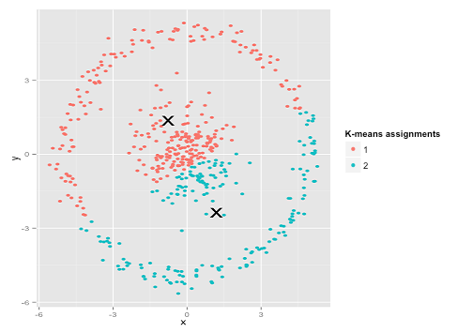
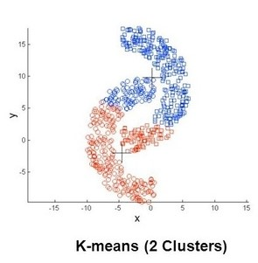
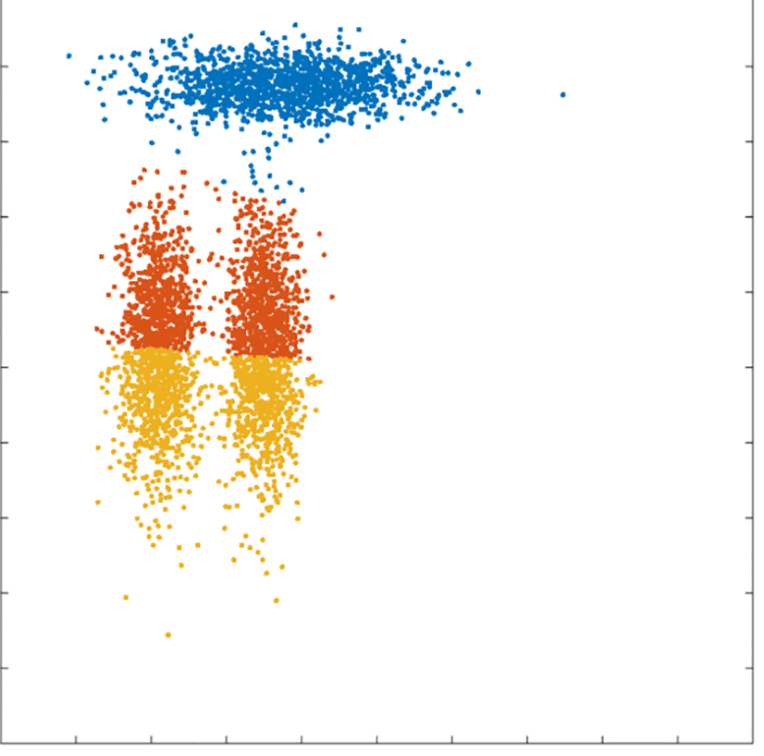
Examples
Nested Clusters
Spiral Clusters
Long Thin Clusters

Slide 13
Methodology 2: Neural Network
Training dataset: 70%
Testing dataset: 30%
Architecture of used Neural Network
Input layer: 57
First hidden layer: 256
Second hidden layer: 128
Third hidden layer: 64
Output layer: 10
For the first 3 layers of the neural network, we have used ‘Relu’ as the activation function whereas for the last layer we have used softmax as the activation function.
For training the model, we have used 200 epochs and a batch-size of 64.

Slide 14
Results
Accuracy on training dataset: 0.9994
Accuracy on testing dataset: 0.9036
Classification with labels is much easy than unsupervised learning algorithms.
Neural Networks can fit flexible non linear boundaries, so can even classify overlapping music genre with good extent.

Slide 15
References
Understanding audio data for deep learning by valerio velardo - https://www.youtube.com/watch?v=m3XbqfIij_Y&list=PL-wATfeyAMNrtbkCNsLcpoAyBBRJZVlnf&index=10
The Mel Spectrogram https://towardsdatascience.com/musical-genre- classification-with-convolutional-neural-networks-ff04f9601a74
For the images used:
https://stats.stackexchange.com/questions/133656/how-to-understand-the-drawbacks-of-k-means
https://www.quora.com/What-are-the-weaknesses-of-the-standard-k-means-algorithm-aka-Lloyds-algorithm
https://journals.plos.org/plosone/article/figure?id=10.1371/journal.pone.0162259.g002

