Slide 1
Crowdsourcing for Disaster Management with Ushahidi
Adil Akhetzhanov a

Slide 2
Crowdsourcing in Disaster Management
Crowdsourcing – Engaging crowd for a common goal
Rise of Social Media Platforms facilitates collaboration
Crisis Mapping - Gathering information and results from the crowd in crisis phases

Slide 3
Role of Crowdsourcing in Disaster Management
Accurate Information in Humanitarian crisis by Mapping – Detecting exact location
Speed up recovery work for Response agencies
Response agencies leverage real time analysis and enrichment of data from sensors and social interactions

Slide 4



CROWDSOURCING SOLUTIONS

Slide 5
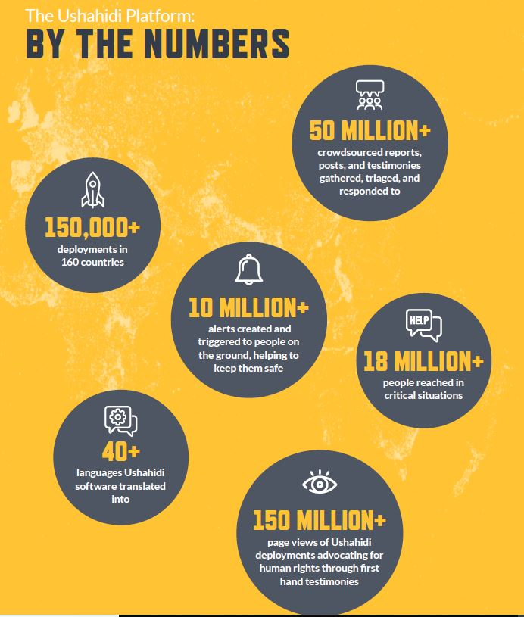
Ushaidi
Ushahidi – founded in 2008 behind violence in Kenya
Data collected by Ushahidi was superior to that reported by the mainstream media in Kenya in 2008
Innovative platform helping in Humanitarian crisis

Slide 6
How Crowdsourcing works in Ushahidi
Data Collection from multiple sources
Combine and aggregate data
Visualize and Analyse the data
Response and take actions

Slide 7
Features of Ushahidi

Slide 8

Data Collection
Data Collection
Multiple Sources, Email, twitter, SMS
Custom Surverys
IoS&Android

Slide 9
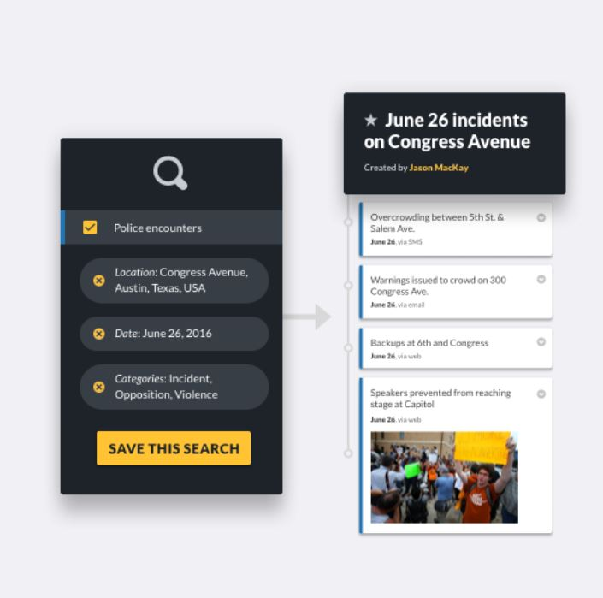
Data Management
Data Management
Mange and trigger reports
Filter and Saved Searches
Workflows
Collections
Team Collaboration

Slide 10
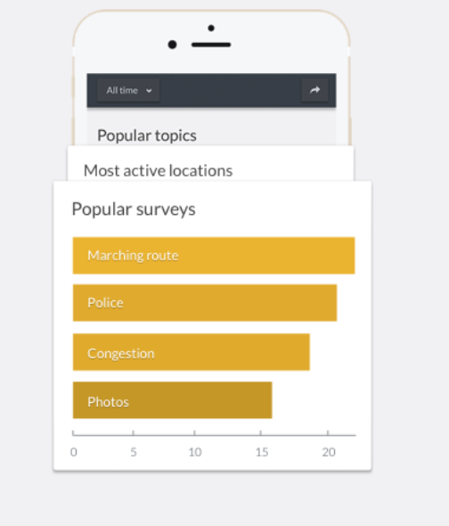
Data Visualization
Data Sources – Map and Visualize data Steams
Chart your work with configurable bar and timeliness views

Slide 11

Alerts and Notifications
Receive alerts about changes and updates
Email Notification
SMS alerts

Slide 12

Enterprise Systems
Private deployments possible
Custom User Roles
Support and Hosting
Setup and Migration

Slide 13

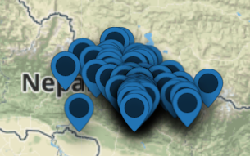
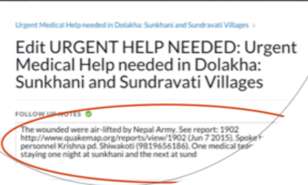
CASE STUDY: NEPAL EARTHQUAKE
2500+ Incident reports
Ushaidi platform used by citizens collected reports from grounds to help relief efforts

