Slide 1
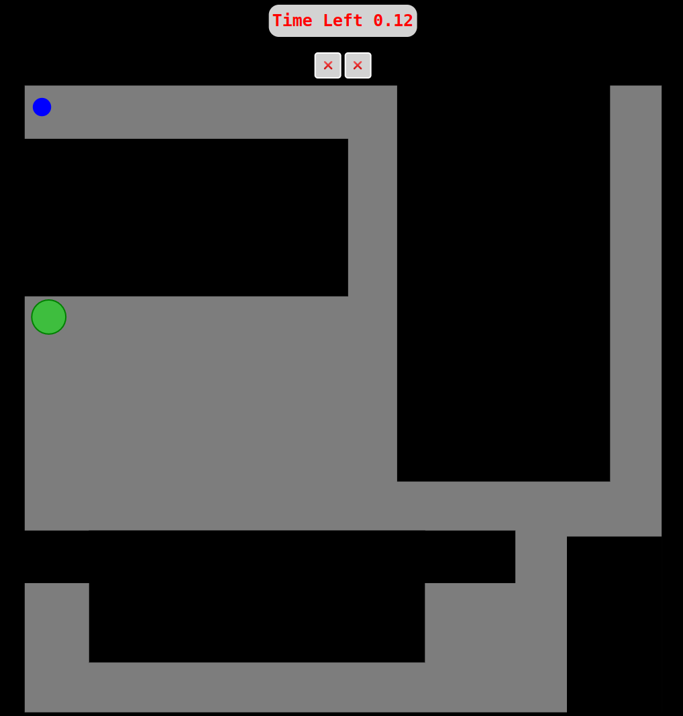

Layout of the game:
Shows remaining time for training or elapsed time for the game.
Black Regions: Represents obstacles
Gray Regions: Represents safe passage
Agent
✅
❌: Indicates goals yet to be reached.
✅: Indicates goals that have been reached.
The goal to be reached.
Joystick Instructions:
Up
Up: Move the agent upward.
Down: Move the agent downward.
Right: Move the agent to the right.
Left: Move the agent to the left.
Left
Right
Down

Slide 2
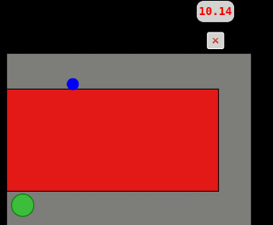
Collision Scenario

