Slide 1
Multimodal LLM Based Chatbot for Planning documents using Retrieval augmented generation (rag)
Name – Shivam Chauhan
DIAT Guide - Dr. C.R.S. Kumar
RCI Guide – M.B. Sai Charan

Slide 2
Problem Statement
The Planning Team manages numerous project documents in PDF, Excel, and Word formats containing details on upcoming projects, ongoing project counts, sanctioned budgets, disbursed funds, expenses, and balances. Due to their unstructured nature, the team struggles to quickly retrieve accurate information, leading to delays.
To address this, the organization requires a secure, entirely offline application that:
Performs intelligent search and question-answering over PDFs/DOCX/XLSX.
Automatically extracts and normalizes project metadata and financial fields to enable roll-ups (counts, totals) .
Generates answers with citations to exact source pages/cells for traceability, and
Provides a user-friendly web interface with access history (who viewed/queried what and when) to support compliance and accountability

Slide 3
Objective
The objective is to design and implement a Retrieval-Augmented Generation (RAG)-based system that:
Enables Intelligent Search & QA – Allows users to query unstructured/semi-structured documents (PDF, DOCX, Excel) and receive accurate, natural language answers.
Provides Data Aggregation – Extracts and summarizes key financial and project metrics (e.g., total sanctioned budget, expenses incurred, remaining balance, project counts).
Ensures Traceability – Generates responses with citations linked to exact document sections (pages, tables, or cells).
Operates Securely Offline – Works without internet connectivity while maintaining access history for compliance.
Delivers User-Friendly Access – Provides a web interface where planning staff can easily query, review, and audit project information.

Slide 4
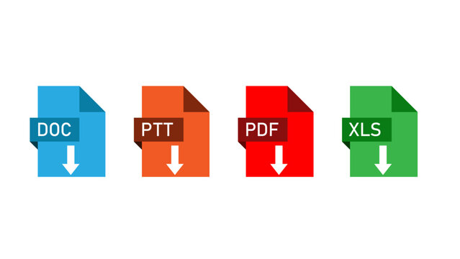
Retrieval-Augmented Generation (RAG)
is an AI technique that combines:
Retrieval → The system first searches and retrieves the most relevant information from documents (PDF, Word, Excel, etc.).
Generation → It then uses a language model to generate a natural language answer based on the retrieved content.
RAG ensures that answers are accurate, grounded in real documents, and traceable with citations.
Example: Query: “What is the remaining budget for Project A?”,
RAG will:
Find the budget and expense details for Project A from Excel/PDF.
Generate a clear answer like “The remaining budget for Project A is ₹ XX” and show the document source.
QUERY
RAG
RETRIEVER
LLM GENERATION
The remaining budget for Project Alpha is ₹ XX

Slide 5
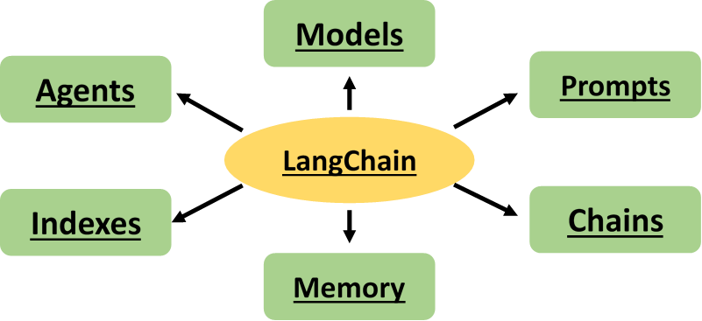
Literature Review
DATA PREPROCESSING
RAG PIPELINE
Medallion Architecture (Bronze → Silver → Gold)
Data ingestion & transformation pipeline follow:
Bronze Layer
Raw extracted text/tables from files (PDF, DOCX, Excel).
Silver Layer
Cleaned/structured Markdown + JSON (schema applied, text normalized).
Gold Layer
Chunks + embeddings in vector DB + structured DB for numeric queries.
This gives: Version control of transformations.
4.LangChain
Used in query-time pipeline:
Models → The core LLMs (like GPT, LLaMA) that generate text.
Prompts → Templates and instructions to guide the LLM’s response.
Chains → Sequences of steps (prompt → LLM → output) to solve tasks.
Memory → Stores conversation history or past results for context.
Indexes → Ways to store and retrieve external knowledge (e.g., vector DBs).
Agents → LLMs that decide which tools/actions to use dynamically
Good for chaining multi-step reasoning
WORKFLOW
Apache Airflow:
Workflow Orchestrator Using DAGs:
Handles automation (no manual ingestion).
Makes pipeline modular (each DAG = 1 stage).
Provides monitoring & retries if extraction/indexing fails.
Integrates with databases & cloud storage.

Slide 6
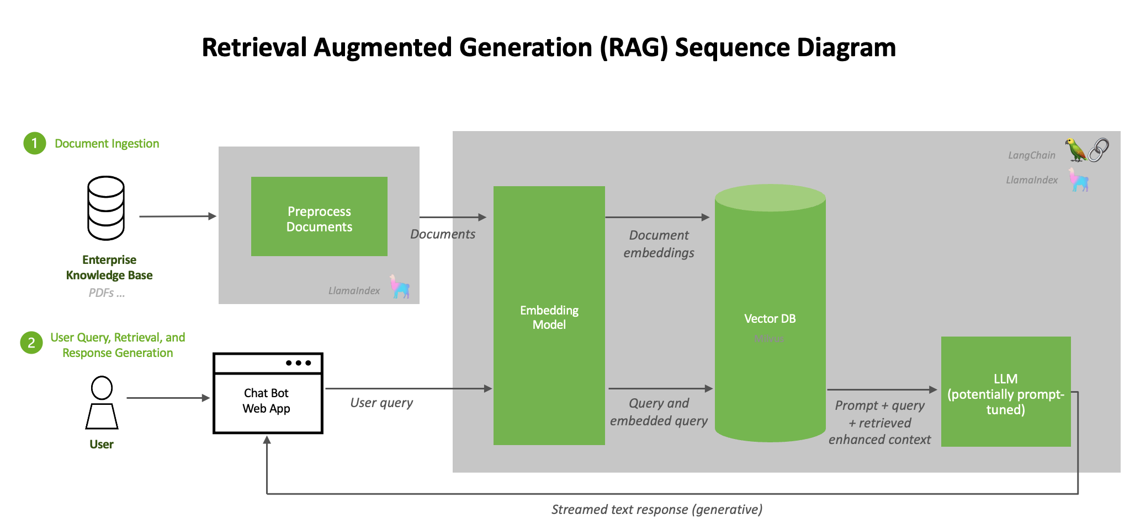
Approach to Solution
Database for storing Tables
SQL

Slide 7
Progress:
PDF Files
Extracting Text, Tables & Images
Using libraries:
Docling
Extracting the text as Markdown
Extracting tables as JSON
Extracting the Images and replace by summary of image and kept the images in separate directory for citation
Semantic Search
Exact Querying.
Example:
If queries are mostly contextual (“what did the report say about project delays?”).
Example:
If queries are both semantic (“which project is over budget?”) and numeric (“total expenses in July”).
If structured reasoning over tabular data.

Slide 8
THANK YOU

