Slide 1
Multimodal LLM Based Chatbot for Planning documents using Retrieval augmented generation (rag)
Name – Shivam Chauhan
DIAT Guide - Dr. C.R.S. Kumar
RCI Guide – M.B. Sai Charan

Slide 2
Problem Statement
There is a lack of intelligent search and question-answering capabilities for unstructured and semi-structured documents such as PDF, DOCX, and Excel files.
Furthermore, there is a need for a secure and user-friendly web interface that maintains access history.
An offline, reliable, and efficient Retrieval-Augmented Generation (RAG) system with proper document citations is required to ensure accuracy and traceability of information.
The application must be capable of functioning entirely in an offline environment to ensure data privacy.

Slide 3
Literature Review
1.Medallion Architecture (Bronze → Silver → Gold)
Data ingestion & transformation pipeline follow:
Bronze Layer
Raw extracted text/tables from files (PDF, DOCX, Excel).
Silver Layer
Cleaned/structured Markdown + JSON (schema applied, text normalized).
Gold Layer
Chunks + embeddings in vector DB + structured DB for numeric queries.
This gives: Version control of transformations.
4.LangChain
Used in query-time pipeline:
Retrieve relevant chunks (vector search).
Retrieve structured rows (metadata filter or SQL search).
Merge into final prompt for the LLM.
Apply prompt templates & chain logic for answering.
Good for chaining multi-step reasoning
(e.g., retrieve → aggregate → answer).
5.Haystack
Alternative to LangChain for retrieval.
DocumentStore abstraction — supports hybrid search (dense + keyword).
More “RAG-native” than LangChain for some use cases.
Can integrate directly with Elasticsearch / OpenSearch for fast filtering.
2.Apache Airflow:
Orchestrates ingestion jobs:
Watch folder / cloud bucket for new docs.
Run extraction + cleaning jobs.
Store into Bronze/Silver/Gold layers.
Trigger embedding/chunking and indexing jobs.
Handles retry logic, logging, alerts if extraction fails.
Lets you run heavy processing in parallel and on schedule.
6.Evaluation Metric:
Sumarization: ROUGE-L, BERT Score
Machine Translation: BLEU Score
Information Retrieval:Recall@K, Precision@k
ROGAS: Relevance, Faithfulness, hallucination
3.LangExtract:Use for structured output

Slide 4
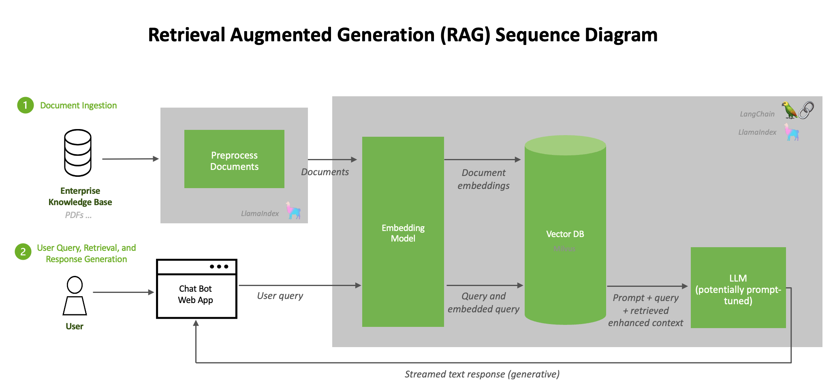
Database for storing JSON file
SQL
Document Processing
(Using docling and langextract.)
Docling: For markdown
Langextract: Structured Output
To Store Textual data

Slide 5
Progress:
PDF Files
Extracting Text and Tables
Using libraries:
Docling, LangExtract
Markdown files for extracting text
LangExtract for structured json output for tables.
semantic search
exact querying.
Simpler to implement (works well for text-heavy documents like reports).
Retains formatting, headings, and inline context.
Preserves relational and semantic meaning (dates, amounts, categories)
Example:
If your queries are mostly contextual (“what did the report say about project delays?”).
Example:
If queries are both semantic (“which project is over budget?”) and numeric (“total expenses in July”).
If you expect structured reasoning over tabular data.

