Slide 1
Heap Data Structure
A heap is a binary tree that follows the shape and order Property.
By shape property , we mean that the heap is a complete binary tree.
By Order property we mean that the heap is either a max heap or min heap.
Notes:
Heap | Delete Insert Reheapify --- https://www.youtube.com/watch?v=njmr_D3E-dM

Slide 2
Heap
There are two kinds of binary heaps
max-heaps
min heaps

Slide 3
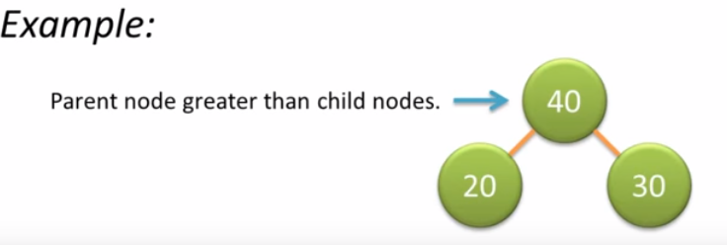
max-heap
A max-heap is a complete binary tree in which the value in each internal node is greater than or equal to the values in the children of that node.

Slide 4
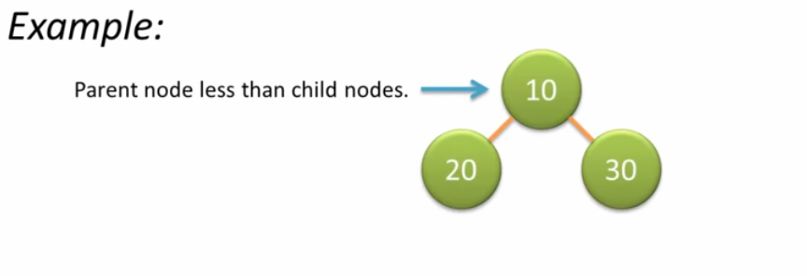
mIN-heap
A min-heap is a complete binary tree in which the value in each internal node is lesser than or equal to the values in the children of that node.

Slide 5
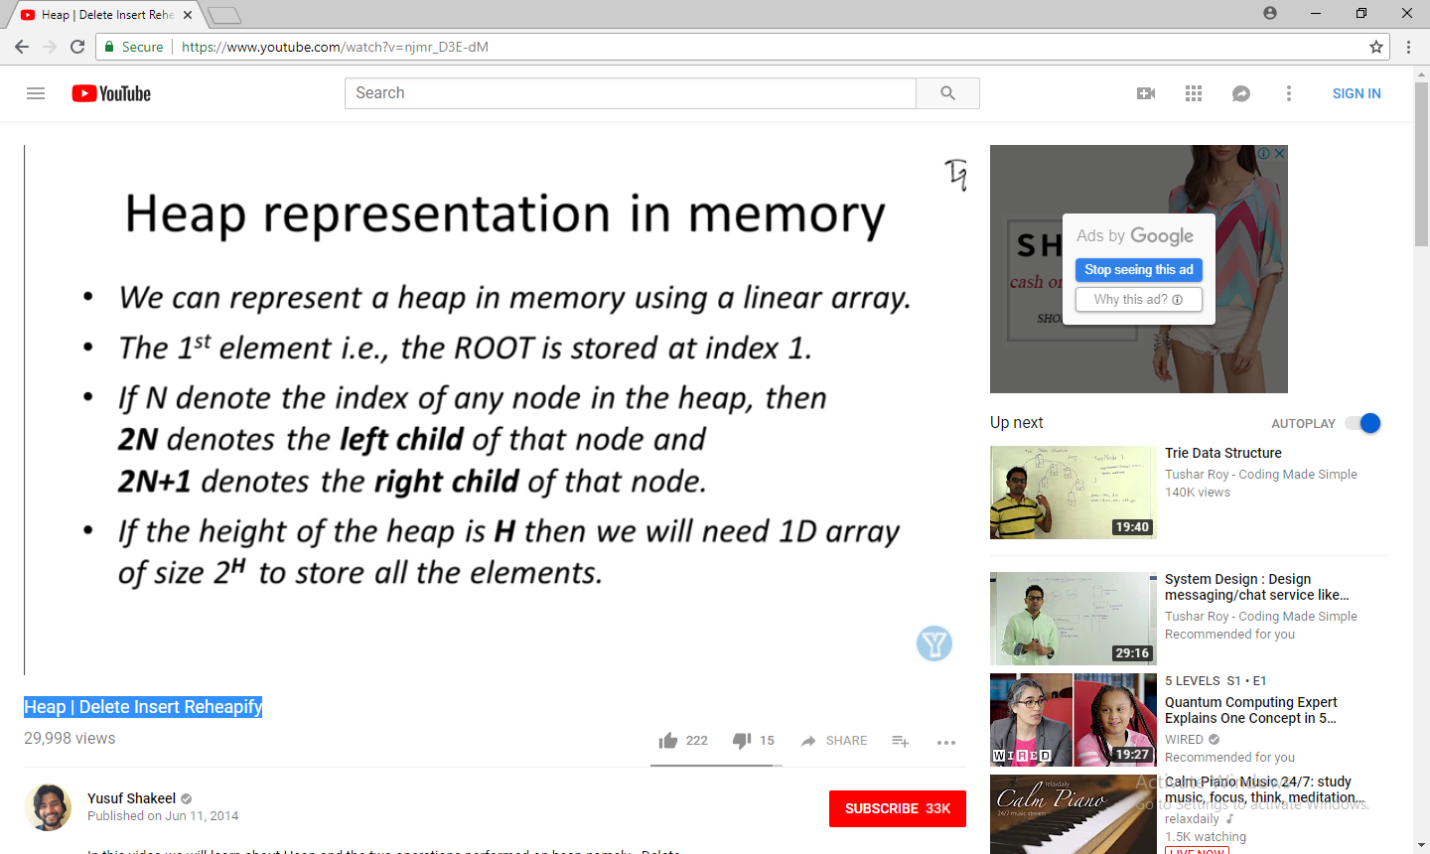
Heap REPRESENTATION in Memory
We can represent a heap in memory using linear array.
The 1st element i.e., the ROOT is stored at index 1.

Slide 6
Heap REPRESENTATION in Memory
1
16
2
14
3
10
4
5
6
7
8
7
9
3
0 | 1 | 2 | 3 | 4 | 5 | 6 | 7
7
16
14
10
8
7
9
3
Note: The 0th index of the array can be used to store the number of elements in the array.

Slide 7
Maintaining the Heap Property
MAX-HEAPIFY(A, i)
l← LEFT(i)
r ← RIGHT(i)
if l <= heap-size[A] and A[l] >A [i] then largest ← l
else largest ← i

Slide 8
Maintaining the Heap Property
If r<= heap-size[A] and A[r] > A[largest]
then largest ← r If largest ≠ i
then exchange A[i] ←→ A[largest] MAX-HEAPIFY(A, largest)

Slide 9
Heap operations
We can perform two operations on heap.
Delete element
Insert element

Slide 10
Heap – DELETE operation
Element is always deleted from the ROOT position.
Last element in the list will be filled at root node space.
Then perform Reheapify Downward operation to make the heap a Max heap or Min heap.

Slide 11
Heap – DELETE operation
In Reheapify Downward operation, we start from the ROOT position and replace any parent node with its child node if the parent is smaller than its children to get Max Heap.
We first compare the parent with the left child and then we compare the parent with the right child

Slide 12
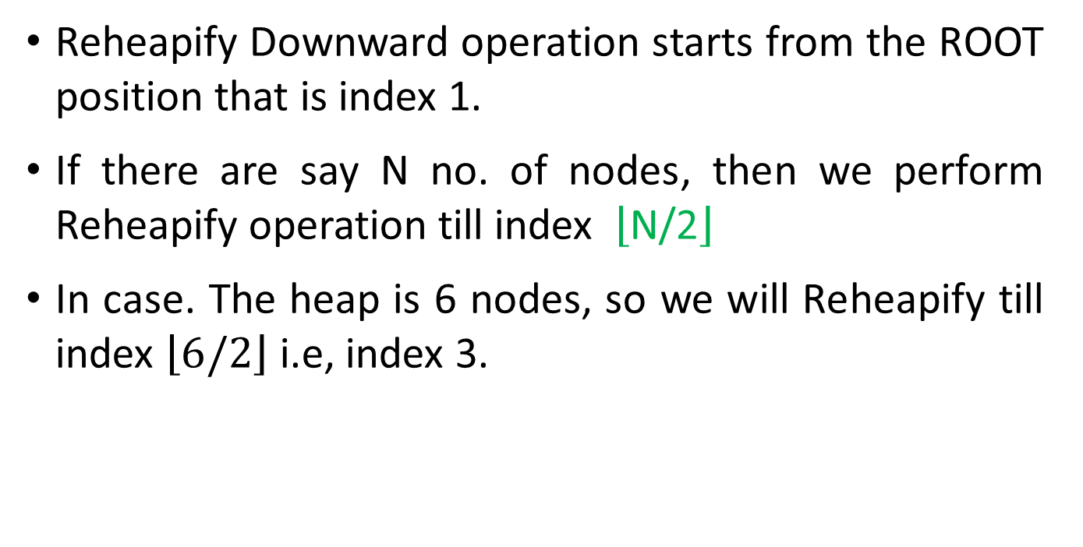
Heap – DELETE operation
Reheapify Downward operation starts from the ROOT position that is index 1.
If there are say N no. of nodes, then we perform Reheapify operation till index $\left\lfloor \text{N}\text{/2}\right\rfloor$
In case. The heap is 6 nodes, so we will Reheapify till index $\left\lfloor 6/2\right\rfloor$ i.e, index 3.

Slide 13
Heap – insert operation
Element is always inserted at the LAST position.
Then perform Reheapify upward operation to make the heap a Max heap or Min heap.

Slide 14
Heap – INSERT operation
In Reheapify upward operation, we start from the middle position and move to the root and replace any parent node with its child node if the parent is smaller than its children to get Max Heap.
We first compare the parent with the left child and then we compare the parent with the right child

Slide 15
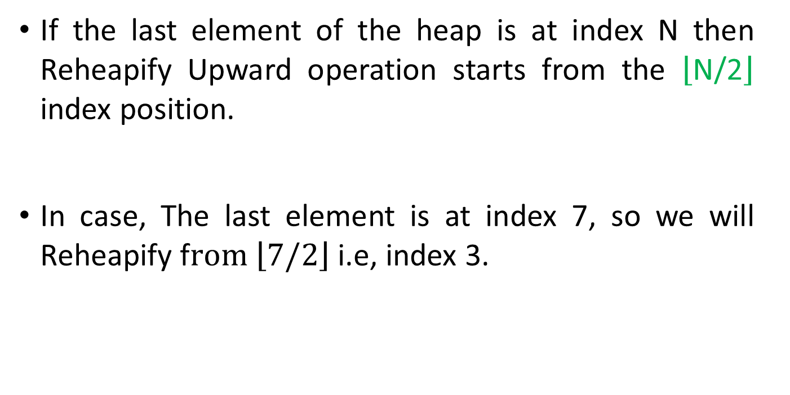
Heap – INSERT operation
If the last element of the heap is at index N then Reheapify Upward operation starts from the $\left\lfloor \text{N}\text{/2}\right\rfloor$ index position.
In case, The last element is at index 7, so we will Reheapify f$rom \left\lfloor 7/2\right\rfloor$ i.e, index 3.

Slide 19
Maintaining the Heap Property
The function of MAX-HEAPIFY is to let the
value at A[i] “float down” in the max-heap so that the sub-tree rooted at index i becomes a max-heap

Slide 20
Maintaining the Heap Property
1
16
2
3
10
i
4
4
5
6
7
14
7
9
3
8
9
10
2
8
1
(a)

Slide 21
Maintaining the Heap Property
1
16
2
3
10
14
4
5
6
7
i
4
7
9
3
8
9
10
2
8
1
(b)

Slide 22
Maintaining the Heap Property
1
16
2
3
10
14
4
5
6
7
6
7
9
3
8
i 9
10
2
4
1
(c)

Slide 23
Building a Heap
BUILD-MAX-HEAP(A)
heap-size[A] ← length[A] for i ← length[A]/2 downto 1
do MAX-HEAPIFY(A, i)

Slide 24
Building a Heap
A
4 | 1 | 3 | 2 | 16 | 9 | 10 | 14 | 8 | 7

Slide 25
Building a Heap
1
4
3
2
1
3
4
5
6
7
10
2
16
i
9
8
9
10
14
8
7
(a)

Slide 26
Building a Heap
1
4
3
2
1
3
4
5
6
7
10
2
i
16
9
8
9
10
14
8
7
(b)

Slide 27
Building a Heap
1
4
3
2
1
3
i
4
5
6
7
10
14
16
9
8
9
10
2
8
7
(c)

Slide 28
Building a Heap
1
4
3
2
i
1
10
4
5
6
7
14
16
9
3
8
9
10
2
8
7
(d)

Slide 29
Building a Heap
1
i 4
2
3
16
10
4
5
6
7
14
7
9
3
8
9
10
2
8
1
(e)

Slide 30
Building a Heap
1
16
2
3
14
10
4
5
6
7
8
7
9
3
8
9
10
2
4
1
(f)

Slide 31
Heapsort Algorithm
HEAPSORT(A)
BUILD-MAX-HEAP(A)
for I ← length[A] downto 2
do exchange A[1] ← → A[i]
heap-size[A] ← heap-size[A] -1 MAX-HEAPIFY(A,1)

Slide 32
Heapsort Algorithm
16
14
10
8
7
9
3
2
4
1
(a)

Slide 33
Heapsort Algorithm
14
8
10
4
7
9
3
i
16
2
1
(b)

Slide 34
Heapsort Algorithm
10
8
9
4
7
1
3
i
2
14
16
(c)

Slide 35
Heapsort Algorithm
9
8
3
4
7
1
2
i
10
14
16
(d)

Slide 36
Heapsort Algorithm
8
7
3
4
2
i
1
19
10
14
16
(e)

Slide 37
Heapsort Algorithm
7
4
3
i
1
2
8
9
10
14
16
(f)

Slide 38
Heapsort Algorithm
4
2
3
i
1
7
8
9
10
14
16
(g)

Slide 39
Heapsort Algorithm
3
2
1
i
4
7
8
9
10
14
16
(h)

Slide 40
Heapsort Algorithm
2
1
3
i
4
7
8
9
10
14
16
(i)

Slide 41
Heapsort Algorithm
1
2
i
3
4
7
8
9
10
14
16
(j)

Slide 42
Heapsort Algorithm
A
1 | 2 | 3 | 4 | 7 | 8 | 9 | 10 | 14 | 16
k

