Slide 1

My Data My Story
Shivam Gupta
Reg. No. 12325170
Roll No: 71
Section: DE328
Submitted for the Mini Project #3 of CAP776

Slide 2
Context Setting
Intuition
I have chosen this particular activity because I want to keep track of my screen timing especially while using social media and during doing productivity tasks.
Objective
Objective was to track how much time I am spending on social media, as well as it improved my productivity also.
Challenges
While capturing data sometimes I forgot to add data in the dataset or sometime because of urgent work I was’t able to update it.
Submitted for the Mini Project #3 of CAP776
Name: Reg. No. Section:

Slide 3
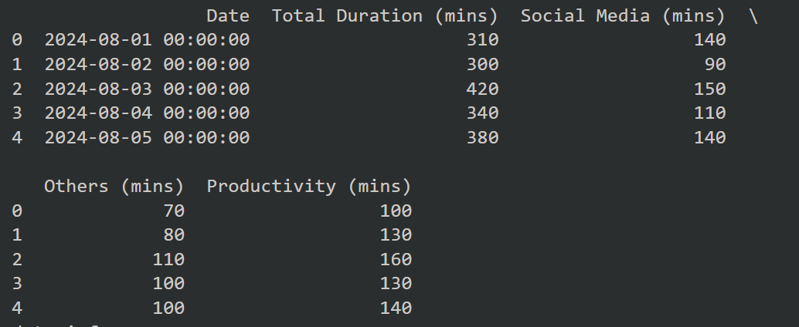
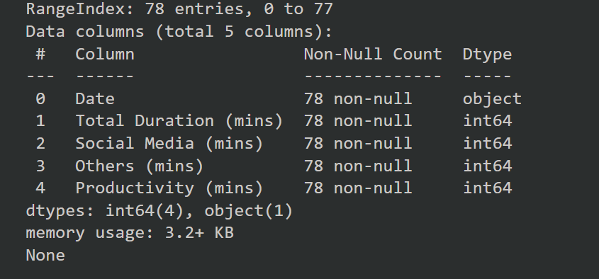
The data captured
Data description
df.head(): df.info()
Submitted for the Mini Project #3 of CAP776
Name: Shivam Gupta Reg. No. 12325170 Section: DE328

Slide 4
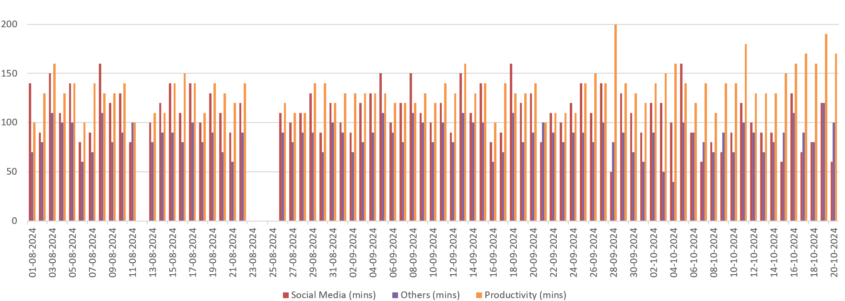
Story board #1
In this era of notifications and constant scrolling. I felt like I was wasting a lot of time in scrolling social media. one day I got a notification from the Samsung Wellbeing app and I was shocked when I saw screen time. the maximum time consumed by social media applications. from that point, I decided to record my screen time in Excel. At first, I was very enthusiastic about adding data. Still, at the same point of time, it was a very cumbersome task for me because many times I forgot to add data to my dataset but at last, I felt improvement in myself by seeing a significant productivity improvement. I was consuming social media very little.

Slide 5
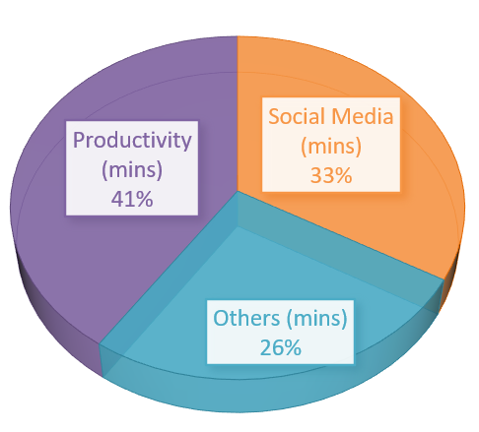
Story board #2
Total Duration
Submitted for the Mini Project #3 of CAP776
Name: Shivam Gupta Reg. No: 12325170 Section: DE328

Slide 6
Inferences drawn
Tracking my screen time gave me valuable insights into my phone usage.
I became more aware of how much time I spent on social media.It helped me reduce social media usage and increase productivity.
There were some challenges, like forgetting to log data or being too busy to update it.
The biggest benefit was learning to manage my time better.
I can maintain a good balance between work and leisure, even without tracking every detail.
Submitted for the Mini Project #3 of CAP776
Name: Shivam Gupta Reg. No.12325170 Section: DE328

Slide 7
Future scope [Optional]
Managing my time better: Keep a good balance between social media and productive work.
Tracking my habits regularly: Keep an eye on my screen time to stay aware of how I use my time.
Using this method in other areas: Track things like studies, work, or fitness to improve in those areas too.
Building self-discipline: Stay focused on my goals and avoid distractions.
Changing routines when needed: Make adjustments based on my tracking to keep good habits and stay productive.
Submitted for the Mini Project #3 of CAP776
Name: Shivam Gupta Reg. No. 12325170 Section: DE328

Slide 8
Thank You!
Submitted for the Mini Project #3 of CAP776
Name:Shivam Gupta Reg. No. 12325170 Section: DE328

