Slide 1

AI-Driven Chronic Pain Management System
MCA 2nd year 4th semester SESSION 2025-26
Under the guidance of :
Dr. Upendra Kumar
Ms. Varsha Sharma
Group Members :
Ayush Rawat : 2400520140020
Mohammad Mujtaba : 2400520140040
Shivam Kumar Gupta : 2400520140062

Slide 2
Table of Contents
Abstract
Introduction
Existing System
Proposed System
Data Flow Diagram
Methodology
Conclusion
References

Slide 3
Abstract
Chronic pain affects millions worldwide and relies on subjective reporting.
This project uses wearable physiological signals to classify pain levels
(1–10).
Machine learning model helps to improves accuracy and provides real-time monitoring.

Slide 4
Introduction
Chronic pain lasts longer than 3 months and impacts physical, emotional, and mental health.
Wearable sensors capture measurable physiological changes related to pain.
This project develops a machine-learning-based system to classify pain levels using physiological signals collected from a watch device.

Slide 5
Existing System
Pain assessed using:
Numerical Rating Scale (0–10)
Visual Analogue Scale
Manual doctor examination
Completely dependent on patient feedback
Not continuous, not automated
Limitations of Existing Systems
Highly subjective
Inaccurate for patients who cannot express pain
Not real-time
Do not capture physiological reactions
No automated predictions

Slide 6
Proposed System
An AI-based system that uses wearable physiological signals to predict pain intensity.
Features:
Provides instant real-time monitoring.
Measures pain using non-invasive sensors.
Allows continuous wearable pain tracking.
Predicts pain level on 1–5 scale.

Slide 7
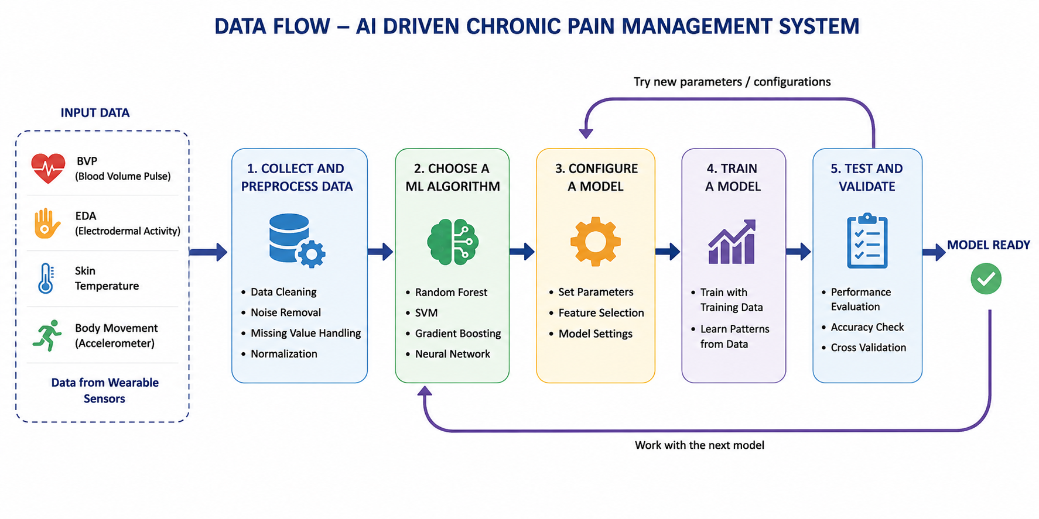
Data Flow Diagram

Slide 8
Methodology
1. Data Collection
Physiological data collected using wearable biosensors
Parameters used:
i. Heart Rate (HR) ii. Electrodermal Activity (EDA)
iii. Temperature iv. Blood Volume Pulse (BVP)
Dataset obtained from Kaggle for chronic pain prediction analysis
2. Data Preprocessing
Removing missing values
Cleaning noisy sensor data
3. Feature Extraction
Extraction of important physiological features from sensor signals.
Features extracted:
i. Heart Rate (HR) ii. Electrodermal Activity (EDA)
iii. Blood Volume Pulse (BVP) iv. Body Temperature

Slide 9
4. Model Training
Split into train/test sets.
Models trained: Random Forest, SVM, Gradient Boosting.
5. Model Evaluation
Accuracy, F1-score, precision, recall.
Confusion matrix for all 5 pain levels.
Comparison between ML models.
6. Prediction
Final model outputs Pain Level (1–10).
Real-time compatibility for wearable systems.

Slide 10
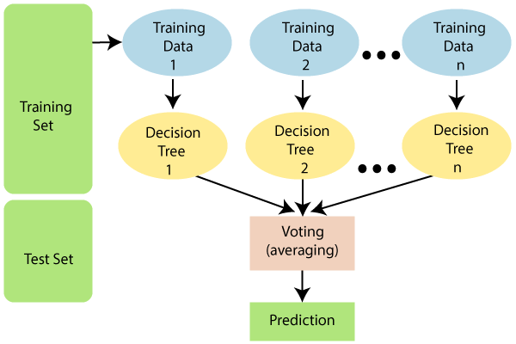
Machine Learning Algorithms
Random Forest:
Random Forest is a popular machine learning algorithm that belongs to the supervised learning technique. It can be used for both Classification and Regression problems in ML. It is based on the concept of ensemble learning, which is a process of combining multiple classifiers to solve a complex problem and to improve the performance of the model.

Slide 11
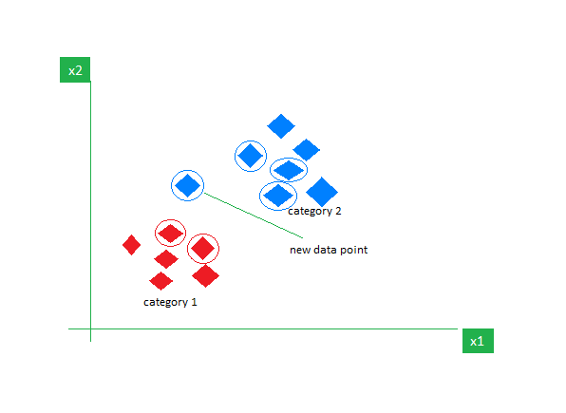
K-Nearest Neighbor(KNN)
KNN is one of the most basic yet essential classification algorithms in machine learning. It belongs to the supervised learning domain and finds intense application in pattern recognition, data mining, and intrusion detection.
It is widely disposable in real-life scenarios since it is non-parametric, meaning it does not make any underlying assumptions about the distribution of data (as opposed to other algorithms such as GMM, which assume a Gaussian distribution of the given data). We are given some prior data (also called training data), which classifies coordinates into groups identified by an attribute

Slide 12
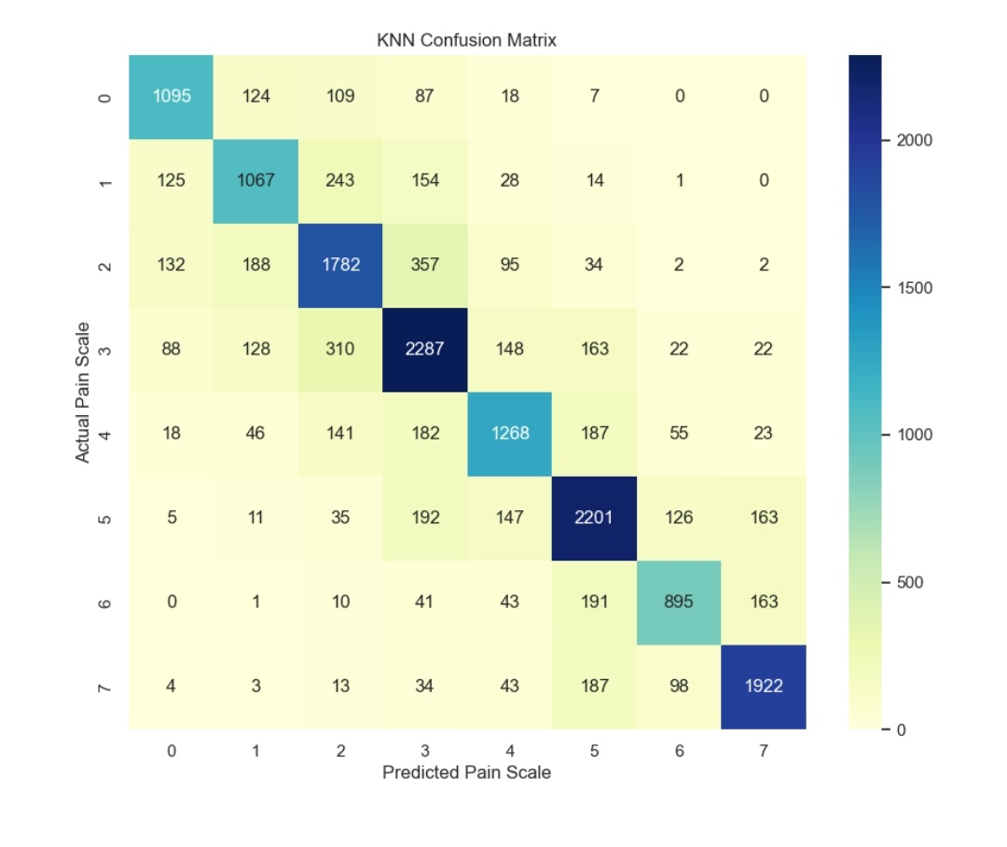
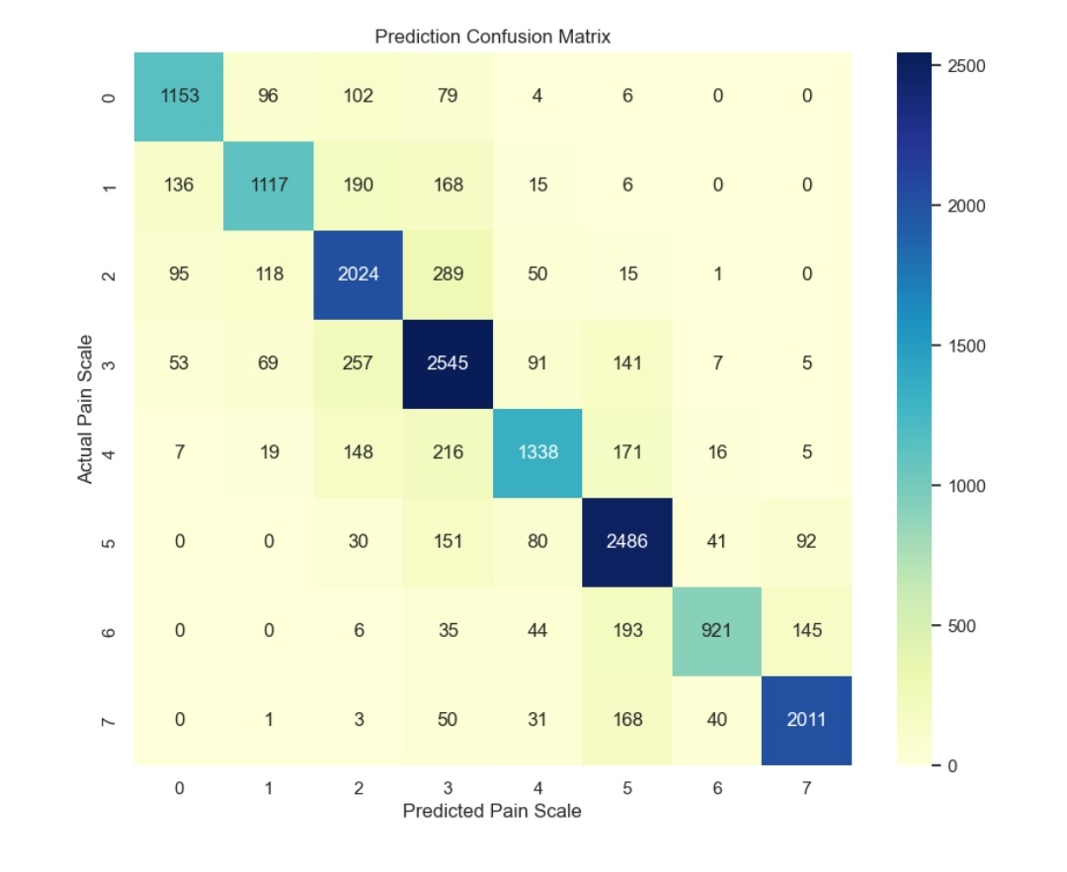
Accuracy of Different Models
Random Forest
Accuracy-79%
KNN
Accuracy-72%

Slide 13
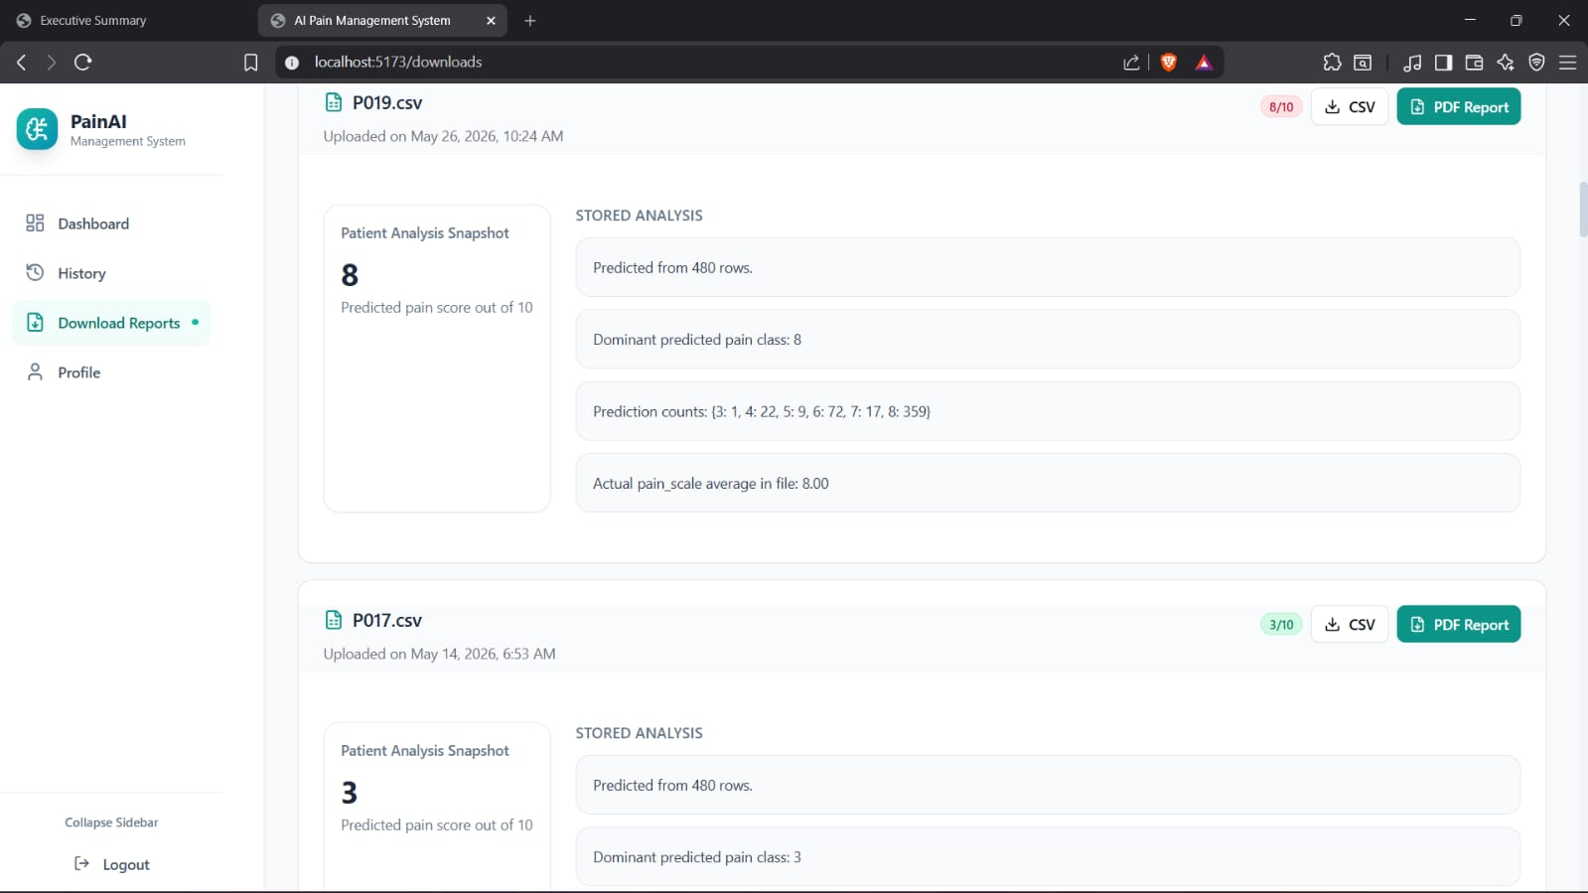
Sample Output:

Slide 14
Conclusion
The AI-driven chronic pain management system accurately predicts pain levels using wearable sensor data.
It offers objective, continuous, and automated pain assessment, reducing dependency on subjective reporting and improving healthcare decision-making.

Slide 15
References
[1] Pouromran, F., Radhakrishnan, S., Kamarthi, S. Exploration of Physiological Sensors, Features, and Machine Learning Models for Pain Intensity Estimation, PLOS ONE, 2021. → Discusses the use of physiological sensors and machine learning models for predicting pain intensity.
[2] Schuurmans, A.A.T., de Looff, P., Nijhof, K.S., Rosada, C., Popma, A., Otten, R. Validity of the Empatica E4 Wristband to Measure Heart Rate Variability (HRV) Parameters, Journal of Medical Systems, 2020. → Evaluates the accuracy of the Empatica E4 wristband by comparing it with ECG measurements.
[3] Campanella, S., et al. A Method for Stress Detection Using Empatica E4 Bracelet Signals and Machine-Learning Algorithms, Sensors, 2023. → Explains stress detection techniques using Empatica E4 sensor data and machine learning algorithms.
[4]Treede, R.D., et al. Chronic Pain as a Symptom or a Disease: The IASP Classification of Chronic Pain, Pain, 2019. → Explains the definition, classification, and impact of chronic pain as a major health condition.

Slide 16
[5] Raja, S.N., et al. The Revised International Association for the Study of Pain (IASP) Definition of Pain, Pain, 2020. → Provides the updated medical definition of pain and discusses challenges in pain assessment.
[6] Apkarian, A.V., et al. Chronic Pain Patients Are Impaired on an Emotional Decision-Making Task, Pain, 2004. → Explains how chronic pain affects emotional and psychological well-being.
[7] Breivik, H., et al. Survey of Chronic Pain in Europe: Prevalence, Impact on Daily Life, and Treatment, European Journal of Pain, 2006. → Presents statistics and real-world effects of chronic pain on patients across different countries.
[8] Gureje, O., et al. Persistent Pain and Well-Being: A World Health Organization Study, JAMA, 1998. → Highlights the global impact of chronic pain on quality of life and mental health.
[9] B. Charbuty and A. Abdulazeez, “Classification based on decision tree algorithm for machine learning,” Journal of Applied Science and Technology Trends, vol. 2, no. 01, pp. 20–28, 2021.
[10] M. R. Segal, “Machine learning benchmarks and random forest regression,” 2004.

