Slide 1
Trader Performance vs Bitcoin Market Sentiment
Short summary and actionable insights
Candidate: Shiva Mishra

Slide 2
Key Findings
- Dataset merged: 211218 trades across 3 sentiment labels
- Mean PnL by sentiment saved in sentiment_summary.csv
- Stat test (t-test) p-value: 0.2156 (see stat_tests.csv)

Slide 3
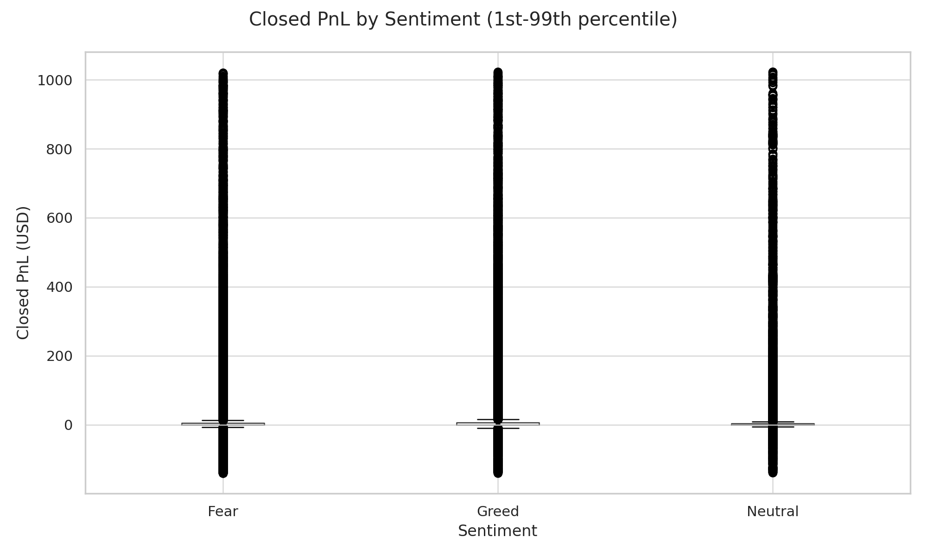
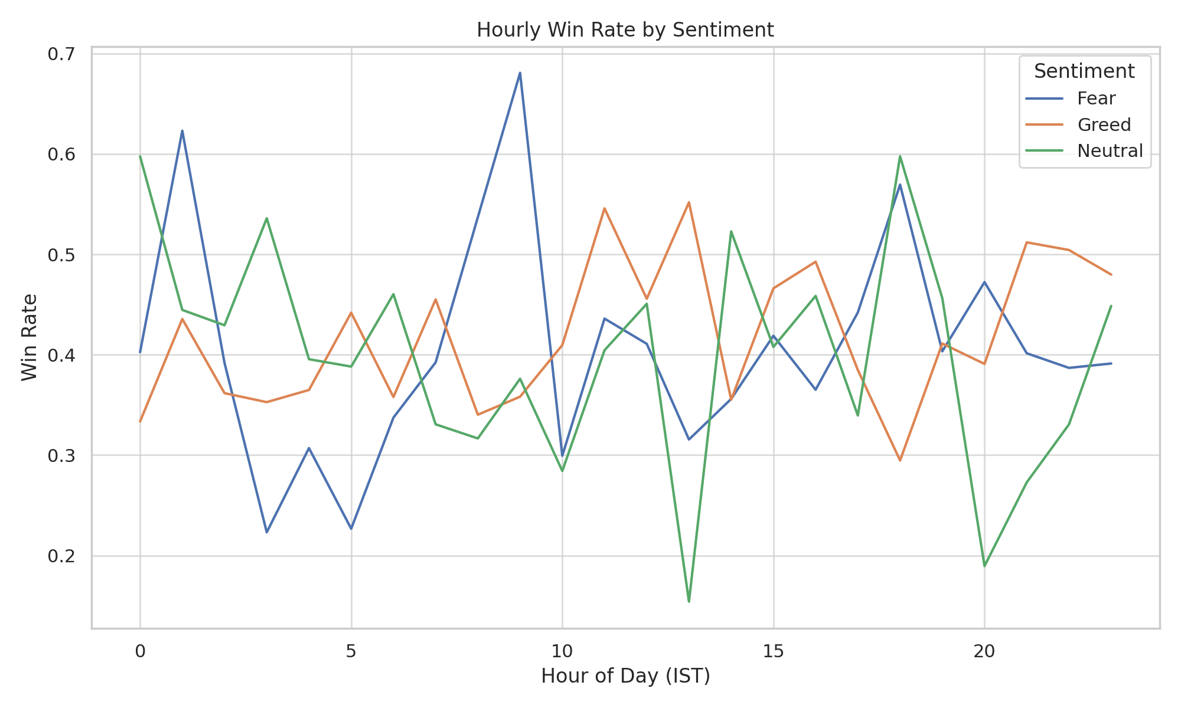
Artifacts: analysis_notebook.ipynb, boxplot_pnl_by_sentiment.png, hourly_winrate.png, sentiment_summary.csv, top_coins_by_sentiment.csv, stat_tests.csv, model_report.csv

