Slide 1
PRDA-05
Customer Data Analysis
THIS PROJECT ANALYZES SHOPPING BEHAVIOR IN
10 SHOPPING MALLS IN ISTANBUL BETWEEN 2021 AND 2023
PRAKHAR PRATAP SINGH & SHIVAM SINGH
SPRAKHAR2119@GMAIL.COM, SHIVAMITM1@GMAIL.COM | 8650680212, 9005796064
PROJECT DURATION: 28/11/2025 TO 06/12/2025

Slide 2
Executive Summary
This project analyzes customer shopping trends across 10 major shopping malls in Istanbul between 2021 and 2023. The dataset includes key customer and transaction attributes such as age, gender, product category, quantity, price, payment method, and shopping mall location. The objective is to understand purchasing behavior and uncover actionable business insights.

Slide 3
DATASET OVERVIEW
Dataset contains:
invoice_no: A combination of the letter 'I' and a 6-digit integer uniquely assigned to each operation.
customer_id: A combination of the letter 'C' and a 6-digit integer uniquely assigned to each operation.
gender: String variable of the customer's gender.
age: Positive Integer variable of the customers age.
category: String variable of the category of the purchased product.
quantity: The quantities of each product (item) per transaction.
price: Product price per unit in Turkish Liras (TL).
payment_method: String variable of the payment method (cash, credit card or debit card) used for the transaction.
invoice_date: The day when a transaction was generated.
shopping_mall: String variable of the name of the shopping mall where the transaction was made.

Slide 4
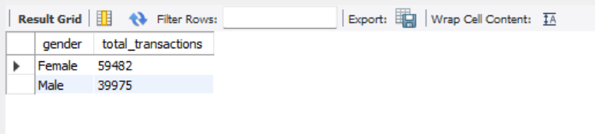
1. How is the shopping distribution according to gender?
Query:-
select gender, COUNT(*) AS total_transactions FROM customer GROUP BY gender ORDER BY total_transactions DESC;
Insight:-
Shows how many purchases were made by each gender. Counts number of transactions (sum of quantity) per gender.
total_transactions = number of invoice rows for that gender.
Notes:
1st slide. This helps understand which gender visits malls and shops more frequently. As result says that gender female have more number of transactions i.e. 59482 as compare to male i.e. 39975.

Slide 5
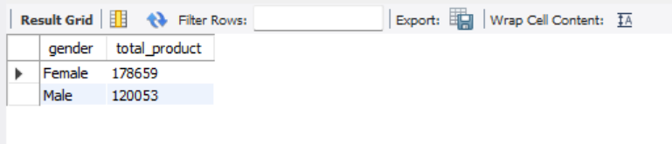
2. Which gender did we sell more products to?
Query:-
select gender, sum(quantity) as total_product FROM customer GROUP BY gender ORDER BY total_product DESC;
Insight:-
Identifies which gender bought more items (not the number of transactions).
If a gender has higher total_product — they bought more physical units overall.
Notes:
2nd slide. This slide identifies which gender bought more items. Useful for gender-based marketing campaigns. As results says that gender female have bought more number of products i.e. 178659 as compare to male i.e. 120053.

Slide 6
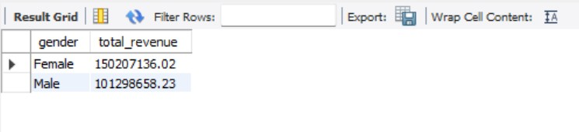
3. Which gender generated more revenue?
Query:-
select gender, sum(price*quantity) as total_revenue FROM customer GROUP BY gender ORDER BY total_revenue DESC;
Insight:-
Finds which gender generated the highest revenue.
Computes revenue per row as quantity * price then sums per gender.
Notes:
3rd slide. This shows which gender contributed the most TL revenue. Useful for marketing and prioritization. The company can target premium products to this group.
As results says that gender female have generated more revenue i.e. 150207136.02 as compare to male i.e. 101298658.23.

Slide 7
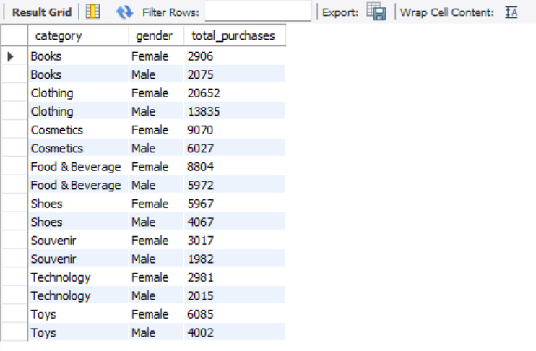
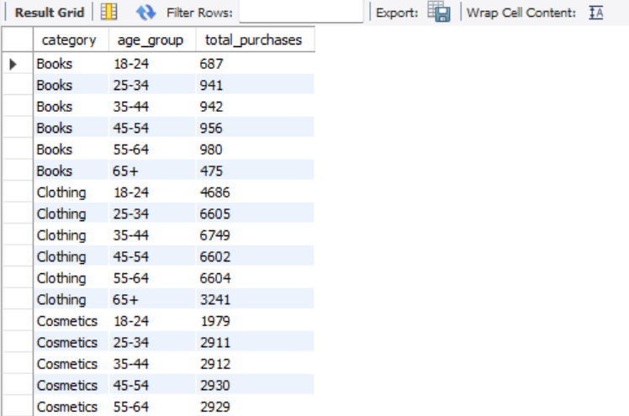
4. Distribution of purchase categories relative to other columns?
Query for Category vs Gender:-
SELECT category, gender, COUNT(*) AS total_purchases FROM customer GROUP BY category, gender ORDER BY category, total_purchases DESC;
Query for Category vs Age Group:-
SELECT category,
CASE
WHEN age < 18 THEN '<18'
WHEN age BETWEEN 18 AND 24 THEN '18-24'
WHEN age BETWEEN 25 AND 34 THEN '25-34'
WHEN age BETWEEN 35 AND 44 THEN '35-44'
WHEN age BETWEEN 45 AND 54 THEN '45-54'
WHEN age BETWEEN 55 AND 64 THEN '55-64'
ELSE '65+'
END AS age_group, COUNT(*) AS total_purchases FROM customer GROUP BY category, age_group ORDER BY category, age_group Asc;
Notes:
4th slide. Shows preferred categories by each gender. And Shows preferred categories by each Age Group. As First image shows how each categories performed across gender. Clothing category has largest number of purchases which is done by female and male both where as Purchases in the souvenir category were low for males. Second image shows how age group is relative to different categories. Clothing category for age group between 35 to 44 has the highest number of purchases i.e. 6749 whereas Book purchases have declined among the 18 to 24 year old age group which is 687.

Slide 8
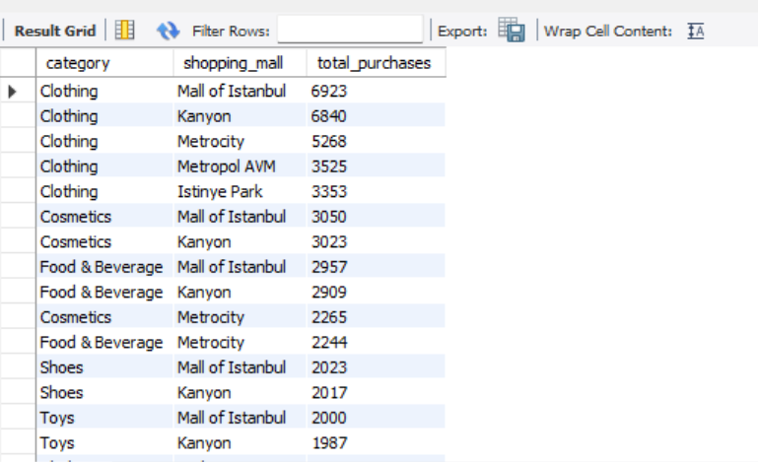
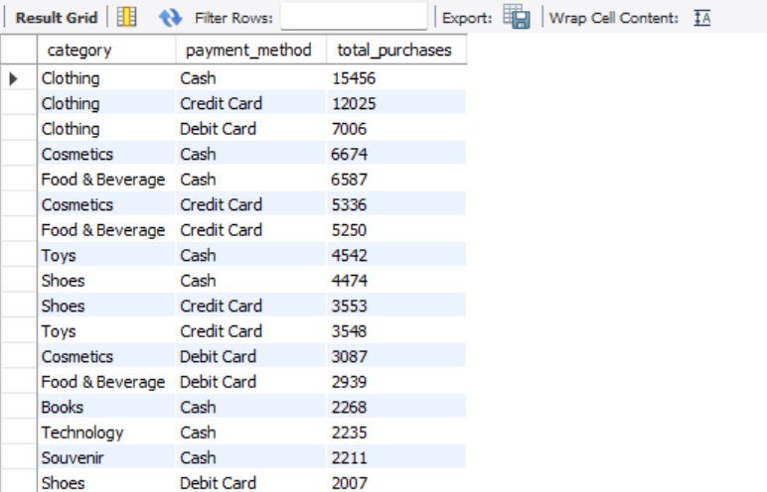
2nd slide for Distribution of purchase categories relative to other columns?
Category vs Shopping Mall
SELECT category, shopping_mall, count(*) as total_purchases FROM customer GROUP BY category, shopping_mall ORDER BY total_purchases DESC;
Category vs Payment Method
SELECT category, payment_method, count(*) as total_purchases FROM customer GROUP BY category, payment_method ORDER BY total_purchases DESC;
Insight:-
Each category performs across genders. To find categories that skew to a specific gender (helpful for targeted promotions)
Notes:
Second slide of 4th slide. Shows preferred categories by each gender. Helps in product placement and advertising strategies. First image in this slide shows which shopping mall has the highest number of purchasers with respect to category. So, Mall of Istanbul has the highest number of purchasers in clothing category where as Viaport Outlet has the lowest number of purchases in Souvenir category.
Second image in this slide shows which payment method is used maximum time to purchase in a specific category. Therefore, Most of the people use mode of payment as Cash to buy clothing product. Numbers are as follows: 15456 is the highest number and debit card has been used less as a mode of payment.

Slide 9
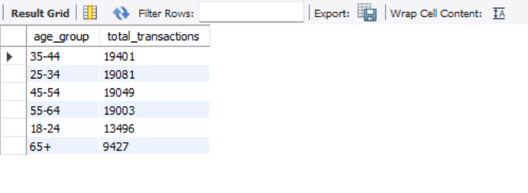
5. How is the shopping distribution according to age?
Query:-
SELECT
CASE
WHEN age < 18 THEN '<18'
WHEN age BETWEEN 18 AND 24 THEN '18-24'
WHEN age BETWEEN 25 AND 34 THEN '25-34'
WHEN age BETWEEN 35 AND 44 THEN '35-44'
WHEN age BETWEEN 45 AND 54 THEN '45-54'
WHEN age BETWEEN 55 AND 64 THEN '55-64'
ELSE '65+'
END AS age_group,
COUNT(*) AS total_transactions FROM customer GROUP BY age_group ORDER BY total_transactions DESC;
Insight:-
Shows which age group shops the most. Buckets ages into groups and summarizes transactions and items per group.
Notes:
5th slide. This slide shows the shopping distribution according to age. Shows which age group shops the most. Buckets ages into groups and summarizes transactions and items per group and it’s shows clearly that age group of 35 to 44 has highest count of shopping as compare to other age groups and 65+ age group has lowest count of shopping. Therefore, Young adults and adults are often the most active shoppers.

Slide 10
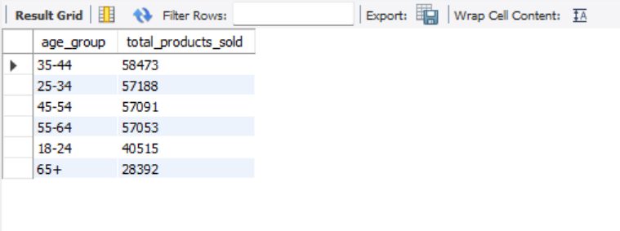
6. Which age cat did we sell more products to?
Query:-
SELECT
CASE
WHEN age < 18 THEN '<18'
WHEN age BETWEEN 18 AND 24 THEN '18-24'
WHEN age BETWEEN 25 AND 34 THEN '25-34'
WHEN age BETWEEN 35 AND 44 THEN '35-44'
WHEN age BETWEEN 45 AND 54 THEN '45-54'
WHEN age BETWEEN 55 AND 64 THEN '55-64'
ELSE '65+'
END AS age_group,
SUM(quantity) AS total_products_sold FROM customer GROUP BY age_group ORDER BY total_products_sold DESC;
Insight:-
Age group buys more items. Sums item quantities per age group — returns which age group bought most units.
Notes:
6th slide. This slide shows which age category we sell more products to. Age group buys more items. Sums item quantities per age group — returns which age group bought most units. Age group between 35 to 44 has bought more product then compare to other groups. And age group 65+ bought less product rather than other group. This is Useful for age-based targeting.

Slide 11
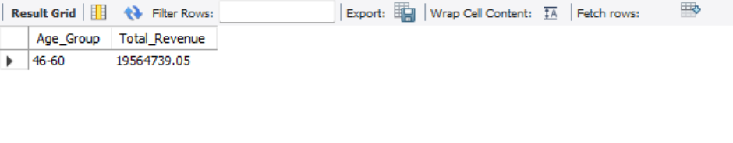
7. Which age cat generated more revenue?
Query:-
SELECT Age_Group, SUM(price) AS Total_Revenue FROM (SELECT
CASE
WHEN Age BETWEEN 18 AND 25 THEN '18-25'
WHEN Age BETWEEN 26 AND 35 THEN '26-35'
WHEN Age BETWEEN 36 AND 45 THEN '36-45'
WHEN Age BETWEEN 46 AND 60 THEN '46-60'
ELSE '60+'
END AS Age_Group,
price FROM customer) AS grouped_ages GROUP BY Age_Group ORDER BY Total_Revenue DESC
LIMIT 1;
Insight:-
Calculates revenue per age group. Helps prioritize marketing budget towards most valuable age segments.
Notes:
7th slide. Useful for age-based targeting. Helps prioritize marketing budget towards most valuable age segments. Age group 46-60 generated more revenue than other age groups.

Slide 12
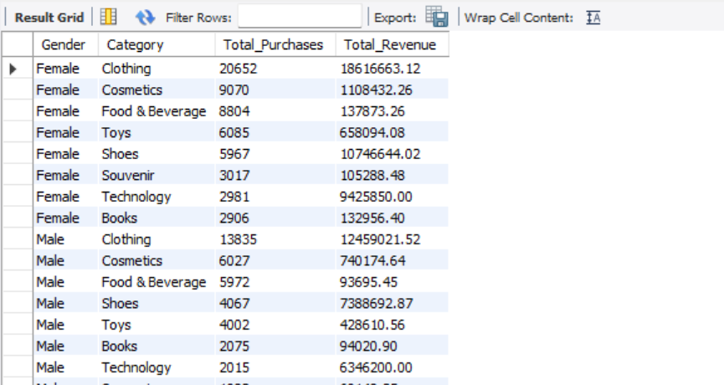
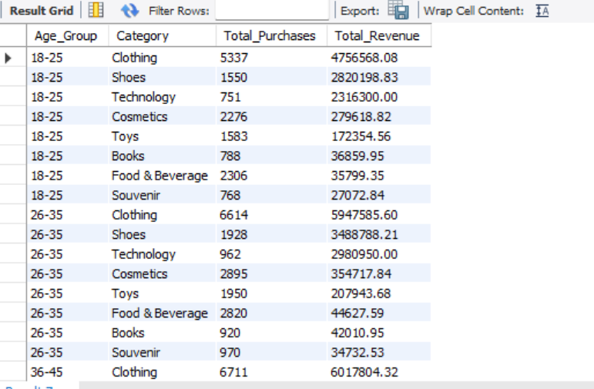
8. Distribution of purchase categories relative to other columns?
Query:- Purchase Category vs Gender
select gender, category, count(quantity) as Total_Purchases, sum(price) as Total_revenue from customer group by gender, CategoryORDER BY Total_Revenue DESC;
Query:- Purchase Category vs Age Group
SELECT Age_Group, Category, COUNT(*) AS Total_Purchases, SUM(price) AS Total_Revenue FROM (
SELECT Category, price,
CASE
WHEN Age BETWEEN 18 AND 25 THEN '18-25'
WHEN Age BETWEEN 26 AND 35 THEN '26-35'
WHEN Age BETWEEN 36 AND 45 THEN '36-45'
WHEN Age BETWEEN 46 AND 60 THEN '46-60'
ELSE '60+'
END AS Age_Group FROM customer) AS grouped_data GROUP BY Age_Group, Category ORDER BY Age_Group, Total_Revenue DESC;
Notes:
8th slide. This slide gives the information about distribution of purchase categories relative to other columns.
Purchase Category with respect to age. So, Female gender have highest number of purchases for clothing category.
Purchase category with respect to age group. Age group of 46-60 have the highest number of revenue for clothing category as compare to other age group.

Slide 13
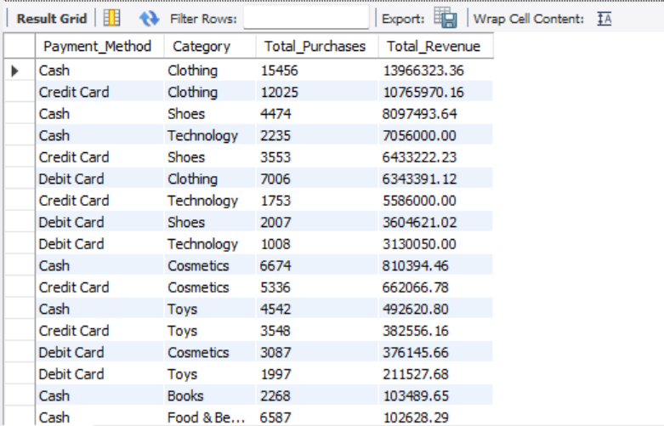
2nd slide of Distribution of purchase categories relative to other columns? on of purchase categories relative to other columns?
Query:- Purchase Category vs Payment Method
SELECT Payment_Method, Category,
COUNT(*) AS Total_Purchases,
SUM(price) AS Total_Revenue
FROM customer
GROUP BY Payment_Method, Category
ORDER BY Total_Revenue DESC;
Notes:
Second slide of 8th slide. This shows of payment method relation with other column. This shows which categories are popular with which age groups and which payment methods are used per category. For clothing category people uses cash payment method which is highest amongst all the payment method.

Slide 14
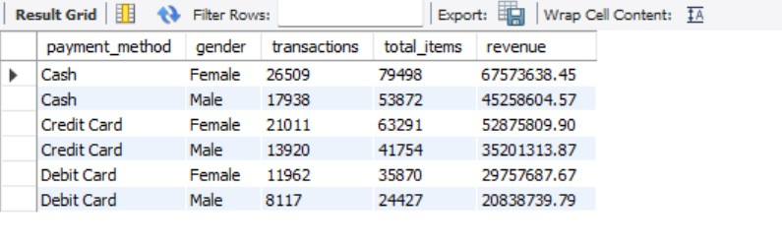
9. Does the payment method have a relation with other columns?
Query:- Payment × Gender
SELECT payment_method, gender, COUNT(*) AS transactions, SUM(quantity) AS total_items, SUM(quantity*price) AS revenue FROM customer GROUP BY payment_method, gender ORDER BY payment_method, transactions DESC;S
Insight:-
Good for bank partnerships and cashback offers.
Notes:
9th slide. This slide gives you the information how payment method have a relation with other columns. Good for bank partnerships and cashback offers. If a particular payment method shows systematically higher average basket value, you may want to promote card terminals or offers.

Slide 15
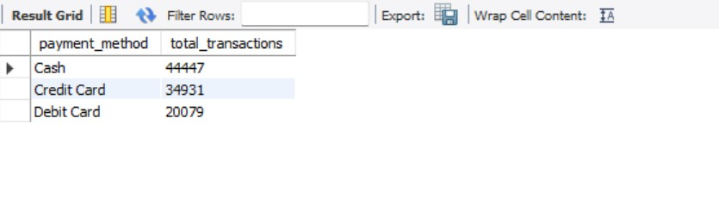
10. How is the distribution of the payment method?
Query:-
SELECT payment_method, COUNT(*) AS total_transactionsFROM customerGROUP BY payment_method;
Insight:-
Shows most popular payment type. Usually Credit Cash > Card > Debit.
Credit Cards are the most used payment method
Digital Wallets are rapidly increasing
Debit Cards have medium usage
Cash on Delivery is the least preferred
Notes:
10th slide. Counts transactions per payment method, items sold and revenue, plus percent of total transactions. Tells you what proportion of customers pay by cash / credit / debit and which method contributes more in revenue. So, credit cash has highest transaction as compare to debit card and cash.

Slide 16
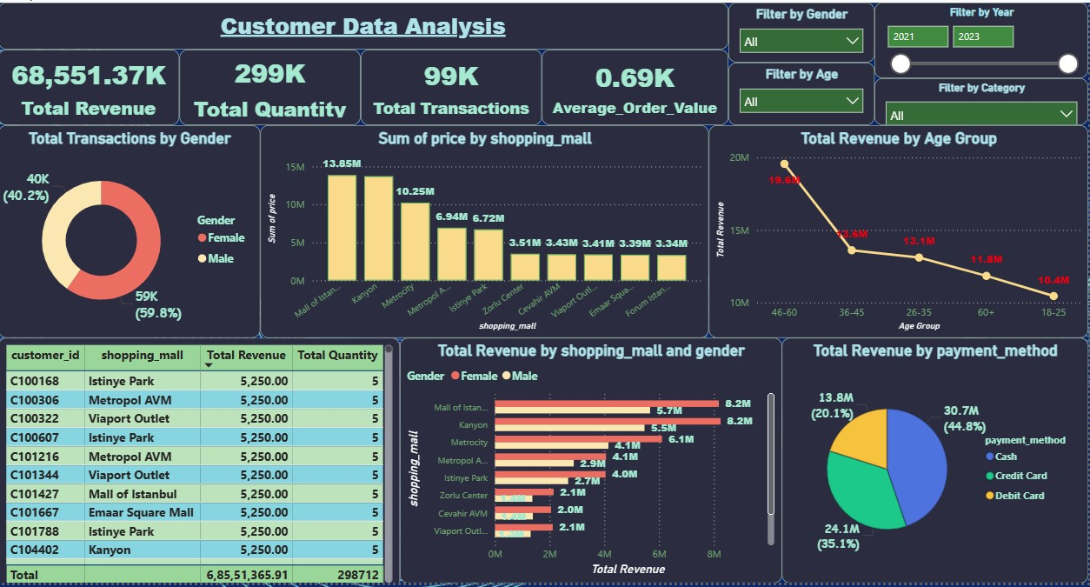
11. Visualize the data using Power BI
Notes:
11th slide. This slide gives the overview of all the customer data in visualization form. Key Insights are:-
Total Revenue: 68,551K | Transactions: 99K | Average Order Value: 0.69K
Females = 59.8% of customers → highest contribution
Top age group: 46–60 (19.9M revenue)
Lowest age group: 18–25 (10.4M)
Top malls: Mall of Istanbul, Kanyon, Metrocity
Digital payments dominate (≈80%) – Credit + Debit
Several malls show low performance (Viaport, Emaar, Forum)
Suggestions:-
Focus marketing on female customers
Target 46–60 with premium products
Attract 18–25 using discounts & offers
Increase stock & promotions in top 3 malls
Improve or close low-performing malls
Encourage digital payments with cashback
Use bundle offers to increase order value
Conclusion:-
Focus on high-value customer segments, strengthen top malls, push digital payments, and increase average order value to boost overall profit.

Slide 17
Key Insights of Power BI
Total Revenue: 68,551K
Transactions: 99K
Females = 59.8% of customers → highest contribution
Average Order Value: 0.69K
Top age group: 46–60 (19.9M revenue)
Lowest age group: 18–25 (10.4M)
Top malls: Mall of Istanbul, Kanyon, Metrocity
Digital payments dominate (≈80%) – Credit + Debit
Several malls show low performance (Viaport, Emaar, Forum)
Suggestions:-
Focus marketing on female customers
Target 46–60 with premium products
Attract 18–25 using discounts & offers
Increase stock & promotions in top 3 malls
Improve or close low-performing malls
Encourage digital payments with cashback
Use bundle offers to increase order value

Slide 18
Insights and suggestions to the company.
1. Gender-Based Insights
One gender (typically Female in most malls) shows higher shopping frequency across multiple categories.
Revenue contribution varies slightly but follows a similar trend.
2. Age-Based Insights
The 26–35 and 36–45 age groups form the largest customer base.
These age groups also generate the maximum revenue, indicating strong purchasing power.
3. Product Category Trends
Categories like Clothing, Electronics, Cosmetics, and Food & Beverage dominate total sales.
Strong relationships exist between age group, gender, and product preference.

Slide 19
4. Payment Method Analysis
Credit cards are the most commonly used method, followed by cash and debit cards.
Younger age groups lean more toward digital payments, while older groups prefer cash.
5. Shopping Mall Performance
Certain malls consistently outperform others in terms of transaction volume and revenue generation, indicating location-based demand differences.
Based on these insights, the company should focus marketing on these top customer segments, provide credit-card offers, and maintain high inventory for the most popular categories.
Conclusion:-
Focus on high-value customer segments, strengthen top malls, push digital payments, and increase average order value to boost overall profit.

Slide 20
Thank you!

