Slide 2

Stack Overflow Developer Survey 2024
Technology Trends and Job Market Analysis
Presented by:Shivani Mittal
June 2026

Slide 3

OUTLINE
Executive Summary
Introduction
Methodology
Results
Visualization – Charts
Dashboard
Discussion
Findings & Implications
Conclusion
Appendix

Slide 4

EXECUTIVE SUMMARY
Analyzed 65,437 responses from the Stack Overflow Developer Survey to identify current and future technology trends
Programming languages:
• JavaScript is the most widely used language (~37,500 respondents) • Python is the most desired language for next year (~25,000 respondents) • Rust and Go enter the top 10 desired languages despite low current usage
PostgreSQL leads future database preference at 47.1%, nearly double the next database
Median compensation rises steadily with age, from ~$25K in early 20s to a peak of ~$110K near age 60
Full-stack development is the dominant role (46.7% of top developer types), and hybrid/remote work prevails across all major countries

Slide 5

INTRODUCTION
This project analyzes the Stack Overflow Annual Developer Survey, a global survey of software professionals
The cleaned dataset contains 65,437 responses across 114 columns covering languages, databases, platforms, compensation, and demographics
Objective: identify currently dominant technologies and those expected to grow next year
Intended audience and use:
• Hiring managers planning recruitment and training • Developers deciding which skills to invest in

Slide 6

METHODOLOGY
- Data collection: gathered job postings via the Jobs API and programming language data via web scraping (Module 1)
Data wrangling: removed 10 duplicate rows; imputed missing values (RemoteWork had 10,631 missing entries, filled with the majority category); normalized compensation data
Exploratory analysis: distributions, outlier detection, and correlation analysis on compensation, experience, and job satisfaction
Visualization and reporting:
• Charts built with Python (Pandas/Matplotlib) • Interactive dashboard built in IBM Cognos Analytics

Slide 7
RESULTS
- Programming language trends — current vs. next year
- Database trends — current vs. next year
- Interactive dashboard — three tabs covering technology usage,
future trends, and demographics

Slide 8
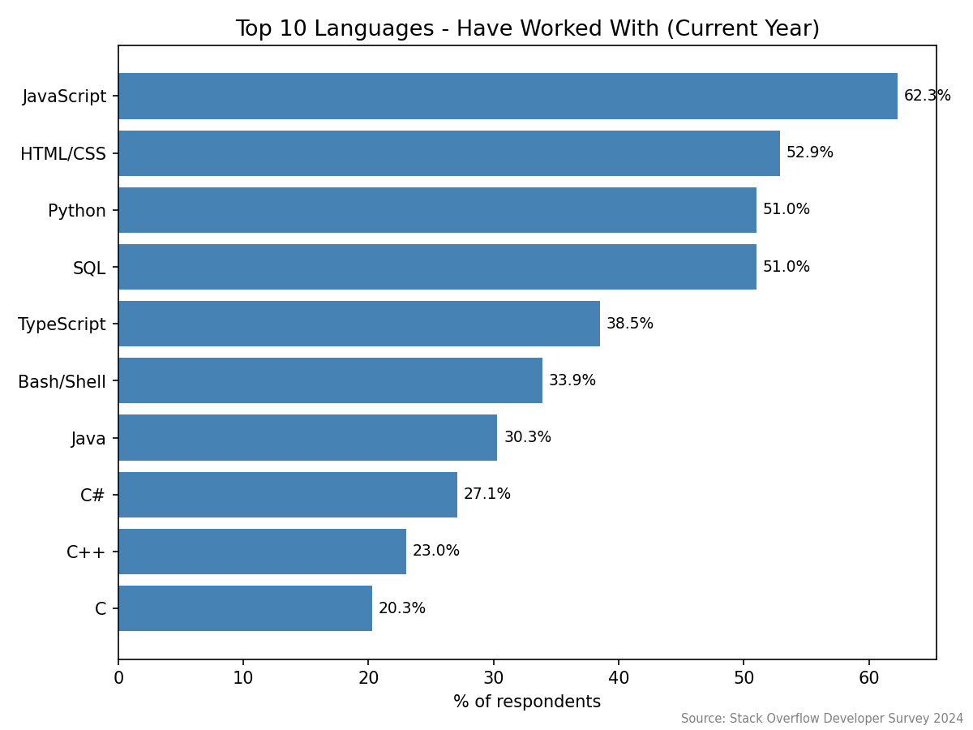
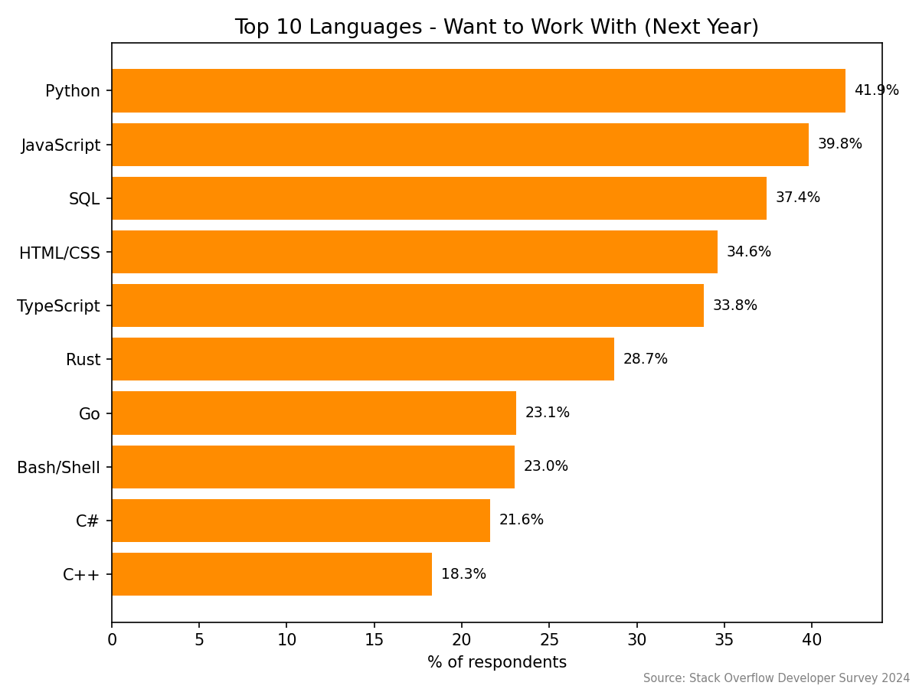
PROGRAMMING LANGUAGE TRENDS
Current Year
Next Year

Slide 9
PROGRAMMING LANGUAGE TRENDS - FINDINGS & IMPLICATIONS
Findings
JavaScript is the most used language (~37,500), followed by HTML/CSS, Python, and SQL
Python has the highest "want to work with" count (~25,000), ahead of JavaScript (~24,000)
Rust (~17,000) and Go (~14,000) appear in the top 10 desired languages despite not being in the top 10 currently used
Implications
Web-stack skills (JavaScript, HTML/CSS, SQL) remain the baseline for employability
Python is the safest forward skill investment, spanning web, data, and AI roles
Rust and Go signal where systems and backend development demand is heading

Slide 10
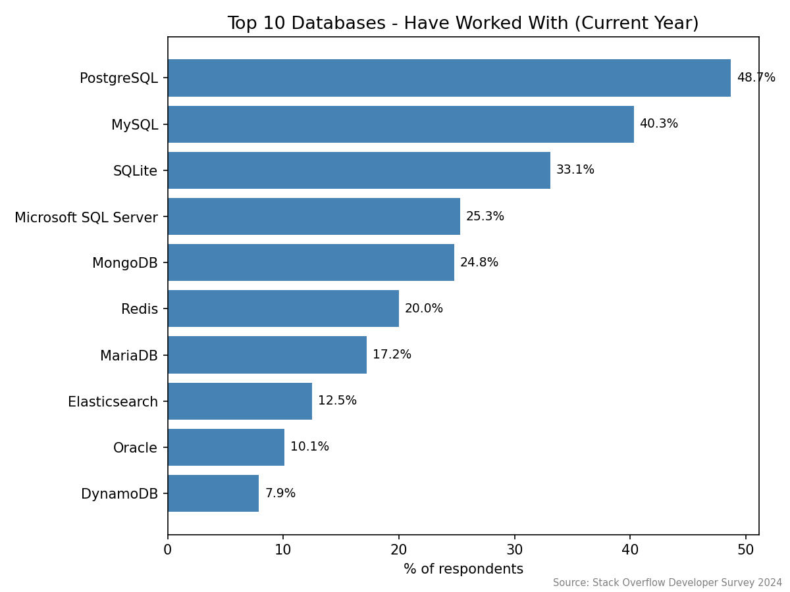
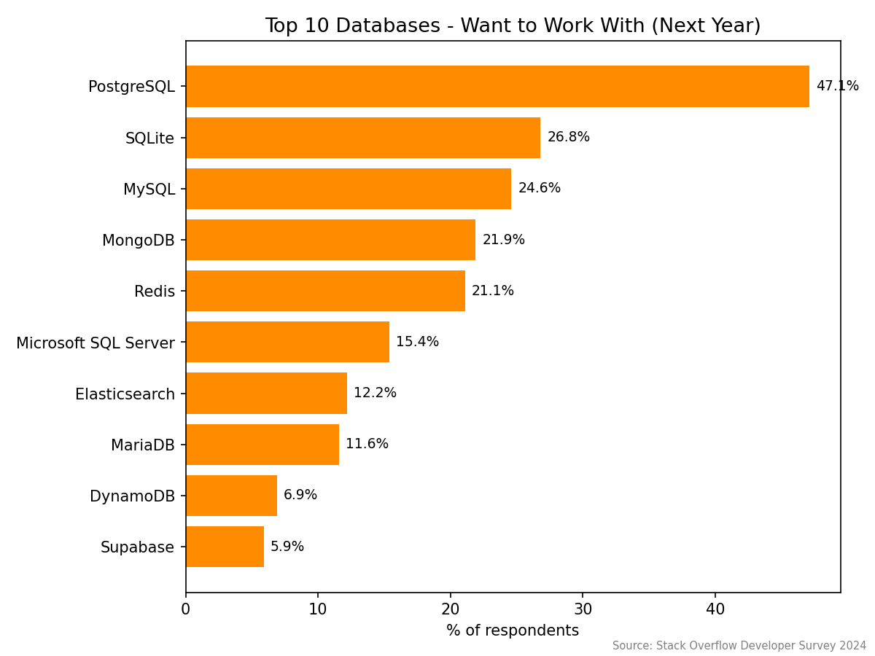
DATABASE TRENDS
Current Year
Next Year

Slide 11
DATABASE TRENDS - FINDINGS & IMPLICATIONS
Findings
PostgreSQL is the clear leader in future preference at 47.1%, nearly double the next database
The entire top 5 desired set (PostgreSQL, SQLite, MySQL, MongoDB, Redis) is open source
SQLite (26.8%) outranks MySQL (24.6%) in future desirability
Implications
PostgreSQL proficiency is becoming a baseline expectation for data-related roles
Proprietary database skills face declining relative demand
Lightweight and NoSQL databases (SQLite, MongoDB, Redis) retain strong specialized demand

Slide 12

DASHBOARD
Dashboard built in IBM Cognos Analytics with three tabs: Current Technology Usage, Future Technology Trends, and Demographics

Slide 13
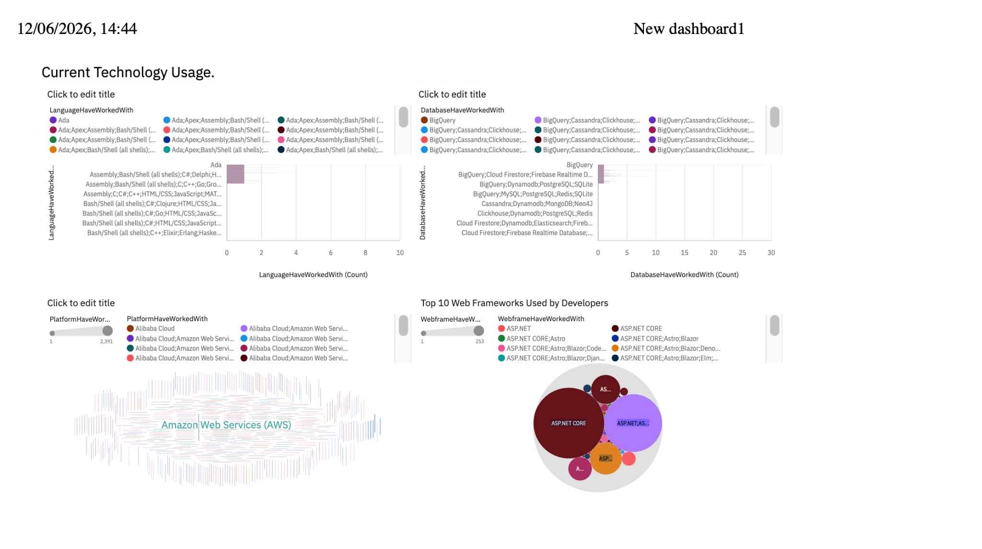
Current Technology
Screenshot of dashboard tab 1 goes here

Slide 14
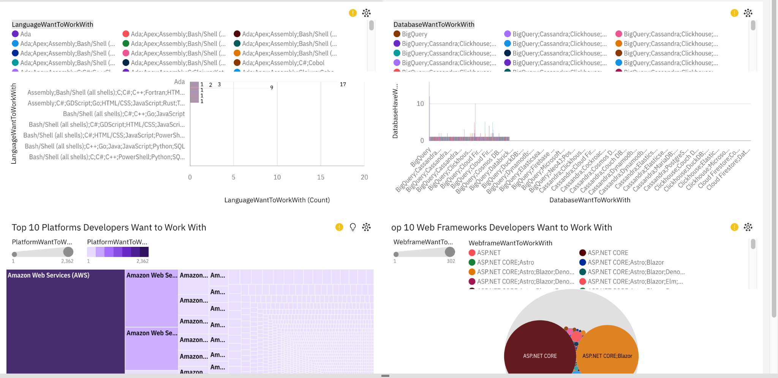
Future Technology
Screenshot of dashboard tab 2 goes here

Slide 15
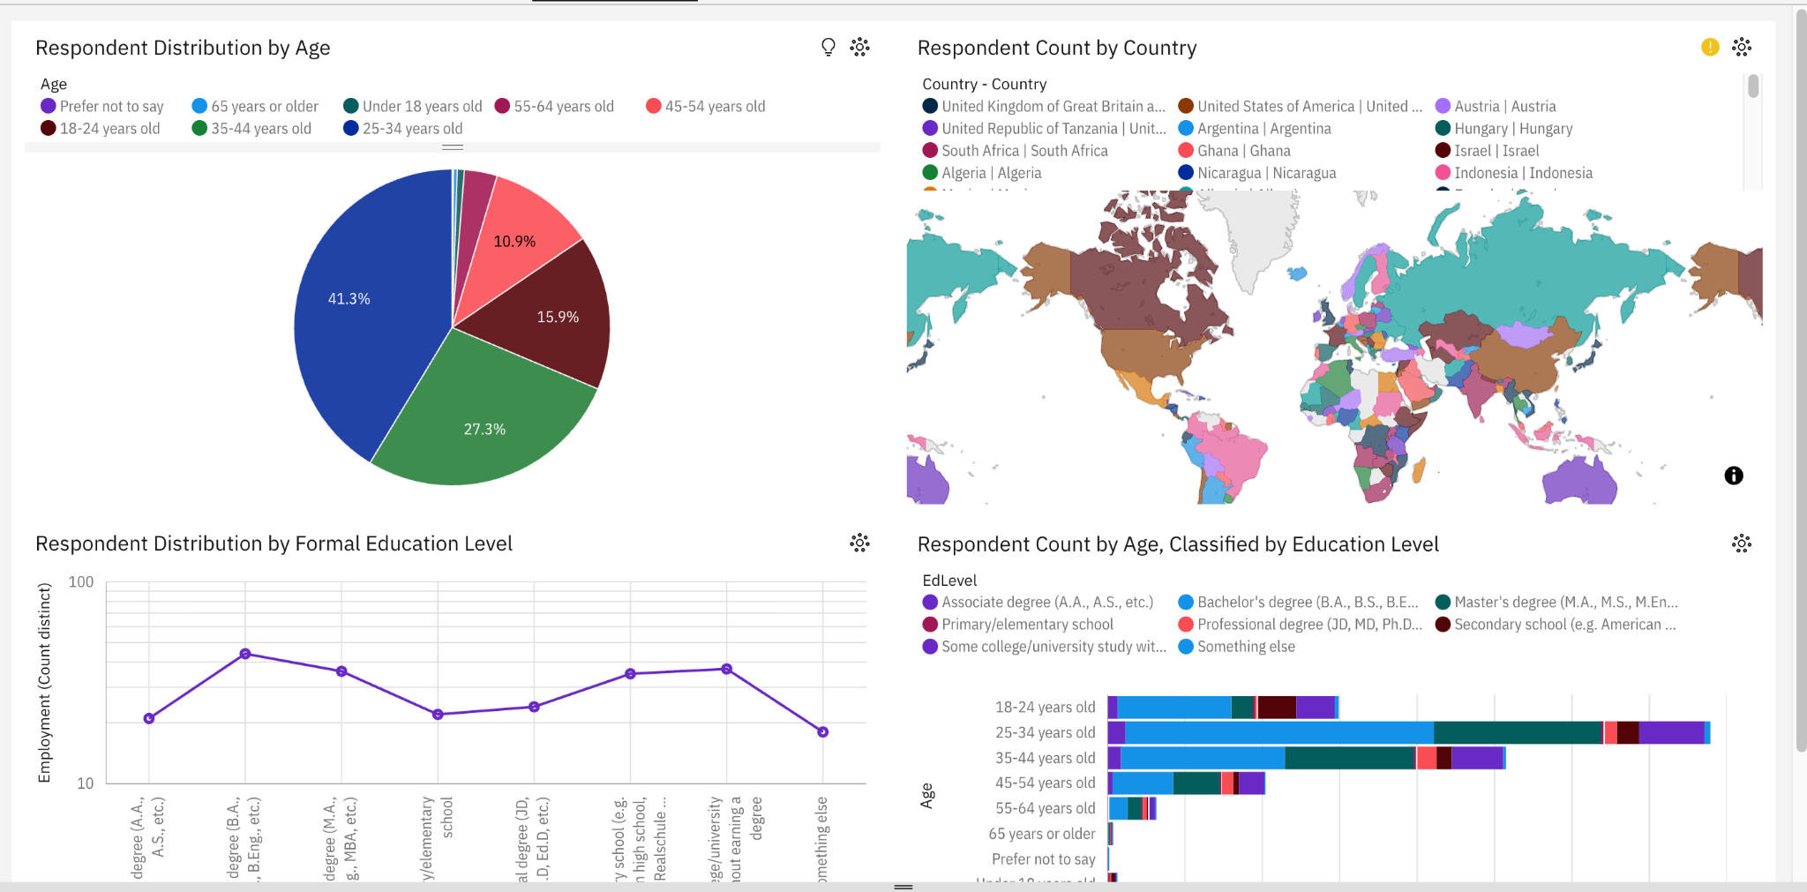
Demographics
Screenshot of dashboard tab 3 goes here

Slide 16
DISCUSSION
- Current vs. future technology intent shows a clear pivot
toward Python and Rust on the language side, and
PostgreSQL on the database side
- Open-source tooling has won the data layer outright;
proprietary databases continue to lose relative share
- Compensation and demographic data confirm that early-
career, full-stack skill investment yields the strongest
returns
- Remote and hybrid work are now the norm across all major
countries — a structural change, not a temporary shift

Slide 17
OVERALL FINDINGS & IMPLICATIONS
Findings
The developer population is concentrated in the 25–34 age group, which leads usage of every major language and database
Median compensation grows most steeply before age 40 (~$25K at 21 to ~$85K at 39), peaking at ~$110K near age 60
46.7% of top developer types are full-stack, and ~77% of respondents are professional developers
Implications
Technology adoption is driven by early-career developers; tools popular with this group will dominate within five years
The strongest compensation returns come from skill investment in the first 15 years of a career
Organizations should prioritize full-stack capability and flexible (hybrid/remote) work arrangements to attract talent

Slide 18

CONCLUSION
- Web technologies (JavaScript, HTML/CSS, SQL) dominate current professional practice
Python and PostgreSQL lead future developer intent and represent the highest-value skill investments
Open-source tooling has decisively won the database layer
Compensation and demographic patterns favor early-career, full-stack skill development supported by remote-friendly policies

Slide 19
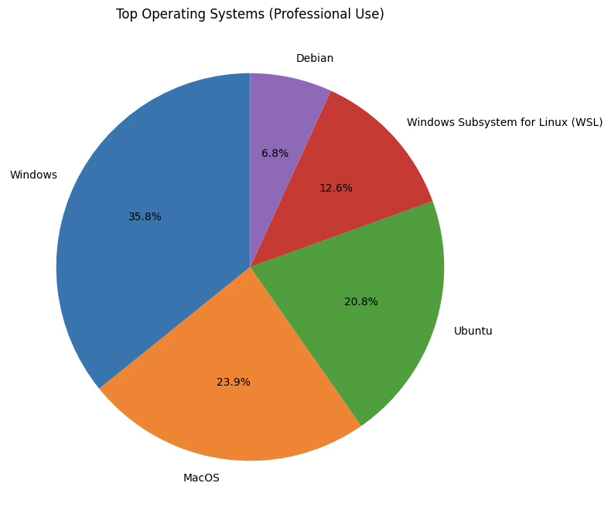

APPENDIX
Top Operating Systems (Professional Use).
Top 5 Developer Types
Remote Work Distribution by Country
Median Compensation by Age
Distribution of Respondent Types (Main Branch)

Slide 20
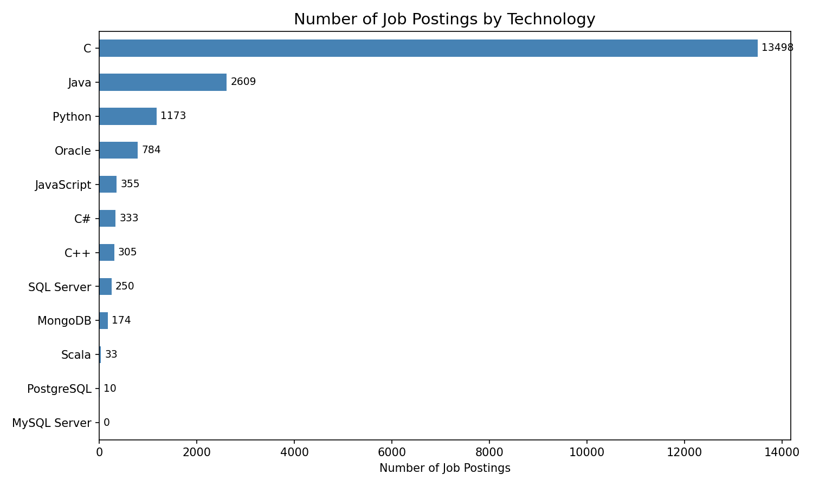
JOB POSTINGS

Slide 21
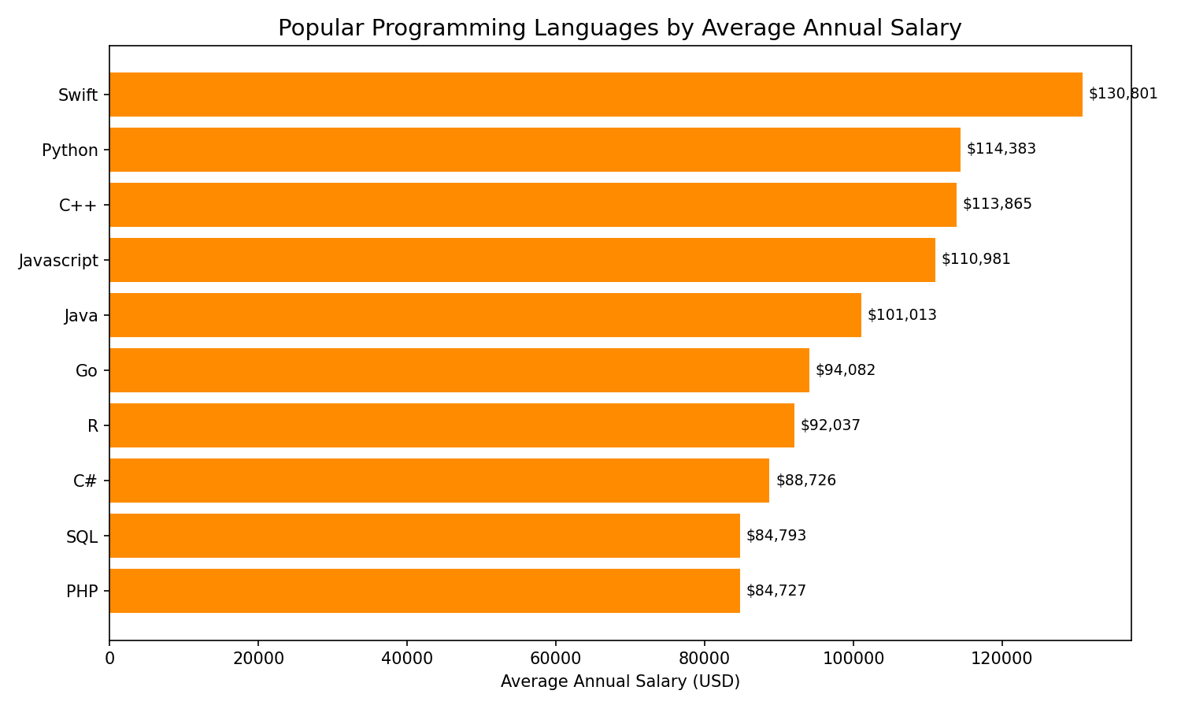
POPULAR LANGUAGES

