Slide 1
Submitted By: Under the Supervision of: Harshit Jain (9916103181) Mr. Himanshu Agrawal Shivam Jolly (9916103206)
Dynamic Spectrum Access Using Deep
Reinforcement Learning in Distributed System

Slide 2
Motivation
Spectrum extension is critical for future wireless communication networks.
Radio spectrum is a costly and scarce resource.
Utilization of most licensed spectrum bands under 30%
Free bands are over-utilized.
Different access priorities for users on same spectrum.

Slide 3
Objective
The main objective of our project is to improve the utilization of radio spectrum resources that are open to public and available for sharing among primary and secondary users.
Reduce the number of collisions between SU and PU within the same band.
Increase the convergence when the number of channels is increased.
Devise a system where the users can learn from the environment through rewards generated in the past.

Slide 4
Problem Statement
As an unlicensed user of the spectrum band, a dynamic spectrum access device (DSA) will face this critical problem:
avoid causing harmful interference to primary users (PU).
This becomes an important concern for a distributed system since there are no centralized controllers. In this project, we would work on a new strategy to help an SU (user without a license) significantly reduce the chances of collision with PU and other SU.

Slide 5
Existing Solutions 1.Reinforcement learning using Q-learning. 2. Deep Reinforcement learning combined with Multi-layer Perceptron ( DRL + MLP). 3. Deep Reinforcement learning combined with Multi-layer Perceptron2( DRL + MLP2). MLP is the initial Artificial Neural Network(ANN) design, which consists of at least 3 layers of operation. MLP2 – means it consists of 2 hidden layers.

Slide 6
Criticize 1.Q-learning iteratively updates the Q-table. So as the data size increases so does the Q-table size which makes it impossible to train using the data. 2. To compare between the two DRL + MLP and DRL + MLP2, in the case of multiple SU’s, the latter performs slightly worse than the former even DRL + MLP2,has more complicated structure because deeper network usually needs more training data and training time to make it converge. 3. Moreover, these MLP based techniques cannot learn temporal correlation and are only able to learn one to one mapping from state to function.
Notes:
The objective of this project is to develop and implement a computer application that utilizes alternate methods for cursor control. Thus proposes a computer vision based cursor control system that uses image processing techniques, using hand gestures captured from a webcam by using colour detection technique. The goal of this project is to create a system that will recognize the hand gestures and control the computer/laptop according to those gestures using colour detection technique.
This system will convert hand gesture/motion into mouse input that will be set to a particular screen position. The Virtual Mouse application will be programmed to detect the position of the defined colours where it will be set as the position of the mouse pointers. Furthermore, a combination of different colours may result in triggering different types of mouse events, such as the right/left clicks, scroll up/down, and more.

Slide 7
Solution
Technologies Utilized —
Deep Reinforcement Learning : It has the ability to adapt to dynamic unknown environments.
It helps DSA devices to obtain accurate channel status and
behavior of PUs. It also solves the large state space problem in
traditional reinforcement learning.
Q-learning : This technique is a model-free approach that learns the policy directly through
interactions with the environment without estimating a model of the environment.
Reservoir Computing : It is a special type of recurrent neural network that reduces the complexity
of training significantly by only training the output weights and our
previous work in the field.

Slide 8
We assume that there are N PU’s and 1 SU, there are totally N wireless channels so that each PU transmit on one unique wireless channel to avoid interference among PUs. Furthermore, we assume that each PU will broadcast warning signals to SU if the corresponding PU’s signal has been collided. All wireless channels are shared by SU, and a SU will select proper wireless channels to access according to its spectrum access strategy.
System Model —

Slide 9
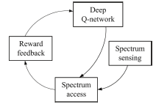

Learning Procedure
Reward function

Slide 10
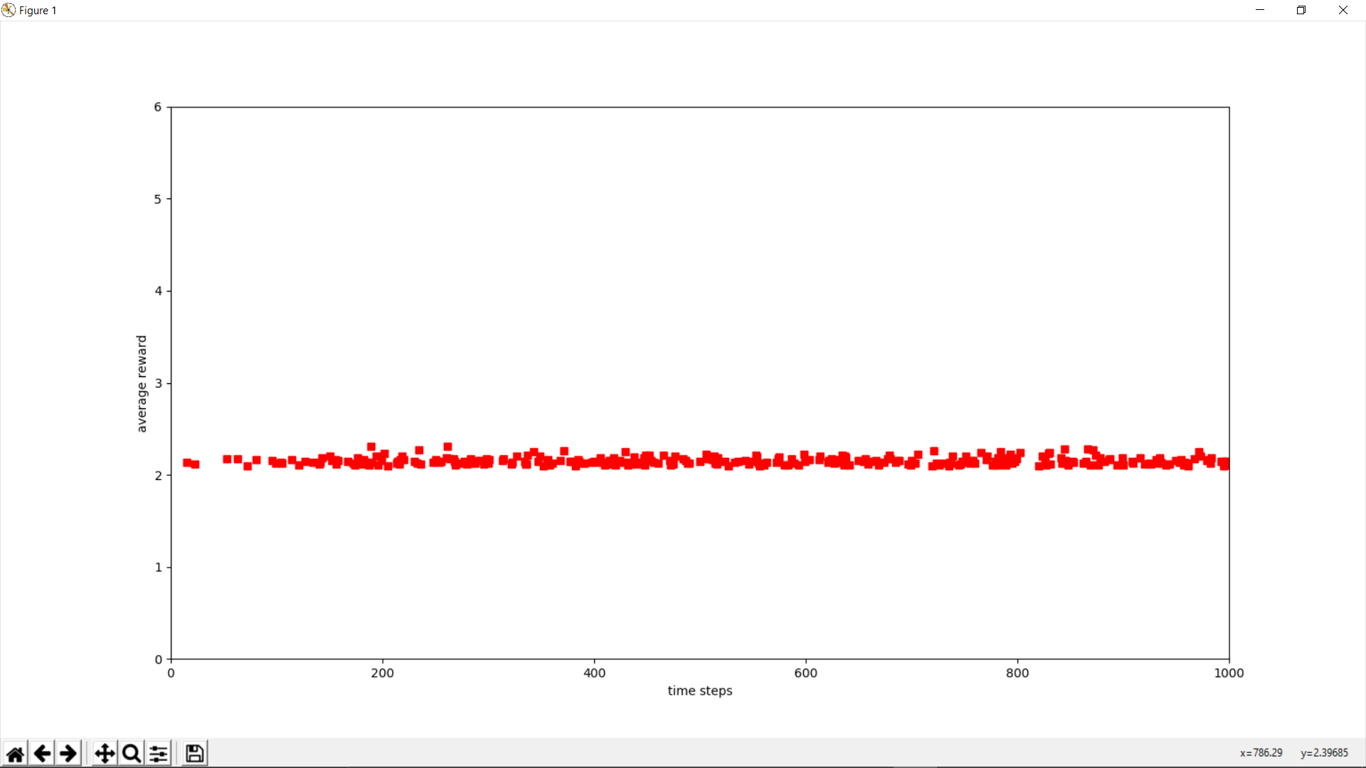
Result

Slide 11
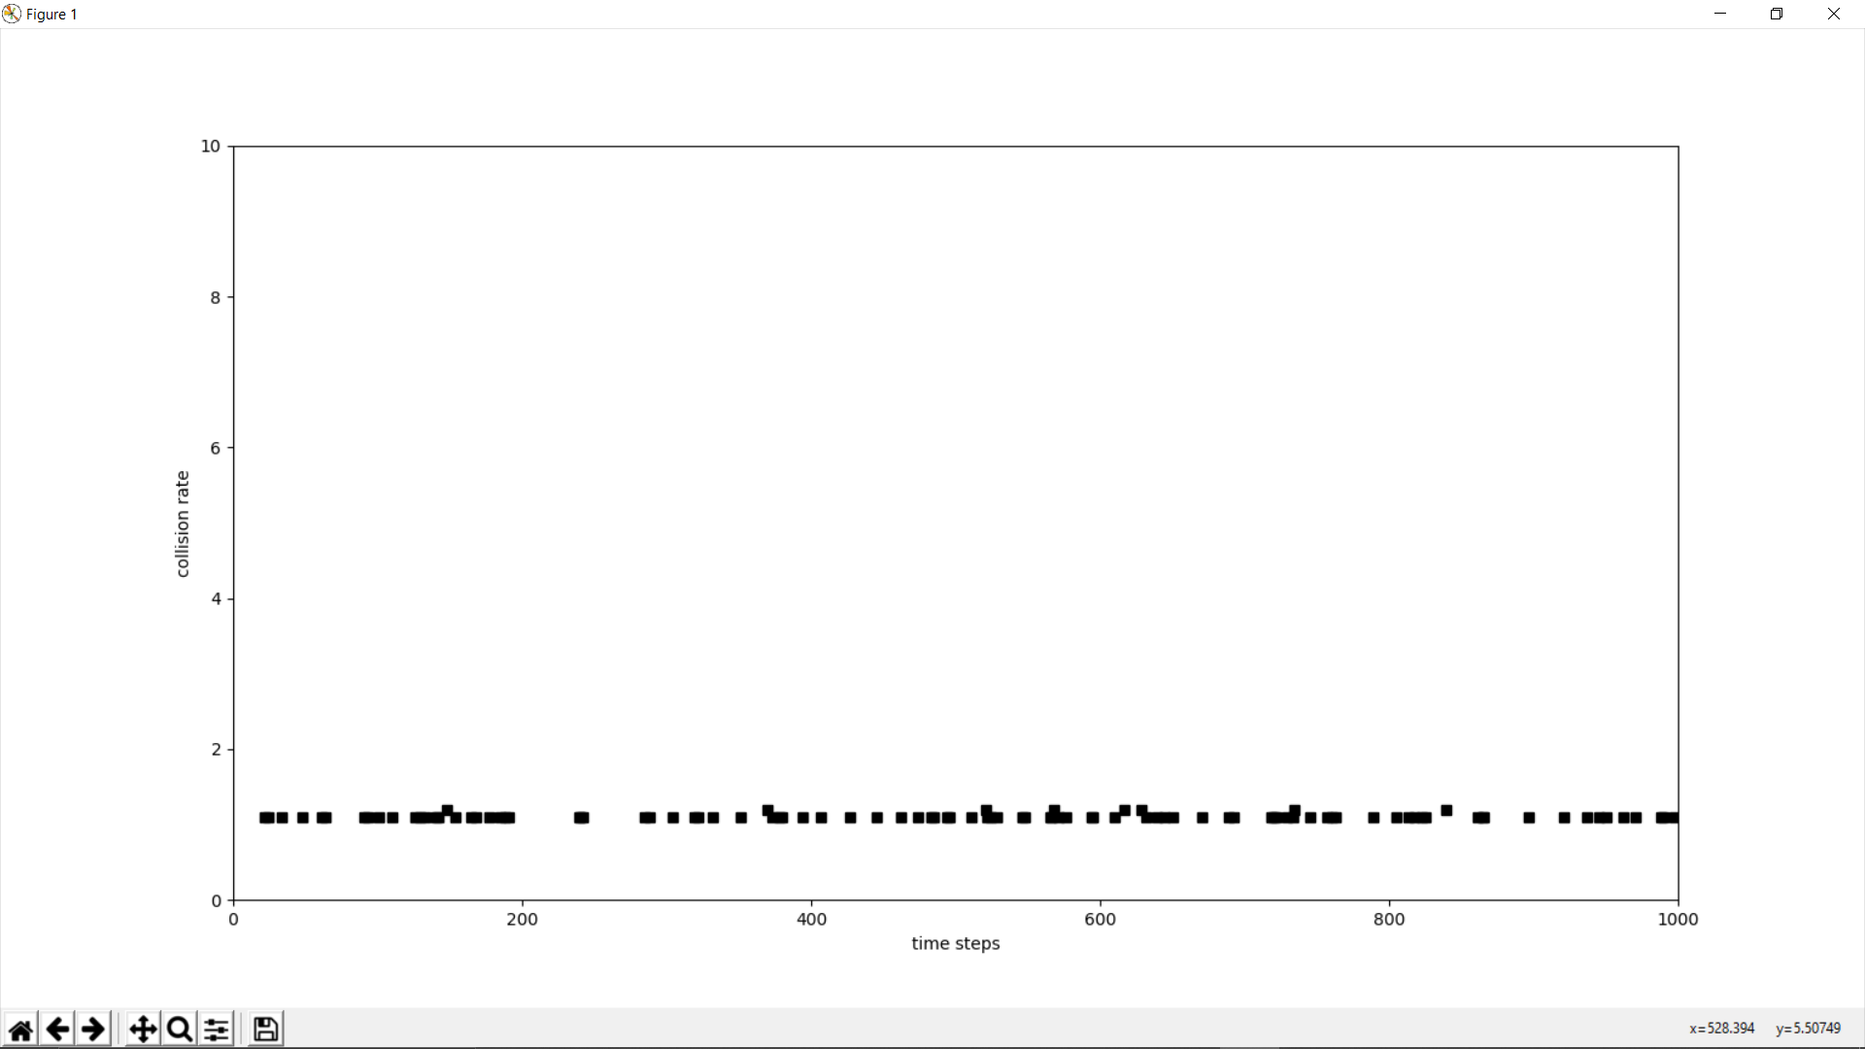

Slide 12
Conclusion
In this project, we use a new approach based on the combination of DQN which is a method of DRL and RC. DRL is employed to learn the availability of spectrum resources, and RC is utilized to realize DQN by taking advantage of the underlying temporal correlation of the DSA network. We wrote a code based on our understanding of the paper and got linear graphs which is not that accurate. Theoretically, this approach should yield higher successful transmission rate and lower transmission collision rate as oppose to the myopic strategy. Due to the recurrent structure of the RC, our DQN+RC-based scheme can outperform DQN+MLP-based scheme when spectrum sensing outcomes exhibit temporal correlation. which generally assumes channel statistics.

