Slide 1
Topic : Student Registration System
MT20130 : Joshi Shivam
MT20114 : Patel Divyang

Slide 2
Project description :
The student registration system handles on-time and late registration of all students for all courses. The courses may be regular, repeat or short term. It handles all registration changes up to the last date for adding/dropping courses. It interacts with the attendance and examination System.

Slide 3
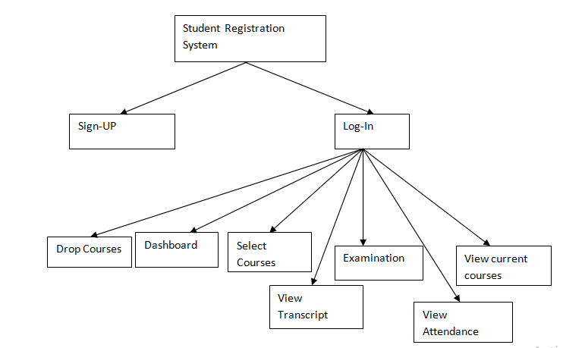
Cartesian decomposition (submitted):

Slide 4
Classes :
Class Application: object of this class This class loads the application and provide three options to the user 1)login 2)signup 3) exit
Class Log-in :
Class sign_up:
Class show_attendence:
Class Dashboard :
Class DropCourse :

Slide 5
Class show_eligiblity:
Class chang_password:
Class SelectCourses:
Class ShowCourses:
Class Student:
Class Transcript :

Slide 6
SRP (Single-responsibility principle)
Class Transcript : The SRP principle states that every class in a program should have responsibility over single part of that program’s functionality which it should encapsulates.
We satisfy SRP principle by assign single responsibility to each class.

Slide 7
OCP (open closed principle)
This principle states that Software entities should be open for extension, but closed for modification.
We make all the variables of classes as private.
All classes are open for extension but close for modification
We implement encapsulation by making variables of class as private variables.

Slide 8
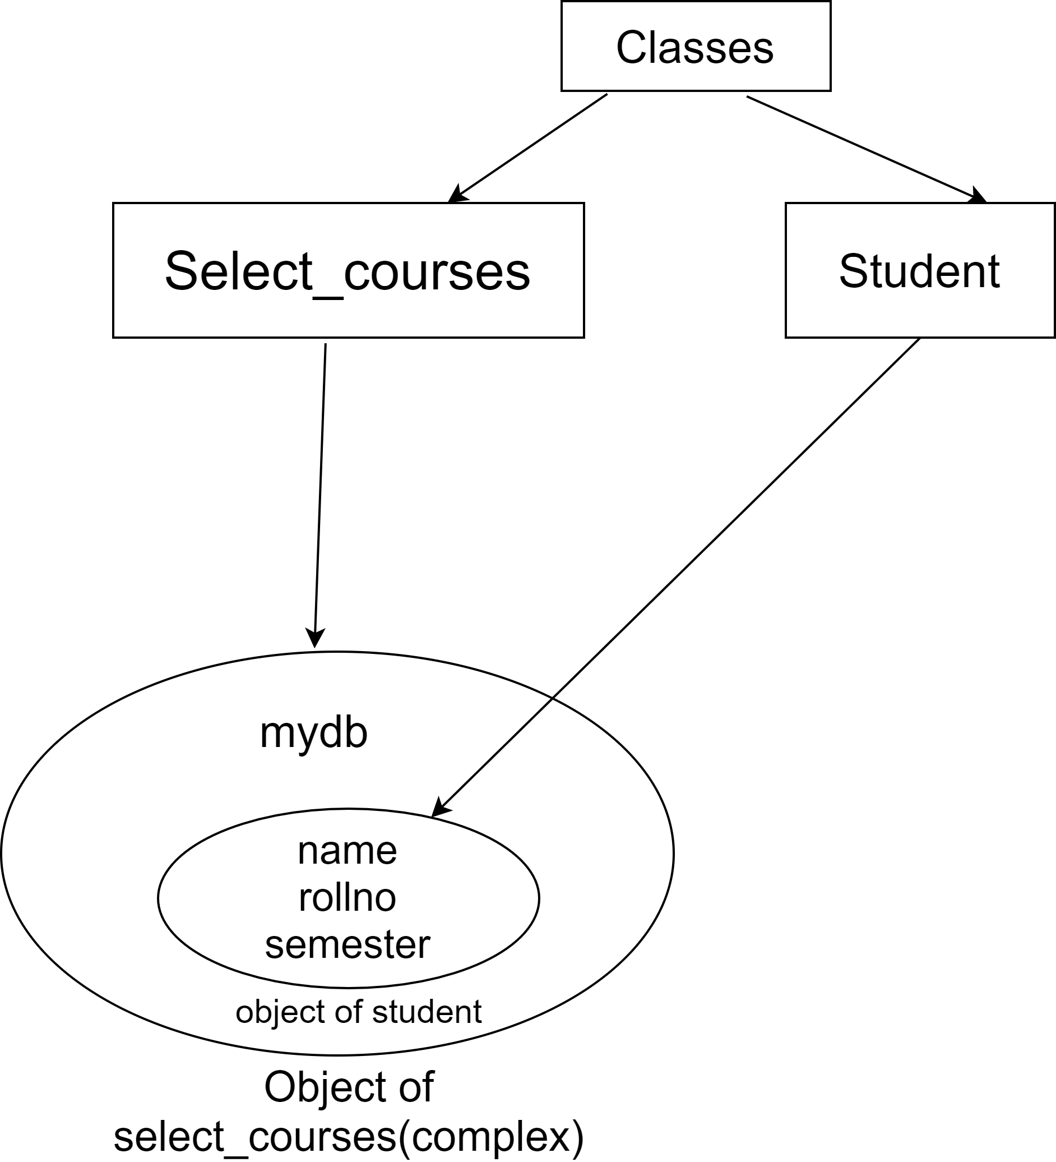
Complex object :

Slide 9
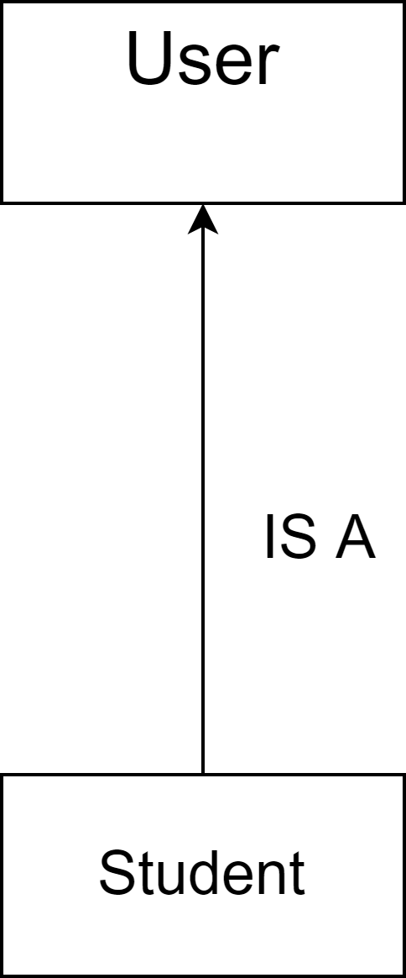
Inheritance :

Slide 10
Complex Objects :
Objects of all the classes are complex except student class object because all the other classes contain object of some other class as instance variable.
Aggregation :
Student class has aggregation with all the other classes
Composition :
Log_in class contain objects of all the other classes

Slide 11
The list of features that we are able to implement :
Sign up: If the student does not have an account then he can create an account using sign up option . It asks for the student information like semester , Roll no , Password.
Login: If the student has already an account then he can directly visit the dashboard by entering Roll no and password.
Dashboard : Display the User information and provide him various option mentioned as below
Select-Courses :Display all the available courses of a particular semester for all the students. Student can select the course of his choice by entering the course id.A student can select maximum courses of 12 credits. courses.A student can select courses during the given deadline.

Slide 12
Drop-Courses: Provide facilities for students to drop the selected courses before deadline.
View Courses :Display record of selected courses of current semester.
View Transcript: Display record of all selected courses(regular/Drop/Short) till now along with Grades
Examination: Display the subject for which student is eligible according to attendance criteria.
View-Attendance: Displays the Attendance of a Student in current courses.

Slide 13
The code flow :
When Student enter into system initially he has three options Log_in , Sign_UP , Exit.
The user must have an account to log_in. He can create it using Sign_Up.
In the sign_up procedure the user have to enter roll_no, name,semester , password.
To log_in into system the user have to enter valid roll_no and password.
When user successfully log_in into system the he can access all the options.
To exit the system user will enter choice number 3.

Slide 14
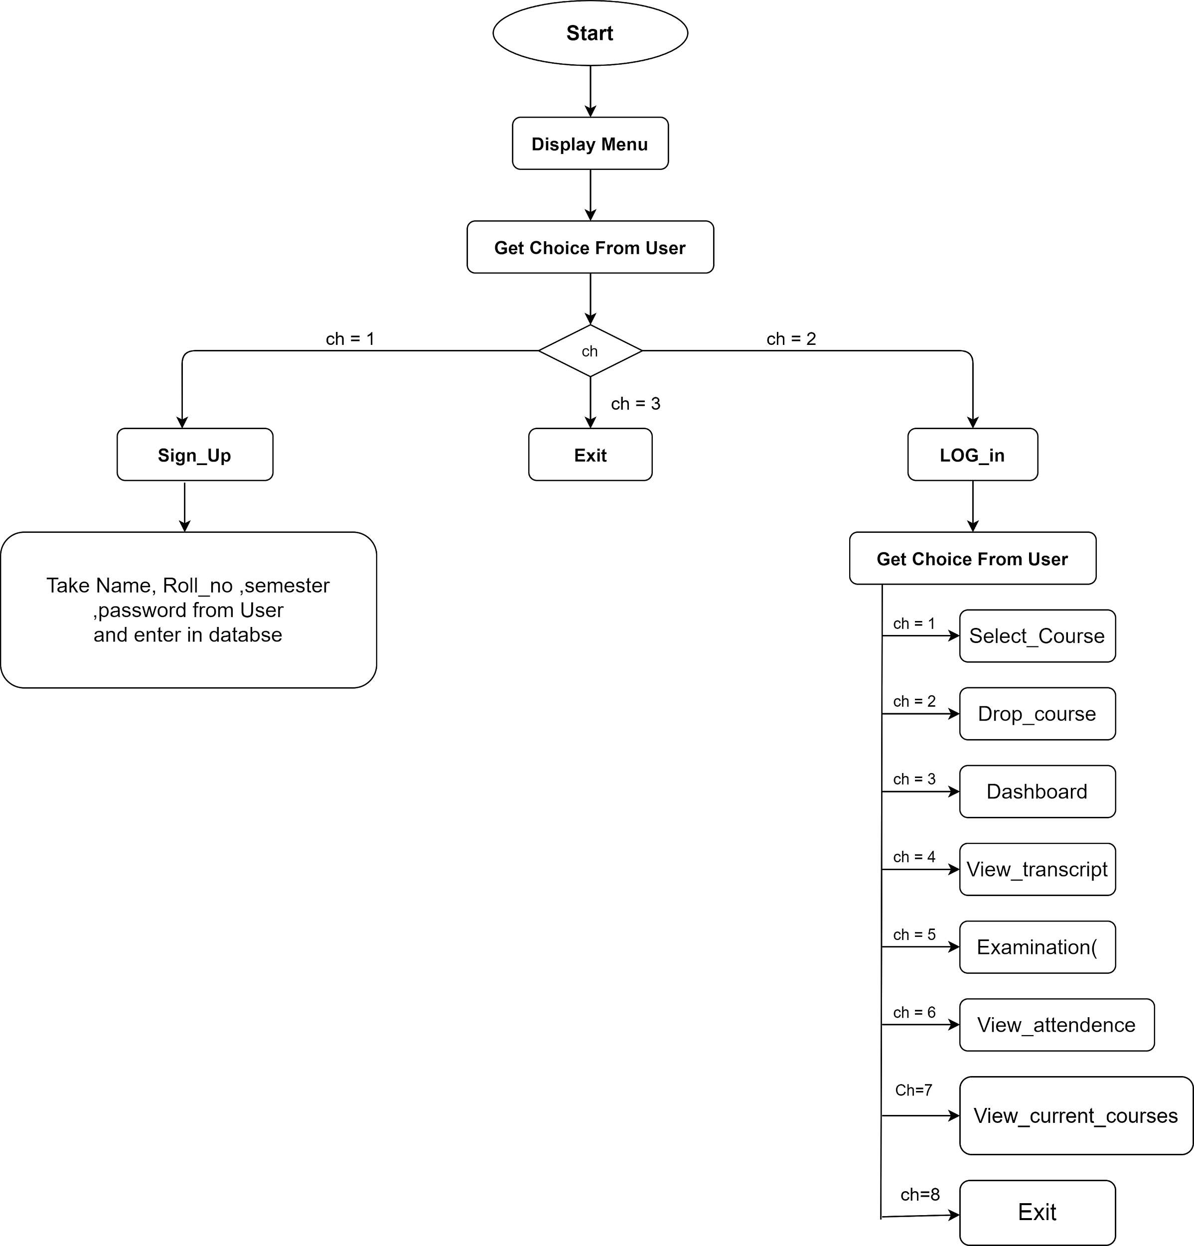
Code Flow :

Slide 15
Contribution of every member in the project :
We divided all the classes into half among ourselves and implemented them.
We help each other when any error occurs in other person’s code.
Classes created by shivam : log_in ,sign_up ,select_courses ,show_courses
Classes created by divyang : drop_courses , display_dashboard , show_transscript , show_attendence

