Slide 1
Topic : Student Registration System
MT20130 : Joshi Shivam
MT20114 : Patel Divyang

Slide 2
Project description :
The student registration system handles on-time and late registration of all students for all courses. The courses may be regular, repeat or short term. It handles all registration changes up to the last date for adding/dropping courses. It interacts with the attendance and examination System.

Slide 3
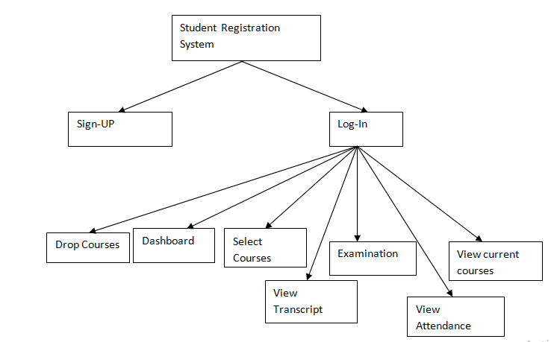
Cartesian decomposition (submitted):

Slide 4
Cartesian decomposition (Implemented):

Slide 5
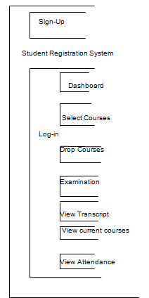
Modular structure (submitted):

Slide 6
Modular structure (Implemented):

Slide 7
There is no difference between cartesian decomposition which was submitted earlier and the cartesian decomposition which we actually implemented .
There is no difference between modular structure which was submitted earlier and the modular structure which we actually implemented.

Slide 8
The list of features that we are able to implement :
Sign up: If the student does not have an account then he can create an account using sign up option . It asks for the student information like semester , Roll no , Password.
Login: If the student has already an account then he can directly visit the dashboard by entering Roll no and password.
Dashboard : Display the User information and provide him various option mentioned as below
Select-Courses :Display all the available courses of a particular semester for all the students. Student can select the course of his choice by entering the course id.A student can select maximum courses of 12 credits. courses.A student can select courses during the given deadline.

Slide 9
Drop-Courses: Provide facilities for students to drop the selected courses before deadline.
View Courses :Display record of selected courses of current semester.
View Transcript: Display record of all selected courses(regular/Drop/Short) till now along with Grades
Examination: Display the subject for which student is eligible according to attendance criteria.
View-Attendance: Displays the Attendance of a Student in current courses.

Slide 10
The code flow :
When user enter into system initially he has three options Log_in , Sign_UP , Exit.
The user must have an account to log_in. He can create it using Sign_Up.
In the sign_up procedure the user have to enter roll_no, name,semester , password.
To log_in into system the user have to enter valid roll_no and password.
When user successfully log_in into system the he can access all the options.
To exit the system user will enter choice number 3.

Slide 11
After successful log_in user have seven choices :
Select_ courses
Drop_course
Display_dashboard
Show_transcript
Examination_eligiblity
Show_attendence
show_courses

Slide 12
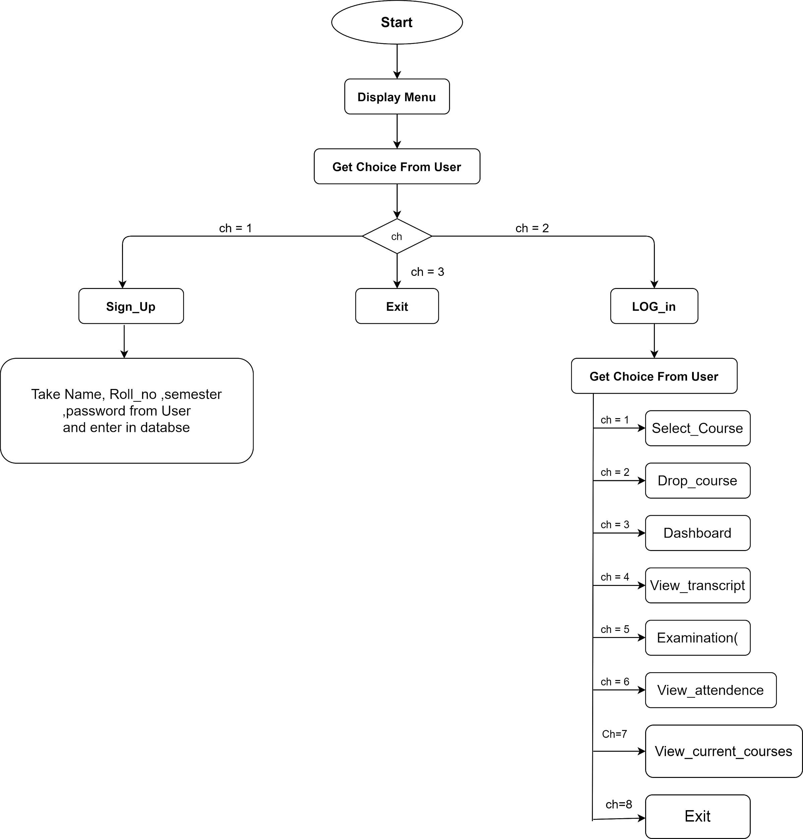

Slide 13
Contribution of every member in the project :
We divided all the modules into half among ourselves and implemented them.
We help each other when any error occurs in other person’s code.
Modules created by shivam : log_in ,sign_up ,select_courses ,show_courses
Modules created by divyang : drop_courses , display_dashboard , show_transscript , show_attendence

