Slide 1

Simulation and Control of Upper Body Exoskeleton
By
Shivam Jaiswal
(Reg. No.:20-06-07)
Under the supervision of
Dr. Subhashisa Sahoo Scientist ‘F’ Centre for Artificial Intelligence and Robotics DRDO, Bangalore
1st Presentation
Center for Artificial Intelligence and Robotics - DRDO Bangalore

Slide 2
Abstract
It starts with collecting data from 100 soldiers at 59.8802 Hz during LCA (Load Carrying Activities).
Function involves are:-
Walking
Bending
Lifting
Walking with load
Dropping the load
Data Analysis
Extraction
Plotting
Verification
Center for Artificial Intelligence and Robotics - DRDO Bangalore

Slide 3
Abstract continued
Simulation of Data
Through angular position (For all available joints)
Through torque (For Elbow)
Modelling of human CAD model
Simulation and analysis of elbow joint
Comparison of results between experimental data and simulated data
Center for Artificial Intelligence and Robotics - DRDO Bangalore

Slide 4
Review of literature
Table 1. Tabulated work of some authors
Author | DoF | Mechanism/Exoskeleton | Actuation | Sensors
Lopez et al., 2020 | 3 | Upper limb exoskeleton | Maxon motor EC90, EC45 | -
Samper et al., 2020 | - | SEA-Cable driven upper limb exoskeleton | Maxon motor 24V-0.5A | sEMG MyoWare
McDonald et al., 2020 | 5 | MAHI-II Exoskeleton | - | Delsys Bagnoli EMG
Su et al., 2020 | - | - | - | sEMG
Accogli et al., 2017 | 5 | NESM Exoskeleton | - | EMG TeleMyo 2400R-Noraxon
Center for Artificial Intelligence and Robotics - DRDO Bangalore

Slide 5
Review of literature continued
Author | DoF | Mechanism/Exoskeleton | Actuation | Sensors
Parri et al., 2017 | 4 | Hip actuated, SEA-based exoskeleton | Maxon motor EC 60 and 100:1 CPL-14 A 100-2A Harmonic Drive | 17-bit Rotary Encoder (DS-37Netzer Precision Motion Sensors
Christensen et al., 2017 | 3 | Double parallelogram linkage, upper limb exoskeleton | Maxon motor EC60 and CSD 25 2A Harmonic Drive | -
Macke et al., 2017 | 1 | Counterweight and spring mechanism | Passive | EMG
Jung et al., 2015 | 5 | Upper limb exoskeleton | - | 6 axis F/Tsensor, ATI mini45
Huang et al., 2015 | 3 | FSR based 3 DoF upper limb exoskeleton | 250841- Maxon motor | HEDL-A11 Encoder, A201 FSR- FlexiForce sensor
Jarrasse et al., 2010 | 4 | Modified ABLE Exoskeleton | - | F/T sensor
Center for Artificial Intelligence and Robotics - DRDO Bangalore

Slide 6
Problem definition
Problem statement
In the field a solider need to carry loads from one place to other, In such tasks, muscle gets tired due to fatigue. To reduce fatigue and provide some assistance to soldiers, a WAP-Exo or upper limb exoskeleton can be developed which can provide additional torque and reduce fatigue, prevent him from injury and increase their efficiency.
The designed exoskeleton must be able to support troops if they are trying pick weight under the specified limit. This support is only provided in sagittal plane, i.e., for flexion and extension of each joint
Center for Artificial Intelligence and Robotics - DRDO Bangalore

Slide 7
Methodology for solution of problems
Steps involved for work so far: -
Stage 1: Data analysis
Stage 2: Data verification through simulation
Stage 3: Design of an accurate human model
Stage 4: Analysis of Elbow joint
Center for Artificial Intelligence and Robotics - DRDO Bangalore

Slide 8
Methodology for solution of problems continued
Stage 1: Data analysis
Extracted data for Elbows, Shoulders, Pelvis joint to simulate and control upper limb exoskeleton and Hips, Knee and Ankle joint to simulate and verification of data and analysis in later stages.
The extracted data includes only flexion and extension of each joint in sagittal plane
A data sets is the combinations of loads, speed and test cases are presented in Table 2.
Figure 1 shows left elbow flexion and extension for data combination of 17 kg – Fast walk (FW) and T3 test case, as highlighted in Table 2.
NW – Normal walk
FW – Fast walk
Table 2. Possible combinations of test
Weights (kg) | Speeds (m/s) | Test case
17 | NW - 1.5 | T1
 |  | T2
 | FW - 1.75 | T3
 |  | T4
22.5 | NW – 1.5 | T1
 |  | T2
 | FW – 1.75 | T3
 |  | T4
29 | NW – 1.5 | T1
 |  | T2
Center for Artificial Intelligence and Robotics - DRDO Bangalore

Slide 9
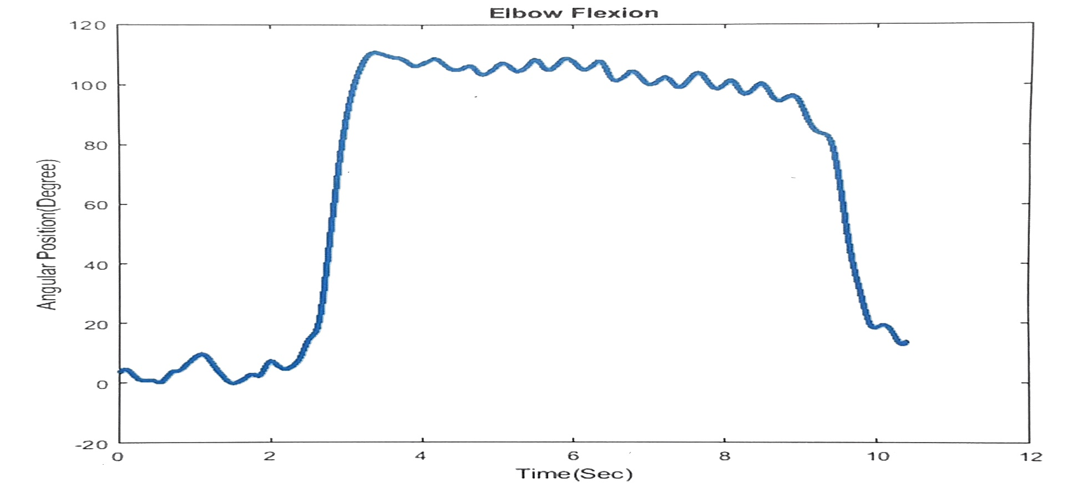
Methodology for solution of problems continued
Figure 1. Angular position of left elbow in sagittal plane with respect to time. This curve is extracted from the experimental data.
Center for Artificial Intelligence and Robotics - DRDO Bangalore

Slide 10
Methodology for solution of problems continued
Stage 1: Data analysis contd.
Table 3 shows maximum values of each parameter which can be used to identity actuator and sensors.
Table 3. Limits of each joint based on experiment
 | Elbow | Shoulder | Pelvis
Velocity (degree/sec) | 350 | 300 | 150
Acceleration (degree/sec²) | 5000 | 2500 | 1000
Torque (Nm) | 40 | 40 | 160
Center for Artificial Intelligence and Robotics - DRDO Bangalore

Slide 11
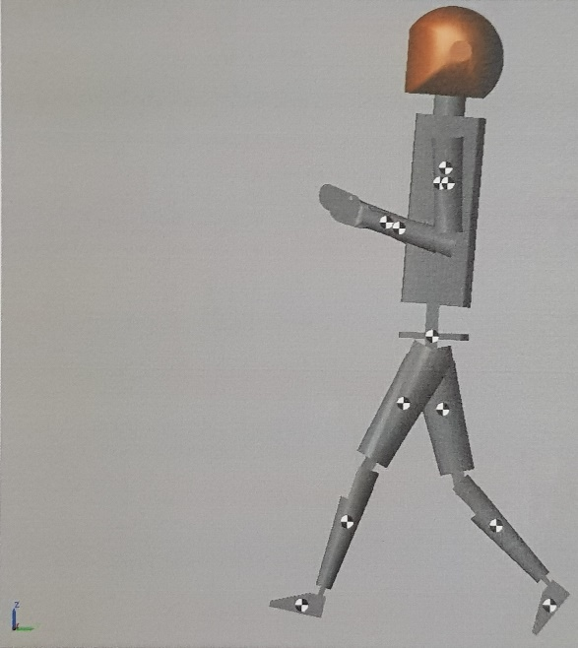
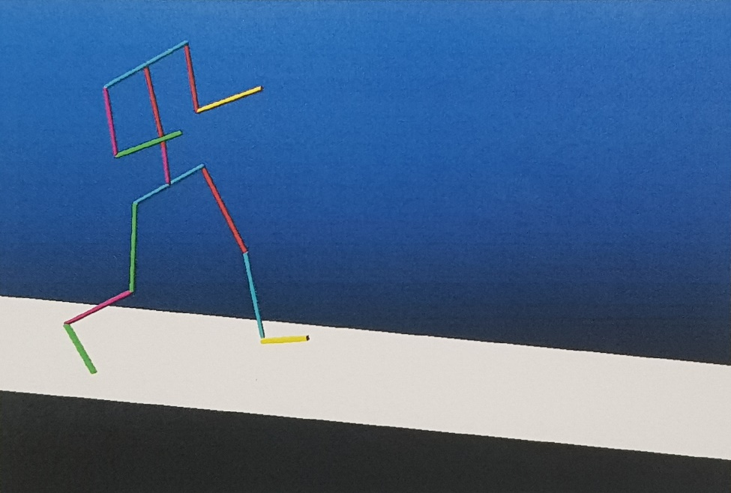
Methodology for solution of problems continued
Stage 2: Data verification through simulation
To verify that data extracted was correct, it was passed to a CAD model designed in Solidworks.
Simulation was conducted on MATLAB-Simulink, MSC-Adams and OpenSim
An instance of the simulation from MATLAB and from MSC-Adams is shown in Figure 2, which is walking while holding load. Load is not added here.
Figure 2. Screenshot from Matlab and Admas simualtion
Center for Artificial Intelligence and Robotics - DRDO Bangalore

Slide 12
Methodology for solution of problems continued
Stage 3: Design of an accurate human model
A CAD model of human body was designed in Solidworks with the help of Table 4. Model’s isometric and side view is shown in Figure 3.
Table 4. Human model specification
Body part | Length (cm (%)) | Weight (kg (%)) | COM/COG wrt Proximal sagittal plane (cm) [15]
Full body | 177 (100 %) | 65 (100 %) | -
Head + Neck | 27.656 (15.625 %) | 5.092 (7.8 %) | (55 %) from Neck joint with Trunk
Torso (excluding Pelvis) Shoulder joint to Umbilicus plane | 36.639 (20.7 %) Sagittal Plane (Shoulder joint to Umbilicus plane) | 23.403 (36.006 %) | (63 %) From Shoulder including Pelvic
 | 43.365 (24.5 %) Frontal Plane (Shoulder to Shoulder)
Center for Artificial Intelligence and Robotics - DRDO Bangalore

Slide 13
Methodology for solution of problems continued
Body part | Length (cm (%)) | Weight (kg (%)) | COM/COG wrt Proximal sagittal plane (cm) [15]
Pelvis | 16.461 (9.3 %) Hip joint to Umbilicus plane | 7.227 (11.118 %) | (5 %) form Umbilicus plane
 | 20.001 (11.3 %) Hip joint to Hip Joint
Left Upper Arm | 33.276(18.8 %) Humerus Bone | 1.944 (2.992 %) | (43.6 %) from Shoulder Joint
Left Forearm (including Hand) | 29.028(16.4 %) Ulna Bone | 1.144 (1.76%) | (43 %) from Elbow Joint
 | 15.222 (8.6 %) Hand | 0.474 (0.73 %) | (46.8 %) from Wrist
Left Thigh | 46.374(26.2 %) Femur Bone | 6.966 (10.717 %) | (43.3 %) from Hip Joint
Left Leg | 39.471 (22.3 %) Tibia Bone | 2.952 (4.542 %) | (43.4 %) from Knee joint
Left Foot | 8.186 (4.625 %) Height | 1.097 (1.688 %) | (50 %) from Ankle Joint Height
 | 22.125 (12.5 %) Length
Center for Artificial Intelligence and Robotics - DRDO Bangalore

Slide 14
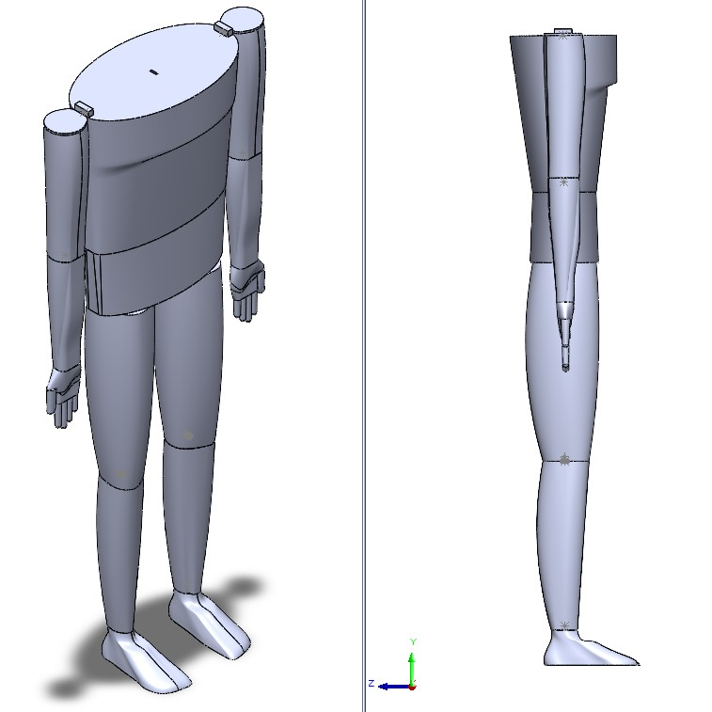
Methodology for solution of problems continued
Figure 3. CAD model of human body using Table 4.
Center for Artificial Intelligence and Robotics - DRDO Bangalore

Slide 15
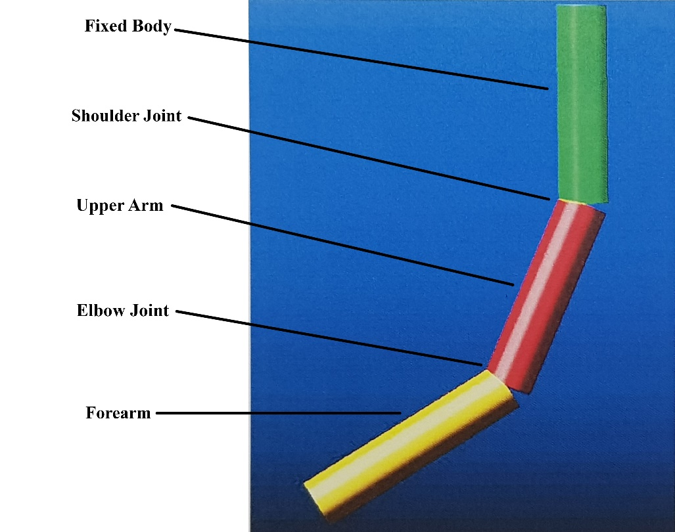
Methodology for solution of problems continued
Stage 4: Analysis of Elbow joint
Primary focus of this study is on Elbow, Shoulder and Pelvis joints. With this focus in mind, we first analyzed elbow flexion and extension using torque data provided in experimental data.
Figure 4. shows a basic link model of human upper limb, forearm and arm having revolute joints at shoulder and elbow joints.
Figure 4. Link model of human upper limb in MSC-Adams (during simulation)
Center for Artificial Intelligence and Robotics - DRDO Bangalore

Slide 16
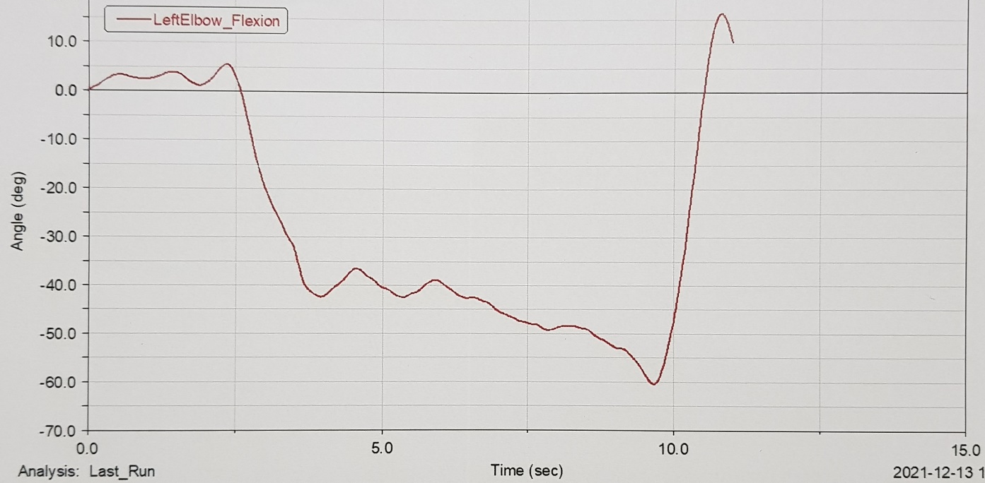
Methodology for solution of problems continued.
Stage 4: Analysis of Elbow joint contd.
The two joints were provided with a random stiffness and damping coefficient.
Torque profile for elbow, Figure 1, and shoulder joint were applied to the model in Adams.
During simulation its behavior was observed, its angular position and angular velocity profiles were generated. Figure 4 shows an instance during simulation and Figure 5 shows simulated result of elbow flexion.
Figure 5. Simulated left elbow flexion from MSC-Adams
Center for Artificial Intelligence and Robotics - DRDO Bangalore

Slide 17
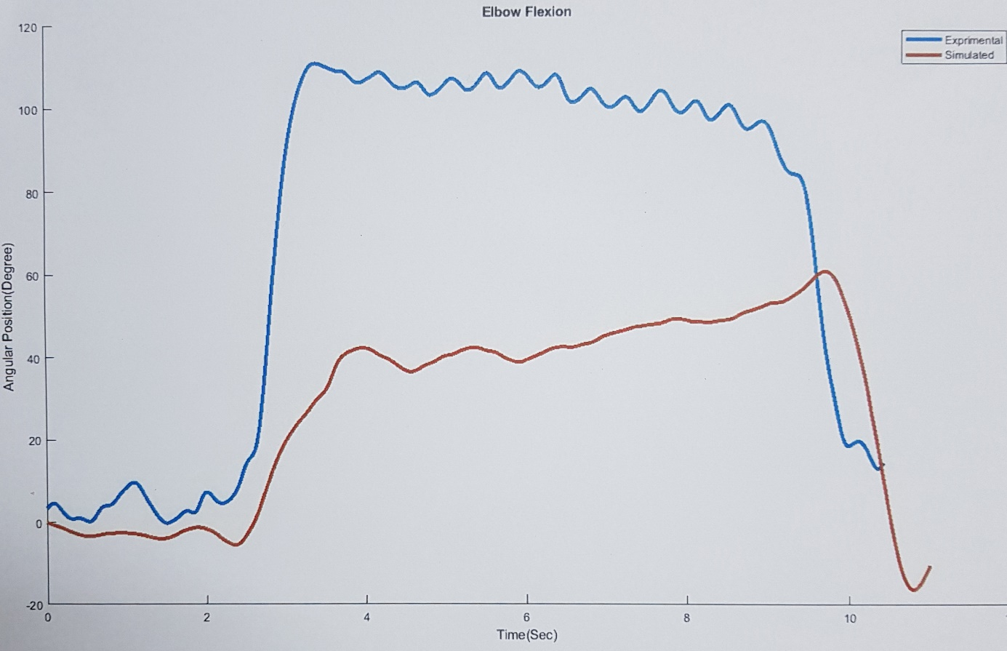
Results
Before comparing simulated and experimental results, data from simulation was pre-processed so that it can be compared with experimental data
After pre-processing both curves were plotted together to compare them, as shown in Figure 6.
Figure 6. Comparison between simulated (red) and experimental (blue) results
Center for Artificial Intelligence and Robotics - DRDO Bangalore

Slide 18
Results continued
As seen from Figure 6, the overall behavior of both plots are similar, which is an expected outcome.
Simulated values are lower than experimental values, which distinguish these two results, reason for such behavior could be,
One of the key reasons for such behavior is non-availability of stiffness and damping coefficient for human joint.
Next factor is limitations of the CAD model
Second factor can be reduced by designing more accurate model, but there always be some limitations.
To determine stiffness and damping coefficient more extensive research and literature survey is needed also they change with the position of the joint in arm, because of muscles being a non-linear flexible entity.
Center for Artificial Intelligence and Robotics - DRDO Bangalore

Slide 19
Future work
Next stage of this project is to design a control system, using space state model of a simple WAP-Exo and upper limb exoskeleton.
The model will be simulated numerically in MATLAB, and in Adams using a simple cable and pulley mechanism operated with a motor.
Simultaneously, one model for upper limb exoskeleton and a WAP-Exo will be designed in Solidworks for prototyping.
And lastly testing control algorithm in real world environment.(optional)
Center for Artificial Intelligence and Robotics - DRDO Bangalore

Slide 20
References
Gull, M. A., Bai, S. and Bak, T. “A Review on Design of Upper Limb Exoskeletons”, Robotics No. 1:16, 2020
Kapsalyamov, A., Hussain, S. and Jamwal, P. K. “State-of-the-Art Assistive Powered Upper Limb Exoskeletons for Elderly”, IEEE Access, 2020
Mosher, R. “Final Report on Hardiman I Prototype for Machine Augmentation of Human Strength and Endurance”, Specialty Materials Handling Products Operation General Electric Company Schenectady, New York, 1971
Parri, A., Yan, T., Giovacchini, F., Cortese, M., Muscolo, M., Fantozzi, M., Lova, R. M., Vitiello, N. “A Portable Active Pelvis Orthosis for Ambulatory Movement Assistance”, Proceedings of the 2nd International Symposium on Wearable Robotics, WeRob2016, Spain 2017
Voilqué, A., Masood, J., Fauroux, J. C., Sabourin, L. and Guezet, O. “Industrial Exoskeleton Technology: Classification, Structural Analysis, and Structural Complexity Indicator”, Wearable Robotics Association Conference, WearRAcon, 2019
Center for Artificial Intelligence and Robotics - DRDO Bangalore

Slide 21
Thank You
Center for Artificial Intelligence and Robotics - DRDO Bangalore

