Slide 1
TVES

Slide 2
What is TVES
Television Event Scheduler is a Dynamic Website which is used to check the live television schedule and with the help of this we can check the timing of our favourite program.
It is very simple and can be accessed by anyone.

Slide 3
Project Guidance
Debashish Sir
Prasad Sir

Slide 4






What are TVES technology
Java
HTML 5
CSS 3
JavaScript
MySqL

Slide 5
TVES
Front End
css
HTML
Back End
Oracle 9
Server Site
JS
Servlet and JSP
Java

Slide 6
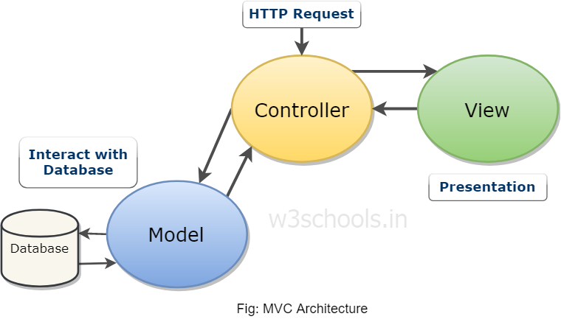
Project Flow

Slide 7
Data Base
Programmes
Channel
Admin

Slide 8
Programmes
Program Name
Start Time
End Time
Description
Channel Name
Date

Slide 9
Channel
Channel Name
Category

Slide 10
Admin
Username
Password

Slide 11
Lets get to Demo

Slide 12
Thank You
Submitted by:
Shivam Chaudhary
Deepak Yadav
Vaibhav Tyagi
Eshika Singhal
Neha Dhama
Ajay Sagar

