Slide 1
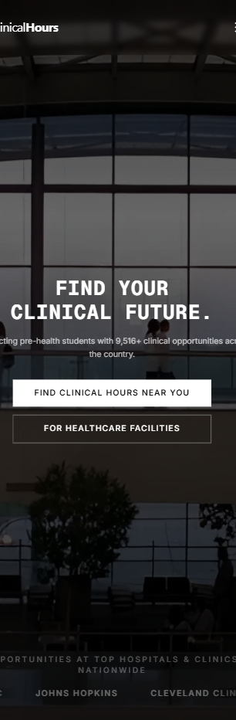
C L I N I C A L H O U R S
01 / 05
01 FRICTION
Finding
clinical hours
still feels
random.
Too many students still piece it together from tabs,
school docs, screenshots, and whatever clinic site
they can find.
random clinic sites
tabs everywhere
school docs
screenshots
PAIN
No single place to
start.
NEED
Something that feels
obvious in one swipe.
Notes:
Pain slide for the student discovery lane. Keep the copy broad, recognizable, and calmer than a fear-based ad.
[Sources]
- Research brief and retention strategy, both dated 2026-05-18
- Capture: home/clinicalhours_home_mobile_430x932_live.png

Slide 2
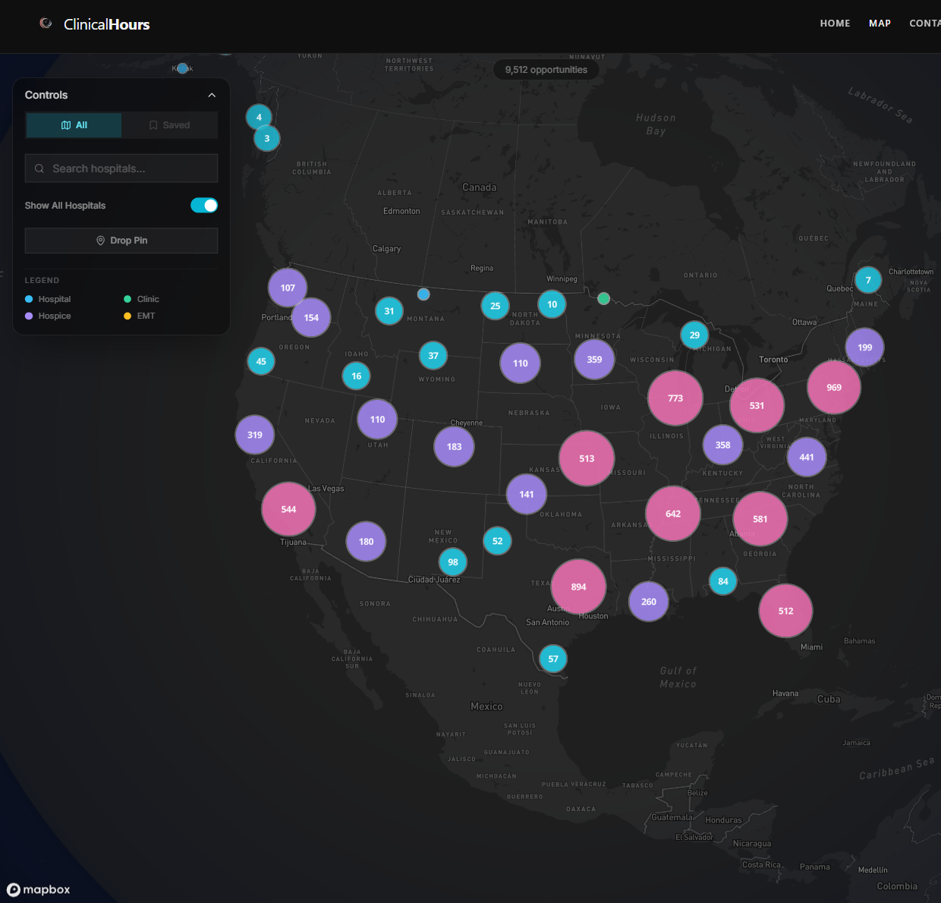
C L I N I C A L H O U R S
02 / 05
02 DISCOVERY
9,512 openings.
One map.
The best student proof is the national map: one screen that
instantly makes the search feel bigger and easier.
MAP-FIRST BETTER THAN HUNTING PAGE BY PAGE
Control filters prove this
is a real search flow.
Big colored clusters
create instant visual
payoff in-feed.
Notes:
Discovery slide. The map is the payoff, so the screenshot needs to dominate the lower half.
[Sources]
- Deck spec: clinicalhours_tiktok_student_bright_v3bright5_deck_spec.json
- Capture: derived/clinicalhours_map_focus_v1.png

Slide 3
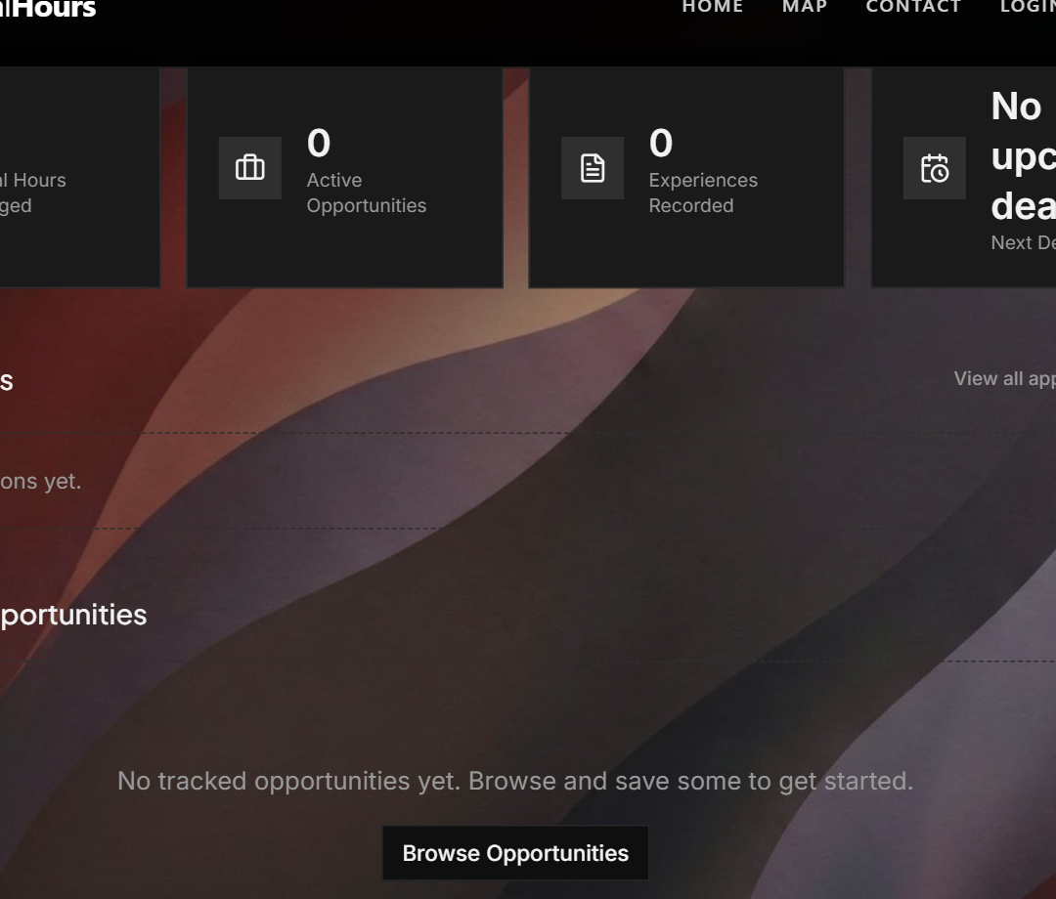
C L I N I C A L H O U R S
03 / 05
03 SIMPLIFICATION
See the clinic
before you click.
Preview-style proof feels useful fast: a featured clinic card
plus a real dashboard view beats another abstract promise.
WHY THIS WORKS
It answers "what happens
next?" without forcing a
login yet.
featured clinic
location
accepting volunteers
Notes:
Simplification slide. The dashboard and featured card should make the product feel like a real next step.
[Sources]
- Deck spec: clinicalhours_tiktok_student_bright_v3bright5_deck_spec.json
- Captures: derived/clinicalhours_dashboard_preview_landscape_v1.png and auth/clinicalhours_dashboard_featured_card_auth_live_v3.png

Slide 4
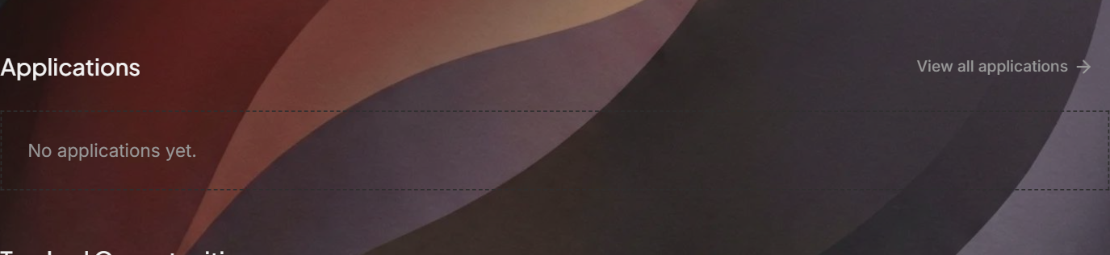
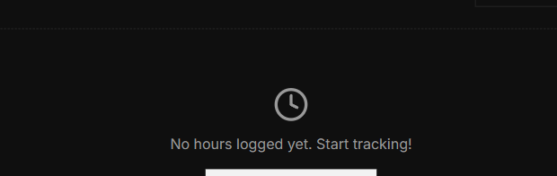
C L I N I C A L H O U R S
04 / 05
04 DIRECTION
Search, save,
track, log.
The account should feel like the next step after discovery,
not a second system you have to learn from scratch.
BETTER STORY
One account for
opportunities and
hours.
OVERVIEWS
LOG HOURS
SAVED OPPORTUNITIES
one account
hours journal
applications
next step feels obvious
Notes:
Direction slide. Show that opportunities and hour logging belong in the same account story.
[Sources]
- Deck spec: clinicalhours_tiktok_student_bright_v3bright5_deck_spec.json
- Captures: derived/clinicalhours_account_overview_band_v1.png, derived/clinicalhours_journal_cta_focus_v2.png, auth/clinicalhours_dashboard_featured_card_auth_live_v3.png

Slide 5
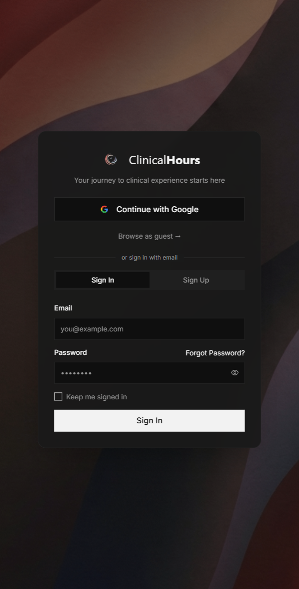
C L I N I C A L H O U R S
05 / 05
05 ACTIVATION
Browse as
guest. Sign in
when ready.
That is a better close for cold traffic: let people explore first,
then create an account when saving progress actually feels valuable.
CALM CLOSE
Start at
clinicalhours.org
Explore the map first. Make an
account when you want the search
and tracking in one place.
Browse opportunities
Sign in to save progress
browse as guest
sign in later
lower friction
Notes:
Activation slide. The CTA should stay low-pressure and reversible.
[Sources]
- Deck spec: clinicalhours_tiktok_student_bright_v3bright5_deck_spec.json
- Capture: derived/clinicalhours_auth_signin_tall_focus_v1.png

