Slide 1
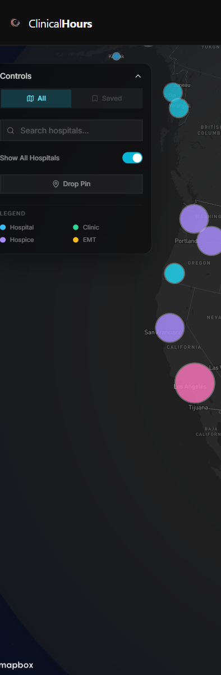
C L I N I C A L H O U R S
01 / 05
01 SUMMER
Still looking for
Summer 2026
hours?
Tabs, school docs, screenshots, and random clinic pages
still pass for a search process.
summer 2026
tabs everywhere
school docs
random clinic pages
STILL SCATTERED
No clear place to
start.
BETTER START
One map beats
ten tabs.
Notes:
Summer timing hook plus scattered search problem. Keep the copy direct and student-facing.
[Sources]
- Research brief: clinicalhours-tiktok-slideshow-research-master-brief-2026-05-18.md
- Copy audit: clinicalhours_tiktok_student_marketing_sequence_and_copy_audit_2026-05-19.md
- Proof asset: captures/derived/clinicalhours_map_tall_controls_focus_v1.png

Slide 2
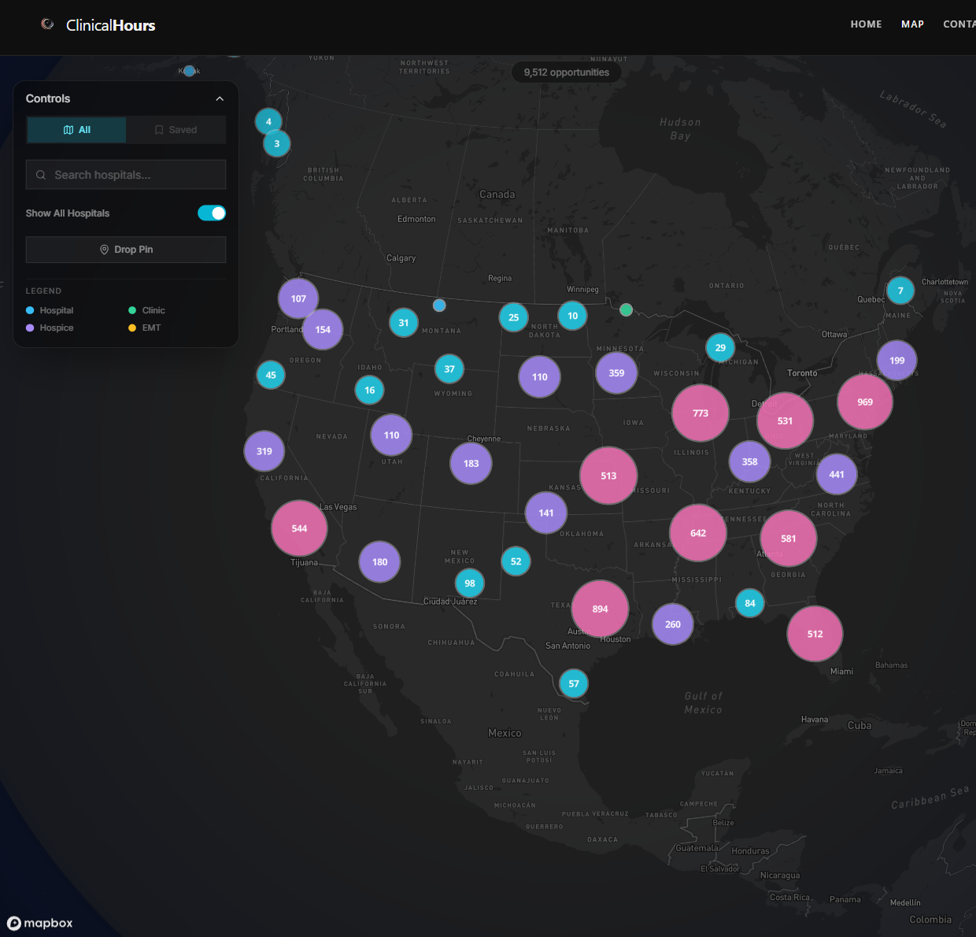
C L I N I C A L H O U R S
02 / 05
02 MAP
9,512 openings.
One map.
If you want Summer 2026 hours, scanning one map beats
hunting page by page.
START YOUR SUMMER SEARCH HERE
Filter by type before you
dig in.
See where the search
actually has volume.
Notes:
Map discovery slide. Use the map as the payoff and keep the line concrete.
[Sources]
- Deck spec: clinicalhours_tiktok_student_bright_v3bright7_deck_spec.json
- Proof asset: captures/derived/clinicalhours_map_focus_v1.png

Slide 3
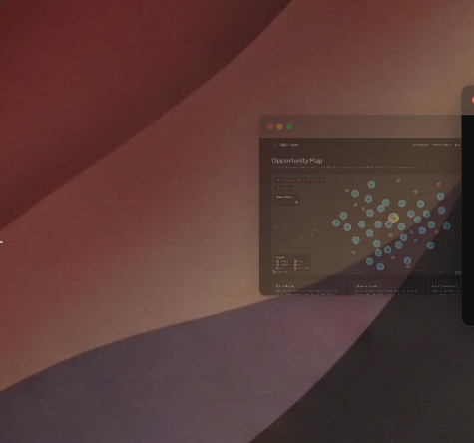
C L I N I C A L H O U R S
03 / 05
03 PREVIEW
See the clinic
before you click.
A featured card lets you spot location, fit, and next step
before you chase the wrong lead.
AT A GLANCE
You can screen clinics
fast.
featured clinic
location
accepting volunteers
Notes:
Preview slide. Pair the dashboard context with the featured clinic card.
[Sources]
- Deck spec: clinicalhours_tiktok_student_bright_v3bright7_deck_spec.json
- Proof assets: captures/auth/clinicalhours_dashboard_hero_auth_live_v2.png and captures/auth/clinicalhours_dashboard_featured_card_auth_live_v3.png

Slide 4
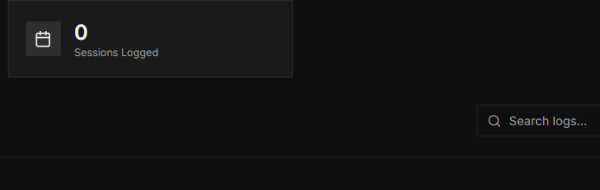
C L I N I C A L H O U R S
04 / 05
04 ACCOUNT
Save clinics.
Track hours.
Summer search is easier when saved clinics and logged hours
stay in one place.
ONE ACCOUNT
Saved clinics and
logged hours in one
flow.
SEARCH
LOG HOURS
SAVED CLINICS
one account
hours journal
saved clinics
summer follow-through
Notes:
Follow-through slide. Show that saved clinics and hours logging live in the same student account.
[Sources]
- Deck spec: clinicalhours_tiktok_student_bright_v3bright7_deck_spec.json
- Proof assets: captures/derived/clinicalhours_map_focus_v1.png, captures/derived/clinicalhours_journal_toolbar_focus_v1.png, captures/auth/clinicalhours_dashboard_featured_card_auth_live_v3.png

Slide 5
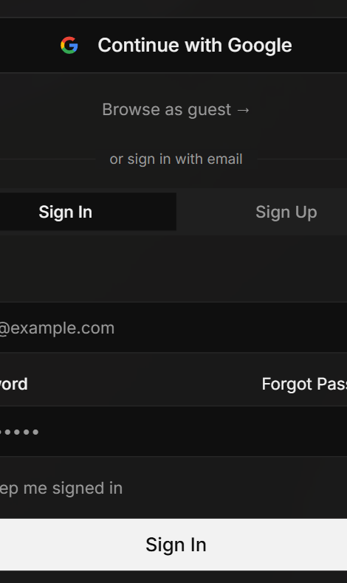
C L I N I C A L H O U R S
05 / 05
05 START
Browse summer
openings first.
Start with the map, then sign in when you want to save
and track.
START HERE
Start at
clinicalhours.org
Open the map first. Sign in when you
want the search and journal in one
place.
Browse opportunities
Sign in to save and track
summer 2026
browse as guest
sign in later
Notes:
Low-friction CTA slide. The close should stay calm and reversible.
[Sources]
- Deck spec: clinicalhours_tiktok_student_bright_v3bright7_deck_spec.json
- Proof asset: captures/derived/clinicalhours_auth_actions_focus_v2.png

