Slide 1
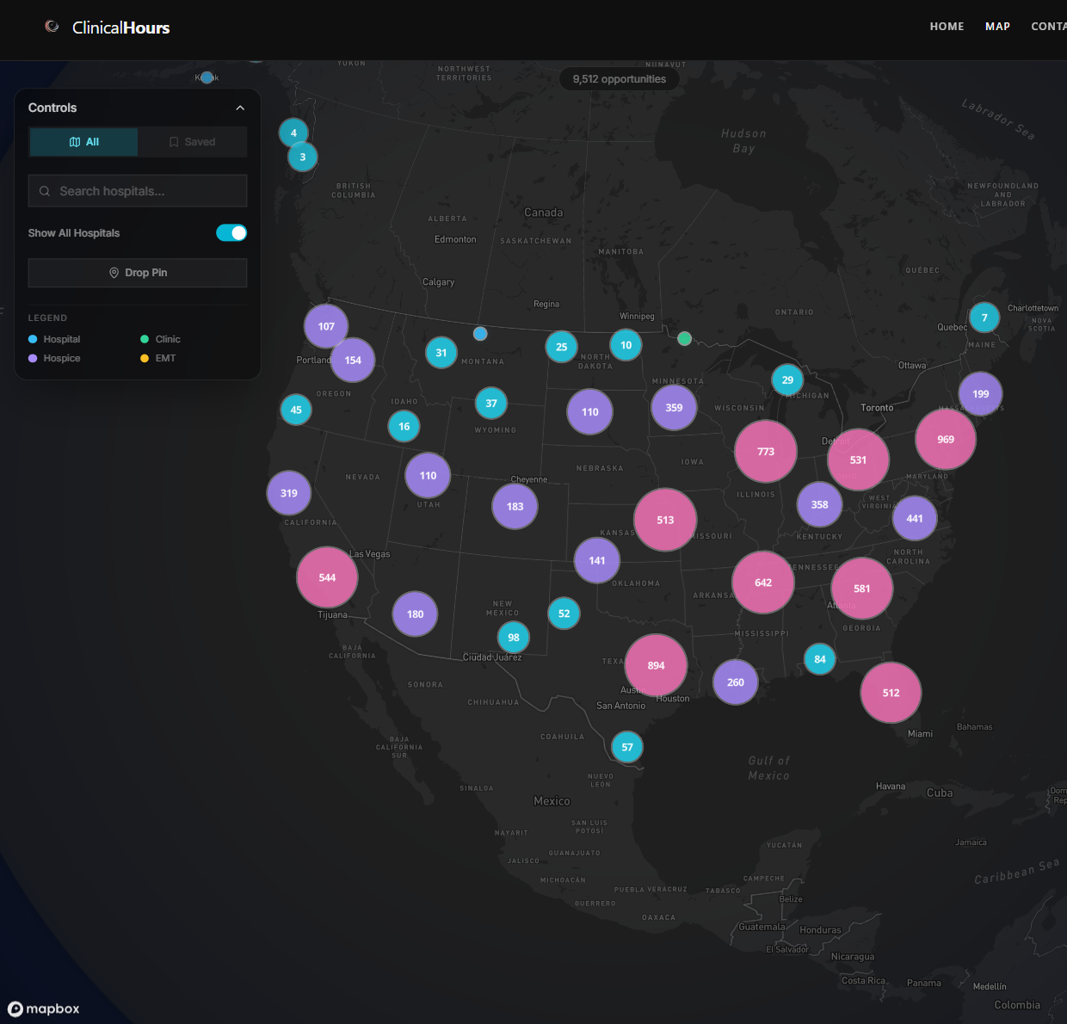
C L I N I C A L H O U R S
01 / 05
01 SEARCH
Don't spend
summer in
ten tabs.
SUMMER FILLS FAST
Search once before
classes and job shifts
crowd the week.
Start with one search page before summer gets noisy.
ONE SEARCH PAGE > TEN TABS
BETTER START
Search first.
Sort the rest later.
Notes:
Open with a direct summer hook and a calmer, more visual proof moment. The first frame should read in under two seconds.
[Sources]
- TikTok Creative Codes: hook in the first six seconds
- TikTok OOP creative guidance updated May 2026
- Proof asset: captures/derived/clinicalhours_map_focus_v1.png

Slide 2
C L I N I C A L H O U R S
02 / 05
02 MAP
Start with
the map.
ALL IN ONE VIEW
Filters and the
map live on the
same screen.
See where to look before you open more tabs.
LOOK FIRST. OPEN TABS LATER.
Notes:
Turn the second slide into the structural payoff. One hero proof asset should make the workflow feel immediately easier.
[Sources]
- TikTok carousel playbook: safe zone and high-resolution image guidance
- Proof asset: captures/derived/clinicalhours_map_focus_v1.png

Slide 3
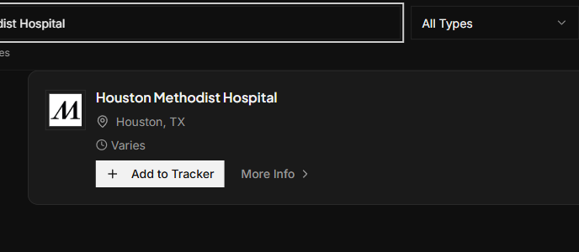
C L I N I C A L H O U R S
03 / 05
03 CHECK
Check one
lead before
you click.
CHECK FAST
01
city
Make sure the lead is actually where you want it.
02
type
Know what kind of clinic you are opening.
City, type, and the next link should make sense fast.
03
more info
Open the next tab only when it looks real.
Notes:
Keep the proof specific. Use one real clinic result so the viewer understands the workflow without extra explanation.
[Sources]
- ClinicalHours v7semesterstart proof continuity benchmark
- Proof asset: captures/official/clinicalhours_opportunities_houston_methodist_live_2026-05-30.png

Slide 4
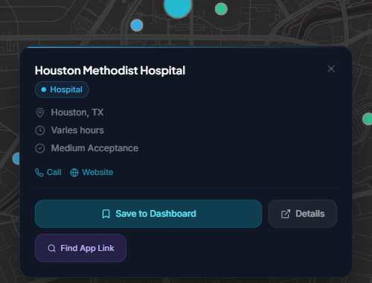
C L I N I C A L H O U R S
04 / 05
04 SAVE
Keep the
next step
close.
Save the match when it is worth following.
SAME CLINIC. NEXT STEP.
WHY SIGN IN
01
save to dashboard
Keep the lead in view for later.
02
details
Reopen the same card without searching again.
03
find app link
Move to the next step without texting yourself.
Notes:
Continue the same Houston Methodist story so the middle slides feel connected instead of stitched together.
[Sources]
- ClinicalHours v7semesterstart save-panel proof mapping
- Proof asset: captures/derived/clinicalhours_houston_save_panel_focus_v1.png

Slide 5
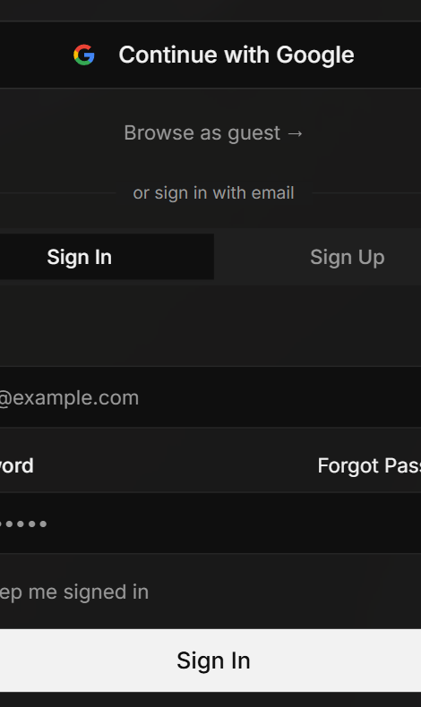
C L I N I C A L H O U R S
05 / 05
05 START
Browse first.
Sign in
later.
Open the map now. Save and track when it helps.
START HERE
clinicalhours.org
Browse first. Keep the account step for later.
Browse openings
Sign in to save
LOW FRICTION CLOSE
Notes:
Close with a reversible CTA. Keep the final frame useful, low-pressure, and native to a social viewer.
[Sources]
- TikTok and Meta guidance: clear CTA plus safe-zone framing
- Proof asset: captures/derived/clinicalhours_auth_actions_focus_v2.png

