Slide 1

Basic Details of the Team and Problem Statement
Ministry : Ministry of Defence
PS Code: 1416
Problem Statement Title: AI based Automatic alarm generation and dropping of payload at a particular object through a Drone.
Team Name : DAMSYS
Team Leader Name: Shivam Kapoor
Institute Code (AISHE): U-0507
Institute Name : Dayalbagh Educational Institute
Theme Name : Disaster Management

Slide 2
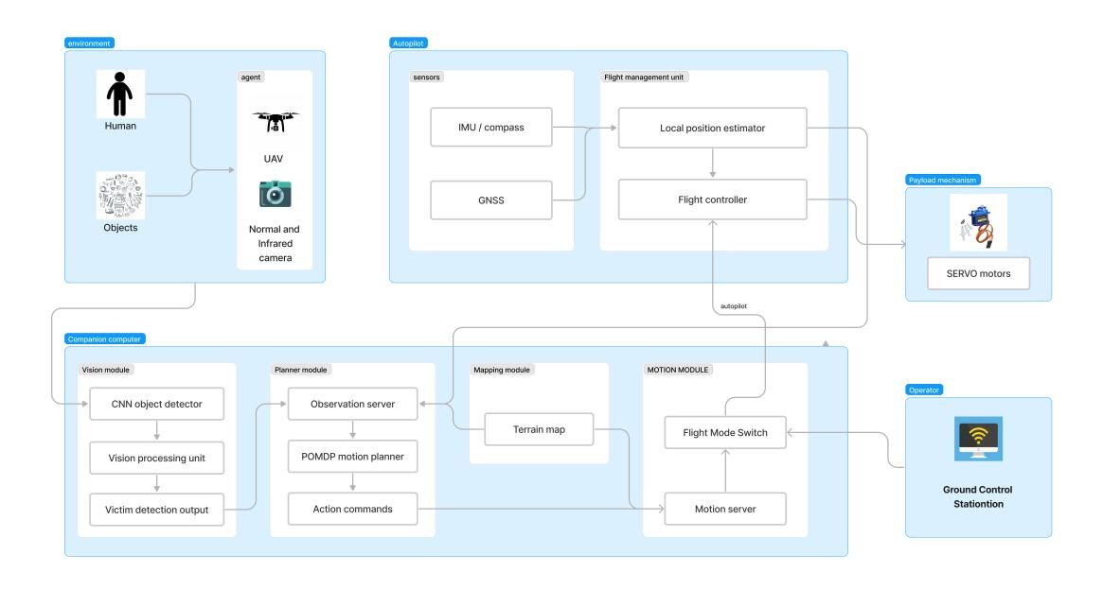





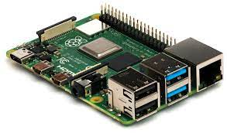



Idea/Approach Details
1. Object Detection and Recognition:
Utilize high-resolution cameras and PIR sensors mounted on drones.
Implement AI algorithms (e.g., Convolutional Neural Networks) for real-time object recognition.
Train the system to identify human beings from an altitude of 50-100 meters at various angles.
2. Alarm Generation:
Incorporate AI-driven alarm generation algorithms triggered upon human detection.
Enable real-time camera feed of distress signals to rescue teams or command centers.
3. Payload Delivery:
Develop a precise payload dropping mechanism on the drone.
Integrate AI-controlled algorithms to calculate and execute optimal payload release points.
Payload options can range from essential supplies (food, clothing) to rescue tools.
4. Validation and Testing:
Rigorously test the system under simulated disaster scenarios.
Fine-tune ML algorithms and payload delivery mechanisms for accuracy and reliability.
Modify ML algorithms based on previous rescue and search operation for better results.
Technology Used

Slide 3
Idea/Approach Details
1. Earthquake Response
Assess damage and locate survivors.
Deliver emergency supplies
2. Search and Rescue
Find missing persons in challenging terrain.
Deliver first-aid kits.
3. Medical Emergency Response
Transport medical supplies and patients.
Airlift critically ill individuals
4. Environmental Disaster Assessment
Evaluate environmental damage.
Collect data for recovery efforts
5. Remote Data Collection
Live camera feed in remote or hazardous areas.
Aid geological and environmental research.
6. Disaster Preparedness
Pre-position drones for rapid deployment.
Improve disaster response readiness with help of Disaster Prediction.
1. User-Friendly Registration and Device Setup:
Streamlined registration process for property owners.
Simplified and guided device setup to ensure easy onboarding.
2. Real-Time Tracing and Monitoring:
An interactive map for real-time tracing of drone activities.
Live updates on drone location, altitude, and sensor data.
Visual representation of fire hazards and environmental conditions.
3. User Profile and Notifications:
User profile management and notification preferences.
Immediate alerts and notifications for emergency situations.
Intuitive navigation and responsive design for a seamless user experience.
1. YOLO-Based Object Detection:
YOLO neural networks are utilized for real-time object detection from drone-mounted cameras.
The system identifies humans and other critical objects in disaster scenarios.
2. Automatic Alert Algorithm:
Upon detecting survivors or critical objects, an automatic alert algorithm is activated.
It initiates emergency alerts to disaster response teams, such as rescue crews or authorities.
3. Drone Payload Algorithm:
A specially equipped drone is dispatched with a payload delivery algorithm in response to alerts.
The payload algorithm calculates drop points for emergency supplies based on detected object coordinates.
1. Swift Response: Our solution offers the capability for rapid response during the crucial golden hours following a disaster. Every moment counts, and our AI-enabled drones ensure that help arrives swiftly.
2. Increased Reach: In disaster-stricken areas, reaching remote or inaccessible locations can be an arduous task. With our system, we extend our reach to these far-flung areas, ensuring that no one is left without aid.
3. Reduced Risk: The safety of rescue teams is paramount. Our automated delivery system minimizes the risk to these dedicated individuals by taking on the task of delivery, allowing them to focus on other critical aspects of rescue operations.
4. Versatile Applications: Beyond its immediate utility in disaster relief, our solution has versatile applications in both civilian and military contexts. It holds the potential to significantly enhance projects by organizations like the Defense Research and Development Organization (DRDO) while also serving humanitarian missions worldwide.
Use case
Frontend user
interface
Data interpretation
Show stopper

Slide 4
Team Member Details
Team Leader Name: Shivam Kapoor
Branch : BTech Stream : Electrical Engineering Year :III
Team Member 1 Name: Dev Saran Sujan
Branch : BSc Dual Degree Stream : Computer Science Year :III
Team Member 2 Name: Sachin
Branch : BSc Stream : Computer Science Year :III
Team Member 3 Name: Madhavi Nibauria
Branch : BSc Stream : Cognitive Science Year :III
Team Member 4 Name: Afifa
Branch : BSc Stream : Cognitive Science Year :III
Team Member 5 Name: Yash Mudotiya
Branch : BTech Stream : Electrical Engineering Year :III

