Slide 1
Classification of Depressed and Non-Depressed Subjects and Predicting their MADRS Score Using Machine Learning
Submitted by: Guided by:
Shivam Kasat Dr. Sonali Agarwal

Slide 2
Overview
Objectives
Using Awesome Backgrounds
Engage your Audience
Capture Audience Attention

Slide 3
Introduction
What is Depression?
What is motor activity data?
How can we use this sensor based data?
Use of Machine learning in Psychology.

Slide 4
Objectives
Classification of depressed and Non-depressed subjects based on their motor activity data.
Multi-class classification of subjects into No-depression, Mild-depression, severe-depression.
Prediction of MADRS score of the subject which later can be used for classification.

Slide 5
Motivation
The COVID-19 pandemic
Change in lifestyle
Increasing work load
Depression in teenagers

Slide 6
Associated Challenges & Research Gap
Dataset size
Imbalanced dataset
Improvisation in model performance
Multi-class classification

Slide 7
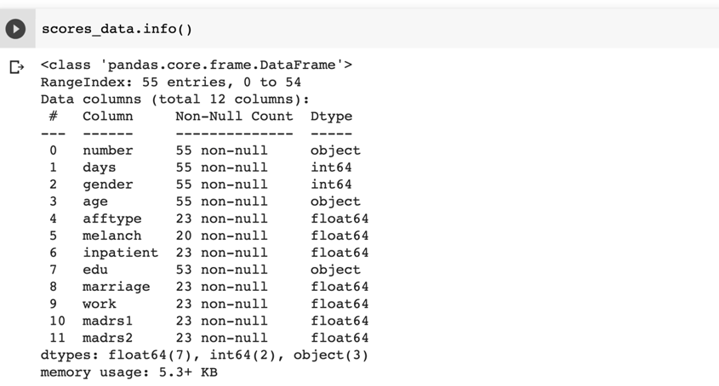
Dataset Explained
Dataset size
Data type
Data content

Slide 8
Work Plan
Binary Classification
Dataset Preparation
Classification task
Multiclass Classification
Dataset preparation
Classification task
MADRS score prediction
Dataset Preparation
Prediction task

Slide 9
Binary Classification
Dataset Preparation
Data Modeling

Slide 10
Binary Classification Results
Without Oversampling
 | Accuracy | F1-Score | Precision | Recall
AdaBoost | 0.71 | 0.56 | 0.56 | 0.56
XGBoost | 0.74 | 0.58 | 0.61 | 0.56
CatBoost | 0.78 | 0.63 | 0.65 | 0.60
GBM | 0.72 | 0.52 | 0.57 | 0.48
1D CNN | 0.63 | 0.65 | 0.66 | 0.60

Slide 11
Binary Classification Results
With oversampling on training set
 | Accuracy | F1-Score | Precision | Recall
AdaBoost | 0.70 | 0.70 | 0.70 | 0.71
XGBoost | 0.72 | 0.72 | 0.72 | 0.73
CatBoost | 0.78 | 0.78 | 0.78 | 0.78
GBM | 0.76 | 0.76 | 0.67 | 0.76

Slide 12
Multi-class Classification
Dataset Preparation
Data Modeling

Slide 13
Multi-class Classification Results
Without Oversampling
 | Accuracy | F1-Score | Precision | Recall
AdaBoost | 0.82 | 0.82 | 0.82 | 0.82
XGBoost | 0.86 | 0.86 | 0.87 | 0.86
CatBoost | 0.85 | 0.85 | 0.85 | 0.85
GBM | 0.84 | 0.84 | 0.85 | 0.84
1D CNN | 0.83 | 0.84 | 0.85 | 0.84

Slide 14
Multi-class Classification Results
With Oversampling on training set
 | Accuracy | F1-Score | Precision | Recall
AdaBoost | 0.89 | 0.89 | 0.89 | 0.89
XGBoost | 0.87 | 0.87 | 0.87 | 0.87
CatBoost | 0.89 | 0.89 | 0.89 | 0.89
GBM | 0.88 | 0.88 | 0.88 | 0.88
1D CNN | 0.83 | 0.84 | 0.83 | 0.85

Slide 15
MADRS Score Prediction
With and without oversampling no major changes in results.
 | MAE | MSE
AdaBoost | 1.68 | 8.60
XGBoost | 1.32 | 7.01
1D CNN | 2.31 | 9.56

Slide 16
Conclusion
Tree based ensemble models can be used to classify subjects as depressed and non-depressed, Also they can be used to classify subjects into no-depression, mild-depression & severe depression. CatBoost ensemble model can be preferred over others.
Tree based ensemble model performed well and thus can be used to predict MADRS.
The results can be improved further with more data, as we saw improvement in results with oversampling.
This work can be used in smartwatche & smartphone applications to warn users about mental health.

