Slide 1

Building a Next Best Action model for Standard Bank
Shivam Chhetry

Slide 2
Agenda
Introduction
Data Cleaning
Data Exploration and Understanding Churn
Exploratory Data Analysis (EDA)
Cross-Validation Setup
Model Training
Results, Interpretability and Conclusion
Hyperparameter Tuning
Model Evaluation
Presentation Title

Slide 3
Introduction
What is Churn?
Churn is defined as movement of customer from one company to another. The reasons can for example be:
Competitive Pricing
Quality of Service
Low interest rates
Location
Change in Life Circumstances
Churn rate usually lies in the range from 10% up to 30%

Slide 4
Why is this important for the bank?
Retention Strategies
Cost Reduction
Revenue Preservation
Customer Experience Improvement
Competitive Advantage
Data-driven Decision Making
Long-term Growth

Slide 5
Data Cleaning
Changing column names
Removing features
Handling Missing values
K-Means-Cluster
Handling categorical features
LabelEncoder
Remove outliers
IsolationForest
Scaler
Quantile Transformer

Slide 6
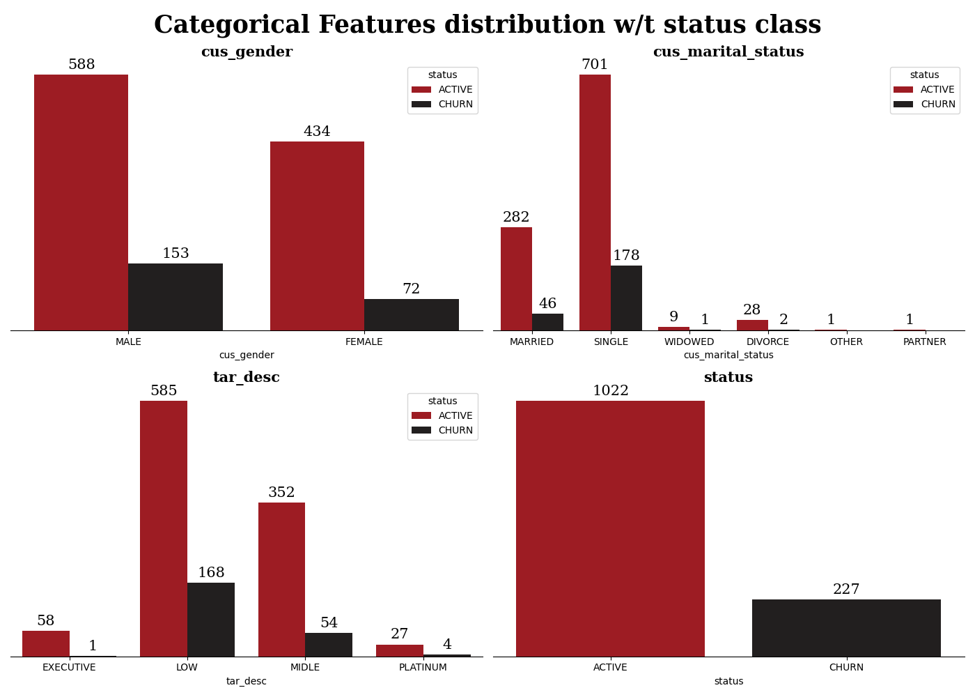
Male churn: 20.6% vs. `Female`: 14.2%, indicates gender-based churn trends.
Singles: Less obligations, more likely to switch banks.
Married: Stability due to joint accounts, lower churn.
Widowed: Stable financial arrangements, low churn.
Others & partner: Fewer churns, stable finances.
Divorce: Major financial changes, potential higher churn.

Slide 7
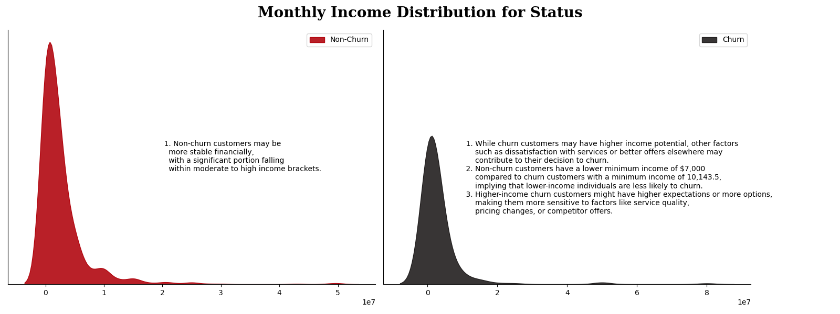

Slide 8
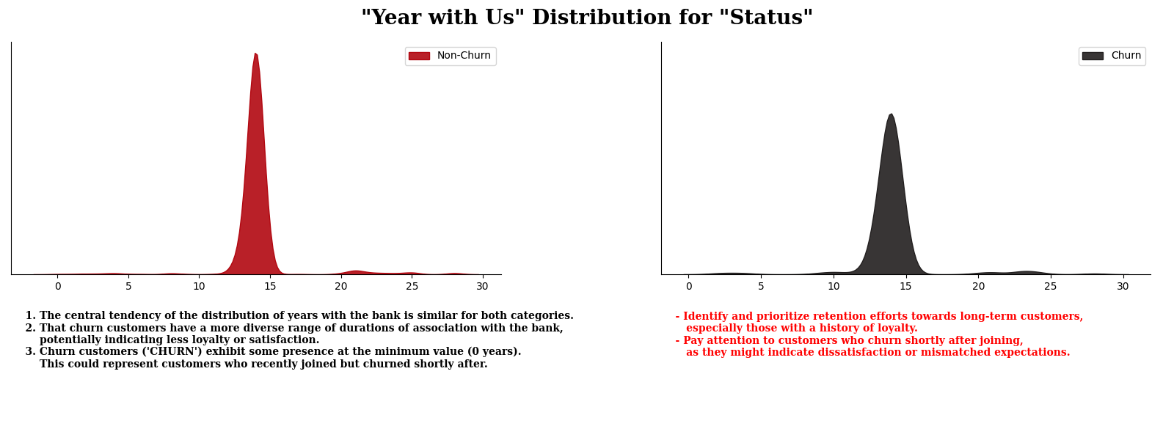

Slide 9
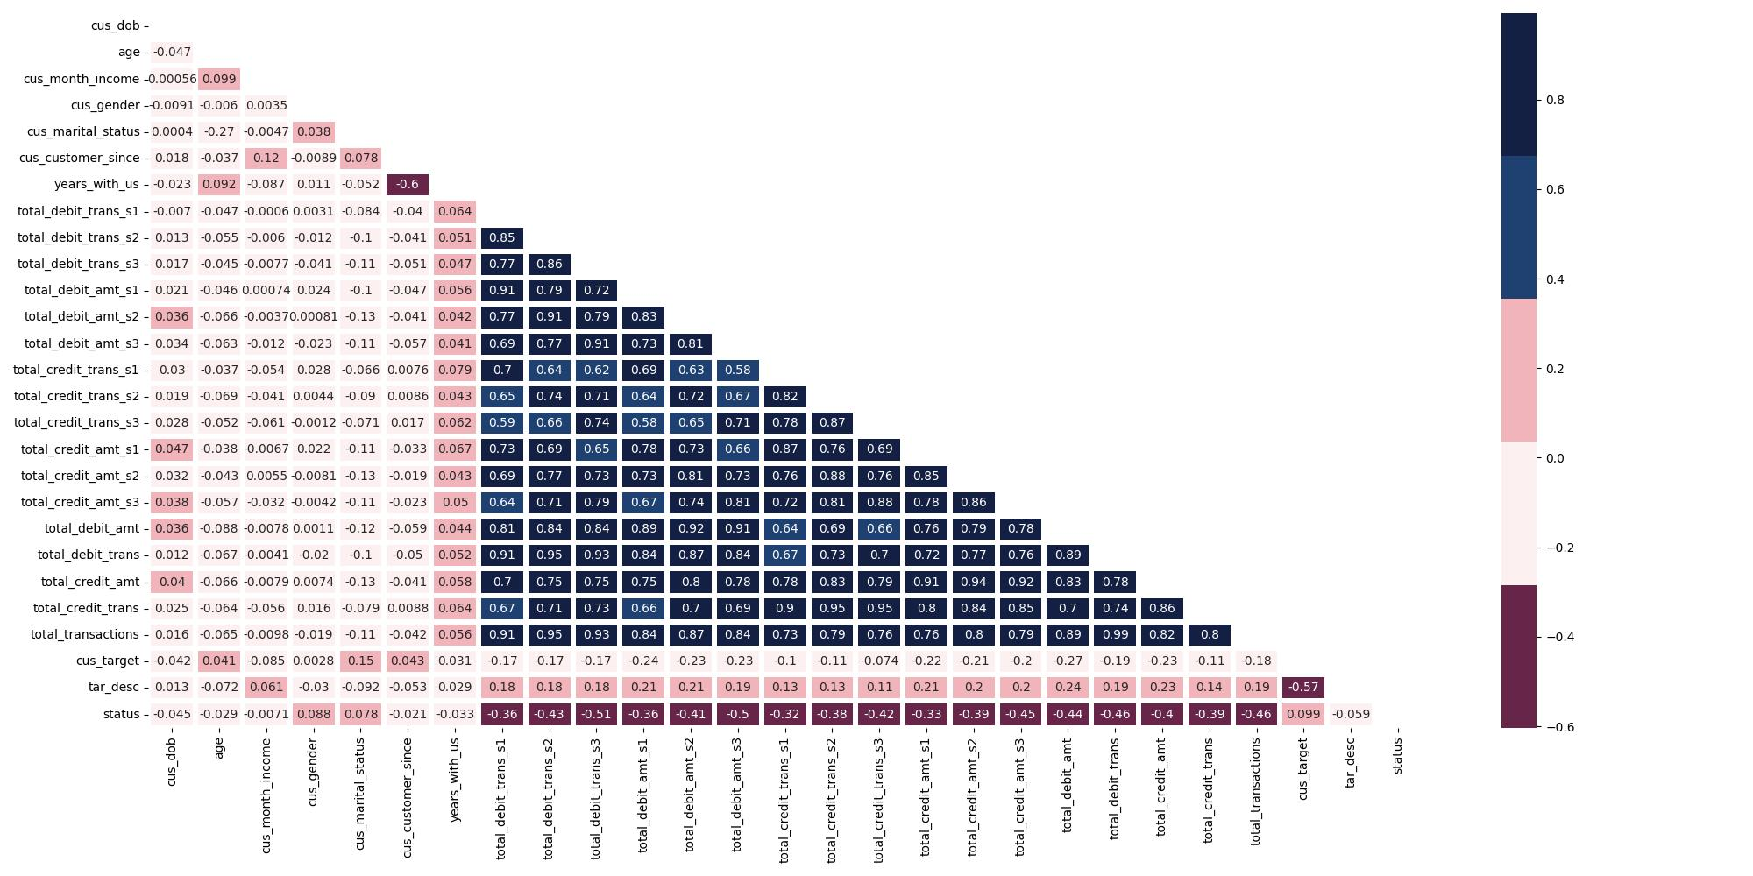
Correlation of features

Slide 10
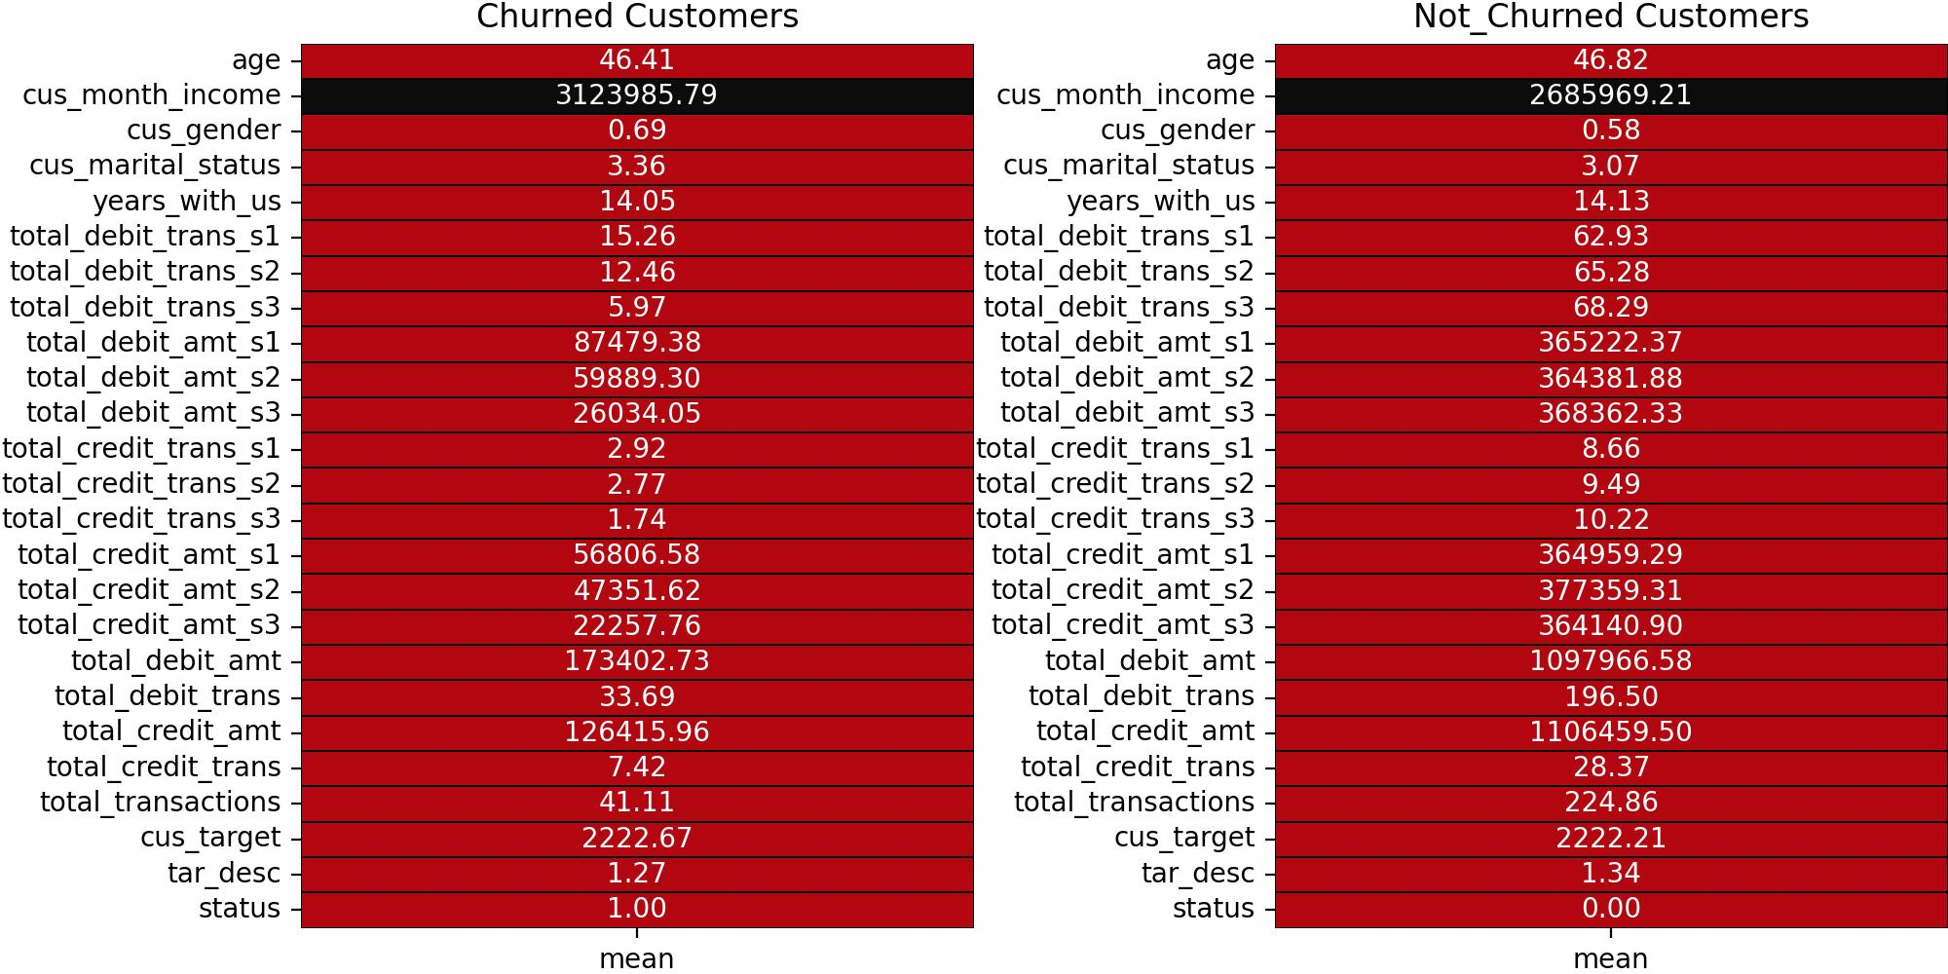
From these mean values, we can say that some of the features display a clear cut difference that can help to focus more churn customers to make sure they retain the services

Slide 11
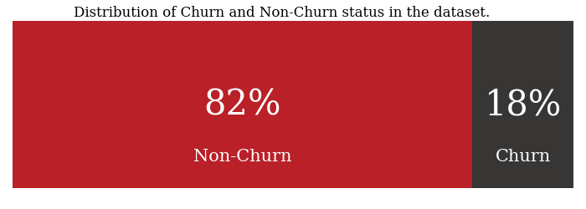
We have Imbalanced classes

Slide 12
Data Preprocessing
SMOTE Method for Data Balancing.
Boost on Train and Test roc score by
approx ⬆3.48%
K-Means cluster for imputing missing values.
IsolationForest for removing outliers.
Quantile Transform for feature scaling
boost on Train and Test roc score by ⬆2.2%

Slide 13
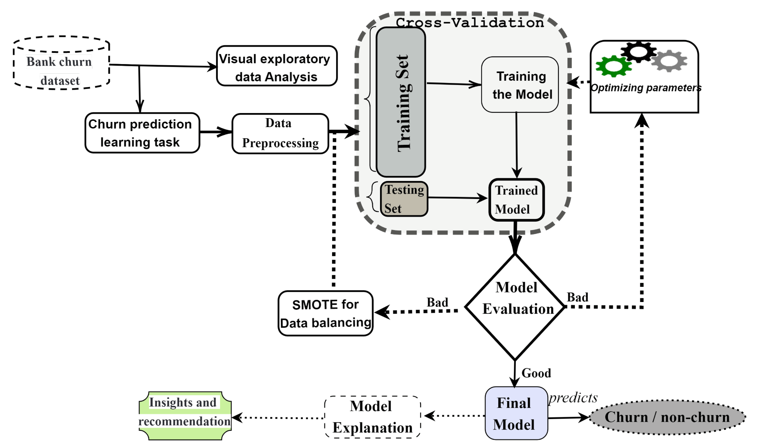
Flowchart of the proposed approach

Slide 14
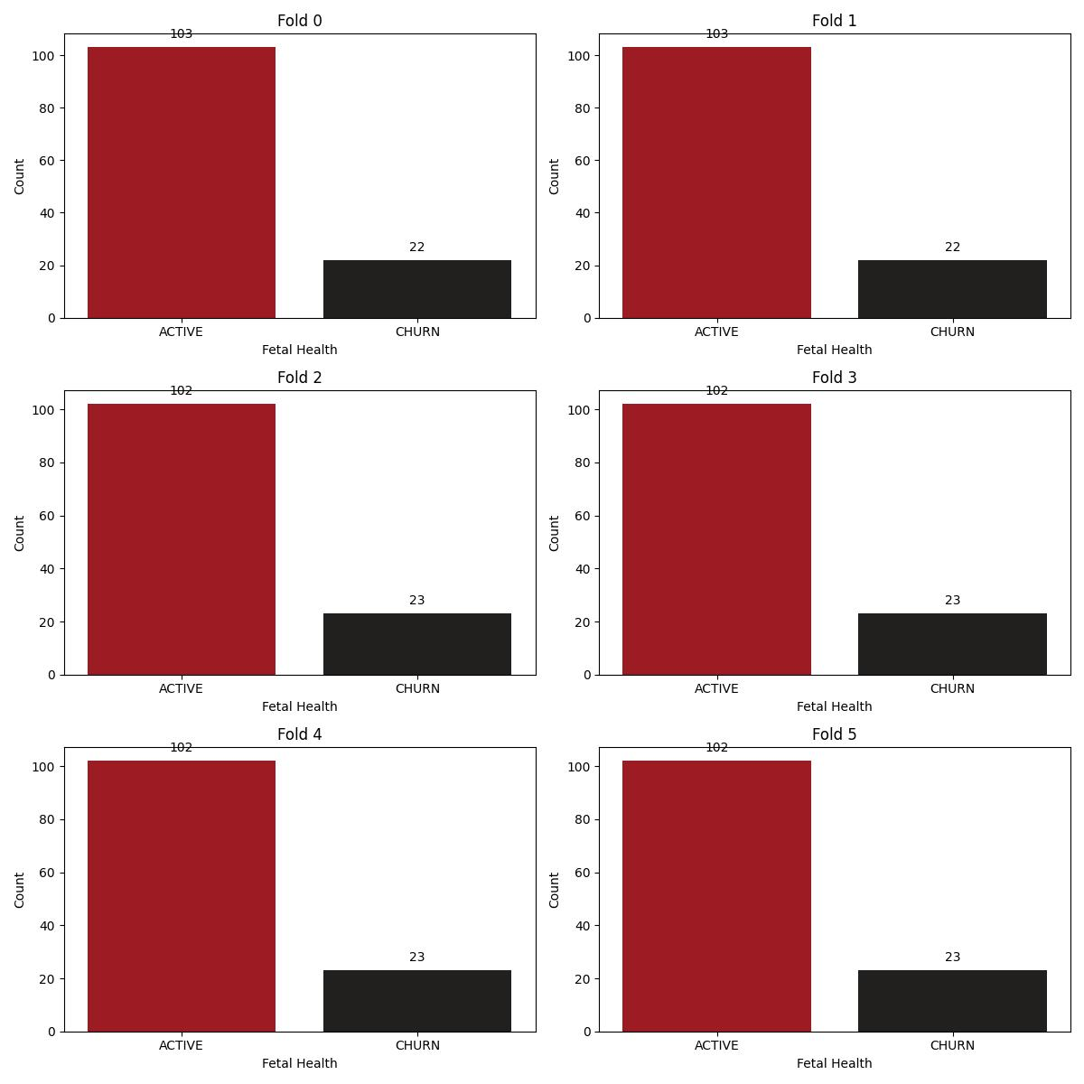
Class Distribution in Fold Cross-Validation
Bias Towards Majority Class
Misrepresentation of Minority Class
Difficulty in Detecting Minority Class
Overfitting to Majority Class
ROC Score
TRAINING SET=0.9566197629615178, TESTING SET=0.8303359683794465

Slide 15
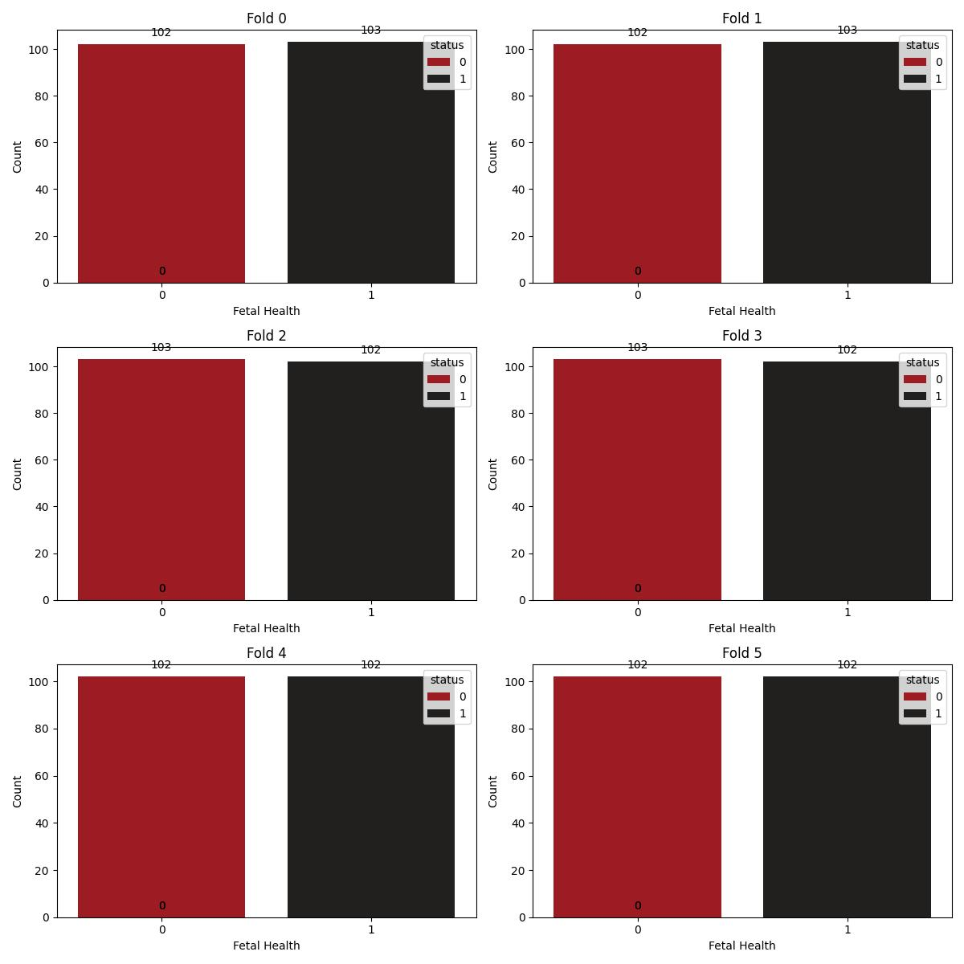
After using SMOTE class distribution in Folds
ROC Score after SMOTE
TRAINING SET=0.9464331518139426
, TESTING SET=0.9051433261292333

Slide 16
Models used with folds
Logistic Regression
Decision Tree
Random Forest
XGBoost

Slide 17
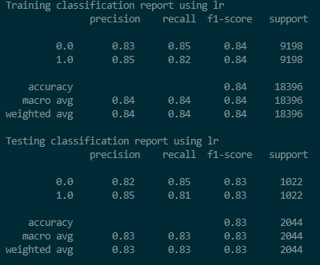
Logistic Regression Performance
linear_model.LogisticRegression(
penalty='l2',
C=1.0,
solver='liblinear'
)
Note: Used GridSearchCV for finding the best parameters

Slide 18
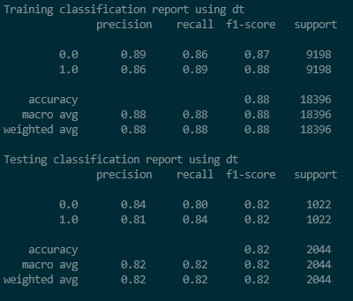
Decision Tree Performance
tree.DecisionTreeClassifier(
max_depth=10,
min_samples_split=50,
min_samples_leaf=10
)
Note: Used GridSearchCV for finding the best parameters

Slide 19
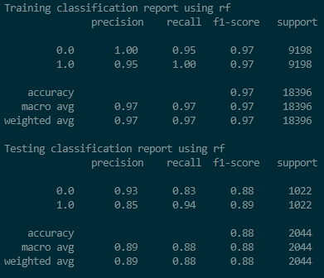
Random Forest Performance
ensemble.RandomForestClassifier(
bootstrap= True,
max_depth=10,
max_features= 'sqrt',
min_samples_leaf= 1,
min_samples_split= 2,
n_estimators=500
)
Note: Used GridSearchCV for finding the best parameters

Slide 20
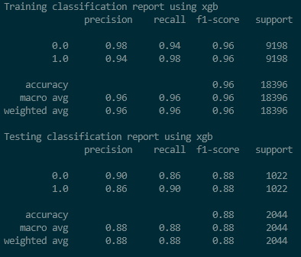
XGBoost Performance
xgb.XGBClassifier(
n_estimators= 200,
max_depth= 3,
learning_rate= 0.08369736219437933,
subsample= 1.0,
colsample_bytree= 0.8,
gamma= 0.0,
reg_alpha=0.1,
reg_lambda= 0.1,
scale_pos_weight=1
)
Note: Used GridSearchCV for finding the best parameters

Slide 21
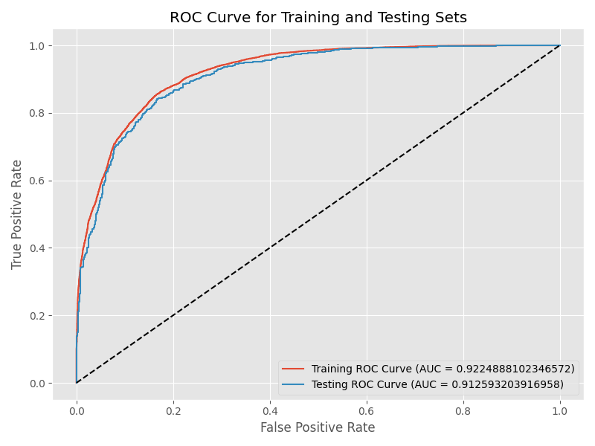
Performance Evaluation:
ROC AUC Analysis of Logistic Regression Model

Slide 22
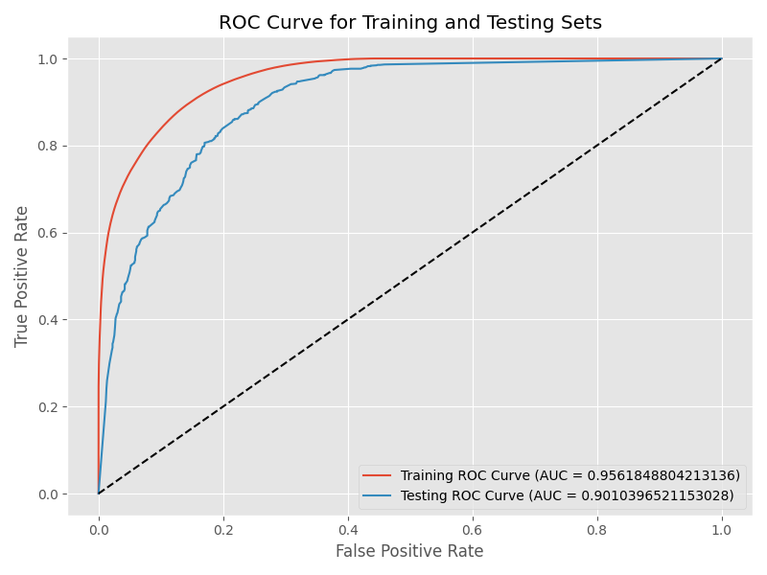
Performance Evaluation:
ROC AUC Analysis of Decision Tree model

Slide 23
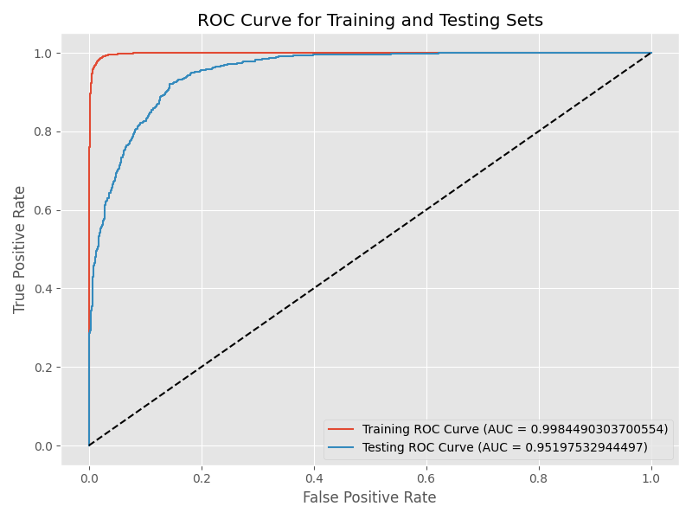
Performance Evaluation:
ROC AUC Analysis of Random Forest Model

Slide 24
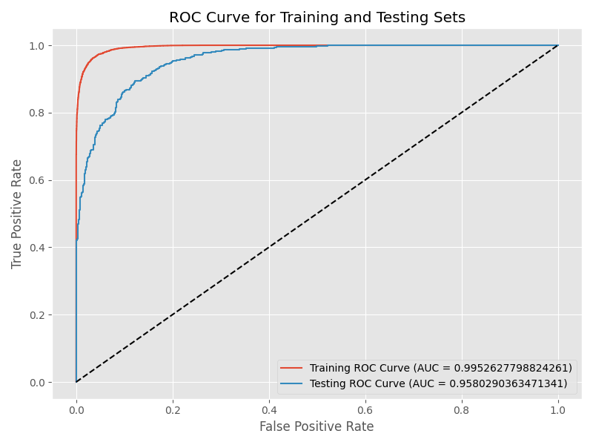
Performance Evaluation:
ROC AUC Analysis of XGBoost model

Slide 25
“Model Interpretability using SHAP”

Slide 26
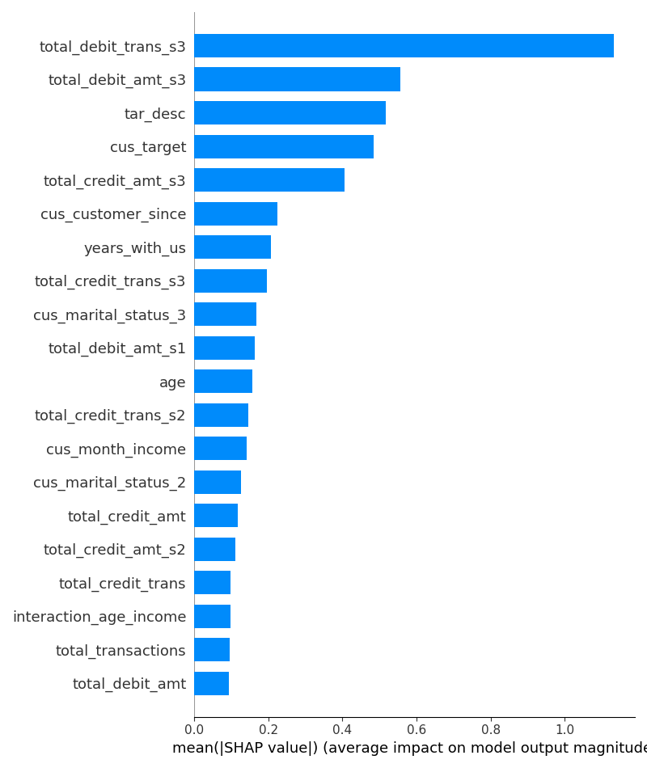
Interpretability of XGBoost model
Reasons could be for Total_debit_trans_s3:
Transactional Activity
Financial behaviour
Customer Engagement
Reasons could be for Total_debit_amt_s3:
Financial Health
Product Usage
Customer Satisfaction
Total_debit_trans_s3 is the most important feature and followed by total_debit_amt_s3

Slide 27
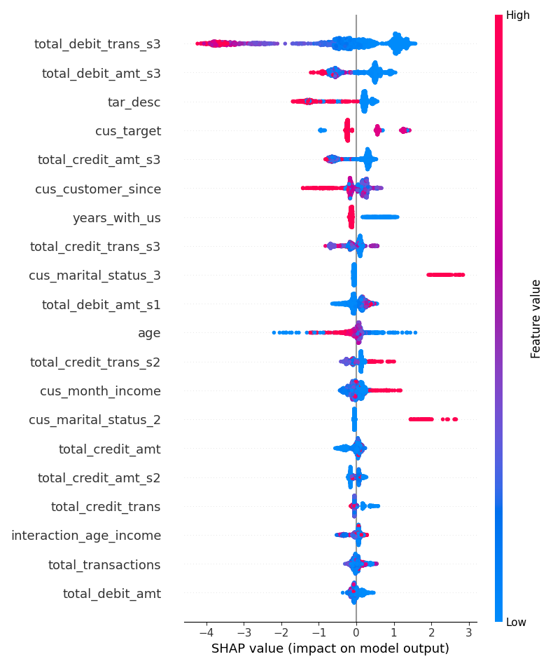

Slide 28
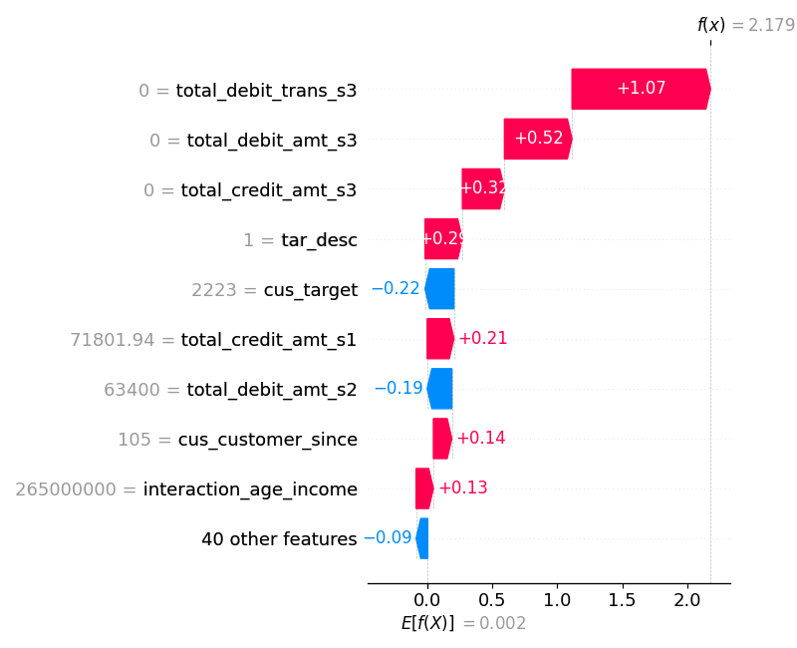
Business Suggestions
Focus on Low Transaction Frequency Customers.
Monitor Account Balances
Tailor Marketing Strategies (tar_desc)
Customer relationship Management (cus_target)
Enhance Customer Experience (cus_customer_since + interaction_age_income)

Slide 29
Results
The most suitable model evaluation metrics, in this case, are precision, recall and ROC-AUC, using recall because it needs to take into account the percentage of False Negative (FN) that must be minimized. While ROC-AUC is to measure how well (balanced) the model predicts each class.
The best model obtained is Xgboost which produces ROC-AUC scores of 0.9952565357779785
and 0.9584462473357893 in test data, respectively.

Slide 30
Business Insights
The churn rate among male customers 20.6% is higher than among female customers 14.2% .This indicates that the bank may need to investigate reasons why male customers are more likely to churn compared to female customers.
Singles might have fewer financial obligations compared to married individuals, making it easier for them to switch banks or financial products. They might also be more prone to exploring different banking options for better deals or perks.
Married individuals may have joint accounts, mortgages, or other financial products that are more cumbersome to switch. Additionally, they might prioritize stability and continuity in their banking relationships due to shared financial responsibilities due to that married individuals have a relatively lower churn count compared to singles.
Widowed individuals might have settled financial arrangements or be less inclined to change their banking relationships due to fewer changes in their financial circumstances compared to singles or divorced individuals.
The others and partner categories might represent unconventional or less common marital statuses, resulting in fewer data points. The lack of churn instances could also indicate that individuals in these categories have stable financial arrangements or are not actively seeking new banking options.

Slide 31
Business Insights
Divorce may lead to significant changes in financial arrangements, including banking relationships. Divorcees might be more inclined to switch banks to separate finances or seek better financial management options post-divorce.
Non-churn customers are financially stable, often falling within moderate to high income brackets.
Churn customers may have higher income potential but might churn due to dissatisfaction with services or better offers elsewhere.
Non-churn customers have a lower minimum income (7,000) compared to churn customers (10,143.5), indicating lower-income individuals are less likely to churn.
Higher-income churn customers may have higher expectations and more options, making them sensitive to factors like service quality, pricing changes, or competitor offers.
Churn customers show a more diverse range of association durations, suggesting less loyalty.
Churn customers exhibit presence at the minimum value (0 years), possibly indicating early churn.
Prioritize retention efforts towards long-term, loyal customers.
Pay attention to early churners, signaling potential dissatisfaction or mismatched expectations.

Slide 32
Business Insights
Churned customers may be experiencing financial instability or facing economic challenges, leading to lower total debit transactions and amounts. This could be due to factors such as unemployment, reduced income, or unexpected expenses.
Churned customers might be dissatisfied with the services provided by the company, leading them to reduce their usage of debit transactions and credit transactions. Poor customer service, high fees, or lack of desirable features could contribute to this dissatisfaction.
Churned customers may have been attracted by competitive offers or incentives from rival companies, prompting them to switch their financial services provider. These offers may include lower fees, better interest rates, or exclusive rewards programs.
Churned customers may have undergone a change in their financial behavior, such as adopting a more conservative approach to spending or seeking alternative financial products. This change could result from personal financial goals, lifestyle changes, or market trends.
Churned customers may have received inadequate communication or engagement from the company, leading to a lack of awareness about available products, services, or benefits. Improving communication strategies and engagement efforts could help retain customers and prevent churn.
External factors such as economic downturns, changes in regulatory policies, or shifts in consumer behavior may influence the financial decisions of customers and contribute to churn.

Slide 33




Thank you
Shivam Chhetry
shivam.11712711@gmail.com

