Slide 1


EXL EQ 2023
Air Pollution Level (PM2.5) Prediction
Solution being presented by NIT JAMSHEDPUR - Team Maruti
LET’S UNDERSTAND THE PROBLEM STATEMENT
The Rapid Industrial and Economic growth of the country has resulted in a significant rise in air pollution levels. Industrial activities, such as manufacturing, power generation and transportation often releases pollutants into the air, Including PM2.5.
PM2.5 refers to atmospheric particulate matter that has diameter of 2.5 micrometer or less. These particles can be emitted directly into the air from various sources and can also be formed as a result of complex chemical reactions in the atmosphere involving pollutants like Sulphur dioxide, Nitrogen oxide and Volatile organic compounds.
The high concentrations of PM2.5 particles in the air have significant adverse effects on human health, particularly on the respiratory and cardiovascular systems. These particles pose a serious threat to the well-being of individuals, emphasizing the need for their reduction and control to ensure a healthier environment.
To do the given job, we have been provided with the historical data of PM2.5 of 34 different Indian cities.
Our task is to study the data, derive Insights and than develop a real time predictive tool to accurately forecast the concentrations of PM2.5 across the given 34 Indian cities. This will help the government to Increase awareness amongst people and focus on controlling industrial pollution in highly hazardous cities.

Slide 2
Solution Design and Methodology
Given historical PM2.5 data for the past 3 years.
1. Understanding the data:
>Got an over-view of data by first creating the dataframe then applying functions like .info(), .describe() , .nunique() etc.
2. Data Preprocessing and Data Treatment:
>Handled missing values:- Missing values were imputed using mean or median based on skewness
> Converted object-type attributes to appropriate data types (int, float, datetime) based on their respective characteristics.
>Removed outliers:- Outliers were identified using boxplots and removed using the z-score method.
3. Exploratory data analysis:
>Plotted PM2.5 variation over time for all cities - Identified patterns from the plot.
>Created pie chart to visualize the distribution of data across various cities.
>Created Scatter plots depicting PM2.5 levels dependence on inorganic and organic content in the air.
4. Feature Engineering and Feature Selection:
>Dropped unwanted features-used correlation table > Transformed existing features into new features - Performed dimensionality reduction.
5. Model Development:
>Applied min-max scaler to normalize the data. > Partitioned the data by city and further divided it into training, Validation and test sets.
>Explored multiple models and calculated metrics such as MSE, RMSE, and MAE to assess their performance.
>Selected the best model(CNN-LSTM) based on the obtained errors. >Performed Hyperparameter tuning >The final model was then trained.
6. Model Prediction:
>Obtained PM2.5 levels across 34 cities.

Slide 3
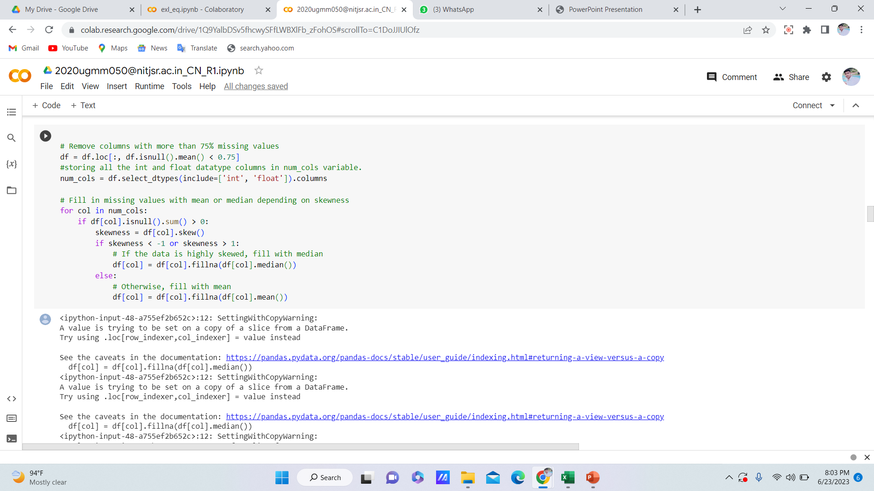
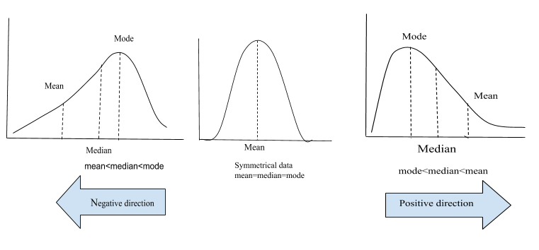
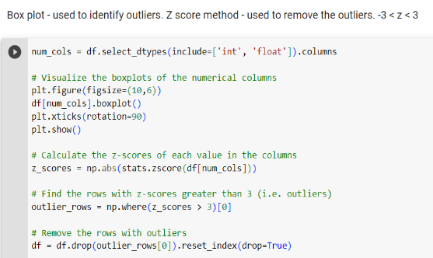
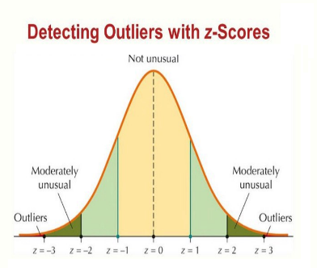
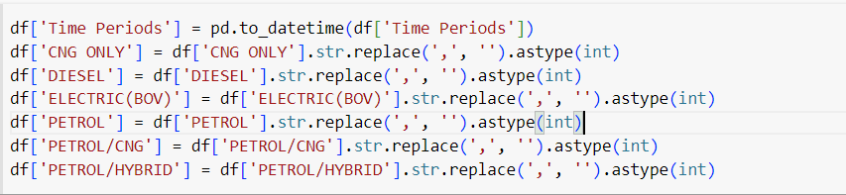
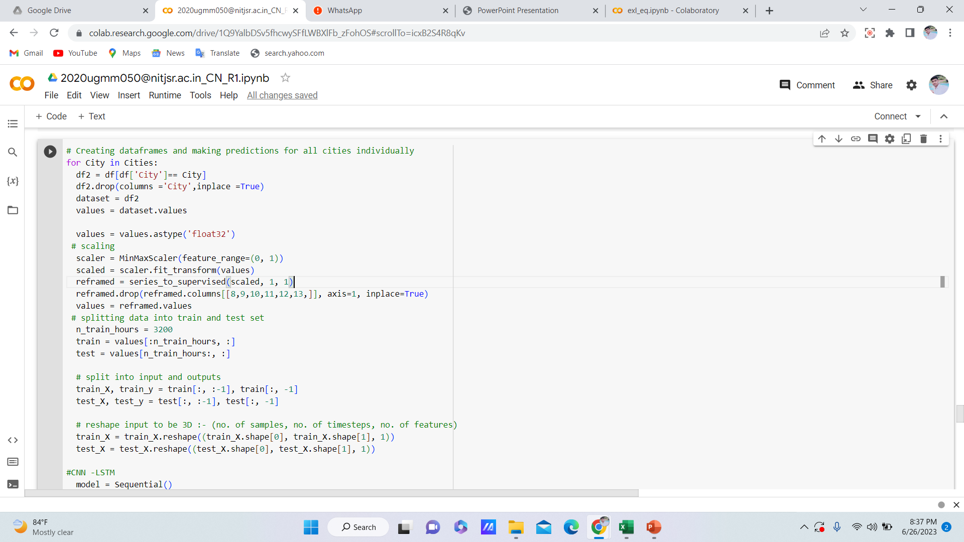
Data Pre-Processing and Treatment
Data pre-processing is required to make the data clean and more suitable for machine learning model which further enhance the efficiency of model
It involves operations as: -
>Importing the dataset >Identifying and handling missing values >Transforming object-type attributes into suitable data types > Detecting and removing outliers >Normalizing features
Missing values Imputation:-
Outlier treatment :-
Missing values in a dataset can occur due to various reasons like human errors during data entry or software bugs in data processing. To address this, we identify missing values per column and fill them with mean or median based on the data's skewness. Median was used for highly skewed data, while mean was used for the remaining columns.
Presence of Outliers in a dataset can distort statistical analysis, modeling, and interpretation of the data. To address this, First, we identified outliers using a box plot. Then, we applied the z-score method to remove outliers. Z-scores were calculated for each row, and rows with z-scores greater than 3 or less than -3 were considered as outliers and removed from the dataset.
Converting object-type attributes to appropriate data types :-
Normalizing features :-

Slide 4
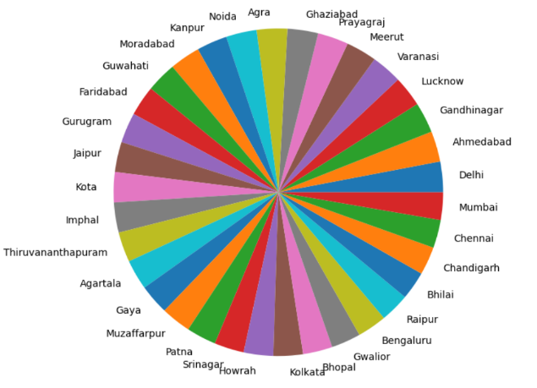
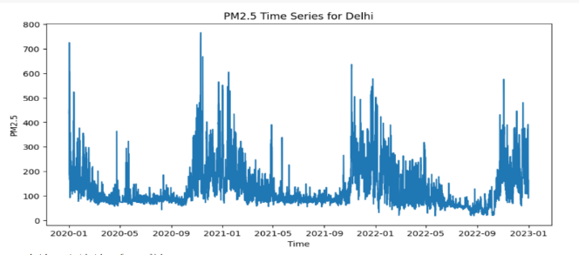
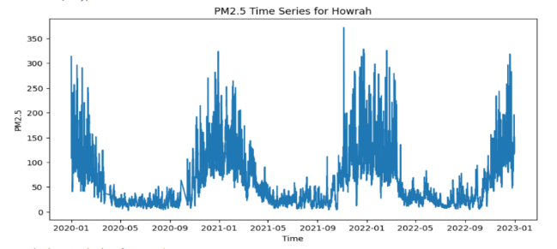
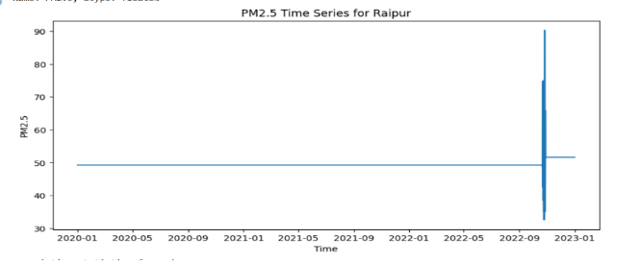
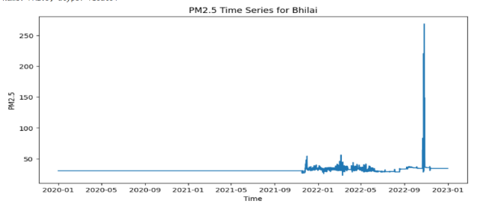
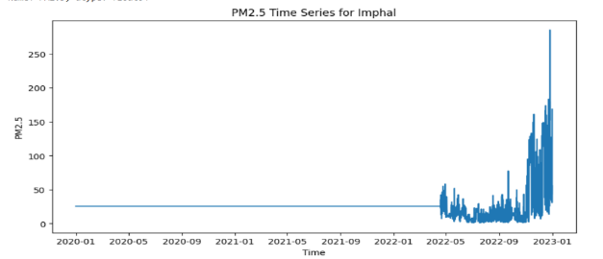
Data Visualization
Data Visualization enhances data understanding, promotes data-driven insights, and facilitates effective communication of findings.
It Involves following findings: -
1. Our dataset is well-balanced, with an equal number of records for each city, as depicted by the pie chart. Specifically, we have 6576 records available for each city in our dataset. This balanced distribution ensures fair evaluation.
2. In our dataset, the trend of PM2.5 with time exhibits distinct patterns. For certain cities, the PM2.5 levels vary periodically over time, displaying seasonal fluctuations. In contrast, for other cities, there is a consistent relationship between PM2.5 and time, indicating a constant trend. The accompanying plots visually depict these diverse patterns.
Here, Delhi and Howrah shows periodic trend of PM2.5 with time while Raipur, Bhilai and Imphal shows constant trend.

Slide 5
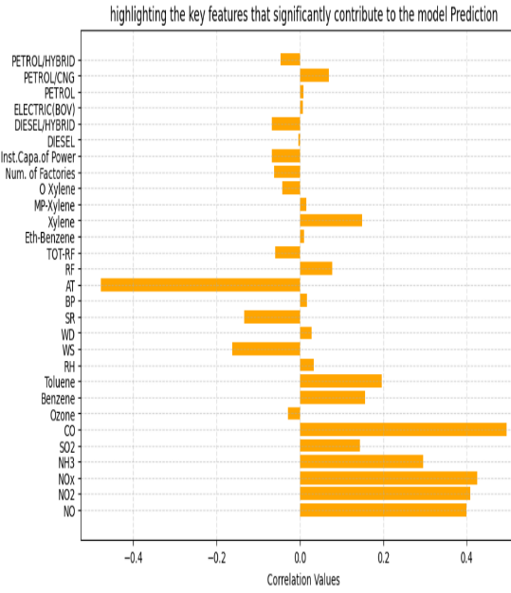
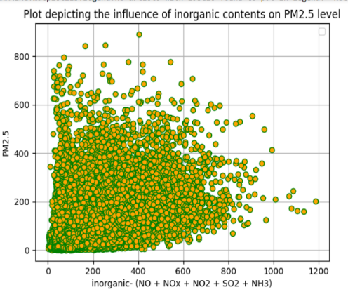
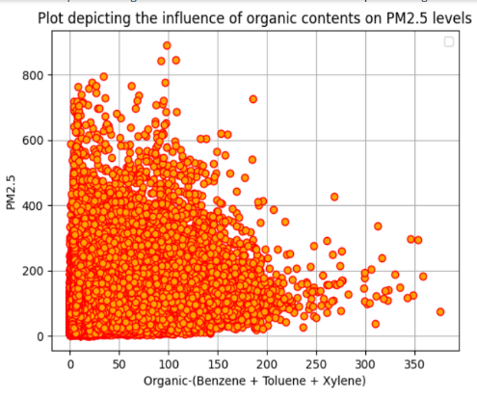
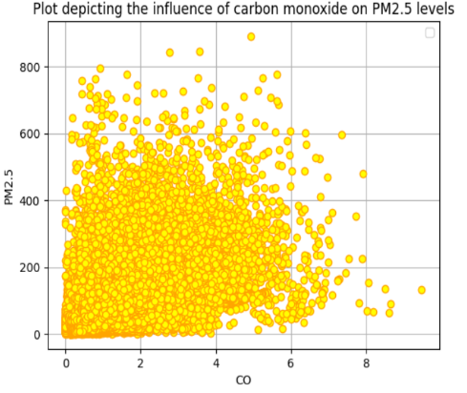
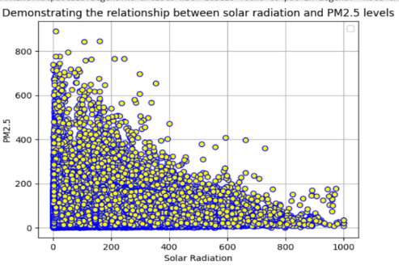
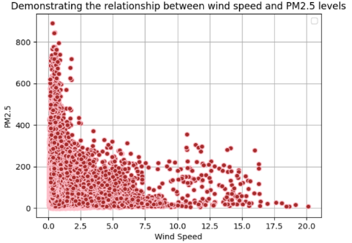
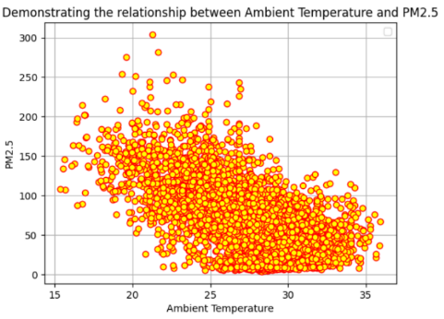
Data Visualization
3. Our dataset consists of essential features that have been analyzed based on their correlation with PM2.5. The given bar chart provide insights into the strength and direction of the relationship between the features and PM2.5 levels.
4. In the analysis we found PM2.5 levels are notably influenced by the inorganic and organic content present in the air. The plots reveal a direct correlation between PM2.5 levels and the presence of inorganic and organic air pollutants. Emissions of substances like NO, NO2, NH3, benzene, toluene, etc., contribute to increasing PM2.5 concentrations.
The below plots show a negative relationship between ambient temperature, solar radiation, and wind speed with PM2.5. However, this relationship is intricate and influenced by multiple factors

Slide 6
Model Metrics
The table shows the overall comparison of different models on the basis of error metrics.
The best model according to the different error rates is CNN-LSTM.
The CNN-LSTM model has demonstrated better performance in forecasting of PM2.5 due to its ability to capture both spatial and temporal dependencies in the data.
Model | MSE | RMSE | MAE | MAPE
CNN-LSTM | 15.38 | 3.92 | 3.92 | 4.01
GRU | 20.61 | 4.53 | 4.37 | 4.77
LSTM-3 LAYER | 31.50 | 5.61 | 5.02 | 5.42
LSTM- 1 LAYER | 33.40 | 5.77 | 5.12 | 5.61
MSE- Mean Squared Error RMSE- Root Mean Squared Error
MAE- Mean Absolute Error MAPE- Mean Absolute Percentage Error
Model prediction and recommendations:- Future works for Improvement:-
>The model successfully predicted the future PM2.5 levels for all 34 cities under consideration. The results revealed that Delhi exhibited the highest concentration of PM2.5, followed by Chandigarh, Ghaziabad, Noida, and Moradabad. These findings emphasize the poor air quality conditions in these cities and required intervention strategies to address the pressing issue of pollution in these areas.
>Collective efforts from general public and government are required to mitigate pm2.5 pollution. The possible ways by which they can address the issue includes:- Embrace Clean Energy, Boost EVs adoption, Strengthen Industrial Regulations, Enhance public transportation systems to encourage people to use buses, Awareness Programs etc.
>The use of the predictive tools will help people to identify and respond to polluted areas effectively.
>We can employ advanced imputation or interpolation techniques to fill missing values in features like CH4 and temperature, where more than 75% of the data was missing. This will allow us to include these features in our analysis and can lead to improve prediction accuracy.
>Utilizing model ensembling can be beneficial in improving the performance of the model. through this we can improve the model accuracy and robustness.
>Utilizing advanced optimization algorithms such as RMSprop or AdaGrad can enhance the training process and contribute to increased accuracy.

