Slide 1

16 Sep 2022
Vishal Hake
Lead Process Automation.
Redmine Training for On-Site Team
Corporate Office
ABM House, Plot No. 268, Linking Road,
Bandra (West), Mumbai – 400050.
Tel: +91 22 4290 9700
Email: egovernance@abmindia.com
Web: www.abmindia.com

Slide 2
Redmine
Redmine Overview
Link & Login Page
Login Details
Home Page
Project Menu
Project Overview
Time Sheet Against Project Comman Activities(Wiki)
Time Sheet Against Project Task
Spent Time.

Slide 3
Redmine
Remine is Project Management Tool.
Redmine Provides the following Feature :
    Manage Multiple Project and Associated Subproject
    Role Base Access.
      Issue Tracking (Task).
    Time Tracking.
    Wiki.
    Document.
    Many More...

Slide 4
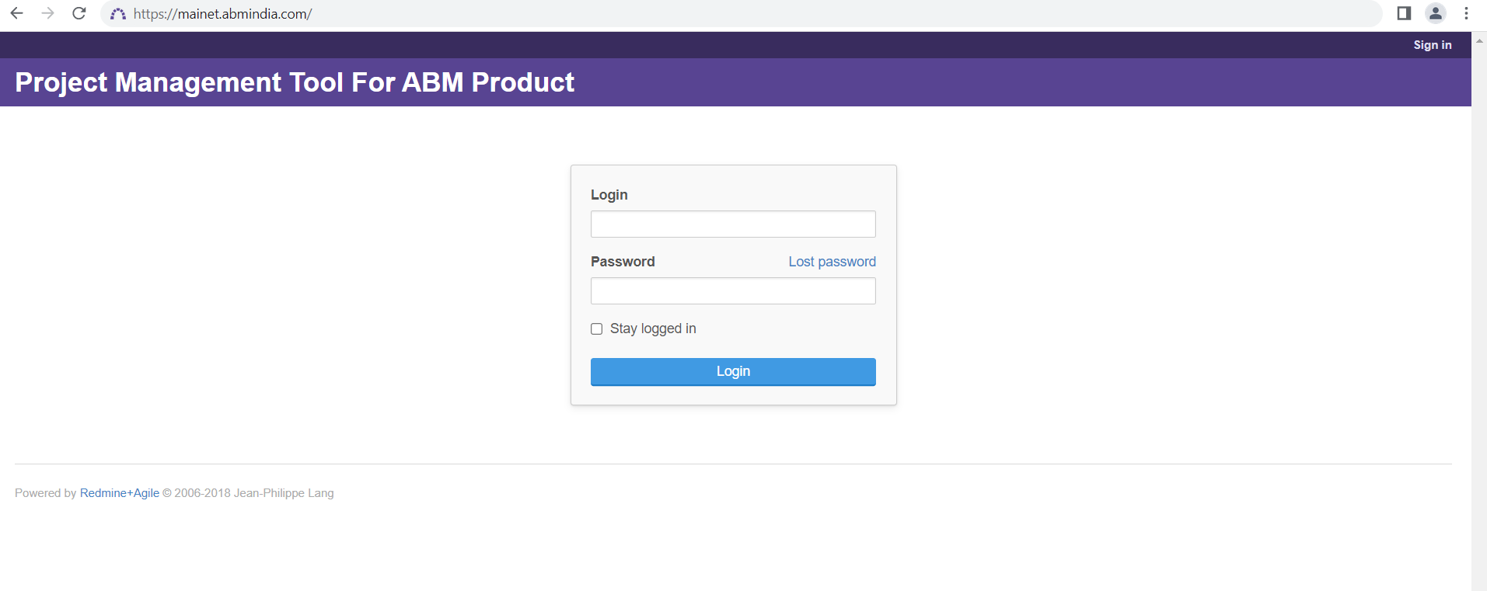
Redmine Link & Login Page
Link : https://mainet.abmindia.com/
Login ID : First Name, Dot(.) & Last Name
e.g : vishal.hake
Password : Minimum 8 charecter
e.g: *********

Slide 5
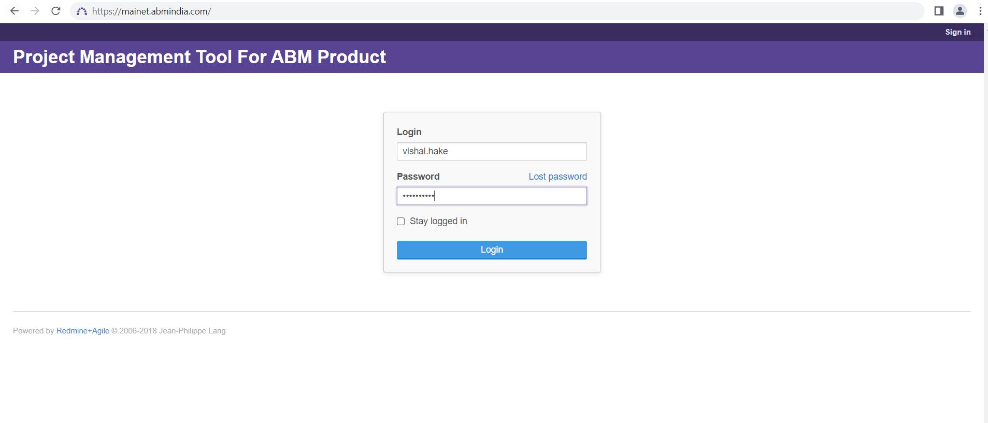
Login Detail Page
Once You Fill the Login Id and Password then Click on Login
Login & Password is correct then Redirect on Home page of Redmine (Mainet)

Slide 6
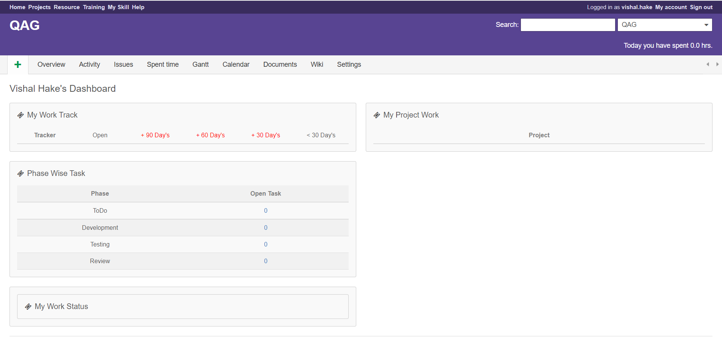
Home Page
Home Menu is consists of particular User assigned Task different Dashboard :
  My Work Task.
  Phase Wise Task.
  My Work Status.
  My Project Work.

Slide 7
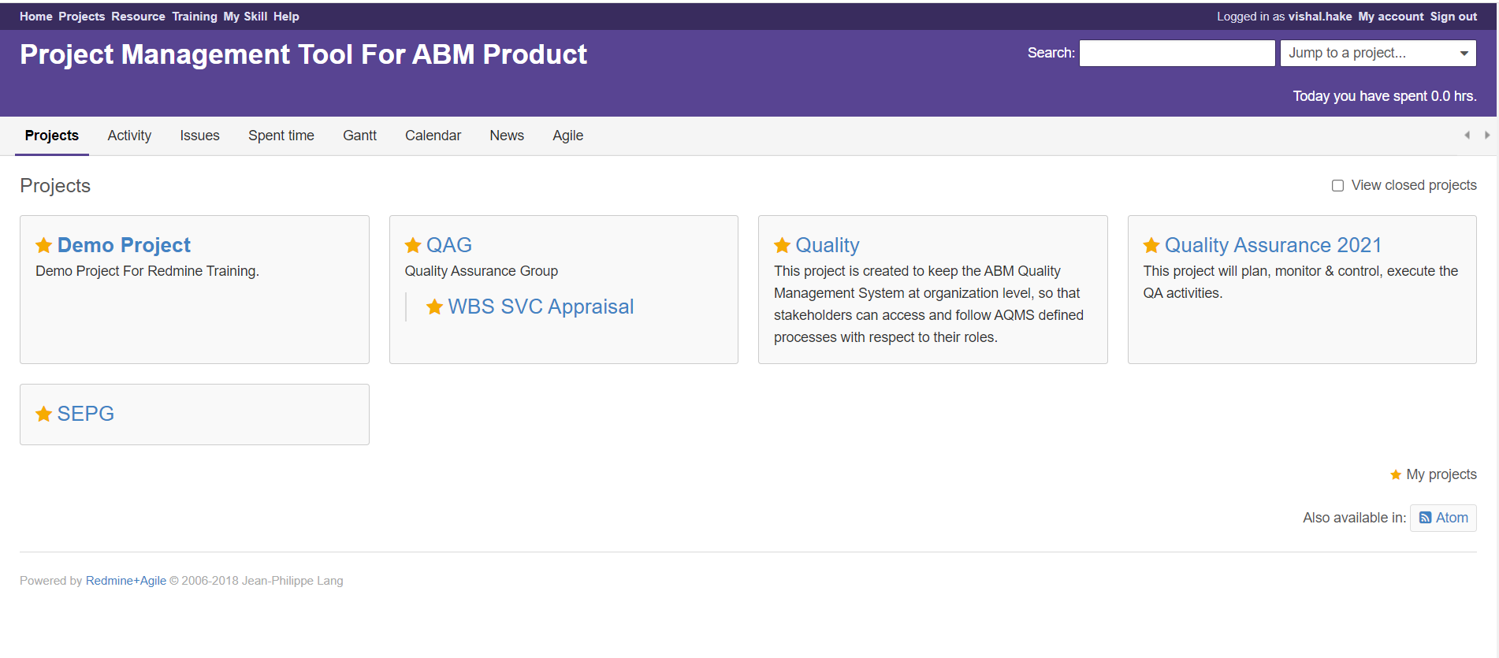
Project Index Page
Project Tab is consists of assigned project list of particular User.
    Demo Project
    Quality
    TSCL , ASCL, Aqua,ect...
Once you click on particular project, it will redirect on that Particular Project Overview page.

Slide 8
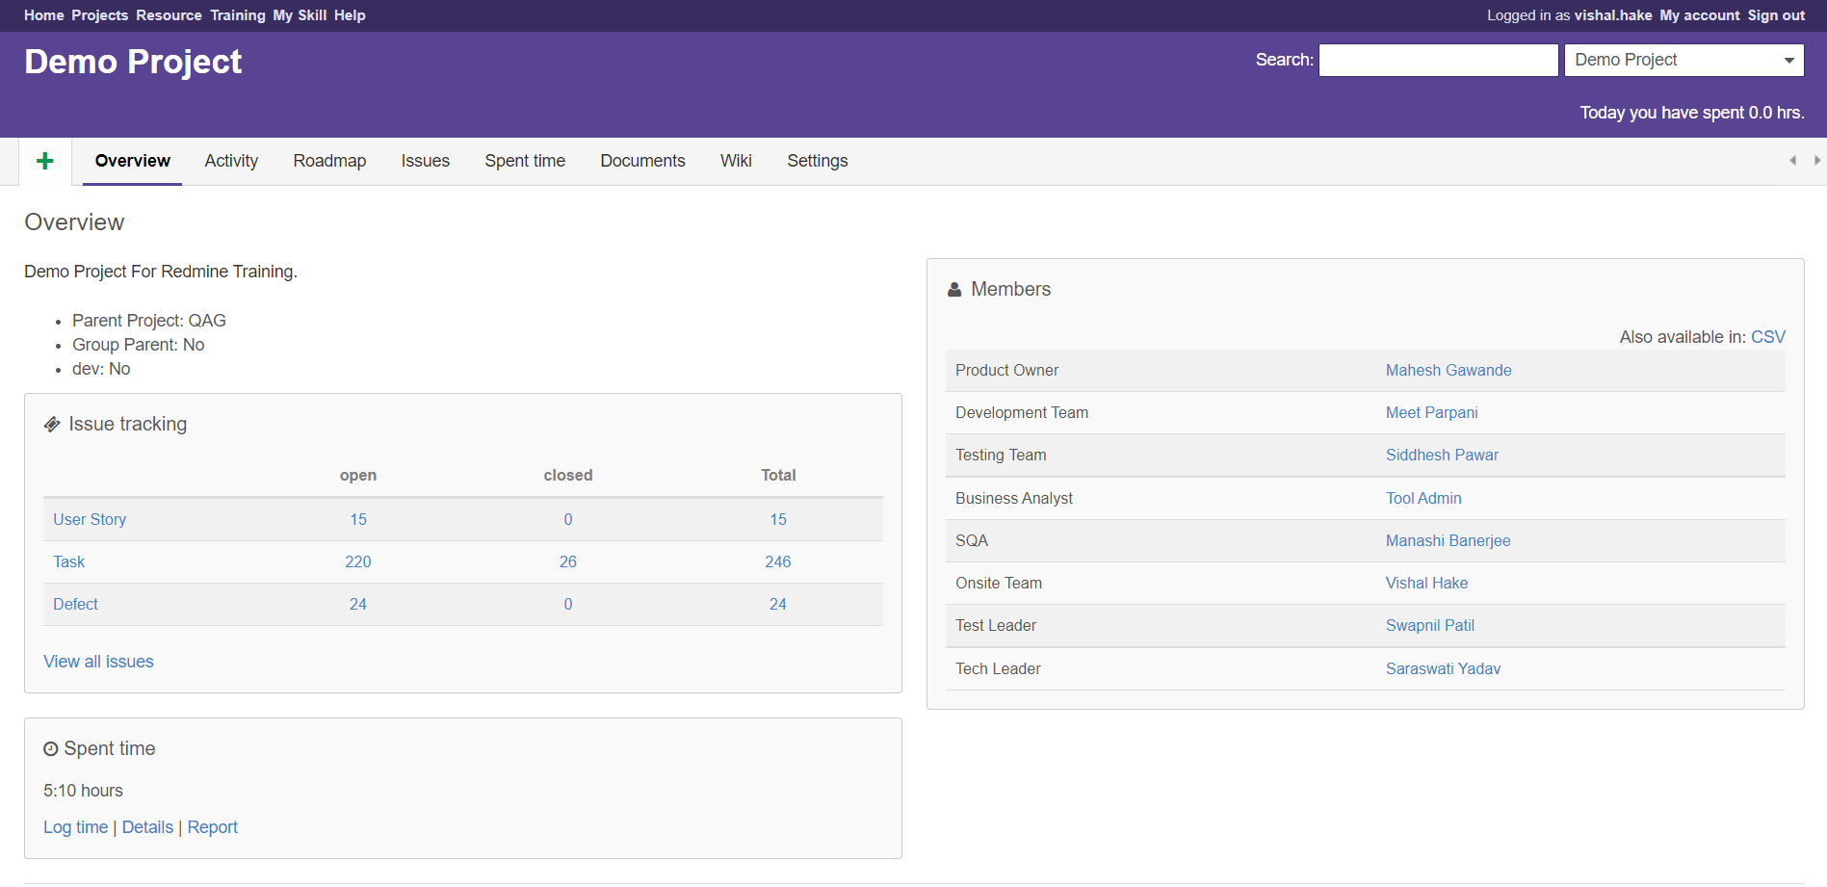
Project Overview

Slide 9
Time Sheet Option
Log Time in redmine against the task which you have worked on that particular time.
Time Sheet Fill options available on 4 days back from current date.
e.g : today is 16-sep-2022 and you can fill the time sheet in redmine back 4 days (means 12-Sep,13-Sep,14-Sep,15-Sep and 16-Sep )days only not other days.
you can fill the timesheet max. 12hrs in one day.
There are two way to fill the Time Sheet
    Against Project Comman Task
    Against Project Task

Slide 10
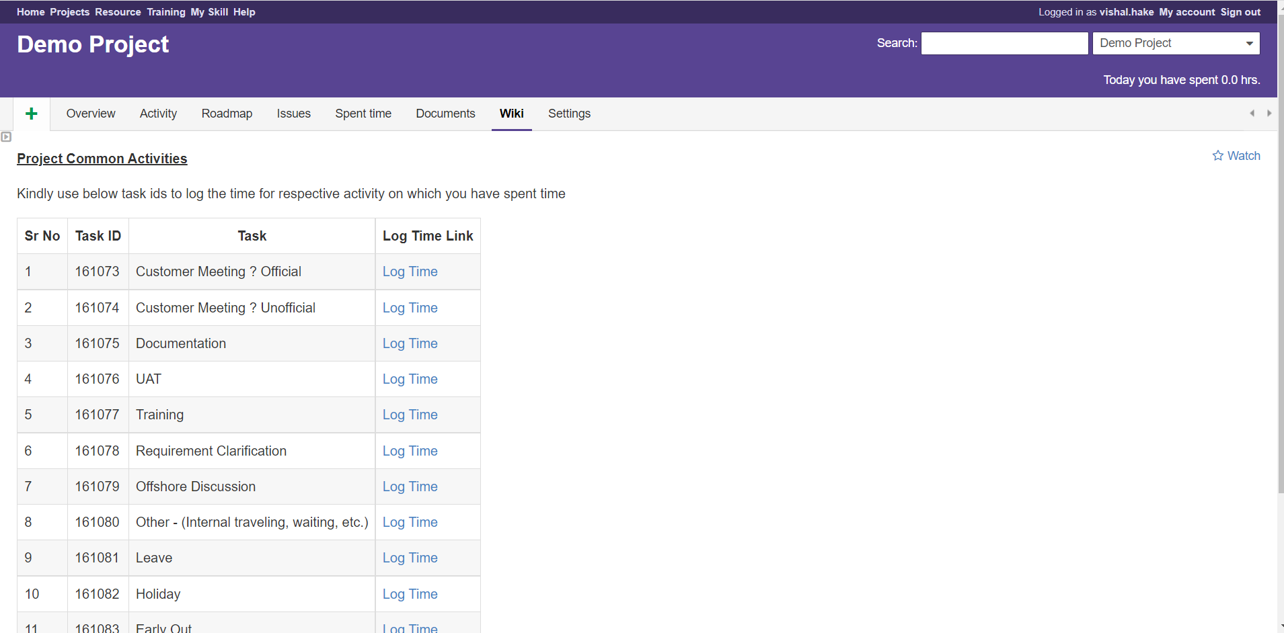
Time Sheet
Against Project Common Activities :
  Step 1 : Click on Wiki
  Step 2 : Click on Log Time
  Step 3 : Spent Time Form Will open
  Step 4 : Fill the Form
  Step 5 : Click on Create

Slide 11
Time Sheet
Step 2 Click on Log Time :

Slide 12
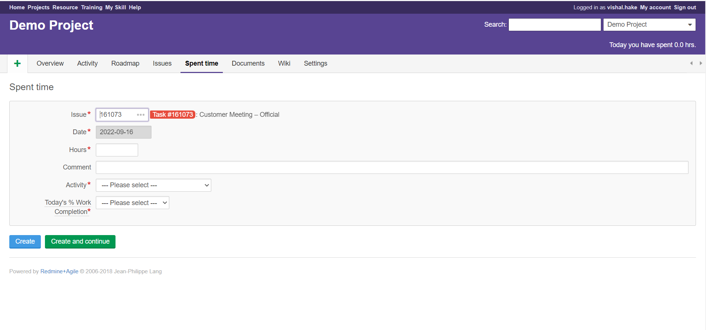
Time Sheet
Step 3 : Spent Time Form Will Open

Slide 13
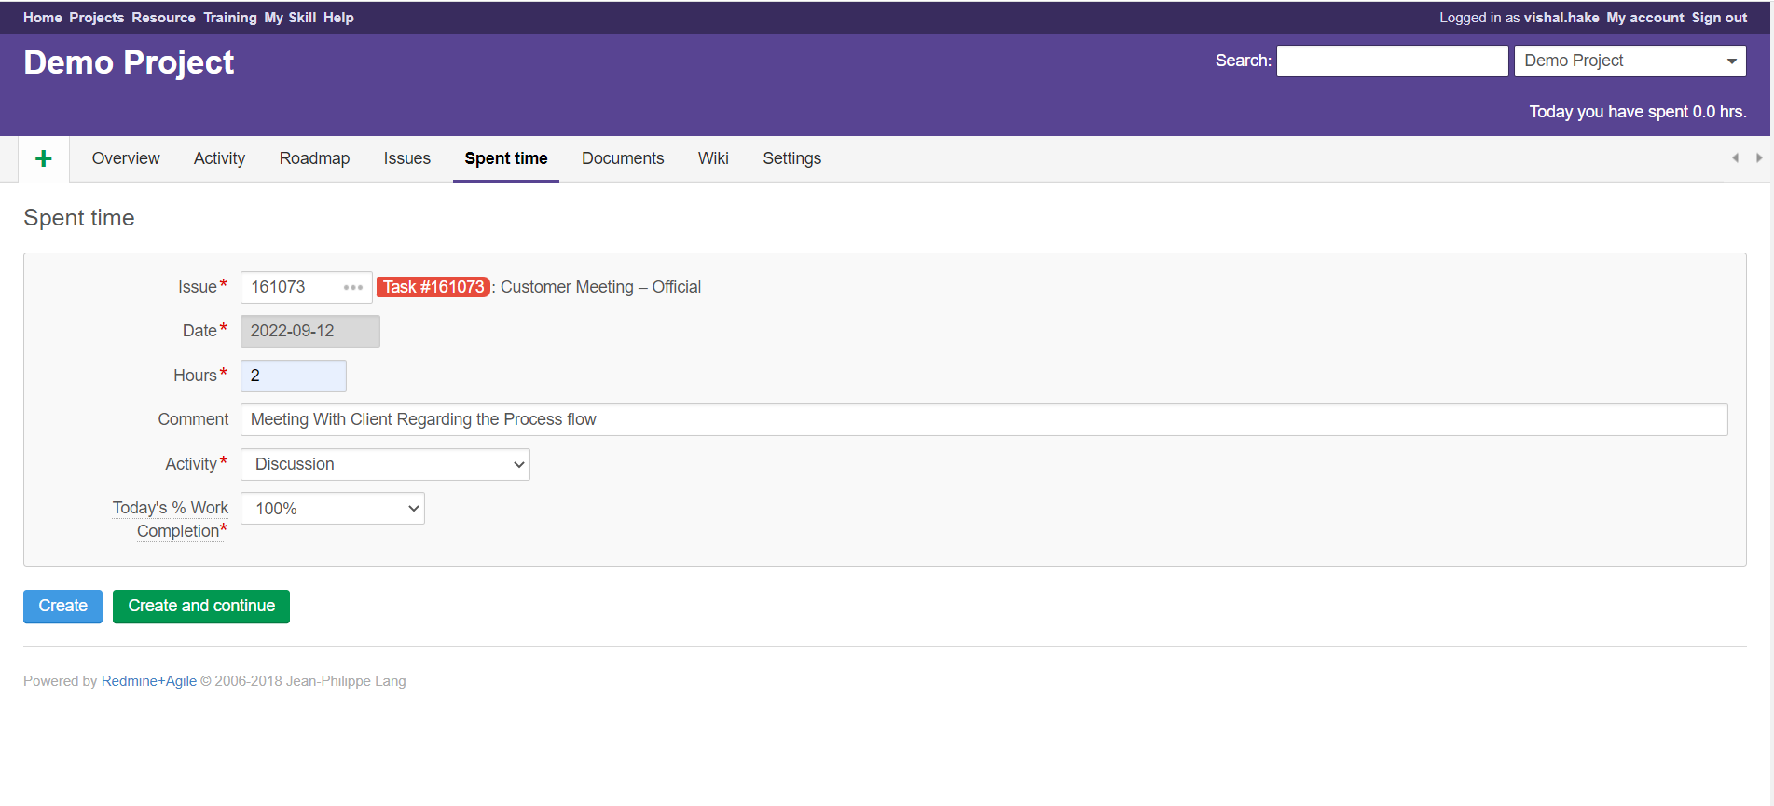
Time Sheet
Step 4 Fill the Form and Click on Create or Create and Continue :

Slide 14
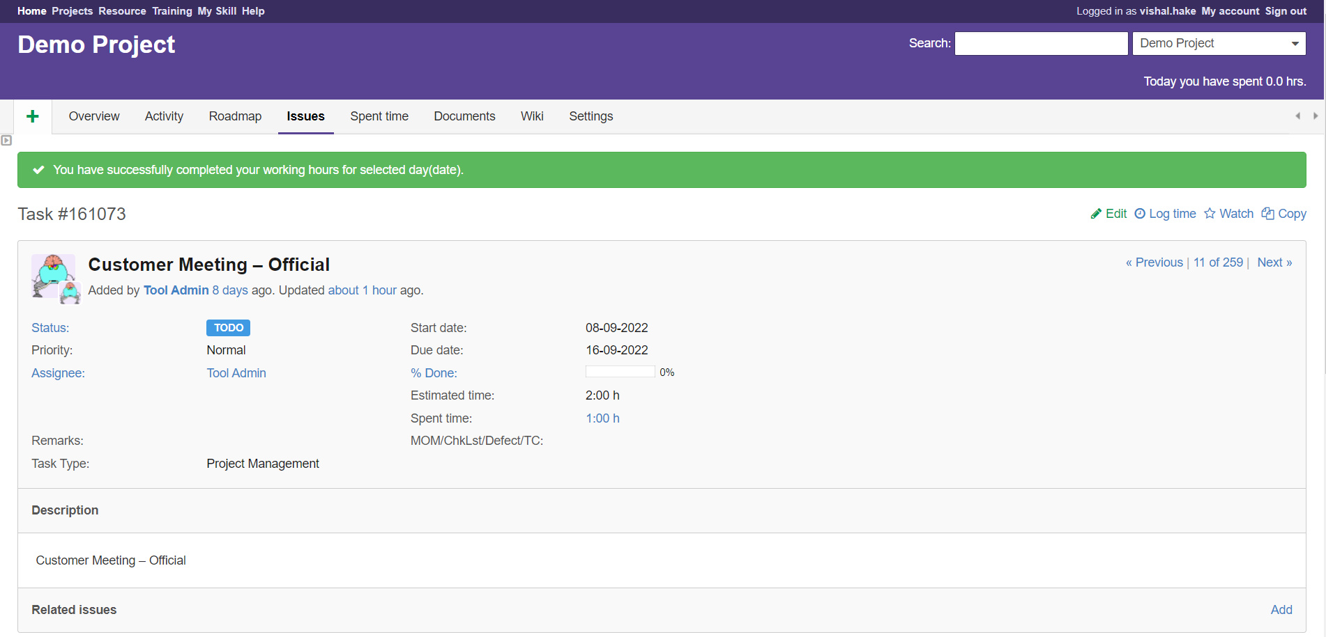
Time Sheet
If You Click on Create then redirect on task page
If You Click on Create and Continue then redirect on same spent time form

Slide 15
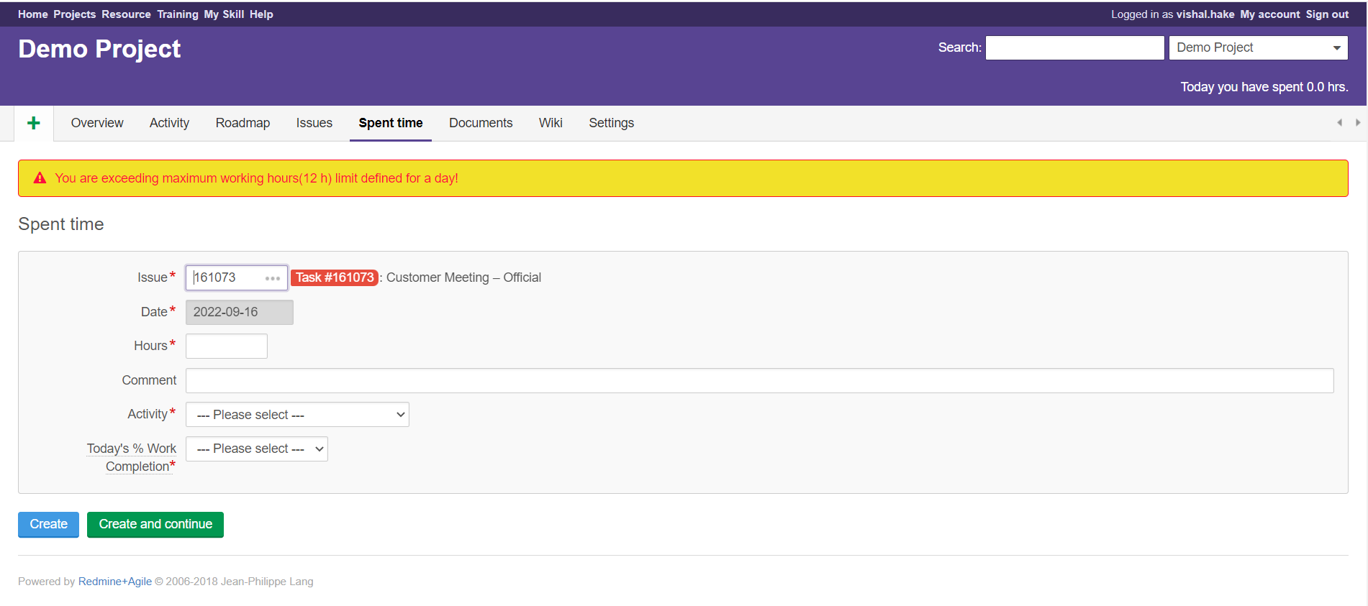
Time Sheet
If You try to fill the Time Sheet more than 12 hrs in one day then it will show you exception :

Slide 16
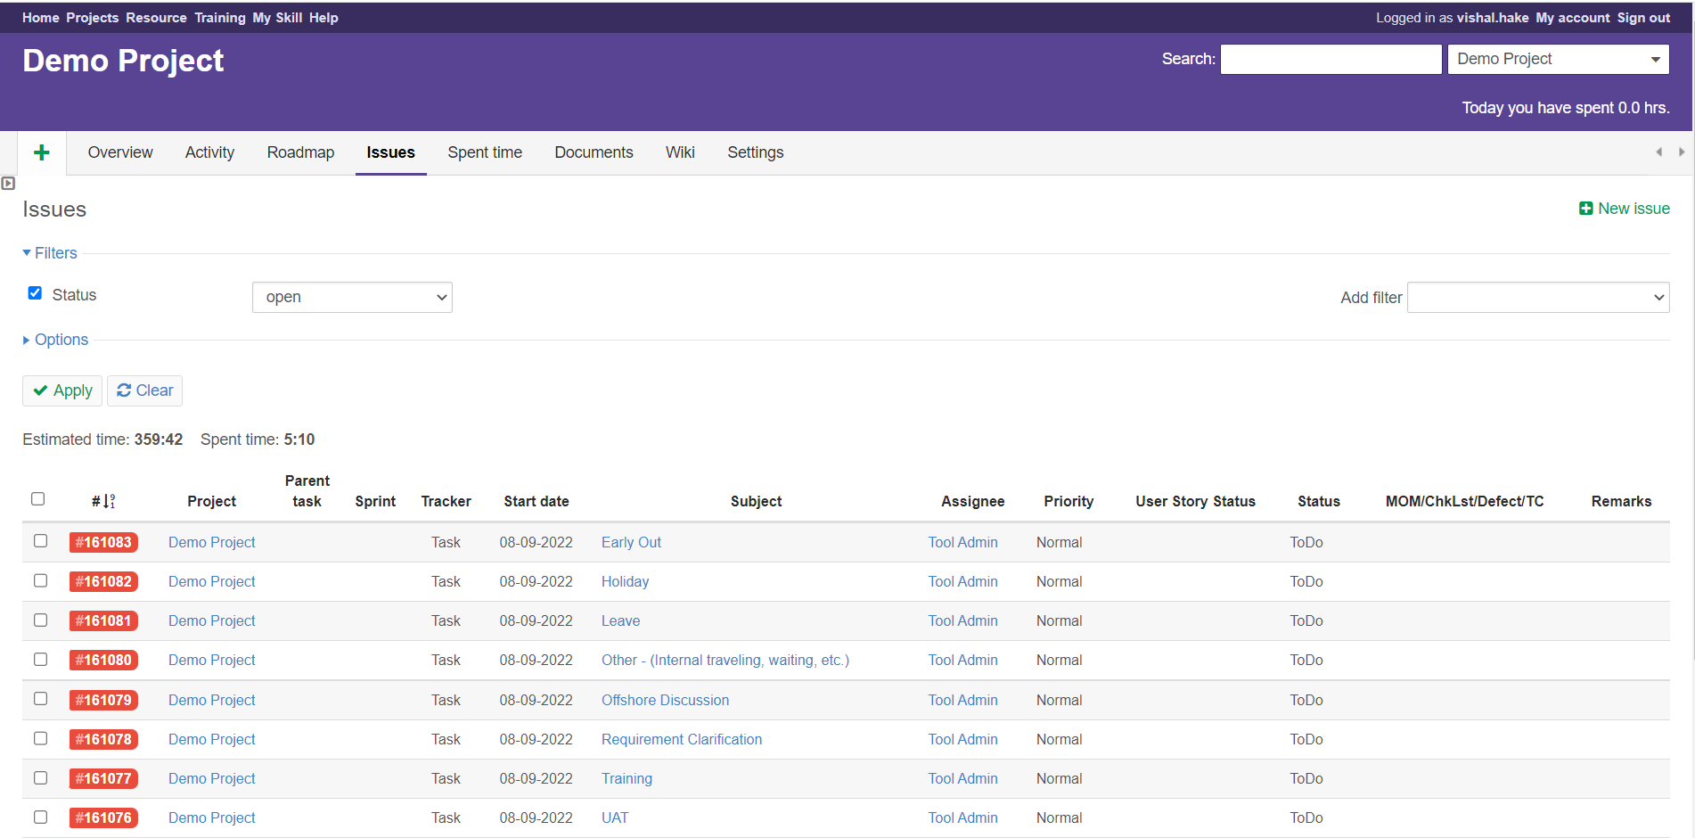
Time Sheet
Against Project Task :
  Step 1 : Click on Issue
  Step 2 : Open Particular Task
  Step 3 : Click on Log Time
  Step 4 : Spent Time Form Will open
  Step 5 : Fill the Form
  Step 6 : Click on Create

Slide 17
Time Sheet
Against Project Task :
  Step 2 : Open Particular Task

Slide 18
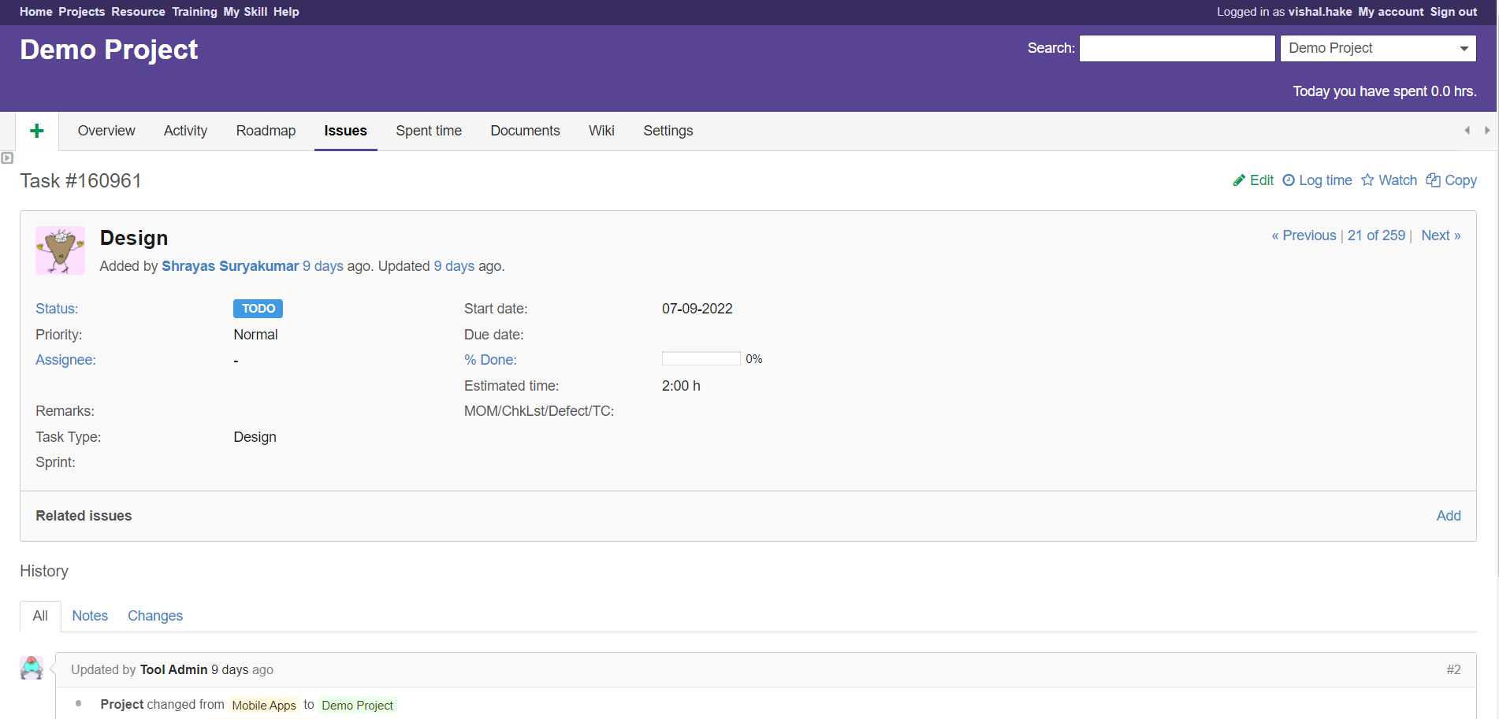
Time Sheet
Against Project Common Activities :
  Step 3 : Click on Log Time

Slide 19
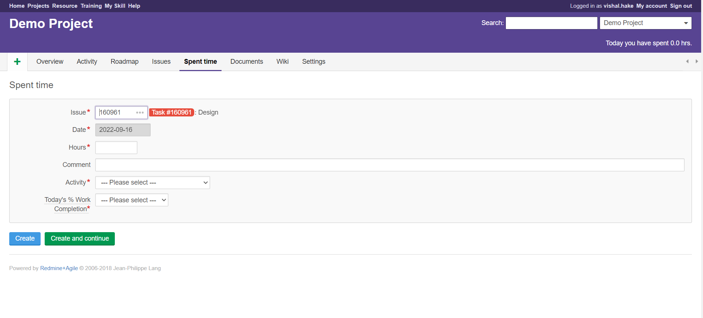
Time Sheet
Against Project Task :
  Step 4 : Spent Time Form Will open

Slide 20
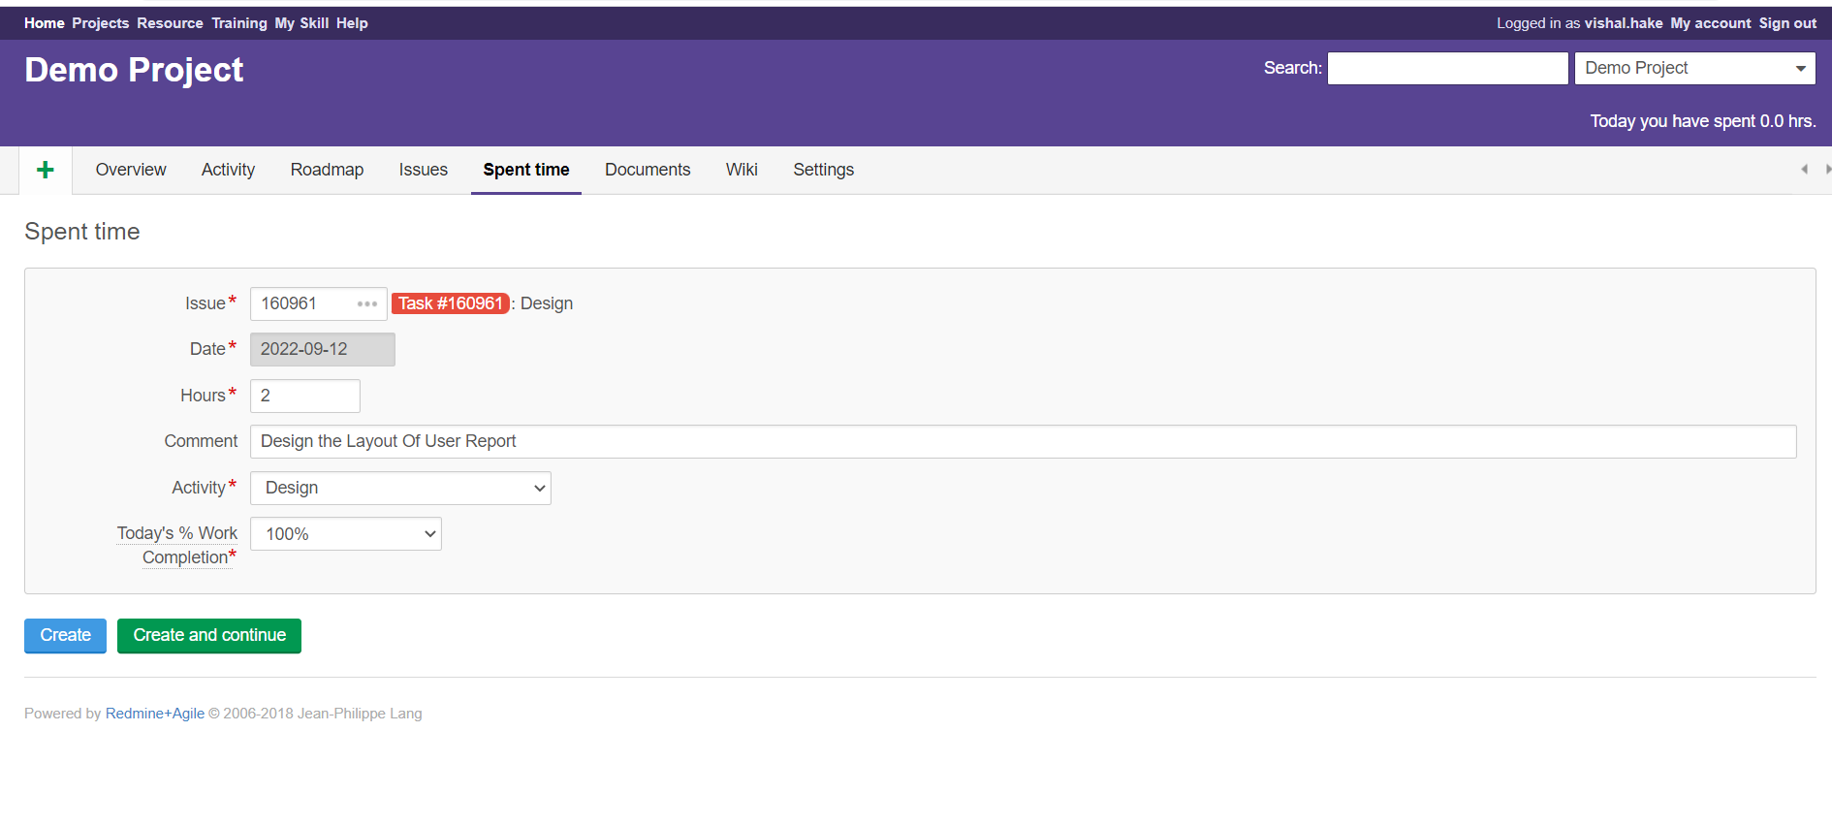
Time Sheet
Against Project Task :
  Step 5 : Fill the Form

Slide 21
Time Sheet
Against Project Task :
  Step 6 : Click on Create or Create and Continue

Slide 22
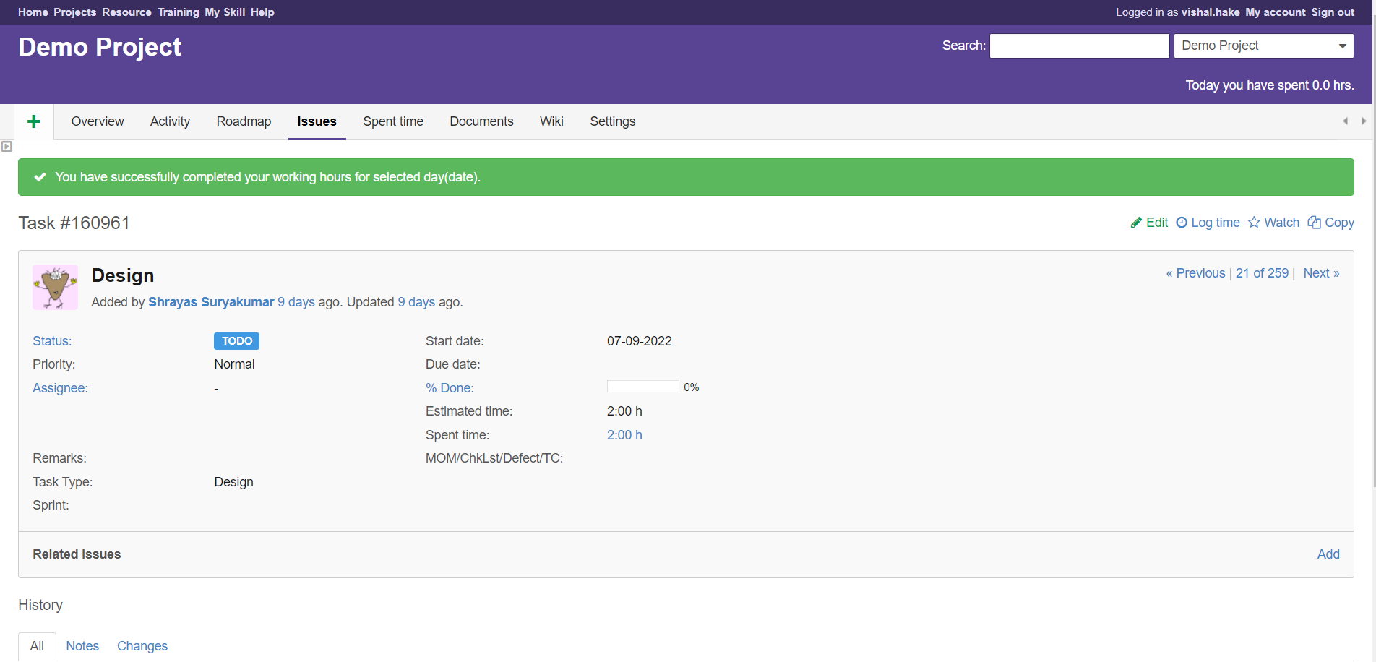
Time Sheet
If You Click on Create then redirect on task page
If You Click on Create and Continue then redirect on same spent time form

Slide 23
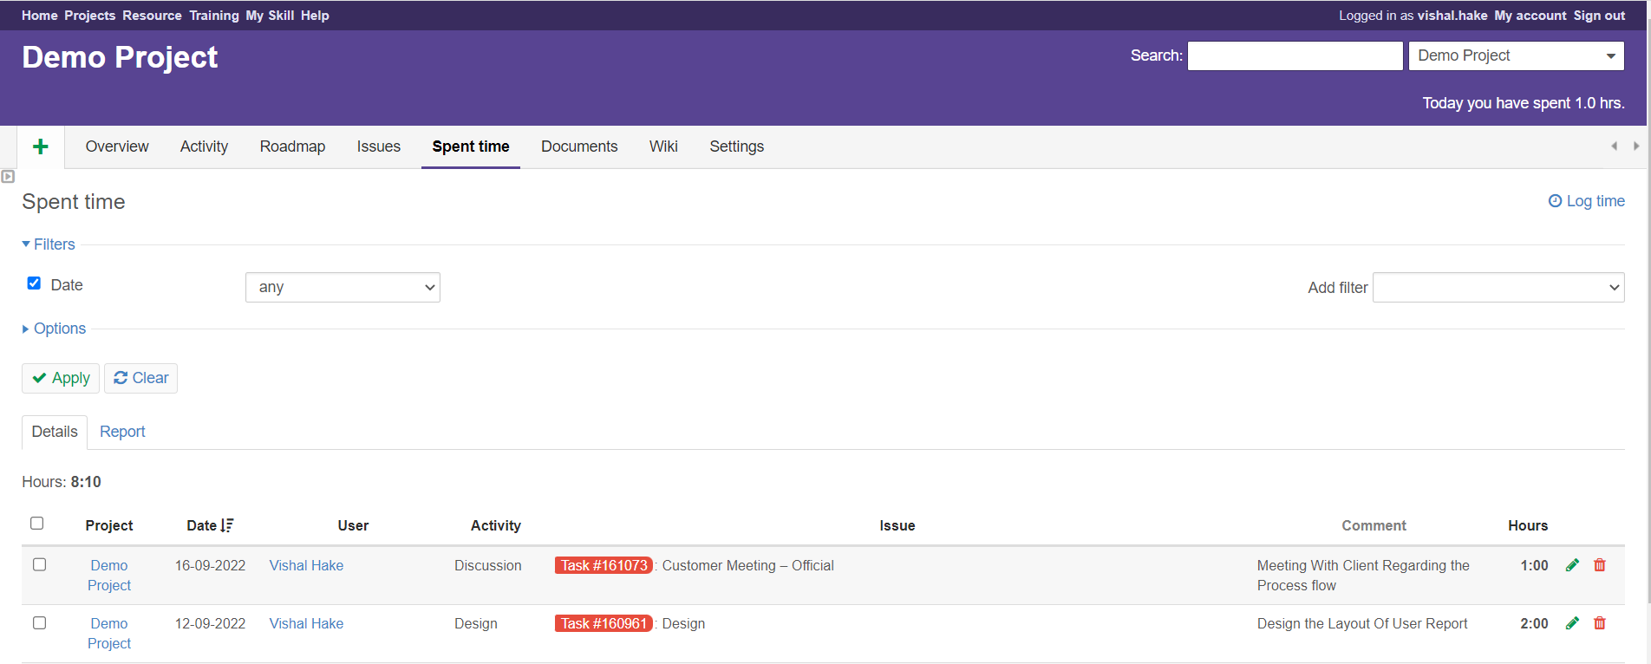
Spent Time
Spent Time Tab is consists all time sheet details :

Slide 24


Slide 25
Thank You!

