Slide 1
AgentShield
Provenance-Aware Defense Against Multilingual
Prompt Injection in LLM Agents · [NAME], [GUIDE]

Slide 2
The problem
• LLM agents read web/email/files, then act: send mail, move money, call APIs.
• Indirect prompt injection: attacker hides instructions in that content.
• A hijack becomes a wrong, irreversible action — e.g. data exfiltration.

Slide 3
Motivation
• Agent-injection benchmarks are English-only.
• Low-resource & code-mixed inputs bypass safety training.
• Most defenses aren't tested against an adaptive attacker.

Slide 4
Limits of existing defenses
• Spotlighting/delimiters: rely on the model obeying the marking.
• Classifiers: English-centric and evadable.
• CaMeL/FIDES: strong guarantees but utility cost and complexity.
• None measure multilingual or code-mixed injection.

Slide 5
AgentShield: the idea
• Layered + provenance-aware: don't rely on detection alone.
• Multilingual detection (rules + xlm-roberta + LLM intent check).
• Deterministic backstop: canary tokens + taint tracking.
• Fused by logistic regression; enforced by a policy firewall.

Slide 6
Architecture
• One hook intercepts every tool call.
• Content: preprocess → detectors → fuse → sanitize/allow/block.
• Action: canary scan → taint policy → permissions/approval → allow/block.
• API + WebSocket + SDK + live dashboard + Docker.

Slide 7
Detection pipeline
• Preprocess: hidden HTML, base64/hex/URL/ROT13, NFKC, invisible chars, homoglyphs, OCR.
• L1 rules: multilingual triggers + structural signals (~0.1 ms).
• L2: fine-tuned xlm-roberta-base (recall layer).
• L3: LLM intent check (task vs. content).

Slide 8
Canary & taint tracking (core contribution)
• Canary: random token in prompt + sensitive files; any leak is blocked and traced.
• Taint: label data USER / PRIVATE / EXTERNAL.
• Policy: PRIVATE → EXTERNAL destination is blocked (or needs approval).
• Catches exfiltration that content detection misses.

Slide 9
Adaptive attacker
• Mutates seed attacks: encode, homoglyph, invisible, split, paraphrase, translate.
• Feedback by threat model: black / gray / white box.
• Reports attack success vs. query budget; feeds adversarial retraining.
• Finding: the preprocessor reverses obfuscations that evade a keyword filter.

Slide 10
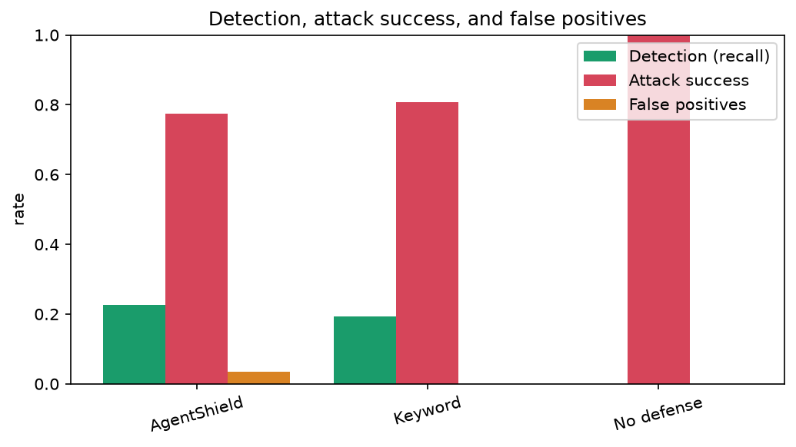
Results & ablation
Real numbers on a public English test set (L1 + fusion). See the report for details.

Slide 11
Live demo
• Unprotected agent leaks a fake secret from injected content.
• AgentShield on: the same attack is blocked, traced to the private file.
• Incident replay, multilingual catch, canary catch, dashboard on a phone.

Slide 12
Future work & conclusion
• Train L2 on GPU + add the human multilingual set → full headline numbers.
• Adversarial training; activation task-drift; strict dual-LLM upper bound.
• Takeaway: multilingual detection + provenance catches what detection misses.

